Slide 1
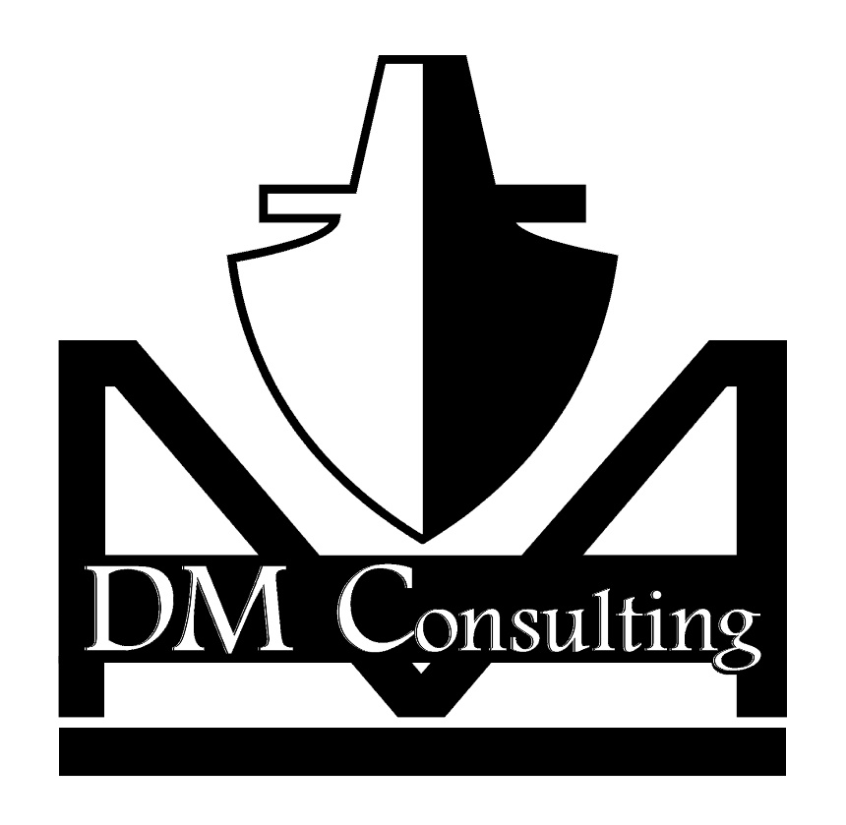
NSRP Panel Project
Fast Docking System Study
DM Consulting

Slide 2
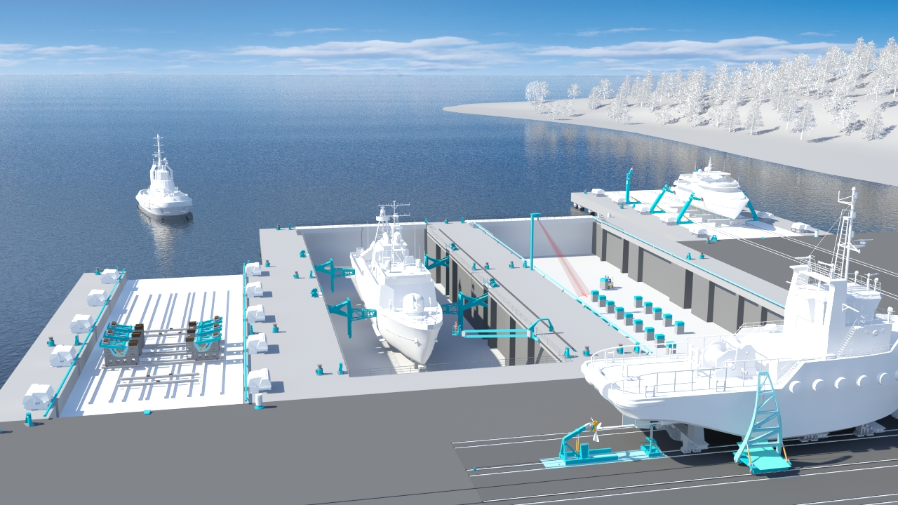
Fast Docking Systems by Syncrolift
Innovative hydraulic side block support systems

Slide 3
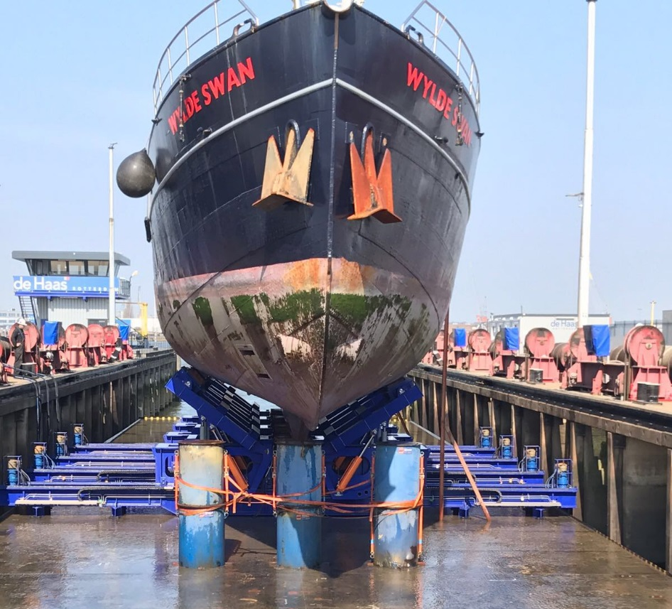
Typical Hydraulic Side Supports

Slide 4
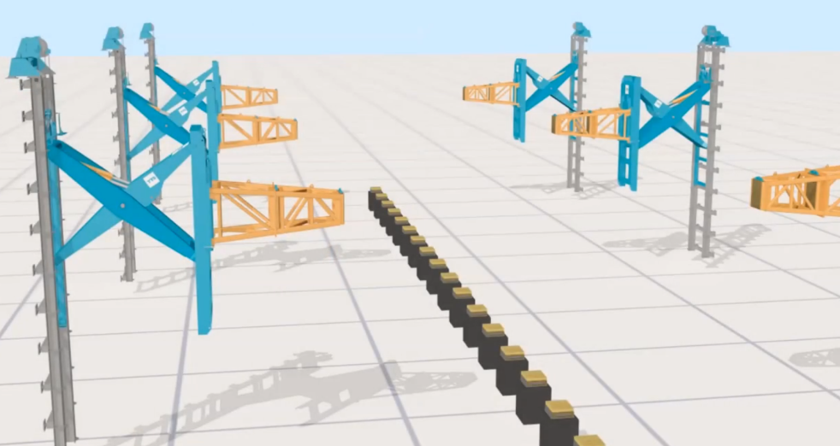
Unique Hydraulic Shores

Slide 5
Summary
Reduce preparation time
Reduce material cost (offset by increase maintenance cost)
Reduce material waste
Increased hull access

Slide 6
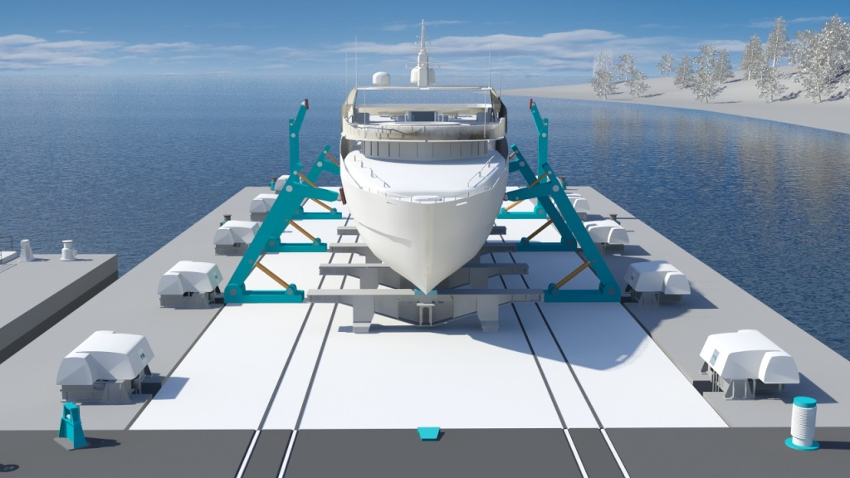
Unique Hydraulic Shores Towers

Slide 7

Thank you

