Slide 1
NSRP Panel Project PP 24-22 [2024 panel project] LIGHTING ON NAVAL SHIPS DOD-HDBK-289(SH) MODERNIZATION SUPPORT EFFORT Giovanni Tomasi RSL Fiber Systems, LLC
December 15, 2023
DISTRIBUTION STATEMENT A. Approved for public release: distribution unlimited.

Slide 2
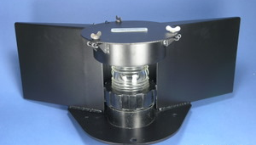
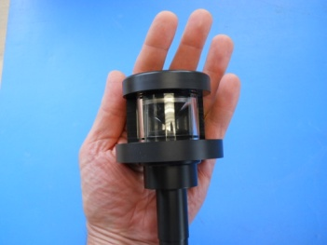
DOD-HDBK-289(SH) MODERNIZATION SUPPORT EFFORT
OBJECTIVE
Provide support to NAVSEA 05Z33 from an industry team comprised of multiple lighting manufacturers, shipyards, and Navy entities to expedite the revision process and accelerate the modernization of the U.S. Navy lighting.
PROBLEM(s) STATEMENT
Outdated Specifications: DOD-HDBK-289(SH) Last Revised November 1986.
Based on technological capabilities of 40 – 50 yrs. old lighting devices.
Many legacy technologies becoming obsolete.
New lighting technologies not retrofittable to legacy systems.
New lighting technologies have different decay / failure mechanism than legacy lights.
SOLUTION
Re-define FUNCTIONAL REQUIREMENTS of lighting applications.
Evaluate new, advanced lighting technologies and determine ability to meet FUNCTIONAL REQUIREMENTS.
Create a set of recommendations for Navy effort to revise DOD-HDBK-289(SH).
~ 12”
Vs.
DISTRIBUTION STATEMENT A. Approved for public release: distribution unlimited.

Slide 3
DOD-HDBK-289(SH) MODERNIZATION SUPPORT EFFORT
TASKS
Select the most critical lighting applications to be analyzed for upgrade with the new technologies.
Identify the functional requirements and compare them to those stated in the DOD-HDBK-289, including any requirements and guidelines that have become obsolete and should be deleted due to the use of new lighting technologies.
Evaluate new lighting technologies including LEDs, OLEDs, diode lasers, and fiber optic lighting to determine the one(s) most suitable to meet the applications’ requirements from a new build and retrofit standpoint.
Develop a new set of requirements reflecting the functional needs of the applications selected and the capabilities of the available technologies.
Identify emerging lighting technologies that may be used once mature.
Estimate forward-fit new construction and retrofit costs.
Provide NAVSEA a document with recommendations for revisions to the DOD-HDBK-289(SH) [ALL].
TEAM MEMBERS
Prime/Lead: RSL Fiber Systems, LLC
Team Members: HII – Ingalls Shipbuilding, HII – Newport News, Austal USA, U.S. Navy: NAVSEA 05Z33, SUPSHIP Gulf Coast; Phoenix Lighting, Signal Mate; PSU EOC.
ATI Project Manager: Lydia Szydlo
Program Technical Representative: Walt Skalniak (Ashby Co.)
ESTIMATED ROI
Fleet Savings from Legacy to Solid State Lighting: $ 6 M /year
(Estimated by NSRP Panel Project 2019-477-002 “Advanced Topside Lighting”)
PROGRAM FUNDS
$ 150,000
DURATION
12 Months
DISTRIBUTION STATEMENT A. Approved for public release: distribution unlimited.

Slide 4
PROJECT HIGHLIGHTS
Solicit input from marine lighting industry.
Lighting devices.
Control systems.
New lighting applications.
Investigate similar efforts to modernize / update lighting requirements and specifications.
American Boat & Yacht Council C-5 Document.
UL / Intertek documents.
ANSI / IEC / FDA Laser safety documents.
Identify differences in New devices vs. Legacy and effect on specifications / regulations.
Failure modes.
Light intensity.
Spectral emissions.
Interference with other devices.
“Future Proof “ Lighting Document.
Interference with future Intelligence, surveillance, target acquisition, and reconnaissance devices.
Increased use of composites for corrosion mitigation.
New applications.

Slide 5
QUESTIONS?
Giovanni Tomasi
RSL Fiber Systems, LLC
860-282-4930 x-4929
gptomasi@rslfibersystems.com

