Slide 1

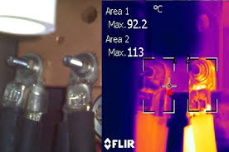
NSRP 2023 Panel Project 2019-477-04
DTS Integration into Electrical Plant Controls for Conditions Based Maintenance
REPORT 2
December 15, 2023
Giovanni Tomasi
RSL Fiber Systems, LLC
DISTRIBUTION STATEMENT A. Approved for public release: distribution unlimited.

Slide 2
TABLE OF CONTENTS
PROJECT OUTLINE
PROJECT BACKGROUND
  TESTS PERFORMED & LESSONS LEARNED
PROJECT STATUS
NEXT STEPS
FOLLOW-ON PROJECT / IR&D

Slide 3
2023 PANEL PROJECT - DTS Integration into Electrical Plant Controls
OBJECTIVE
[Detect → Isolate → Determine Severity → Define Action]
Methodology to secure the fiber optic sensors to the electrical connections.
Determine hardware device location to provide data from DTS.
Configure the GUI to display actionable CBM data collected by the DTS.
Create baseline specifications to qualify and implement DTS on Navy vessels.
Provide baseline for project to finalize development and qualify DTS system for MV panels monitoring.
TEAM MEMBERS
Prime/Lead: RSL Fiber Systems, LLC
Team Members: Penn State University – ARL, General Dynamics – Bath Iron Works, DV7 Engineering, NAVSEA, NSWCPD.
ROI
Reduce labor costs by eliminating the need for annual inspection of electrical connections.
Eliminate the safety hazards involved in visually inspecting electrical panels.
Eliminate the risk of fire and conductors’ damage resulting from loose electrical connections.
PROGRAM FUNDS
$ 150,000
DURATION
12 Months
DISTRIBUTION STATEMENT A. Approved for public release: distribution unlimited.

Slide 4
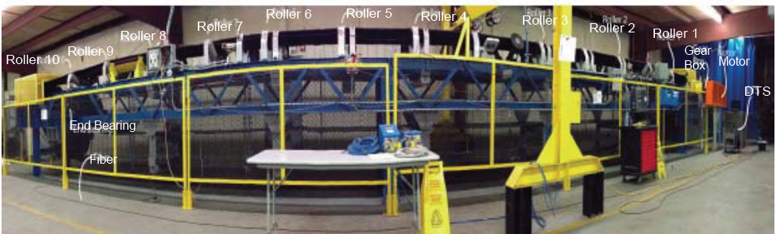
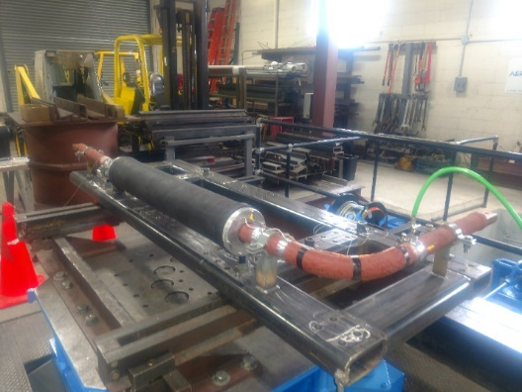
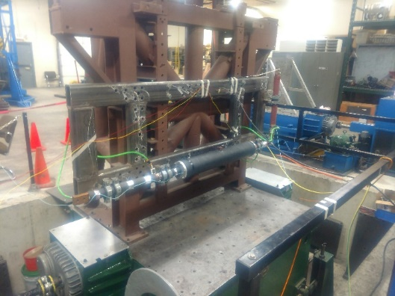
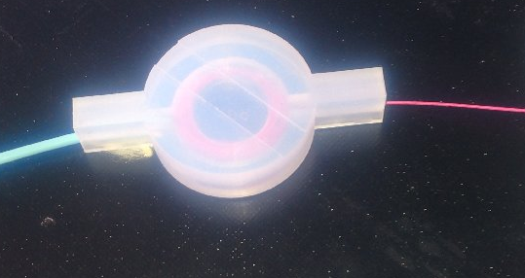
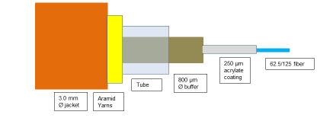
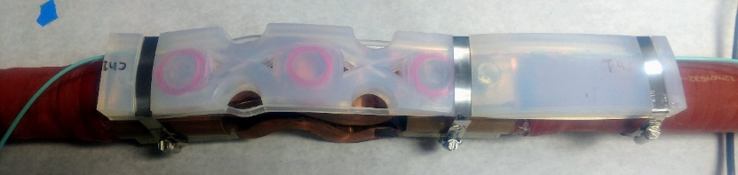
PROJECT BACKGROUND
Past Projects & Lessons Learned
Conveyor belt monitoring in Coal Mines (NIOSH Contract 2012-N-14257)
Evaluation of DTS for MV electrical panels (PSU EOC Panel Project 2017-422)
Raman DTS to monitor connections of Insulated Bus Pipe and IBP connections to equipment (Hepburn and Sons RA 19-01 and RA 20-01)
  Shock and Vibration
  Sensing assembly design
  Sensing cable construction
  Installation methods

Slide 5
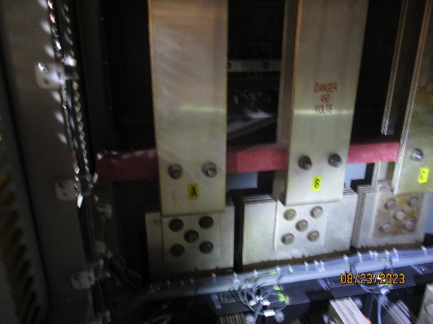
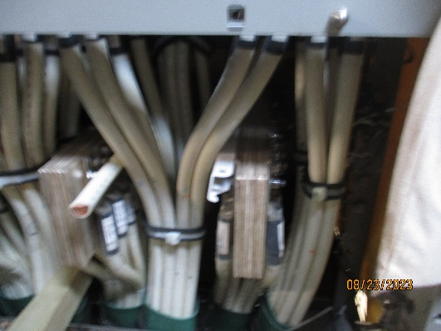
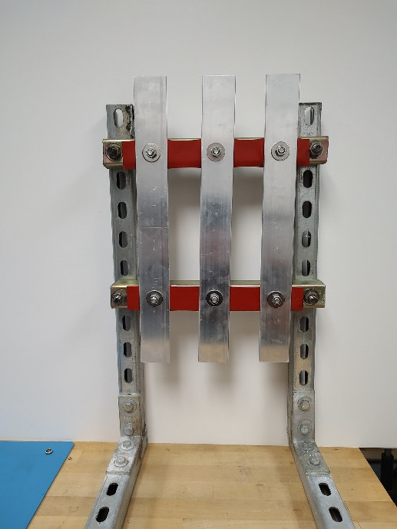
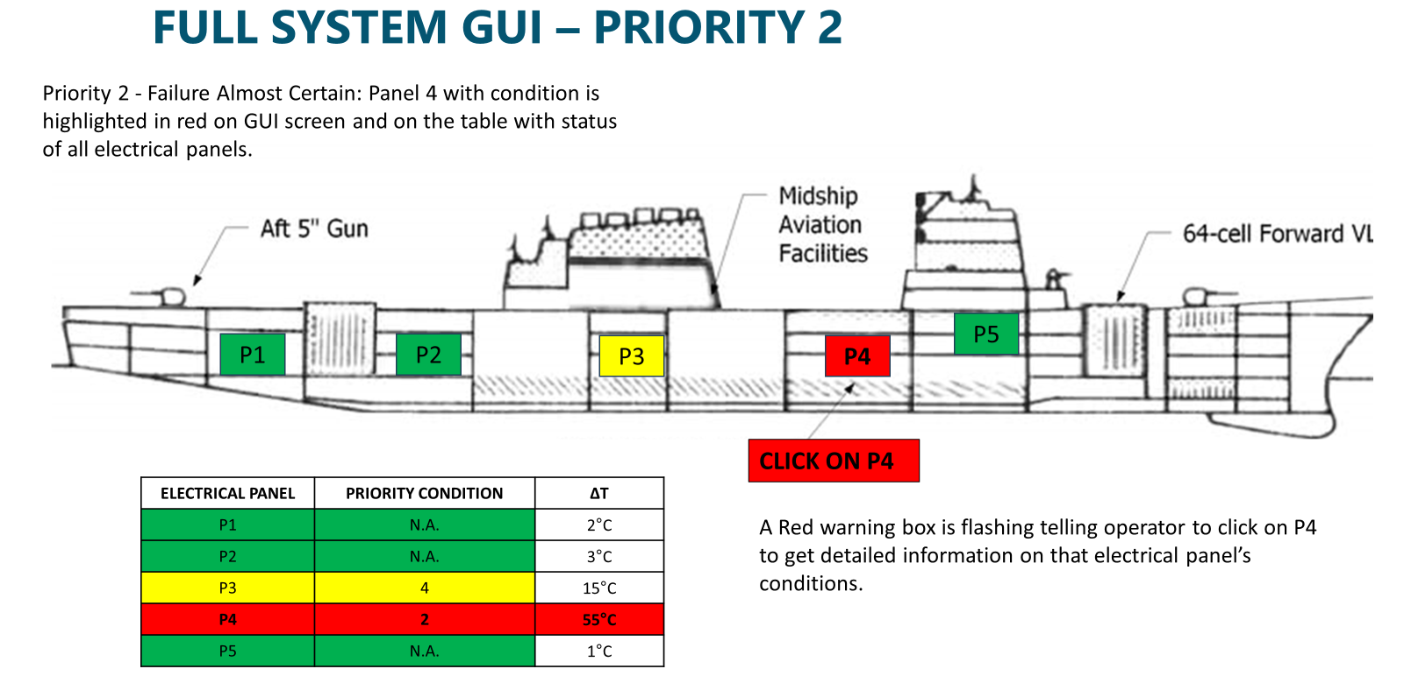
NSRP PROJECT UPDATE
ACTIVITIES
Performed two (2) hands-on demonstrations
  NAVSEA, HII Office, 300 M Street, Washington, D.C.
  NSWC PD, Philadelphia Navy Yard
On-Ship Inspection of LV Panels
Defined warnings and alarm levels (MIL-STD-2194 INFRARED THERMAL IMAGING SURVEY PROCEDURE FOR ELECTRICAL EQUIPMENT)
Presented at MFPT 2023 [Co-Authors: G. Tomasi, C. Nemarich]
Presented at SNAME SMC 2023 [Co-Authors: G. Tomasi, C. Nemarich and R. DeLoge]
Finalized DTS Controller Selection – Added Silixa to Team
Outlined GUI for Team’s input
Evaluating Materials for Sensing Assembly
Built Busbars Mock-Up in RSL Lab
Started GUI development
Notes:
5
DTS alarms can be set based on Min-Max temperature parameters, rate of change, and temperature difference.

Slide 6
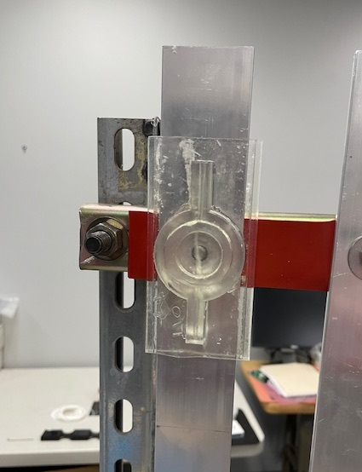
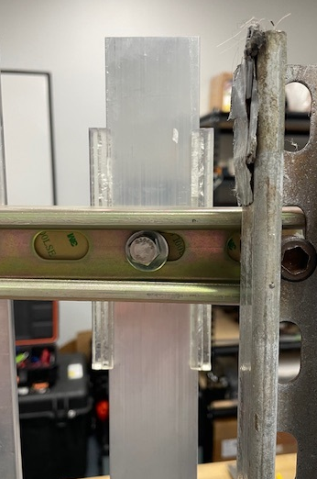
NSRP PROJECT UPDATE
DECISIONS / ACTIONS
  Use a dedicated screen for DTS display to simplify cybersecurity requirements.
  Add LV panels (450 VAC) also candidate for DTS → many on ships w/ faults most common.
  Pre-installed fiber sensing assemblies may get damaged when installing power cables.
    Install assemblies after power cables.
  Metal straps used in the IBP to be reconsidered in MV and HV panels to prevent arcing.
    Evaluating molded assemblies’ shapes to attach without straps.
  Materials under evaluation for 90°C Max normal operation and 120°C Max excursions.
    Using data from NSRP 2019-477-03 Cable Jacket Panel Project to identify materials.
  Plan on-ship system demo for project close.
    Use DDG 51 F-III under construction.
NEXT STEPS
  Set up hands-on Demo for PMS 400D
  Configure baseline GUI for Demos.
  Select sensing assemblies’ material and configure fiber attachment methodology to busbar.
    Need confirmation of normal and max operating temperatures for materials selection
Notes:
6
DTS alarms can be set based on Min-Max temperature parameters, rate of change, and temperature difference.

Slide 7
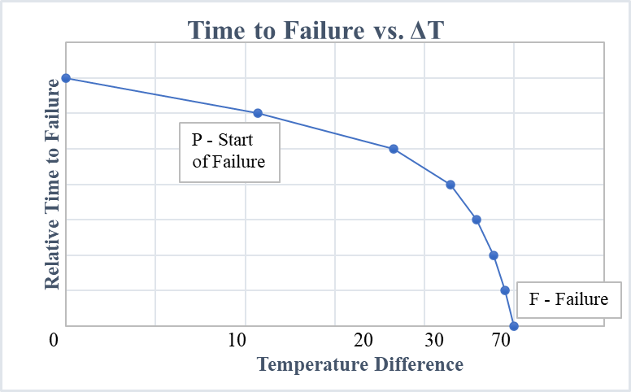
FOLLOW-ON EFFORTS / IR&D
DATA ANALYTICS → CONDITIONS BASED MAINTENANCE
Define Prevention – Failure (P-F) curve for LV, MV, and HV electrical panels from data collected by DTS controller.
Priority | Temp Rise or ΔT | Operational Assessment | Severity Code | Action
1 | ≥ 70°C | Failure Imminent | **** | Equipment should be secured immediately and not operated until repairs are complete.
2 | 40°C to < 70°C | Failure Almost Certain | *** | Equipment should be secured if operating conditions permit otherwise monitored until corrective action can be taken.
3 | 20°C to < 40°C | Failure Possible | ** | Corrective action should be taken as soon as feasible.
4 | 5°C to < 20°C | Performance Degraded | * | Corrective action should be taken at next scheduled routine maintenance period or as schedule permits.
 | < 5°C | N/A | N/A | No corrective action required; note for future reference.
Notes:
7
DTS alarms can be set based on Min-Max temperature parameters, rate of change, and temperature difference.

Slide 8
2023 PANEL PROJECT - DTS Integration into Electrical Plant Controls
TASKS AND SCHEDULE
DESCRIPTION | Date
CONTRACT AWARD | 3/24/2023
Project Plan & Schedule | 4/4/2023
TASK 1: Review DTS tests performed and previous related work
Q1 Project Status Report | 5/16/2023
TASK 2: Method(s) to apply sensors in panels and mods to DTS for MIL specs
TASK 3: El conditions hierarchy, method to access info, & display of warn/alarms
Q2 Project Status Report | 9/12/2023
TASK 4: Data interface, cyber security, and comms protocols to integrate DTS into ERM. GUI for DTS data.
TASK 5: Sampling rates, rates of temp change, operating temp & temp diff, data retention for CBM
Q3 Project Status Report | 12/26/2023
TASK 6: DTS system design: FO cable, sensors, controller, and interface. Outline specs with qual tests
Final Report with Recommendations | 3/25/2024

Slide 9
QUESTIONS?
Giovanni Tomasi
RSL Fiber Systems, LLC
860-282-4930 x-4929
gptomasi@rslfibersystems.com

Slide 10
BACK UP SLIDES

Slide 11
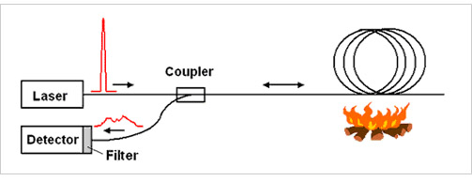
Fiber Optic Distributed Temperature Sensing
Entire fiber is the sensing unit – over 2000 zones per fiber channel.
Standard MM 50/125, 62.5/125 or SM fiber.
Up to 30 Km MM, 40 Km SM - real time monitoring across entire length.
Temperature rise of 0.1ºC
Spatial Resolution down to 50 cm.
Based on Raman Scattering.
Notes:
A DTS uses the fiber optic cable as a continuous lineal temperature sensor. The fiber cable can be embedded in the power cable or placed over the cable to detect temperature changes.
DTS systems can be configured to the specific application, with distances, sampling intervals, alarms and other parameters customized as needed.

Slide 12
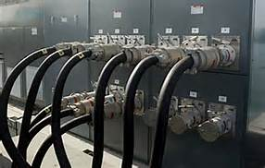
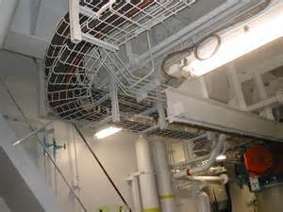
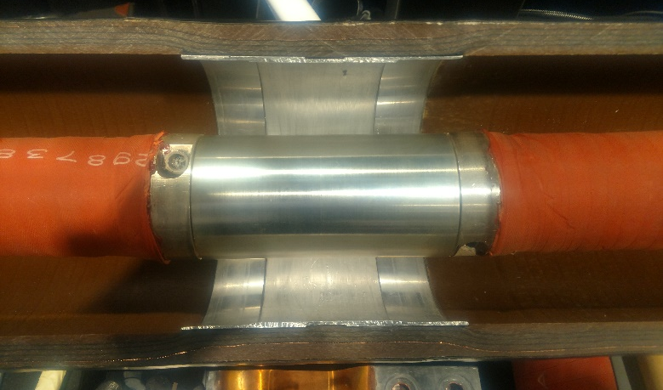
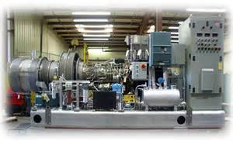
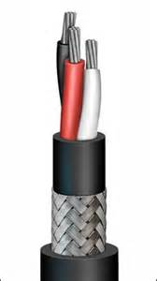
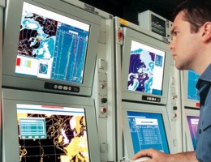
DTS – Possible Shipboard Applications
Insulated Bus Pipe Connections
Fire detection
MV and HV electrical panels monitoring
Machinery health monitoring
Cabling systems health monitoring
Food storage spaces
Others…
Single DTS and single cable for multiple functions
Data displayed on Integrated Bridge System Controller

