Slide 1
NSRP Panel Project High-Density Ribbon Fiber Optic Cable & Tooling for Shipboard Installations
NSRP All Panel Meeting
Charleston, SC
March 28-30, 2023

Slide 2
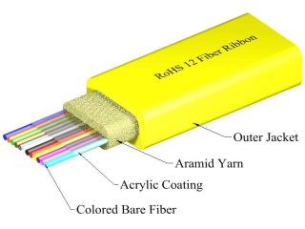
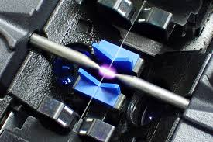
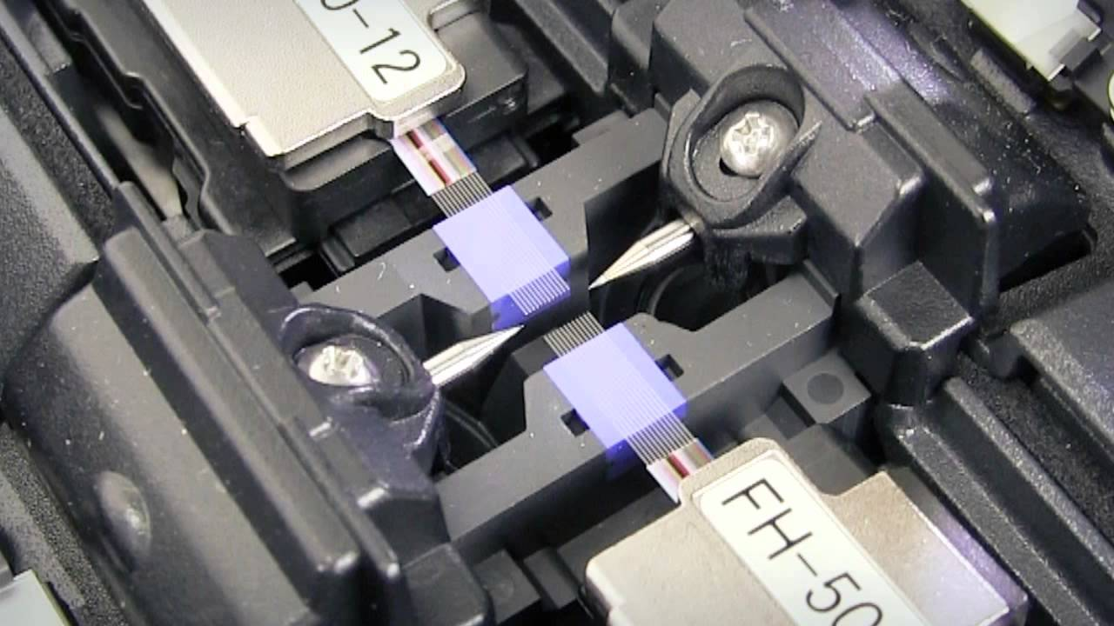
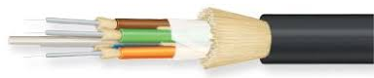
Background
Shipboard network infrastructure is rapidly evolving and will impact fiber optic cables on future ship programs
Navy ship programs are planning to use high density fiber optic cable configurations to meet increasing demands of shipboard networks
Ribbon fiber facilitates increased signals in smaller package
This new fiber type is expected to reduce cableway congestion and facilitate the increasing demand on shipboard data networks
New cable configurations will require new tooling, processes, and training in order to be successfully deployed on Navy ships
TLC Ribbon Cable 12 Fiber - COTS
(FIS)
Fusion Splicer Individual Fiber
Fusion Splicer Ribbon Fiber
Standard M85045 Cable Example

Slide 3
Project Overview
Goals & Project Objective:
To evaluate the impact of new, high-density fiber optic cable configurations for U.S. Navy shipboard applications
To identify process and tooling impacts of using this new technology
Study will:
Identify shipyard impacts to new cable type
Evaluate new fiber and connector technologies
Conduct field studies
Provide feedback to Navy and manufacturers on field impacts
Identify new tooling required for implementation
Identify necessary changes and process updates to support successful transition at shipyards

Slide 4
Project Team
Ingalls Shipbuilding (Lead)
Newport News Shipbuilding
Penn State ARL Electro-Optics Center
KITCO Fiber Optics
Naval Surface Warfare Center Dahlgren Division
Project Technical Representative (PTR)
Walt Skalniak, Ashby Co
NSRP Project Manager
Nick Laney, ATI

Slide 5
Task Summary
Task 1 - Review Requirements & Procedures
Task 2 - Industry Survey: Ribbon Fiber & Tooling
Task 3 - Hardware Evaluations
Task 4 - Analysis of Shipyard Impacts
Task 5 - Final Report & Technology Transition Plan

Slide 6
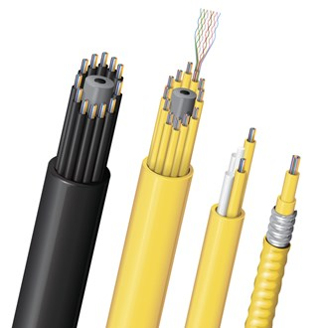
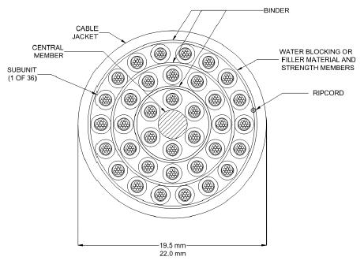
Fiber Optic Ribbon Cable
Ribbon fiber is widely used in
commercial markets
High density configuration facilitates increased signals in smaller package
Recent NAVSEA specifications published:
Cables: MIL-PRF-85045/33, /34, /35, and /37
Ribbon Splice: MIL-PRF-24623/8
Ribbon Splicer: A-A-5799
COTS Ribbon Fiber Cable Examples
(Belden)
Standard M85045 Cable Example
M85045 Ribbon Cable with 36 Subunits

Slide 7
Next Steps
Kick-Off Meeting
Develop requirements
Review current processes

