Slide 1
PP23 - Modern Shipbuilding Design Courses 3 Darren Guillory

Slide 2
Project Team
Lead
Rob Parker - Professional Services Manager
Darren Guillory - Technical Solutions Specialist
Nate Kroodsma – Engineering Manager
Rodney Patrick – Workforce Development Manager
J. Scott Christman, Ph. D. – Program Manager of Trade Training & Apprenticship
Rene’ Lenord – VP Engineering & Program Management
Robert Simmons – Chief Capability Officer
Brenda Downey – Asst. Dean Workforce Development

Slide 3
Project Problem
Qualified coursework for marine design-specific education is lacking across the industry.
Previous NSRP efforts produced marine design courses that were taught at local universities (University of Wisconsin Marinette and University of South Alabama) but have since stopped being offered and have not been updated to include modern advances in design software.

Slide 4
Project Goals
This project will update the original Marine Design coursework and provide an implementation path and resources to allow the updated coursework to be offered at a local level to train and prepare a capable marine design workforce for the modern shipbuilding industry.

Slide 5
Completed Project Tasks
Kickoff meeting – Conducted on 11/4/2022
Kickoff meeting Report delivered 11\15\2022
Acquired Original Course Material and Deliverables for Review
Quarterly Report 1 Delivered 12/20/2022
Identified and notated areas for update or revision
Quarterly Report 2 Delivered 3/20/2023
Updated the curriculum as required

Slide 6
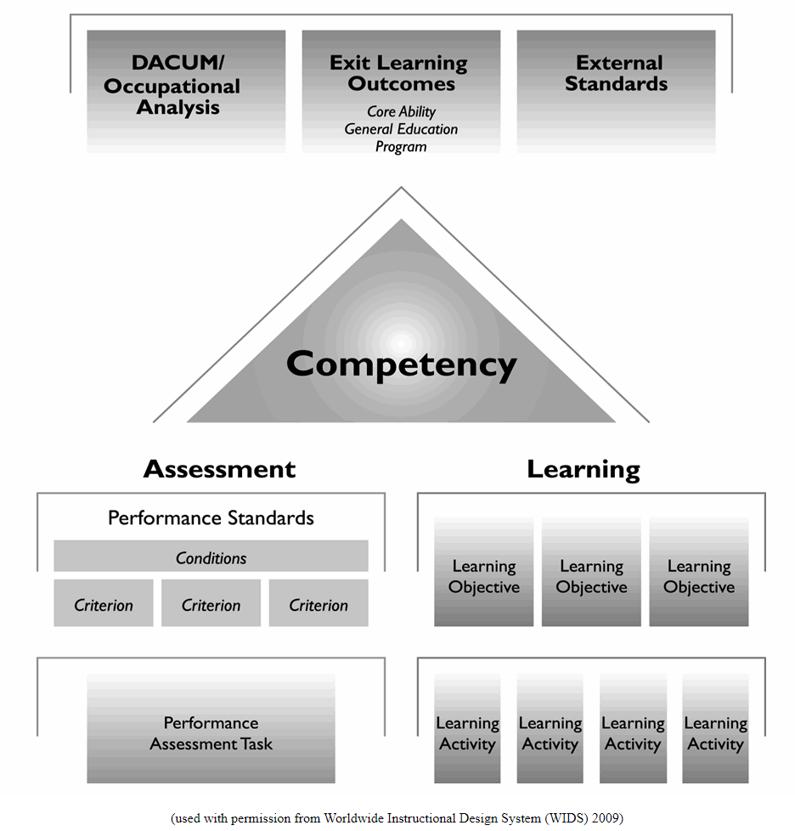
Review of Original Course Material
The original course material was developed using a software called WIDS (Worldwide Instructional Design System)
This software is for designing and mapping a course curriculum.

Slide 7
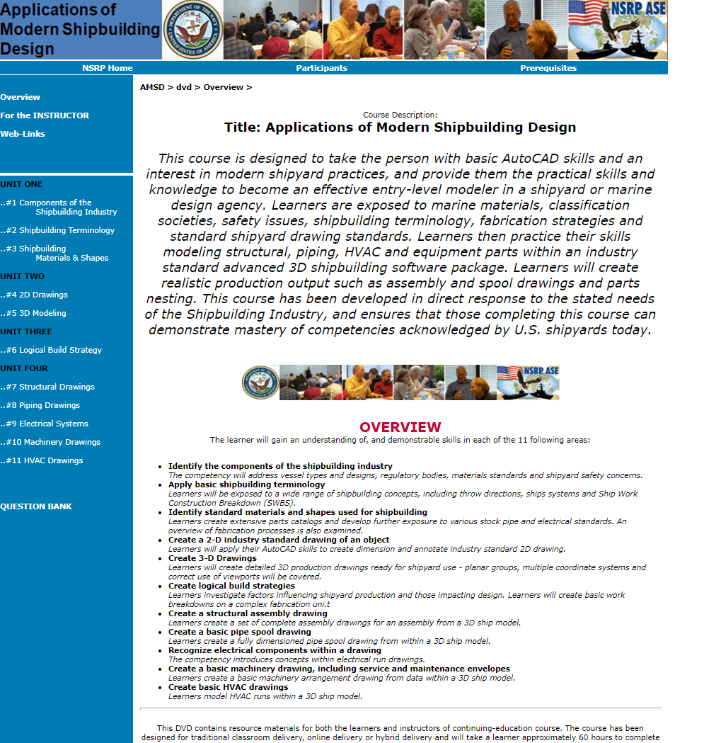
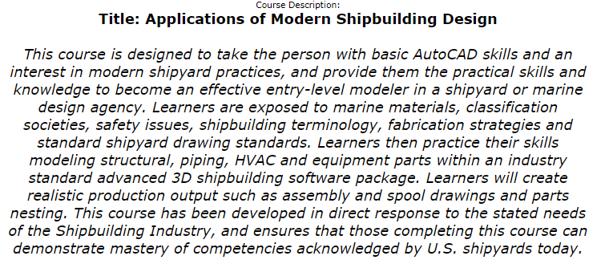
Review of Original Course Material

Slide 8
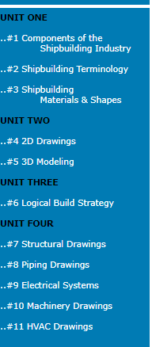
Review of Original Course Material
The original course material was set in a visual format that an instructor or individual can follow in a step-by-step manner.

Slide 9
Updated course Curriculum
The intent is to maintain the order of the course, while updating the content to suit today’s modernized industry standards.
Structure
• 2D Scantling Drawings
• Scantling Drawings and the Build Strategy
• Creating 3D Parts in a Planar Group
• Creating a 3D Structural Model
• Creating Assembly and Profile Plot Drawings
• Creating Nest Drawings
Electrical
• Electrical Theory
• Basics of Electrical Systems
• Impact of Rules and Regulations on Electrical System Design
• Design Process and Production Planning
• 2D Electrical System Drawings
• 3D Electrical Models
Piping
• Interpreting a Schematic
• Modeling Parts and Associated Equipment
• Creating Parts and Fittings
• Assigning Runs to a System
• Interferences with Structural and Insulation Parts
• Creating Penetrations
• Creating Spool Drawings
• Creating Arrangement Drawings
• Managing Revisions
Design for Production (DFP)
• Purpose of Design for Production
• Principles of Design for Production
• Applying Design for Production to a Design Model
• Building and Reporting for Design for Production

Slide 10
Updated course Curriculum
The intent is to maintain the order of the course, while updating the content to suit today’s modernized industry standards.
HVAC
• Interpreting a Schematic
• Modeling Parts and Associated Equipment
• Creating Parts and Fittings
• Assigning Runs to a System
• Interferences with Structural and Insulation Parts
• Creating Penetrations
• Creating Spool Drawings
• Creating Arrangement Drawings
• Managing Revisions
Equipment (NEW)
• Interpreting Vendor Furnished Information (VFI)
• Modeling Equipment for the Equipment Library
• Managing an Equipment Library
• Inserting Equipment into the Model
• Creating Machinery Arrangements
• Managing Revisions

Slide 11
Questions?

