Slide 1
Multi-factor Monitoring During Laser and Hybrid Laser-Arc Keyhole Welded Steel Butt Joints “First Time Welding Quality Control” Welding Panel Meeting 1-5-22
OSU Team: Shawn Sutton, Dr. Boyd Panton, Dr. Dennis Harwig | NASSCO | NSWCCD | EWI | Ingalls |

Slide 2
Outline
Motivation
Objectives
System Set-up
Procedure Development
Inline Coherent Imaging Testing
In-, pre-, and post-weld analysis
Conclusion
Future Work

Slide 3
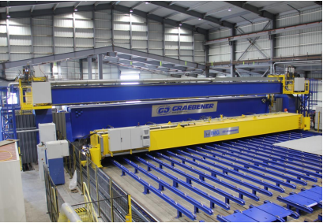
Motivation
Hybrid Laser-Arc Welding (HLAW)
Preferred by shipbuilders for large panel seam welds 6-14mm
https://www.nsrp.org/wp-content/uploads/2019/03/05-NASSCO’S-New-Panel-Line.pdf
HLAW versus standard arc welding processes:
Reduced distortion
Reduced residual stress
Increased travel speed
Increased weld penetration

Slide 4
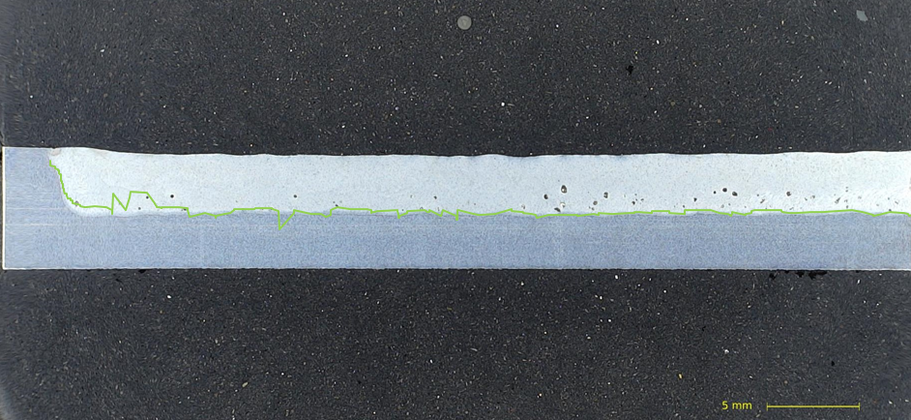
Motivation
Issues with intermittent defect formation in HLA welds
Porosity, Undercut, Lack of Penetration
First-time quality desired to mitigate re-work
Real-time weld monitoring technology needed to identify issues, minimize repairs, and potentially minimize post-weld NDE (future)
Inline Coherent Imaging Technology (ICIT) offer potential for this need

Slide 5
Objectives
Develop quality scenario test (QST) procedures for laser and hybrid laser-arc welding for assessment of the ICIT system
Determine sensitivity and accuracy of the ICIT system using autogenous laser keyhole welds; partial versus full penetration
New measurement tools needed to evaluate arc interaction on pre- and in- scans
Evaluate ICIT for pre-, in-, and post-weld monitoring scans on different QST
Evaluate the effect of scan settings such as orientation and cycle time on weld profile resolution
Recommend future work for ICIT of HLAW for implementation
Potential for electrode alignment tracking
Potential for arc length control

Slide 6
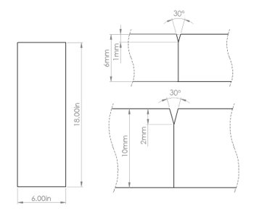
Setup
6mm thick AH36 structural ship steel ​
Y-groove butt and bead-on-plate (laser welds) joint configurations
1.2mm (0.045”) E71T15-M21A4-CS1 filler wire
Hybrid Laser-Arc Weld Tests
IPG YLS 20000
Lincoln Power Wave i400
EWI B3 Optics
Lincoln RapidArc waveform
90%-10% Argon-carbon dioxide gas shielding
Laser Weld Tests
IPG YLS 6000
IPG D50 Optics
Motoman MC2000 robot
99.99% Argon gas shielding
​​ | Fe​​ | C​​ | Si​​ | Mn​​ | P​​ | S​​
E71T15-M21A4-CS1​​ | Bal.​​ | 0.05​​ | 0.66​​ | 1.69​​ | 0.008​​ | 0.013​​
OSU’s Laser System

Slide 7
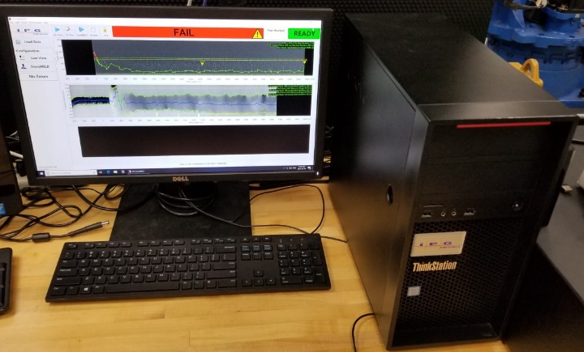
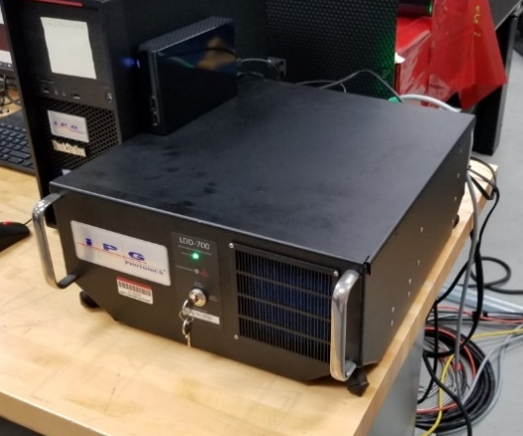
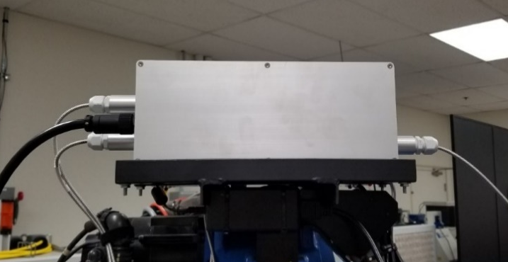
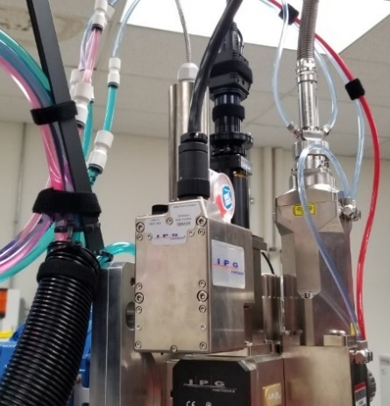
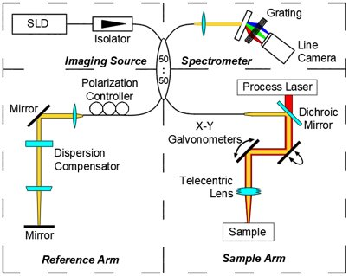
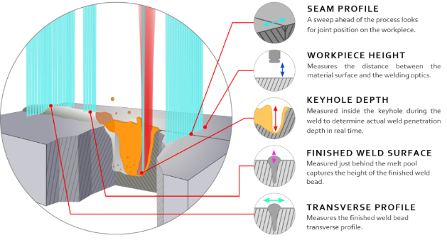
Laser Depth Dynamics
Laser Depth Dynamics (LDD) 700 System
IPG Brand
ICIT monitoring system developed by Dr. Paul Webster
800-900nm wavelength laser
10,000x10,000µm scan region
6mm field of view (FOV)
Comprised of four components
Capable of measuring up to five geometric characteristics simultaneously

Slide 8
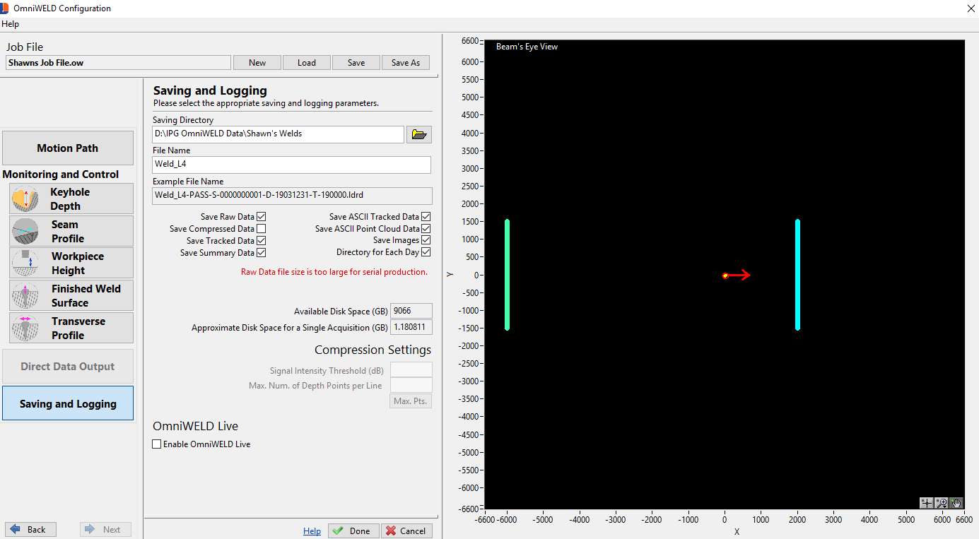
OmniWeld Software
OmniWeld – software for LDD system control
Live viewing
2D and 3D
Scan setting
Tracking settings
Save settings
Recording of all pre-, in-, and post-weld scans requires an acquisition of data
Post weld data manipulation

Slide 9
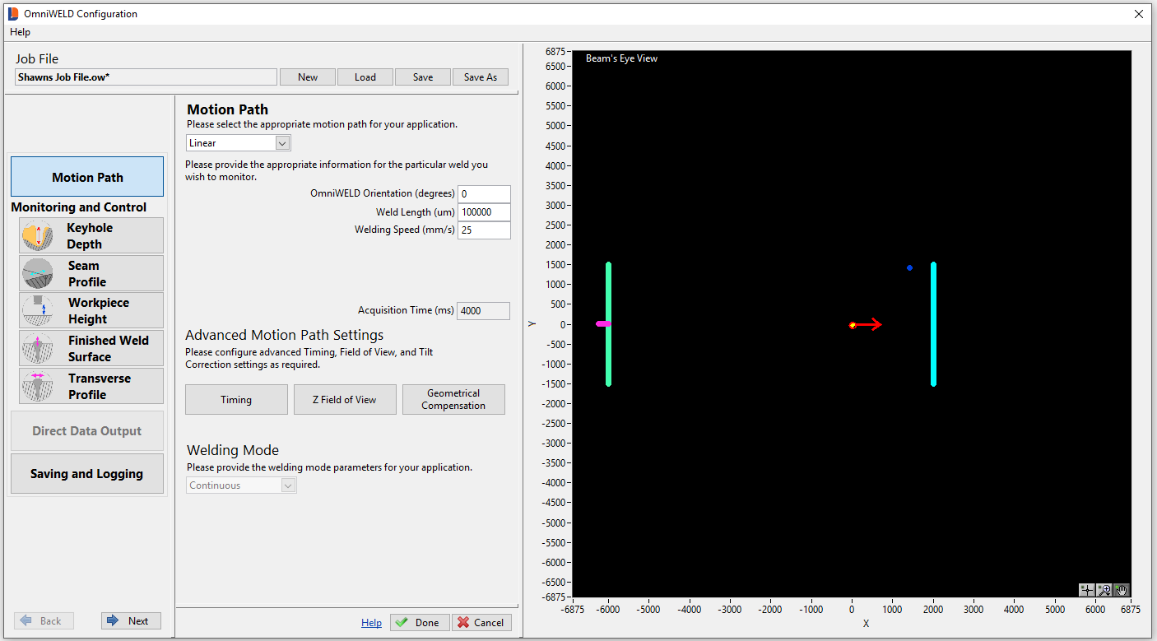
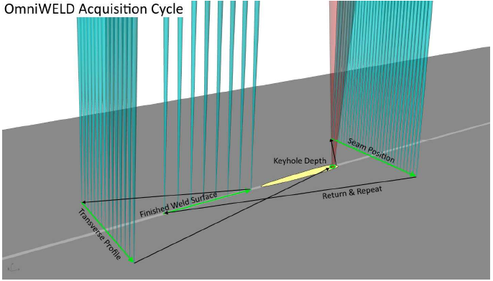
Scan Cycle
To perform each scan for all active modes OmniWeld will cycle in the following order:
Finished surface
Transverse Profile
Keyhole Depth
Seam Profile
Workpiece Height
Time to complete one full cycle of all modes is known as the cycle time
Minimum allowable cycle time is determined by:
Quantity of active scans
Scan geometry

Slide 10
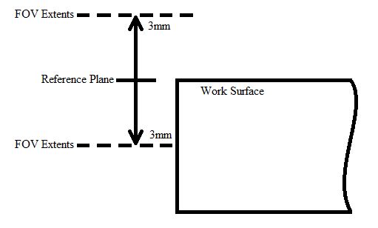
Reference Plane and Field of View
Reference Plane
Plane with which all measurements are with reference to
The work surface
Field of View (FOV)
Distance where all measurements take place
FOV can be shifted

Slide 11
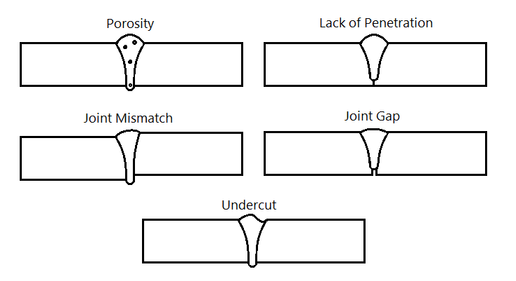
HLAW Procedure Development
Established “base-line” weld parameters with a relatively defect free weld
Laser Power (kW)​​ | Defocus (mm)​​ | Travel Speed (in/min)​​ | Beam to Wire Distance (mm)​​ | Wire-Feed-Speed (in/min)​​ | Trim​​ | Electrode Stick-out (in)​​ | Torch Angle (°)​​
6​​ | -2​​ | 59​​ | 2​​ | 333​​ | 1.05​​ | 0.5​​ | 45​​
Developed and performed multiple QSTs for defects and defect forming conditions including:
Joint Gap
Joint Mismatch
Undercut
Porosity
Lack of Penetration

Slide 12
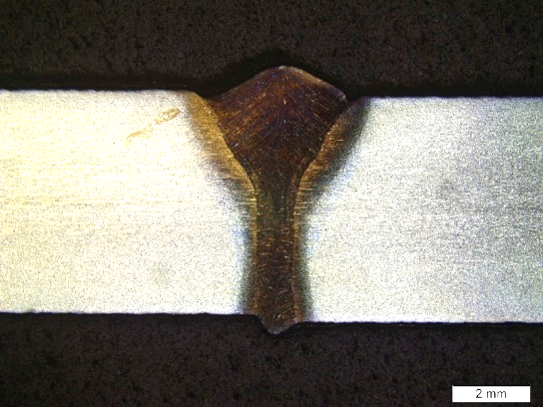
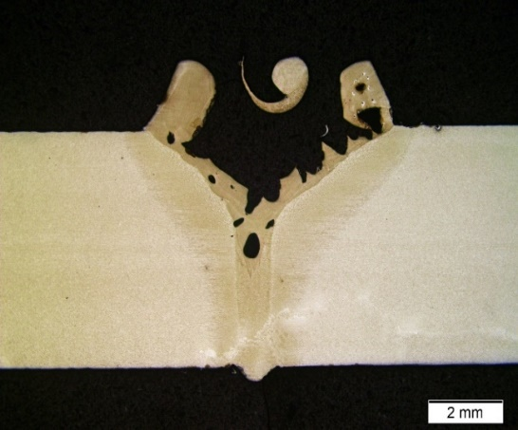
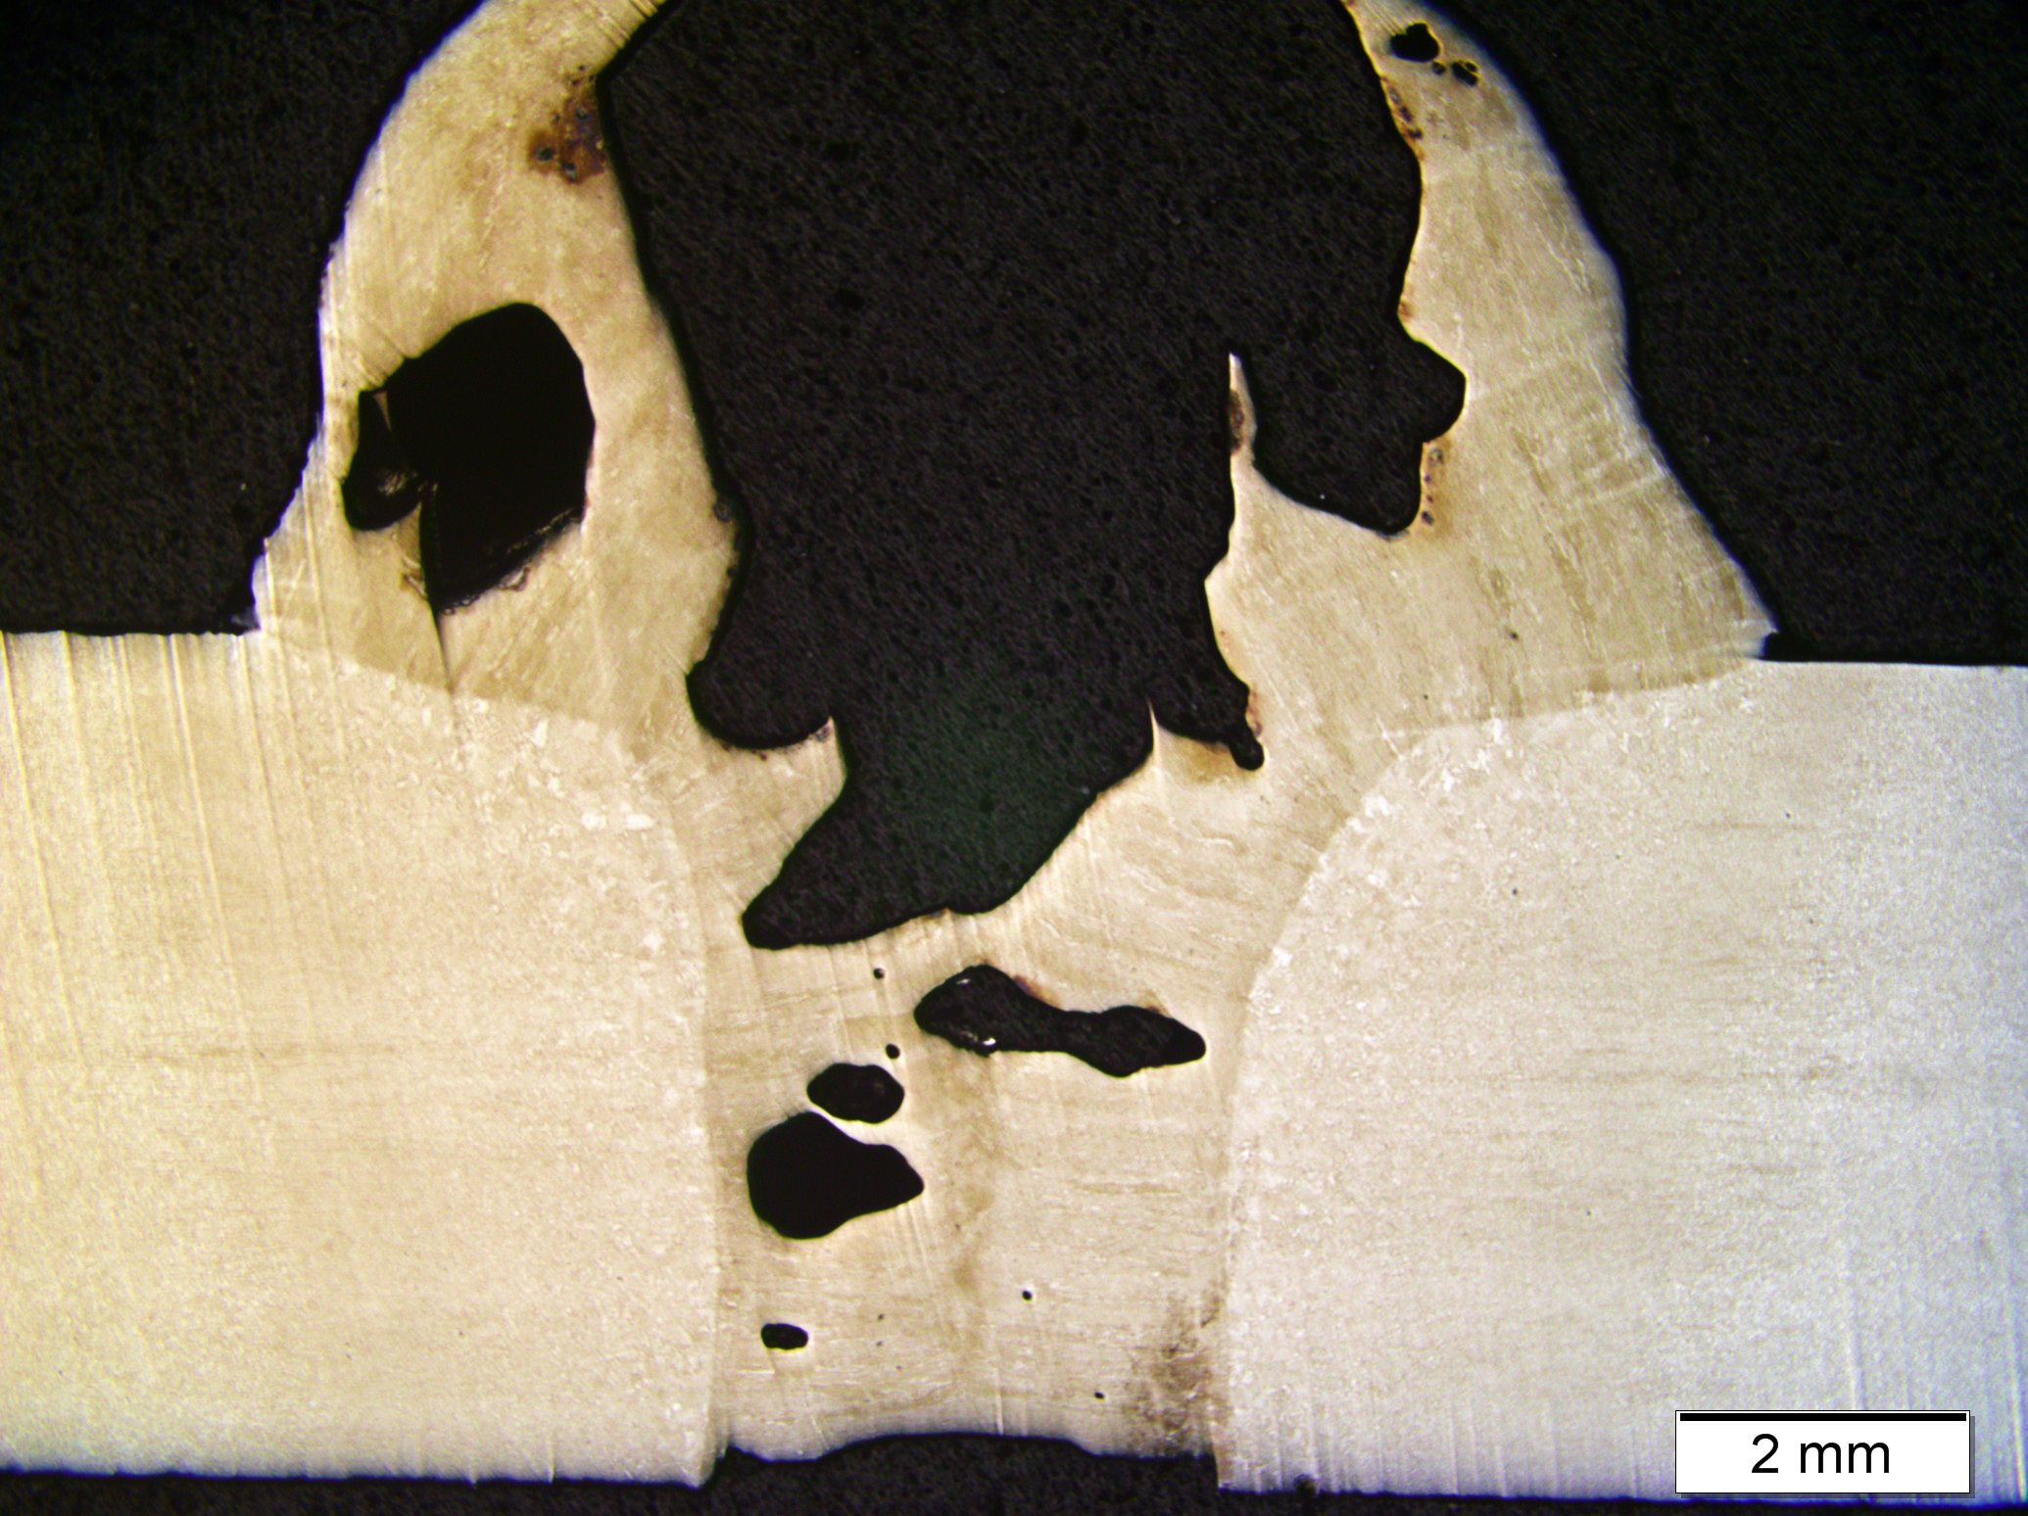
Joint Condition | Weld ID | Procedure | Type of Defects |  | Description
Joint Gap | JG | 0.01” shim placed in the weld joint | Porosity | Lack of Penetration | Some small and medium-sized porosity interspersed
 |  |  | Cracking | Lack of Fusion
 |  |  | Undercut | Underfill
 |  |  | Excessive Convexity
Joint Mismatch | JM | 0.01” shim placed underneath one side of joint | Porosity | Lack of Penetration | Small intermittent porosity; undercut at the weld surface along a portion of the length
 |  |  | Cracking | Lack of Fusion
 |  |  | Undercut | Underfill
 |  |  | Excessive Convexity
Oil in Joint | OJ | 3-in-1 oil placed along the full length | Porosity | Lack of Penetration | Small to medium porosity throughout; underfill in the weld root along a portion of the length
 |  |  | Cracking | Lack of Fusion
 |  |  | Undercut | Underfill
 |  |  | Excessive Convexity
Water in Joint | WJ | Water placed in joint | Porosity | Lack of Penetration | Large porosity throughout; small undercut in the weld root for a portion of the weld
 |  |  | Cracking | Lack of Fusion
 |  |  | Undercut | Underfill
 |  |  | Excessive Convexity
Excessive Contact tip to Work Distance | CTWD | Contact tip to work distance increased to 0.75" | Porosity | Lack of Penetration | Large porosity throughout; small undercut in the root and excessive concavity in a few locations
 |  |  | Cracking | Lack of Fusion
 |  |  | Undercut | Underfill
 |  |  | Excessive Convexity
Lack of Arc Shielding | LS | Turned off shield gas to arc torch | Porosity | Lack of Penetration | Large porosity throughout; small undercut in the root and excessive convexity in a few regions
 |  |  | Cracking | Lack of Fusion
 |  |  | Undercut | Underfill
 |  |  | Excessive Convexity
Reduced Travel Speed | RS | Reduced travel speed to 25ipm with constant WFS | Porosity | Lack of Penetration | Massive wormhole porosity, lack of penetration, and excessive convexity for much of the length of the weld
 |  |  | Cracking | Lack of Fusion
 |  |  | Undercut | Underfill
 |  |  | Excessive Convexity
Joint Mismatch
Excessive Electrode Stick-out
Reduced Travel Speed

Slide 13
Penetration Tracking Accuracy
P ​ (W)​ | Reference Plane (µm)​
1000​ | 3000​
2000​ | 3000​
3000​ | 5000​
3000​ | 5000​
3000​ | 6000​
Keyhole Depth Profiles

Slide 14
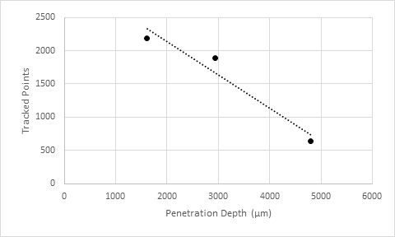
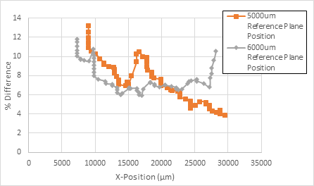
Penetration Depth Tracking
Tracked Data vs. Penetration Depth
% Difference vs. X-Position for Two Reference Plane Positions
Reference Plane Position (um)​ | AVG % Error​ | Sensor Counts​
5000​ | 7.13 | 459​
6000​ | 7.91 | 485​

Slide 15
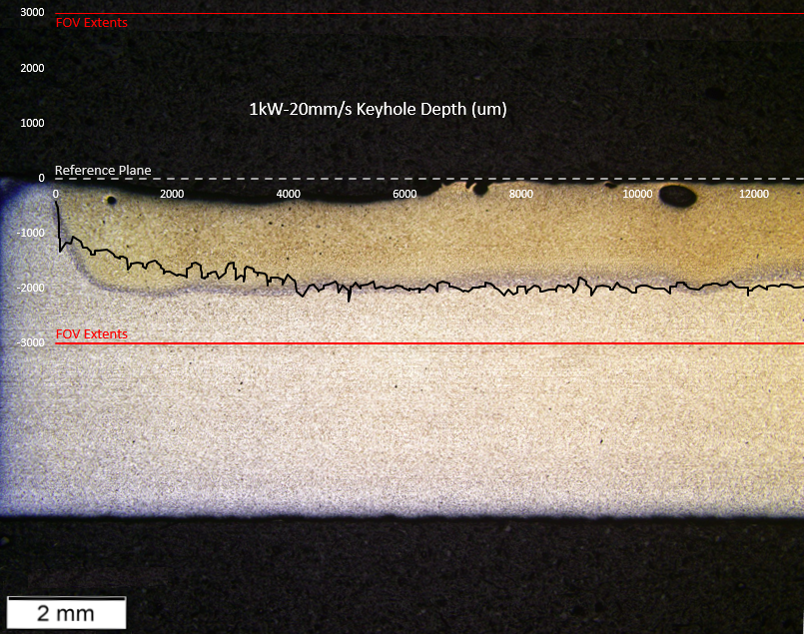
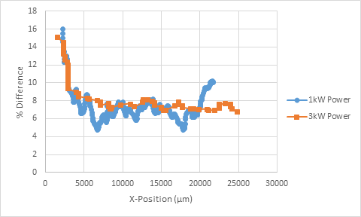
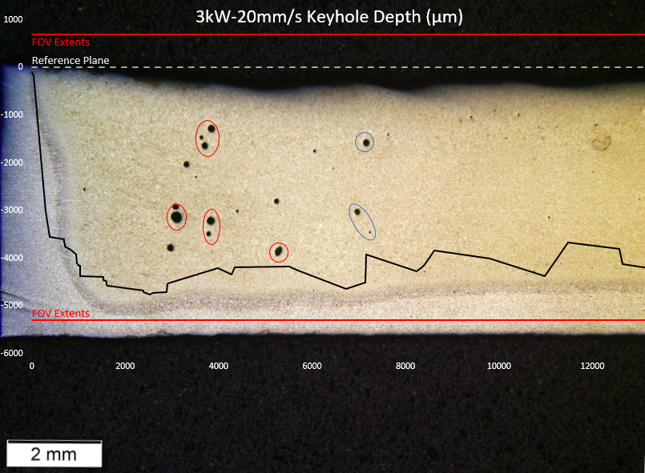
Partial Penetration Tracking Accuracy
P (W)​
1000​
3000​
Sudden shifts in penetration are not tracked accurately
At higher power the accuracy for the LDD decreased
Power (W)​ | AVG % Difference​
1000​ | 7.49
3000​ | 8.63
% Difference vs. X-Position for Two Beam Powers

Slide 16
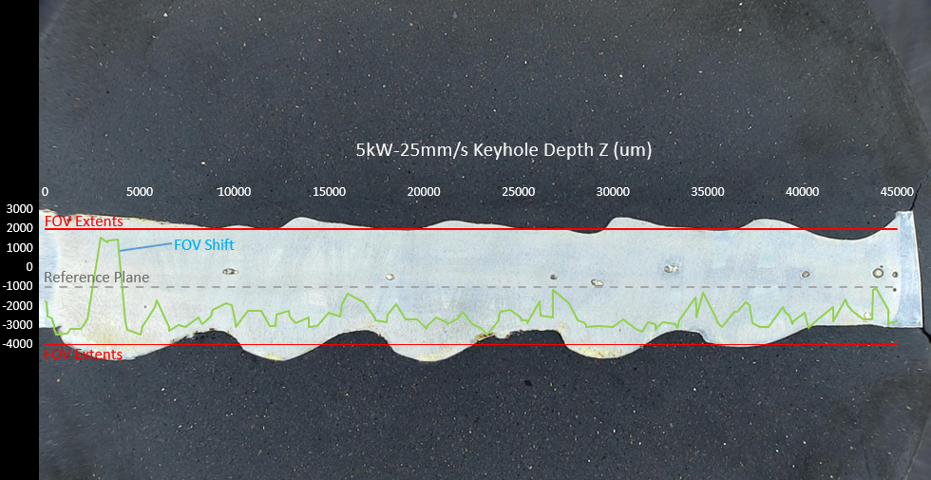
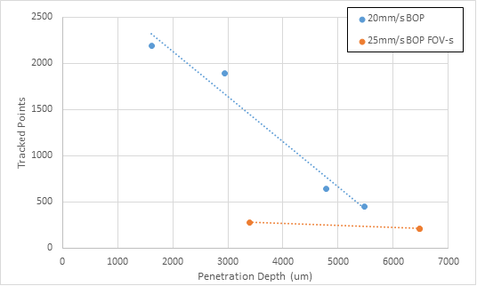
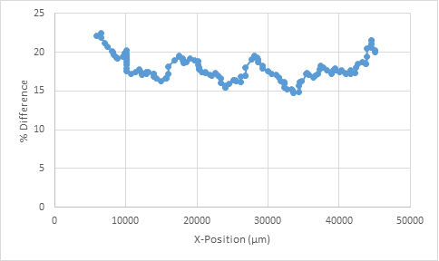
Full Penetration Tracking Accuracy
Poor tracking of weld root for full penetration weld
Little to no evidence of root humping shown
Decrease of plotted points or “counts”
Consistent count total for full penetration weld with 100mm length and 25mm/s travel
Tracked Data vs. Penetration Depth for Two Travel Speeds
% Difference vs. X-Position for Full Penetration Weld

Slide 17
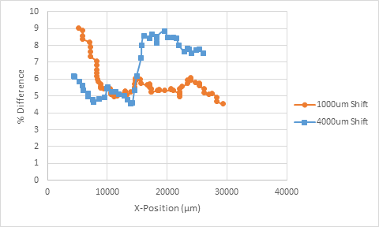
Field of View (FOV) Shifting
Keyhole Depth Profiles
Short peak in root measurement from transition
Transition begins within ~200ms of acquisition start
Better accuracy for smaller shifts
Artifact at the top of both profiles with large shifts
Transition Peak
Unknown Anomalies
Transition Peak
Transition Peak
% Difference vs. X-Position for Two FOV Shift Distances
FOV Shift (um)​ | Shift Time (ms)​ | AVG % Error​ | STD Dev. % Error​
1000​ | 59.6285​ | 5.84 | 0.95​
4000​ | 119.257​ | 6.56 | 1.52​

Slide 18
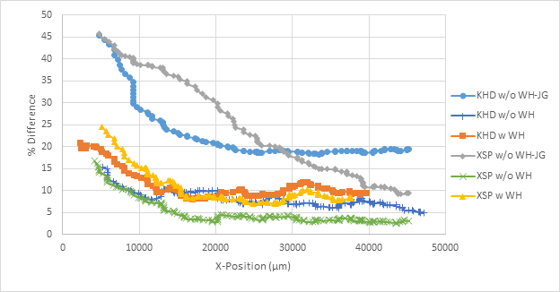
Workpiece Height
Workpiece Height
Workpiece height sets scan reference to its measure
Improves scan accuracy
Keyhole Depth + Finished Surface Profile
Measurement​ | AVG % Error​ | STD Dev. % Error​
KHD w/o WH​ | 8.049 | 1.782
KHD w WH​ | 11.892 | 3.945​
KHD w/o WH-JG | 22.773 | 6.711
XSP w/o WH​ | 4.975 | 3.042
XSP w WH​ | 9.517 | 2.30​
XSP w/o WH-JG | 23.81 | 11.64
% Difference Comparison for Keyhole Depth and Cross-Sectional Parameter

Slide 19
Seam Profile
Weld joint needed for tracking with seam profile
Y-groove joint visible in weld where present
Seam profile and workpiece height synergy
Seam profile has a variety of optional tracking features
One of two tracking modes that can be used in live viewing
Seam Profiles

Slide 20
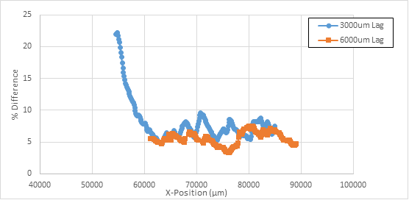
Transverse Profile
Transverse Profiles
Also provides additional optional tracking features
Pre- and post-weld scans can’t accurately measure molten material
Decreased sample spacing for greater data density
% Difference vs. X-Position for Two Scan Lag Distances
Lag Distance (um)​ | AVG % Error​ | STD Dev. % Error​
3000​ | 12.321 | 6.999
6000​ | 4.410​ | 1.255

Slide 21
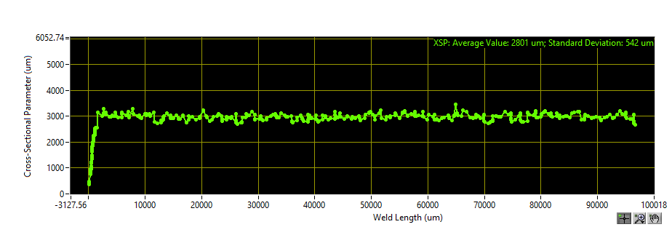
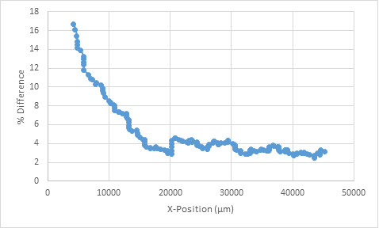
Finished Surface
Keyhole Depth + Finished Surface Profile
Use of keyhole depth and finished surface profile enables optional calculations
Highly accurate
Cross-sectional parameter may be performed using the transverse profile
Cross-Sectional Parameter
% Difference vs. X-Position for the Cross-Sectional Parameter

Slide 22
Quality Scenarios
Joint Condition​ | Weld ID​ | Scenario​ | Results​ | Detected Mode​ | Sensor Response​
Base-line​ | BL​ | Normal keyhole weld​ | Normal keyhole, porosity interspersed​ | Keyhole Depth​ | Short fluctuation in weld root measurement (may be attributable to noise)​
Low/High Power​ | LP / HP​ | Power reduced to 500W / increased to 2000W​ | Conduction mode weld / excessive penetration​ | Keyhole Depth​ | Flat line at reference plane / clipped tracking data​
Joint Mismatch​ | JM​ | 2mm thick shim placed under one side of joint​ | Lap joint like weld​ | Keyhole Depth, Seam Profile, Transverse Profile​ | Increased noise and clustered data near lower plate surface, Two distinct colored surfaces, Two distinct colored surfaces and reduced data in weld center​
Joint Gap​ ​ | JG​ | 0.01” shim placed within weld joint​ | Underfill at the start of the weld (near the shim)​ | Keyhole Depth, Seam Profile, Transverse Profile,​ Finished Surface​ | Clipped root, Noise in edge tracking at the gap, Depressed weld bead height and noise in edge tracking at gap, Depressed bead height​
Beam Misalignment​ | BM​ | Beam driven out of joint after some distance​ | Missed joint after 25mm of travel​ | Seam Profile, Transverse Profile​ | Turning joint (more pronounced), Turning joint (less pronounced)​
Out-of-Focus​ | OF​ | Laser positively and negatively defocused​ | No noticeable difference in welds at surface level​ | Keyhole Depth, other modes untested​ | Shifted root position (upward for negative defocus, downward for positive defocus)​

Slide 23
Quality Scenarios
JG
JM
Keyhole Depth + Finished Surface Profile
Keyhole Depth + Finished Surface Profile
Seam Profile
Seam Profile
Transverse Profile
Transverse Profile

Slide 24
Cycle Time
Seam Profile
Exponential decay in data count for seam and transverse profiles
Visible drop in resolution at high cycle time
No discernable trend in edge tracking standard deviation
Reduced feature tracking sensitivity
Cycle Time (ms)​
7​
25​
50​
Transverse Profile

Slide 25
Data Clipping and Scan Orientation
Keyhole Depth Profiles
Exceeding the region of interest or FOV clipped keyhole penetration data
Increased reference plane position to alleviate issue
Obstructing the scan field also clipped sensor data
Flipped scan orientation results in a weld bead measurement in the seam profile and vise versa for the transverse profile
Transverse Profile
Seam Profile
Transverse Profile

Slide 26
Summary
Procedure Development
A range of quality scenarios and weld parameters were tested
Laser Welds
Accuracy and sensitivity of keyhole depth tracking was dependent on the penetration depth and the reference plane position
Attainment of full penetration was correlated to the total quantity of tracked data for a given travel speed and part thickness
Various conditions were detected in the keyhole depth (in-weld) scan
Accuracy of weld scan improves for welds with shifting surface morphology when the workpiece height (pre-weld) scan is active
The seam profile (pre-weld) scan was heavily affected by deficiencies in joint configuration, this effect was also noted for both post-weld scans (transverse profile, finished surface)
Notes:
the effective quality scenarios were identified for use in later testing
with an increase in average % difference of 1.1% and 0.8% respectively
where for a 100mm weld with a 25mm/s travel speed the total count was 214
Low-power, high-power, joint gap, joint mismatch, and beam out of focus
most notable with the joint gap condition where accuracy was reduced by 11%

Slide 27
Future Work
Further analysis of full penetration tracking accuracy
Develop confidence in signal analysis
Low signal strength is good (full penetration)
Hybrid laser-arc welding with ICIT
Develop electrode & arc length measurement tools
Evaluate arc leading and laser leading hybrid process variants
Evaluate partial penetration monitoring stiffener fillet welds
Evaluate ICIT on HLAW welds in quality scenarios tests
Evaluate Lag distancing for the transverse and FS profiles.
Depending on orientation, the effect of tool position within the joint on ICIT the SP and TP scans.

Slide 28
Acknowledgements
The Ohio State University
Dr. Boyd Panton
Dr. Wei Zhang
Dr. Dennis Harwig
Edison Welding Institute
Jacob Hay
Mark Mohler
Dean Langenkamp
General Dynamics NASSCO
Cody Whitely

Slide 29
Thank you. Questions?

