Slide 1

NSRP Panel Project: (2019-477-003)
SHIPBOARD FIBER OPTIC CABLES JACKETS PERFORMANCE ENHANCEMENTS
Giovanni Tomasi
RSL Fiber Systems, LLC
REPORT 2
December 15, 2023
DISTRIBUTION STATEMENT A. Approved for public release: distribution unlimited.

Slide 2
TABLE OF CONTENTS
PROJECT OUTLINE
PROJECT HISTORY
PROJECT FINDINGS
NEXT STEPS

Slide 3
2023 – SHIPBOARD FIBER OPTIC CABLES JACKETS PERFORMANCE ENHANCEMENTS
OBJECTIVE
Identify new jacketing materials:
  Enhance performance.
  Decrease manufacturing cost.
  Increase the potential sources of supply.
  Increase cable design options.
  Lower TOC of fiber optic systems.
Recommend enhancements that:
  Can be used to revise the existing MIL-PRF-85045 shipboard cable sheets or
  Used to create new sheets.
TEAM MEMBERS
Prime/Lead: RSL Fiber Systems, LLC
Team Members: Huntington Ingalls – Ingalls Shipbuilding, U.S. Navy – SUPSHIP Gulf Coast, ChemPro Technologies LLC
ATI Project Manager: Nick Laney
Program Technical Representative: Walt Skalniak (Ashby Co.)
ESTIMATED ROI
Savings from Thermoset to Thermoplastic: $ 6.3M /year
Thermoplastic w/50% reduction in damage: $ 11.6M / year
PROGRAM FUNDS
$ 150,000
DURATION
12 Months
DISTRIBUTION STATEMENT A. Approved for public release: distribution unlimited.

Slide 4
PROJECT HISTORY - 2019 SHIPBOARD FIBER OPTIC CABLES
DESIGN ENHANCEMENTS PROJECT (Panel Project 2019-477)
CONCLUSIONS
Baseline cable designs are suited for shipboard environment.
Most of rework is caused by on-ship fiber terminations.
Jacket abrasion described as a cause of damage at installation.
Resistance to hot fluids (98-100°C) ranked lowest priority by project participants.
PROJECT FINDINGS – CABLE JACKETS
Use of Thermoset jacket driven primarily by fluids’ immersion temperature requirements taken from M24643 power cables specifications.
Thermoplastic jacket outperformed thermoset jackets in modified scrape abrasion resistance test (10 lbs. weight vs. 1 lb. weight).
Thermoset jackets may have been preferred for perceived vs. actual abrasion resistance.
Thermoplastic jackets have potential to:
  Improve abrasion resistance.
  Decrease cable cost.
  Decrease fiber damage.
  Lower TOC of fiber optic shipboard systems.
RECOMMENDED IMPROVEMENTS
  More strippable buffer.
  Fusion splice pre-terminated connectors vs. field terminations.
  More durable outer jacket materials for improved resistance to abrasion/cut-through.
Fluid | Temperature | % T&E Retention
Fuel Oil | 98°C – 100°C | ≥ 50%
Turbine Fuel | 48°C – 50°C | ≥ 50%
Lubricating Oil | 98°C – 100°C | ≥ 50%
Type | Jacket Type | Cable Outer Dia. (mm) | Avg. Wall Thick. (mm) | Results (Scrapes to Failure per mm thickness)
M85045/18 | Tset (Radiation) | 8.0 | 1.165 | 40%
M85045/18 | Tset (Mold Cure) | 8.2 | 1.39 | 94%
RSL 118052 | Tplastic | 10.2 | 1.77 | 100%
DISTRIBUTION STATEMENT A. Approved for public release: distribution unlimited.

Slide 5
2023 – SHIPBOARD FIBER OPTIC CABLES JACKETS PERFORMANCE ENHANCEMENTS
NON – NEGOTIABLE REQUIREMENTS
MIL-PRF-85045G CABLE SAFETY REQUIREMENTS
TEST DESCRIPTION | Test Std | Requirements (M85045)
Flame Test - Flame Travel (inches) | IEEE 383 | 96 (Max)
Flame Test - Smoke (Total/MRR) |  | 95/0.25
Smoke Index - Jacket | NES 711 | 25 (Max)
Acid Gas Equivalent - Complete cable (%) | M85045 4.8.1 | 2.0 (Max)
Toxicity Index | NES 713 | 5.0 (Max)
Halogen Content (%) | M85045 4.8.2 | 0.2 (Max)

Slide 6
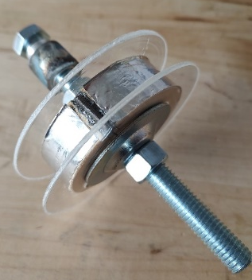
NSRP PROJECT UPDATE
ACTIVITIES
Collected slabs of 12 LSZH jacketing compounds.
Devised scrape abrasion test set-up to evaluate slabs.
  250 cycles with 5 lbs. weight.
Identified three (3) materials for application over cable core.
  Other performance parameters included in selection process.
Added UL-94 Drip Test to requirements.
Identified fiber cable manufacturer with LSZH, marine, and MIL QPL experience to apply materials over cable core.
Held meetings with compounds’ manufacturers and cable manufacturer to review optimal processing conditions.
Abrading blade (2 @ 180°)
3 in. dia. Abrading Wheel
Weight on Sample
Notes:
6
DTS alarms can be set based on Min-Max temperature parameters, rate of change, and temperature difference.

Slide 7
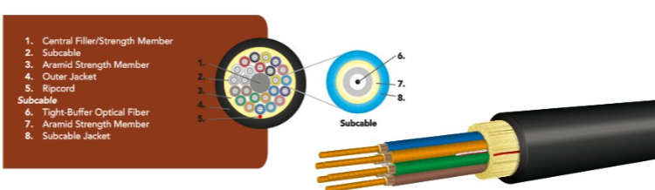
Cable Manufacturer - Optical Cable Corporation
  Company started in 1983.
  Small Business.
  Based in Roanoke, VA – Corporate and cable manufacturing.
  Dallas, TX - Harsh Environment and Specialty Connectivity Manufacturing.
  Asheville, NC - Enterprise Connectivity Manufacturing Facility.
  ISO 9001:2015 registered at all plant locations. Roanoke and Dallas facilities MIL-STD-790G certified.
  Qualified supplier of ground tactical cable to U.S. Army CECOM specs A3159879 (TFOCA Cable) and A3302584 (TFOCA Cable Assemblies)
  QPL’d to MIL-PRF-85045/8B, NOTICE 2, 12-May-2022.
  Low Smoke, Zero Halogen ABS-Approved and DNV-Certified shipboard and marine cables.
  Ship to shore cables to NAVSEA 7379371.
  Experience with specialty and large core fibers.
Notes:
7
DTS alarms can be set based on Min-Max temperature parameters, rate of change, and temperature difference.

Slide 8
2023 – SHIPBOARD FIBER OPTIC CABLES JACKETS PERFORMANCE ENHANCEMENTS
JACKET COMPOUNDS SELECTED FOR CABLING
 | Scrape Abrasion (*) |  |  |  |  |  |  |  |  | Oil (IRM 902) 4 hrs @ 70°C |  | Diesel 24 hrs @ 25°C
Compound Code | Thickness Loss @ 250 Cycles (mm) | UL 94 | Tensile (psi) | Elongation (%) | Tear (lb-in) | Durometer | Low Temp Brittle Point (°C) | O2 Index (%) | Acid gas (%) | Tensile Ret (%) | Elong Ret (%) | Tensile Ret (%) | Elong Ret (%)
A | 0.15 |  | 1800 | 230 | 45 | 98 A | -44 | 39 | 0.2 | 70 | 96 | 77 | 98 | 24 hrs @ 35°C
B | 0.06 | V-0 | 1740 | 190 |  | 55 D | -41 | 49 |  | 100 | 100 |  |  | 1 week @ 100°C
C | 0.11 |  | 5282 | 555 | 63 | 68 D |  | 32 |  | 98 | 118 | 90 | 94
(*) Slabs: 250 Cycles, 5 lbs.

Slide 9
2023 – SHIPBOARD FIBER OPTIC CABLES JACKETS PERFORMANCE ENHANCEMENTS
NEXT STEPS
Apply selected compounds to cable core at OCC [January 2024].
  Use core with optical fiber(s) to insure no negative effect on fibers during processing.
Obtain M85045/18 (4F) cable samples from shipyards – CRITICAL PATH [NLT January 26, 2024].
Perform modified MIL-STD-1678-3 scrape abrasion test (10 lbs. vs. 1 lb.) at Intertek [February 2024].
Perform ASTM D2240 Jacket Durometer test [February 2024].
Final Report [March 23, 2024].

Slide 10
QUESTIONS?
Giovanni Tomasi
RSL Fiber Systems, LLC
860-282-4930 x-4929
gptomasi@rslfibersystems.com

Slide 11
BACK UP SLIDES
Giovanni Tomasi
RSL Fiber Systems, LLC
860-282-4930 x-4929
gptomasi@rslfibersystems.com

Slide 12
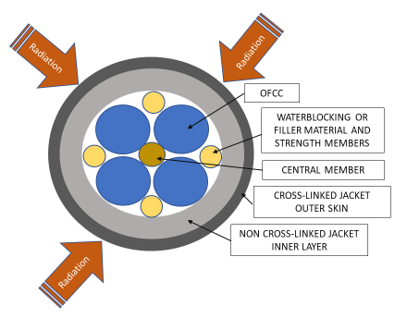
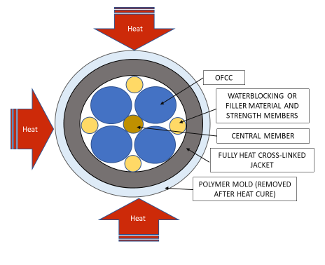
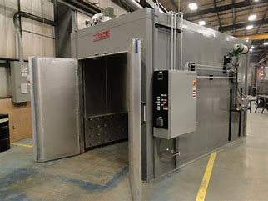
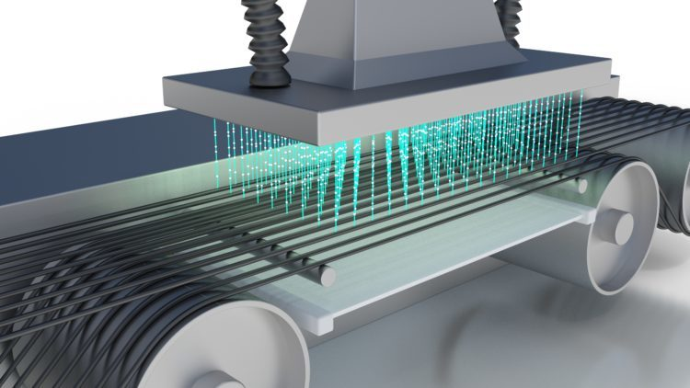
CABLE JACKET CROSS LINKING METHODS
Heat Activated x-linking (Mold Curing)
Polymer “mold” is applied in co-extrusion process with outer jacket.
Entire cable is placed in oven for jacket curing.
Polymer mold is removed after cure process.
Cure temperature may exceed inner components’ max. operating temperature.
Heat process limits the materials that can be used for the inner components.
Irradiation x-linking
Jacketed cable exposed to electron beam.
May not fully penetrate jacket thickness.
Affects fiber attenuation.
Requires recovery period of up to 30 days.
Irradiation effects limit the fiber selection.
DISTRIBUTION STATEMENT A. Approved for public release: distribution unlimited.

Slide 13
2020 OUTER JACKET SCRAPE ABRASION TEST
PROJECT HISTORY - 2019 SHIPBOARD FIBER OPTIC CABLES
DESIGN ENHANCEMENTS PROJECT (Panel Project 2019-477)
MIL-PRF-85045/MIL-STD-1678-3 specifies 454 grams (1 lb.) weight, 500 cycles.
Actual conditions at installation are likely:
  Higher force / Less cycles.
Test performed at Intertek to failure point of jacket:
  4.45 Kg (10 lbs.)
  Up to 250 cycles
Three (3) Cables Tested:
Sample | Type | Jacket Type | Cable Outer Dia. (mm) | Avg. Wall Thick. (mm) | Results (Scrapes to Failure per mm thickness)
1 | M85045/18 | Tset (Radiation) | 8.0 | 1.165 | 40%
2 | M85045/18 | Tset (Mold Cure) | 8.2 | 1.39 | 94%
3 | RSL 118052 | Tplastic | 10.2 | 1.77 | 100%
Results indicate that Irradiation x-linked sample does not have a fully cured jacket
DISTRIBUTION STATEMENT A. Approved for public release: distribution unlimited.

Slide 14

2023 – SHIPBOARD FIBER OPTIC CABLES JACKETS PERFORMANCE ENHANCEMENTS
JACKET COMPOUND SCRAPE ABRASION TEST
OBJECTIVE
Develop a repeatable test method to evaluate 3 in. x 3 in. slabs of LSZH compound for resistance to scrape abrasion.
Challenges
Samples too small to use MIL-STD-1678-3 scrape abrasion wheel.
No other standard test identified to measure scrape abrasion of jacket materials in slab form.
Solution
Build a miniature scrape abrasion tester based on the MIL-STD-1678-3 design.
Run test on multiple slabs to identify the material(s) to apply over cable core.
Abrading blade (2 @ 180°)
Weight on Sample
3 in. dia. Abrading Wheel

Slide 15
2023 – SHIPBOARD FIBER OPTIC CABLES JACKETS PERFORMANCE ENHANCEMENTS
ADDITIONAL TEST – JACKET DUROMETER
ASTM D2240 – Shore A Hardness Test
The Shore A Hardness Scale measures the hardness of rubbers ranging from very soft and flexible, through medium and somewhat flexible, to hard with almost no flexibility at all.
Perform test on outer and inner portion of jacket.
Identify variability in jacketing compounds’ performance.
Identify variability in jacket materials’ processing methods.
Define possible requirement for jacket hardness.

