Slide 1
Rapid Adoption Project (RAP)- Training for the Installation of Viega MegaPress CuNi Fittings
Date: March 2023
Wendy Greenbaum – 207.442.4630

Slide 2
Agenda
Mission Statement
Project Participants
Completion Summary
Task Status/Updates

Slide 3
Mission Statement
Get Pipe Fitters Trained So Shipyards Can Use Viega MegaPress Fittings.
Previous NSRP Projects funded testing of the fittings to prove compliance with ASTM F1387 as required by ship specification section 505.
Technical Warrant Approval Letters 9505 Ser 05Z/181 dated April 14, 2022 and 9505 Ser 05Z/177 dated May 3, 2021 approved the use of the Viega MegaPress CuNi fittings for use in many systems and US Navy ship classes.
Class specific specifications allow use either as a baseline requirement of via Specification Change Notice.
Section 505 of the Class specifications requires training before the pipe fitters can install the fittings.
Since this is a new application for the US Navy a training course is being developed under this NSRP project.

Slide 4
PROJECT PARTICIPANTS
BIW
Wendy Greenbaum – Project Technical Lead
ATI
Mark Smitherman
D’Angelo Technologies, LLC
Maurissa D’Angelo – PTR
Fincantieri Marinette Marine (FMM)
Alberto Woll – TPOC
Supervisor of Shipbuilding, Bath
Joseph Leeman, Gary Morissette
Viega USA
Jesus Herrero

Slide 5
COMPLETION SUMMARY
Draft Course Curriculum – 100% Complete
Mid-Project Report – 100% Complete
Comment of Draft Curriculum – 100% Complete
Final Curriculum – 100% Complete
Order Material – 0% Complete
Obtain Tooling for Class – 50% Complete
Announce Location and Date of Class – 100% Complete
Execute Training Class – 0% Complete
Final Report – 0% Complete

Slide 6
Curriculum Content
General Info about Viega and Press Connect Technology
Support Services
Navsea Approval
Fittings approved
Testing and Test Results
TWH Approval Letters
Fitting Construction
Approved Applications
Fitting Installation and Process Requirements
Tools
Knowledge Checkpoints
Warranty
Credential Testing
Additional Content

Slide 7
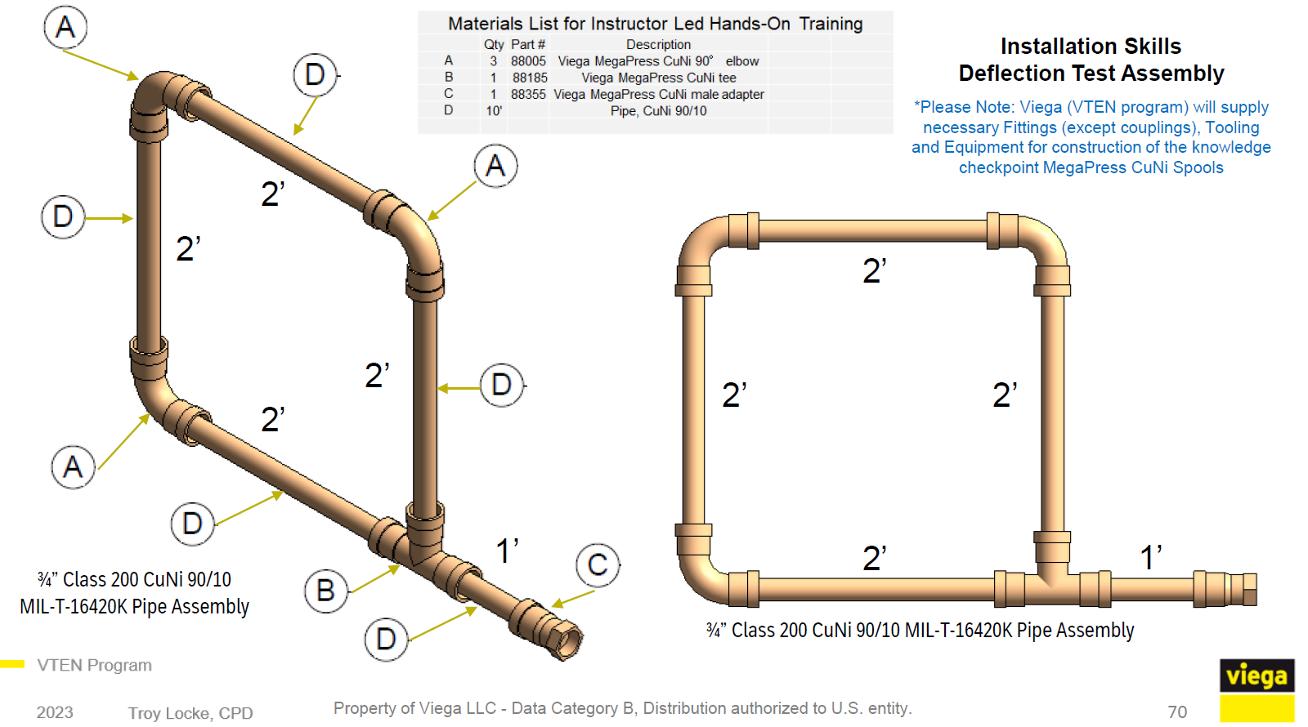
Curriculum Content – Pipe Spools

Slide 8
Curriculum Content – Pipe Spools

Slide 9
Curriculum Content – Pipe Spools

Slide 10
Curriculum Content – Pipe Spools

Slide 11
Curriculum Content – Pipe Spools

