Slide 1
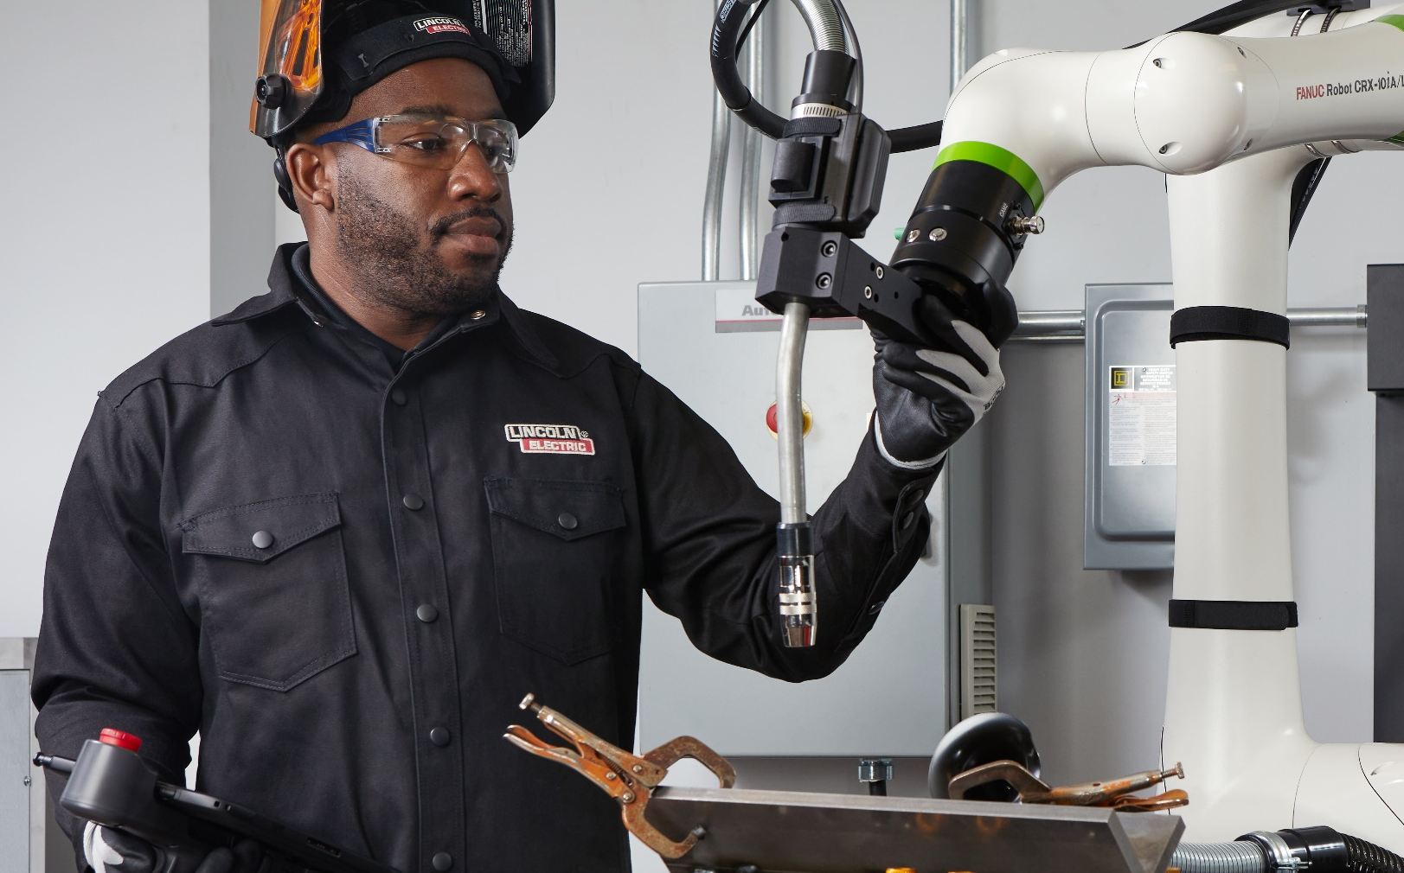

LINCOLN ELECTRIC AUTOMATION™
^{Collaborative Robots}

Slide 2
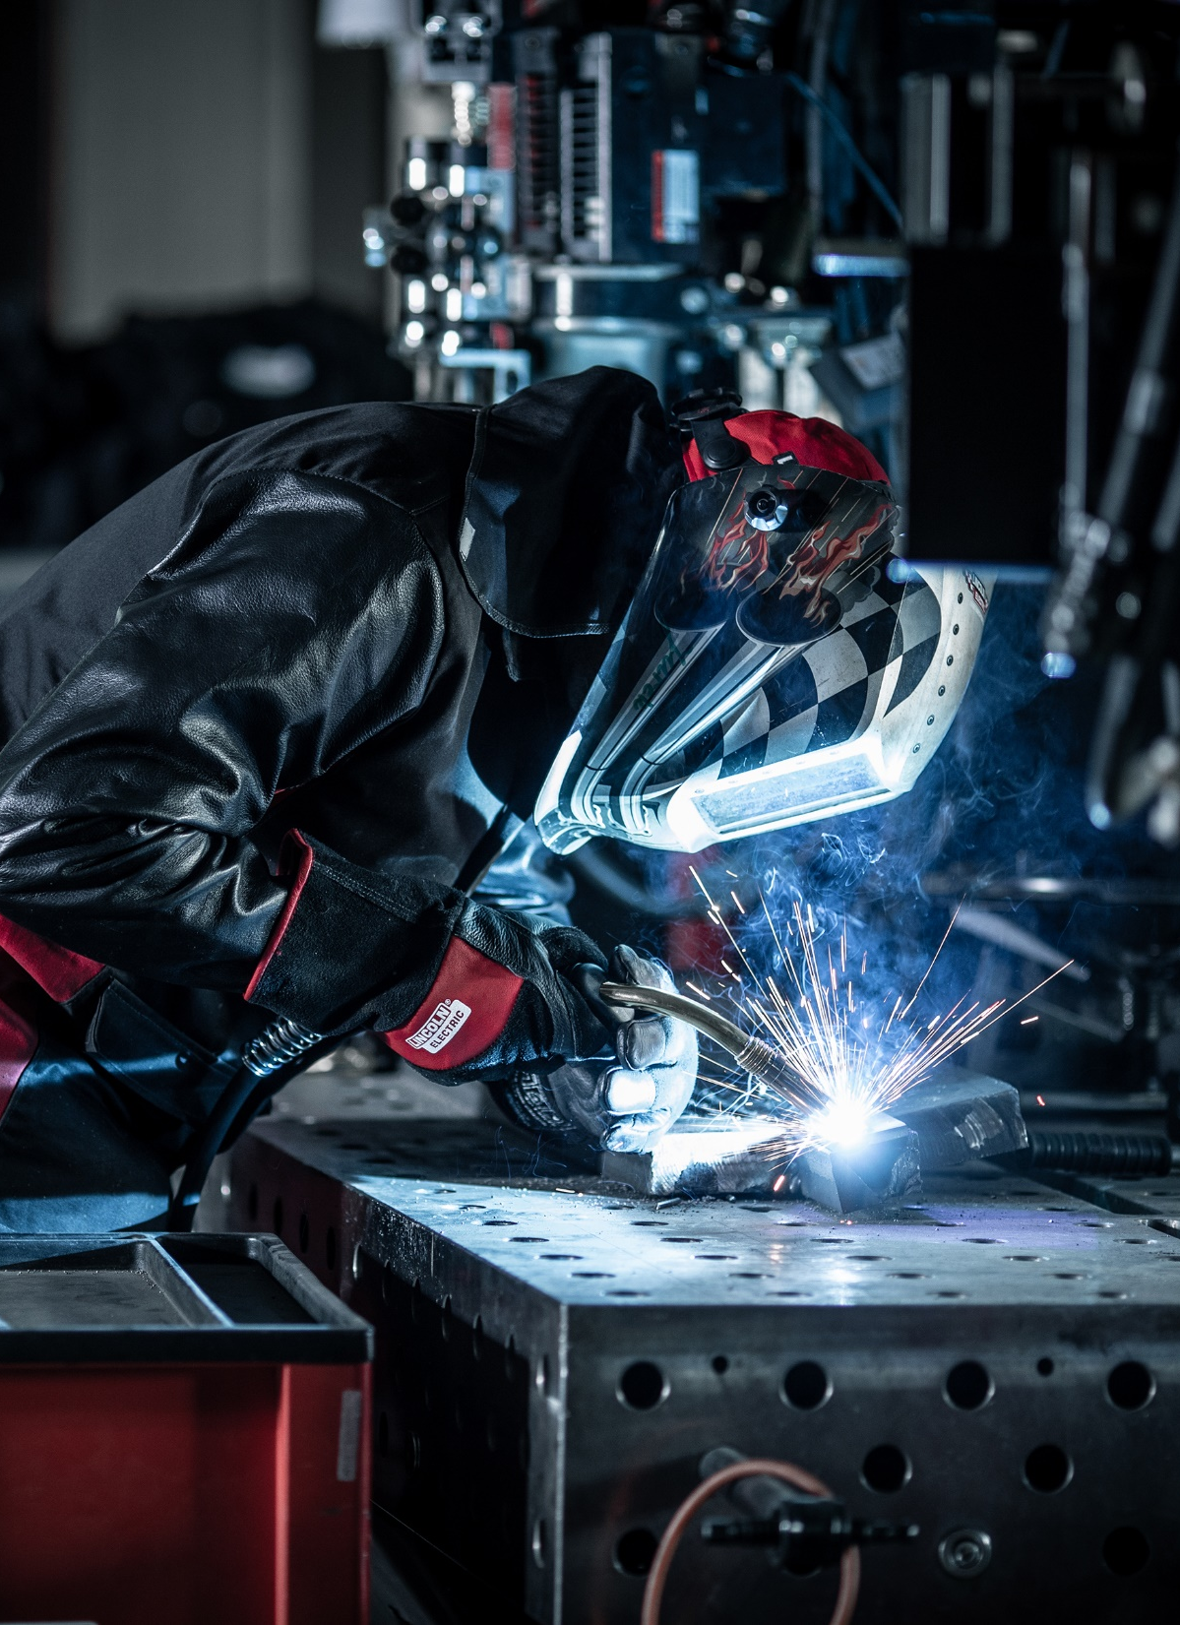
Labor Challenges
“Great Resignation”
Skilled labor shortage by industry
Welding is not a “highly sought after” career for students
Hard to attract next generation of talent
Need people immediately to fill customer demands

Slide 3
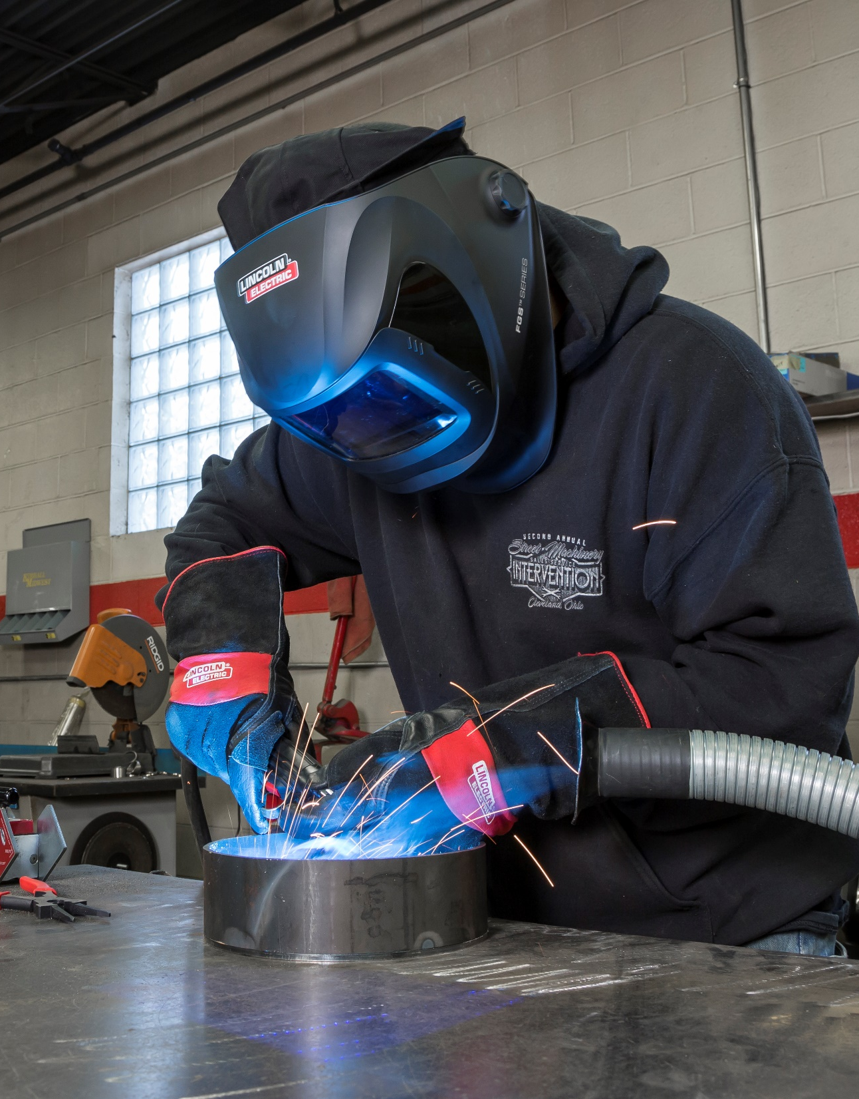
Lack of Welders
Shortage of 300,000 skilled welders by 2026 (per American Welding Society)
  Average welder turnover is 37%
  Average age of welders is 55
  77K welder openings via ZipRecruiter.com on 2/27/2023
Skilled trainers are hard to find
  People with metal fabrication skills are very selective about what jobs to seek
  Education institutions have pay limitations
  Pandemic has exacerbated the situation

Slide 4
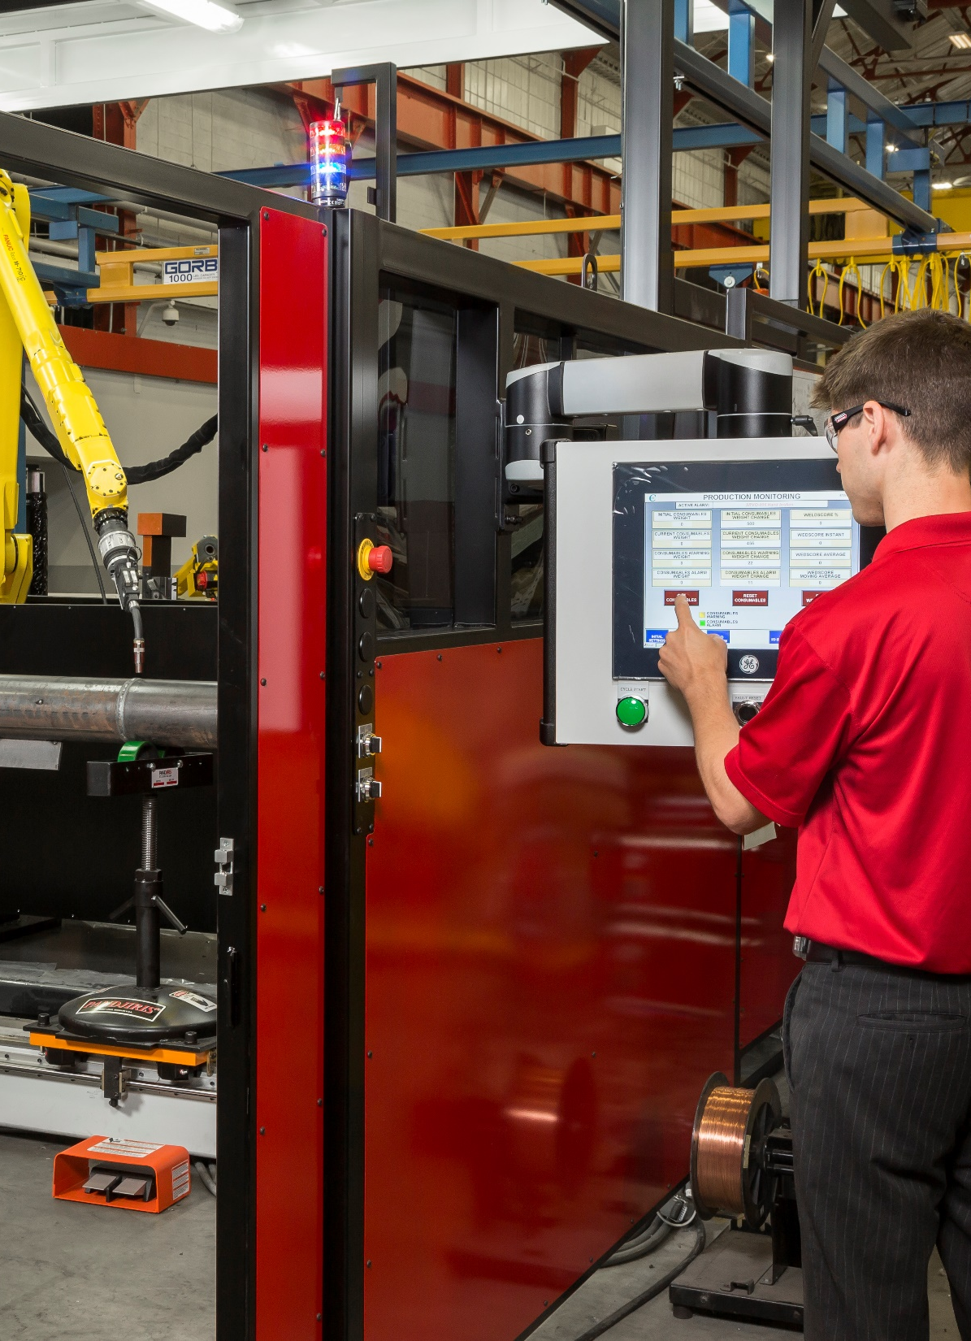
Traditional Automation Challenges
Lack of technical personnel for programming and running cells
Programming cumbersome
Large investment
Part mix difficult to automate
Safety light curtains / fencing required
Dedicated floor space needed

Slide 5
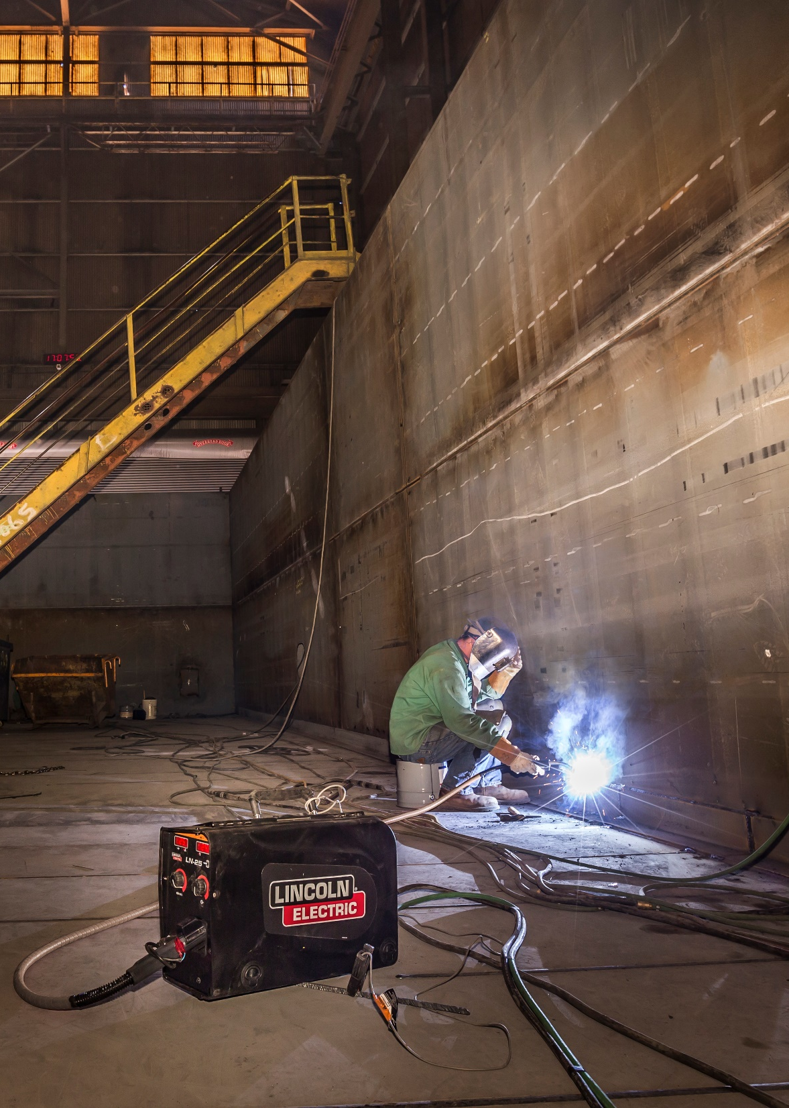
Large Scale and One-Off Part Production
Large investments required
  Capital
  Floor space
Manual welding still required
Defined robotic systems do not fit the changing needs many customers
  Part size can swing drastically

Slide 6
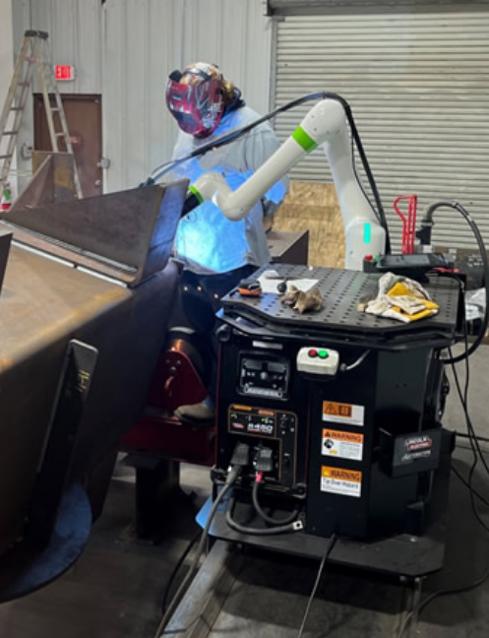
What is a Cobot?
Robot designed for direct interaction with a human within a defined collaborative workspace
No safety curtains / safety fencing needed
Safety features
  Power and force limits
  Speed & separation monitoring
  Soft impact design

Slide 7
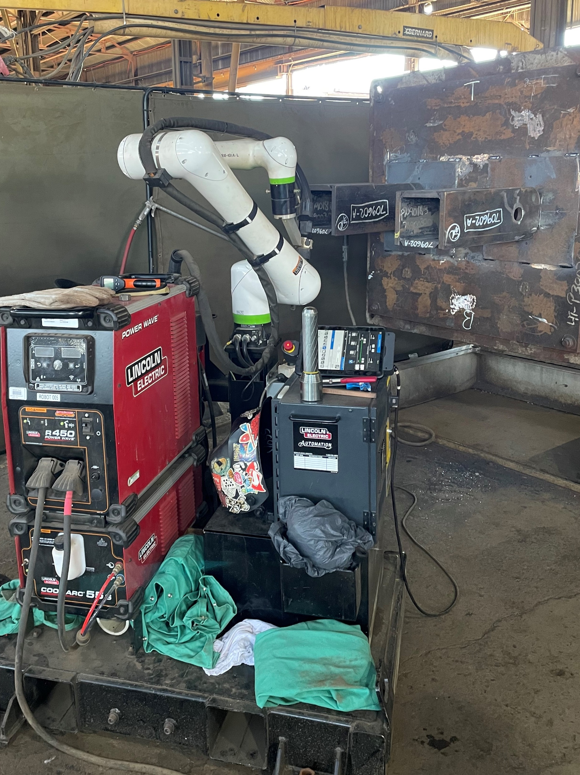
The Best of Welding and Automation
Built Around Customers
COOPERTM WELDING COBOTS
↑ PRODUCTIVITY
↑ EFFICIENCY
↑ SIMPLICITY
↑ SAFETY
↓ HUMAN IDLE TIME
↓ WORKER FATIGUE

Slide 8
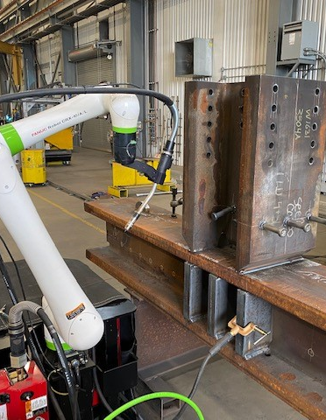
High Mix, Low Volume,
No Problem
Easy and minimal programming
Adapt to variations in part position
Adapt to variations in part size
Work side-by-side to humans without needed safety fencing or curtains
Affordable and practical stepping stone into automation
Easy entry point for customers

Slide 9
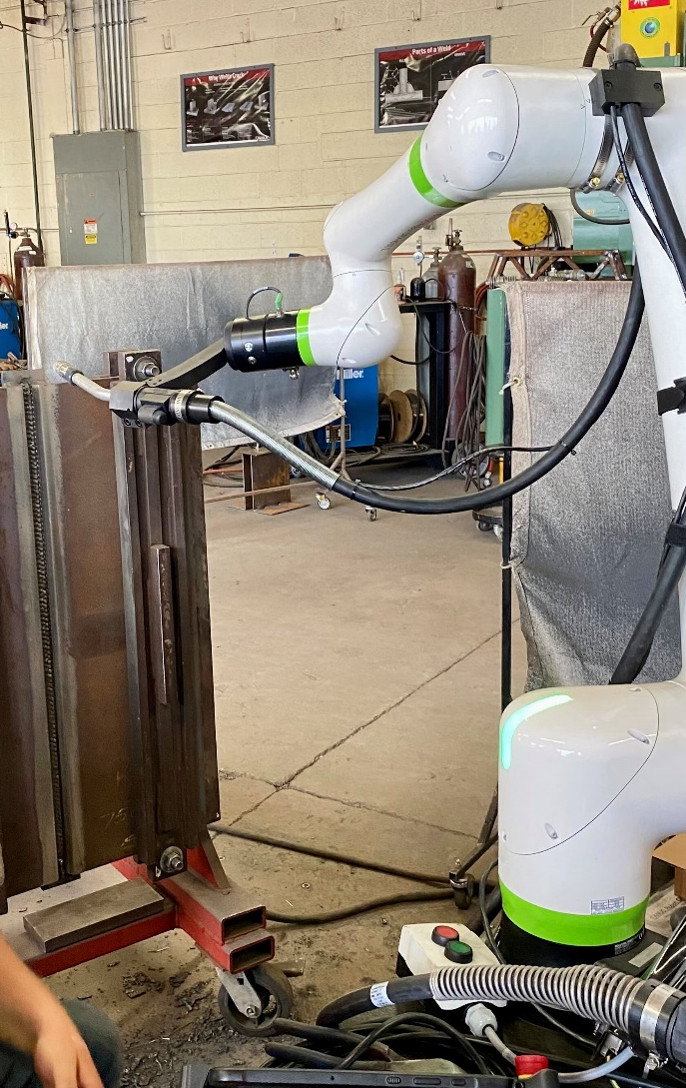
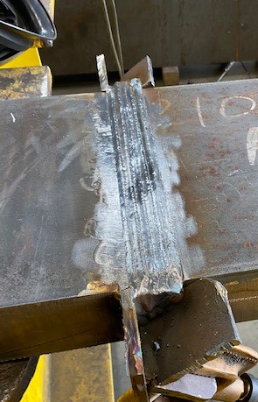
Quality Improvements
Improved consistency
Improved repeatability
Reduced potential human errors
Reduced potential human fatigue for performing long weldments
Improved production rates

Slide 10
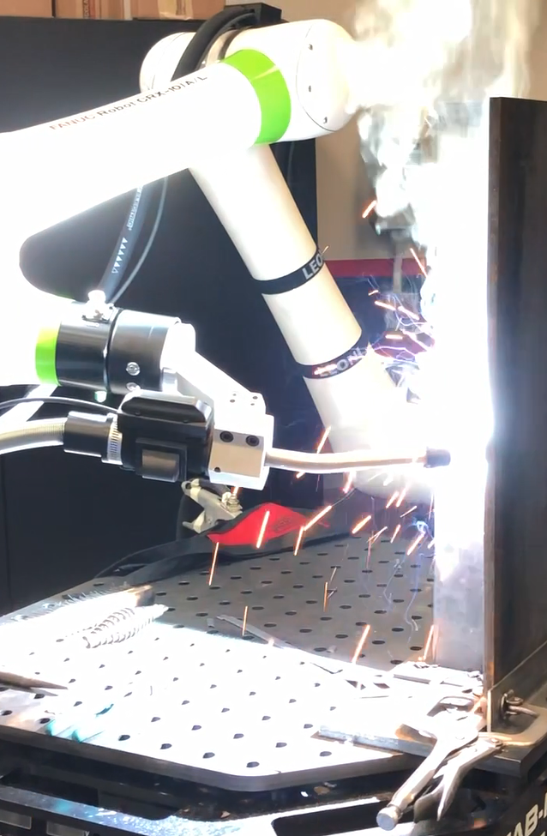
Welding Processes
Multiple processes capable
  Gas-Metal Arc welding
  Pulsed welding
  Metal-cored wire welding
  Self-shielded cored wire welding
  Gas-shielded cored wire welding
  Twin wire welding (Hyperfill)

Slide 11
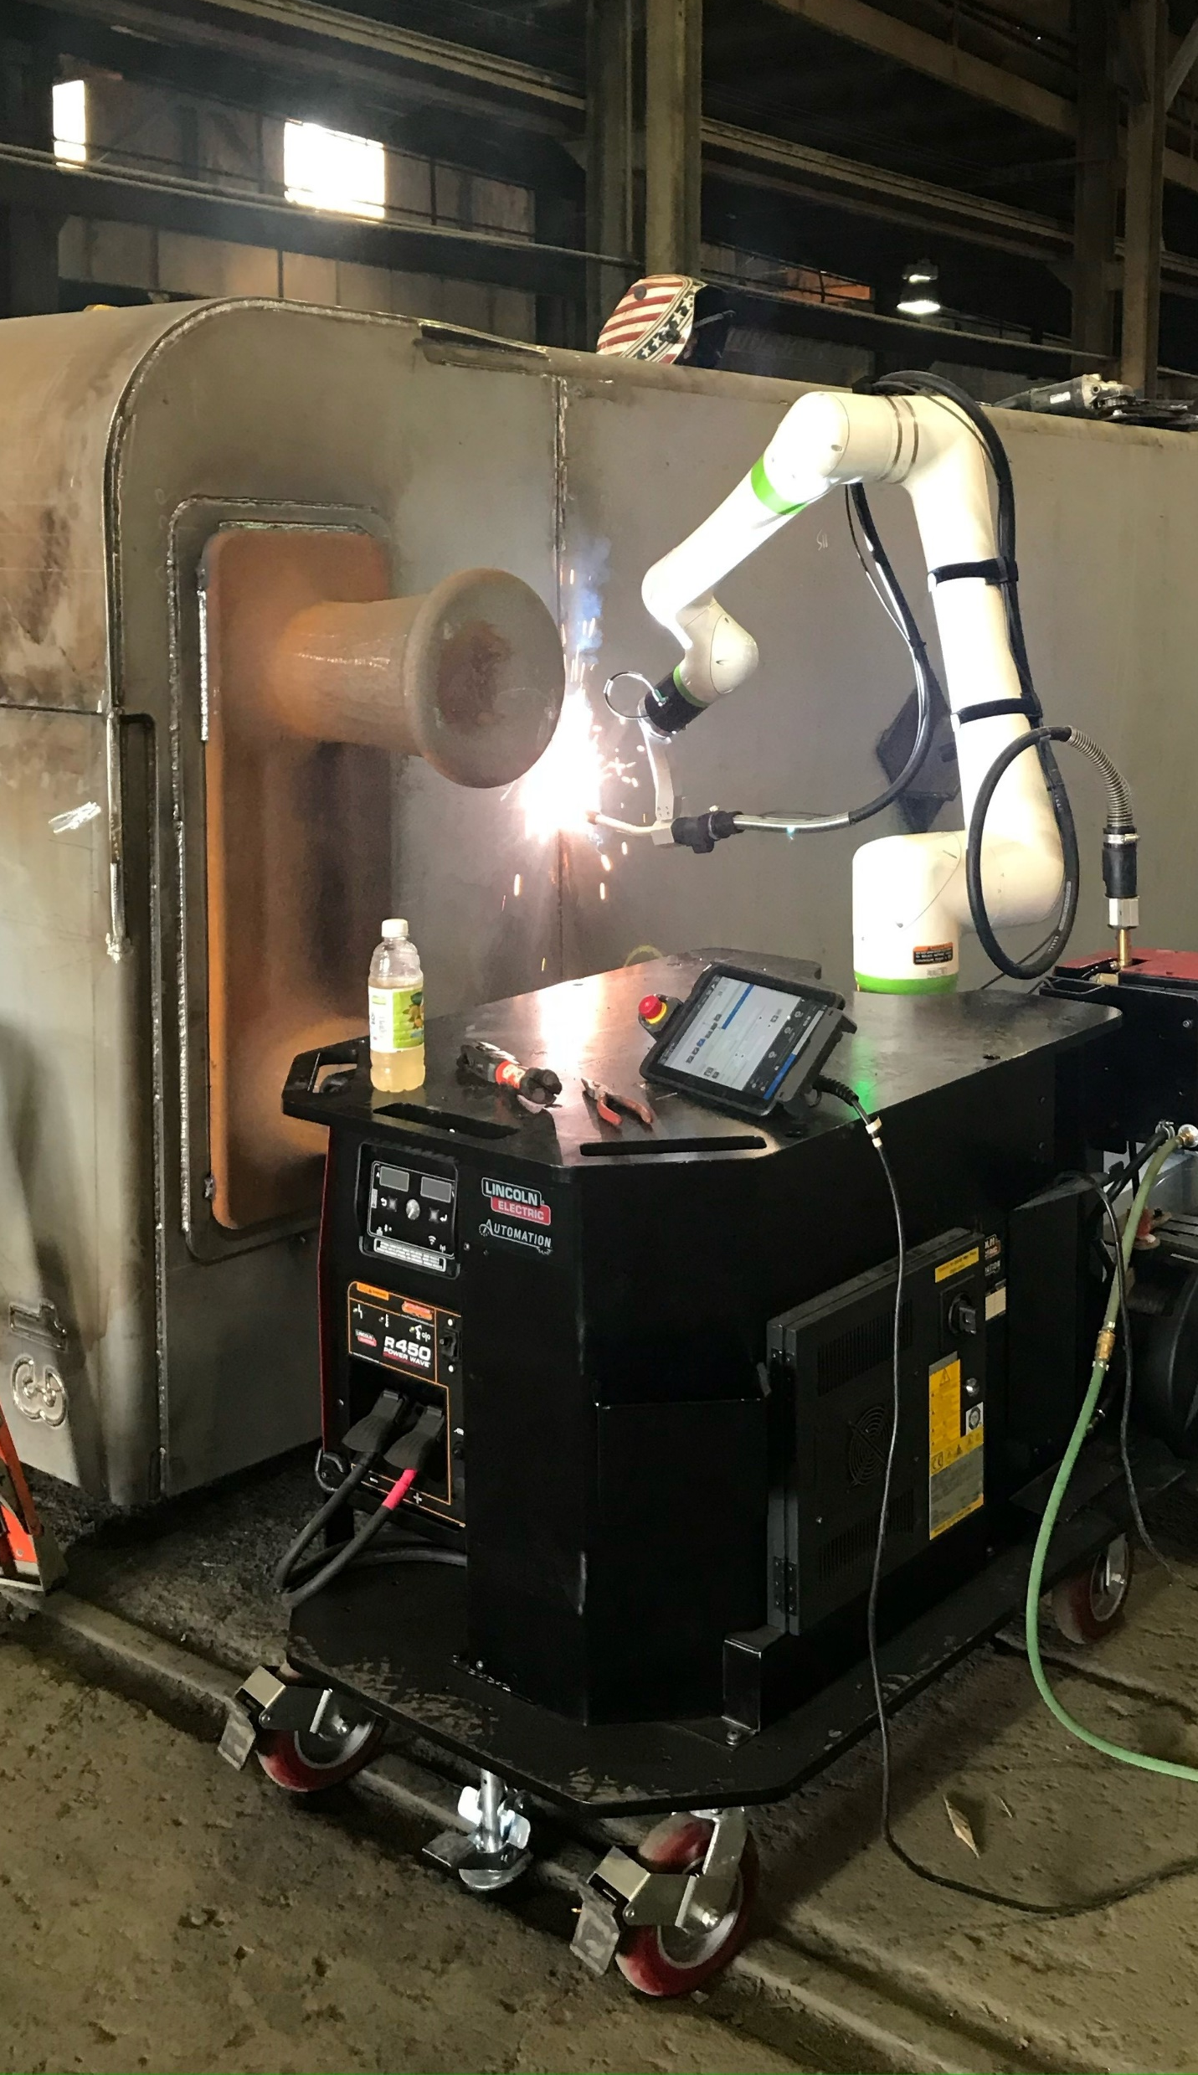
Mobile, Flexible, Compact
Move the cobot cart anywhere in the plant
Highly Flexible – Easy to deploy and re-deploy
Small Footprint – Gain increased production benefits
Advanced Welding Capabilities
  Touch sense
  Multi-pass
  Thru-arc seam tracking

Slide 12
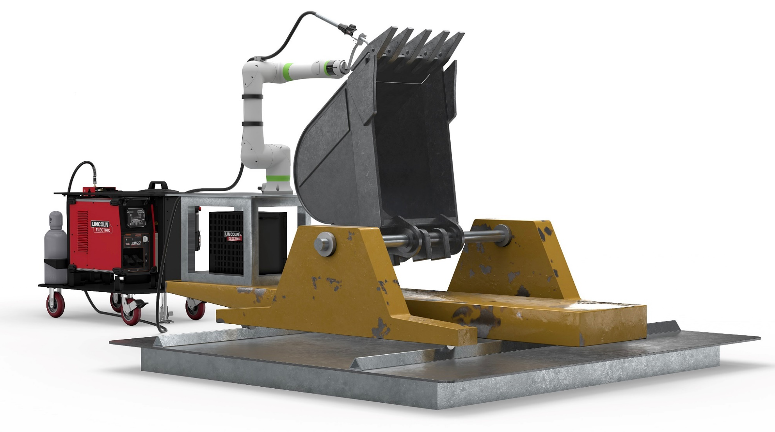
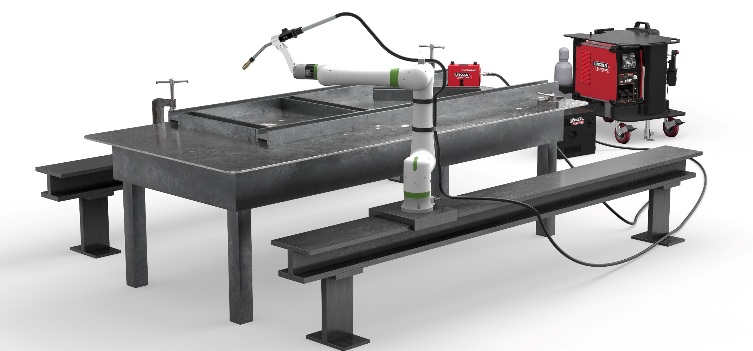
Customize
Your Cooper™ Cobot
One size doesn’t always fit all
Build your own system with Cooper™ Package
Custom cobot cell
  Cobot risers
  Cobot track
  Positioners
  Fixturing

Slide 13
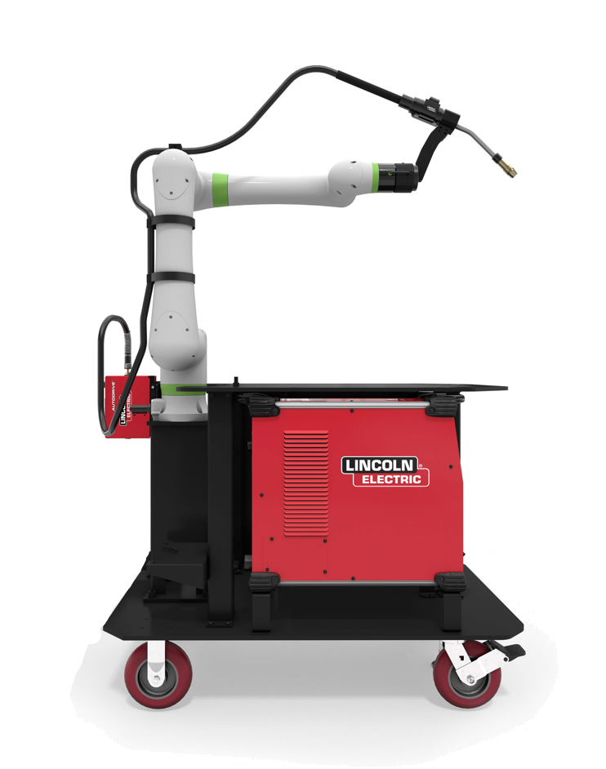
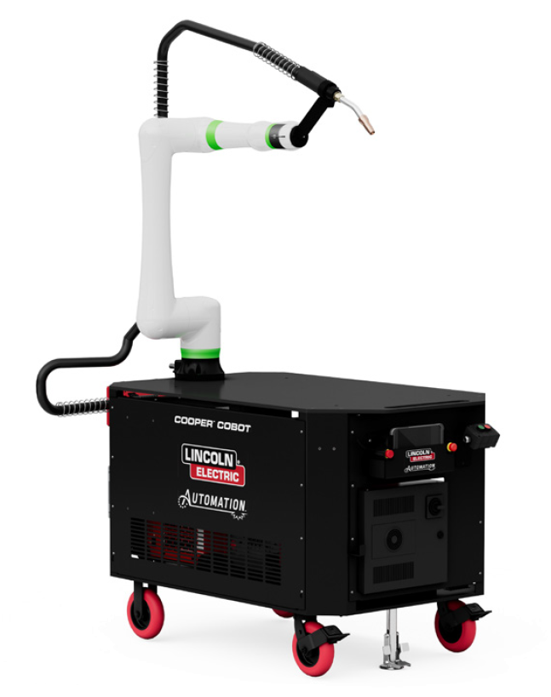
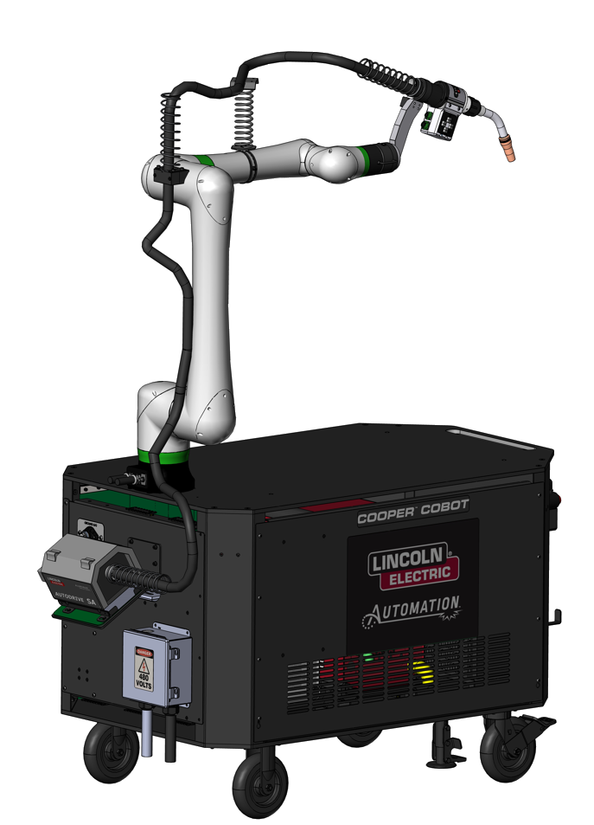
COOPERTM CRX-10iA/L Welding Cobot Cart Packages
Made to Move
COOPERTM CRX-10iA/L Air-Cooled Cart Package
COOPERTM CRX-10iA/L Water-Cooled Cart Package
COOPERTM CRX-10iA/L Aluminum Welding Cart Package

Slide 14
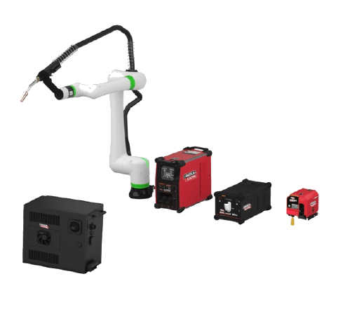
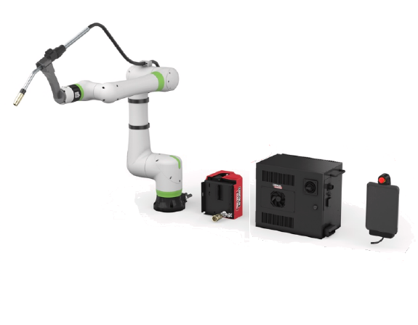
COOPERTM CRX-10iA/L Welding Cobot Welding Packages
Customize Your Solution
COOPERTM CRX Air-Cooled Package
Customize your solution
COOPERTM CRX Water-Cooled Package
Customize your solution

Slide 15
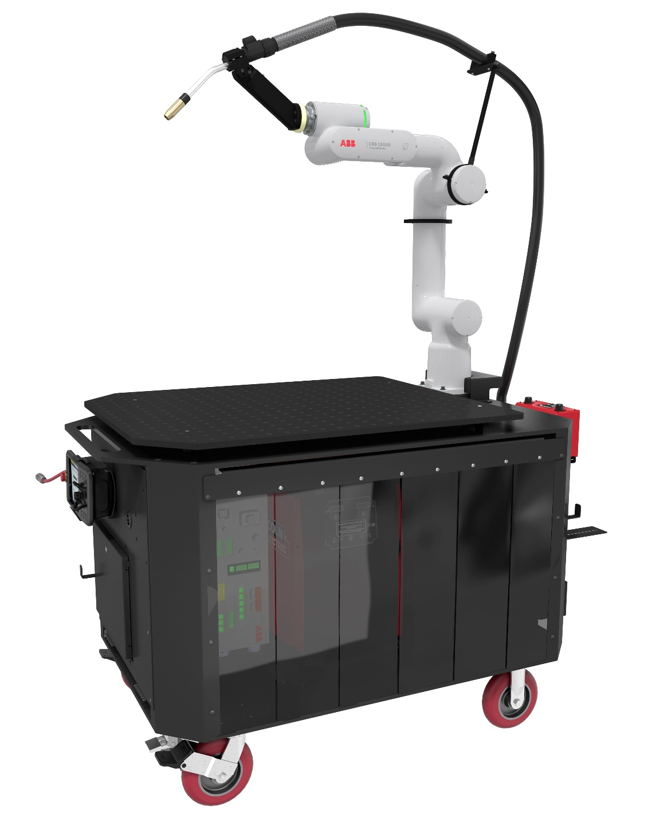
Meet the COOPERTM Welding Cobot Series
COOPERTM ABB Air-Cooled Cart
Made to move

Slide 16
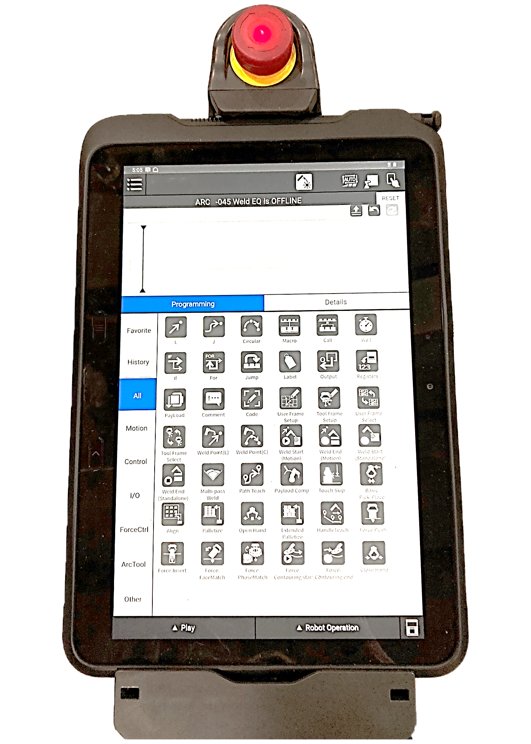
Intuitive Programming
Engineered for the first-time robot user
  Intuitive
  User friendly
  Relatable technology
Easily teach your Cooper weld points when you manually guide the cobot torch and record the points with a simple icon based, drag and drop timeline

Slide 17
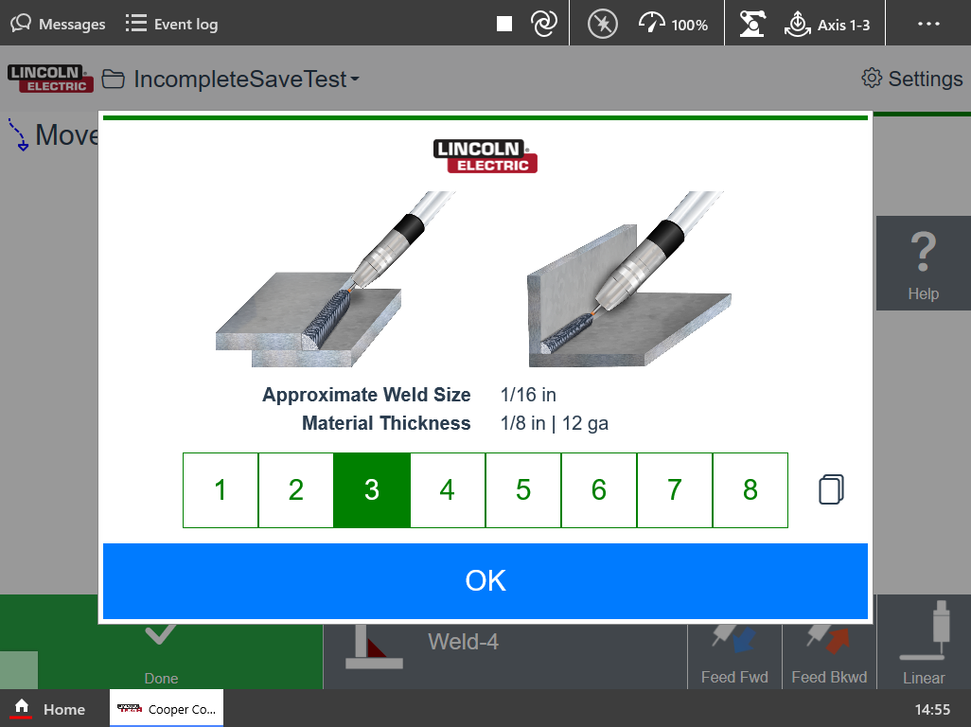
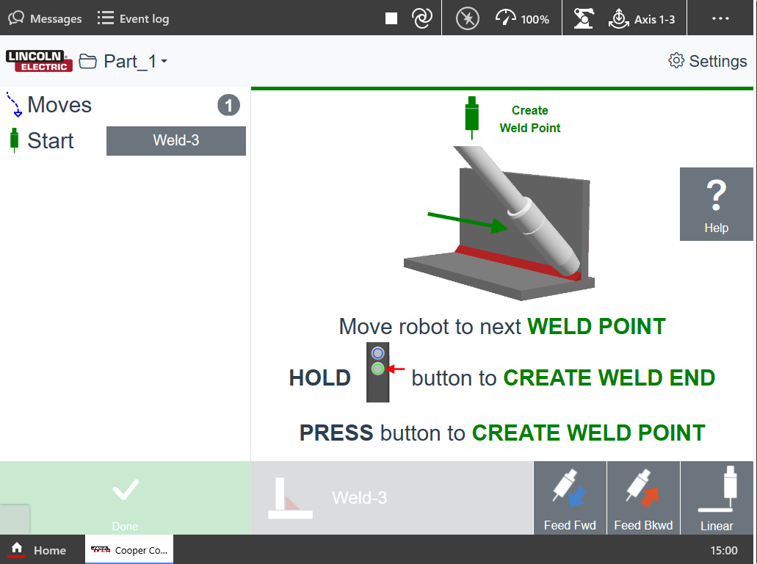
Cooper App
Even simpler programming for cobots
  No welding knowledge needed
  Pick plate thickness
  Program weld start point and end point
  Hit “GO”
  Interface will automatically program voltage, WFS and travel speed

Slide 18
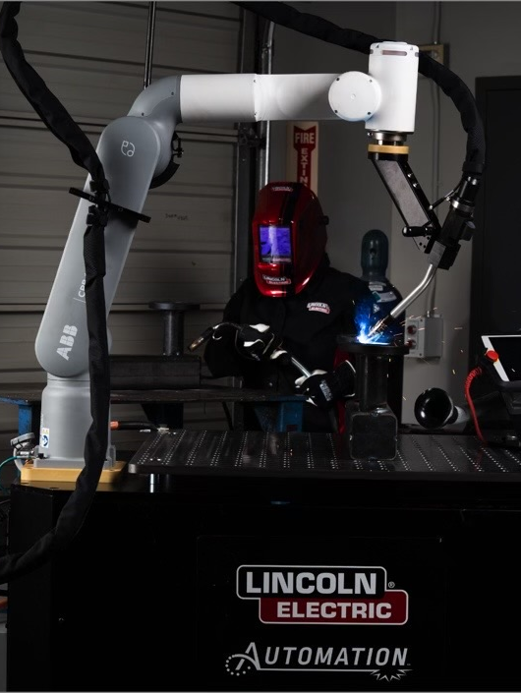
Support
250 Technical Sales Reps in N. America
115 Robotic Technicians
80 Master Certified Trained Technicians

Slide 19
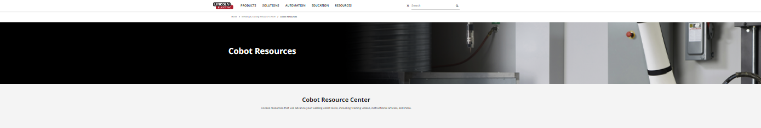
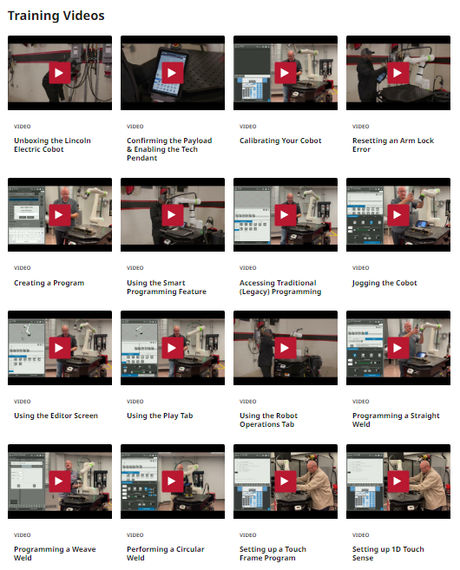
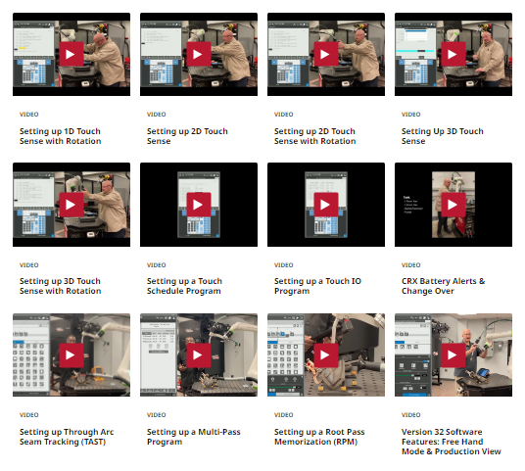

Slide 20
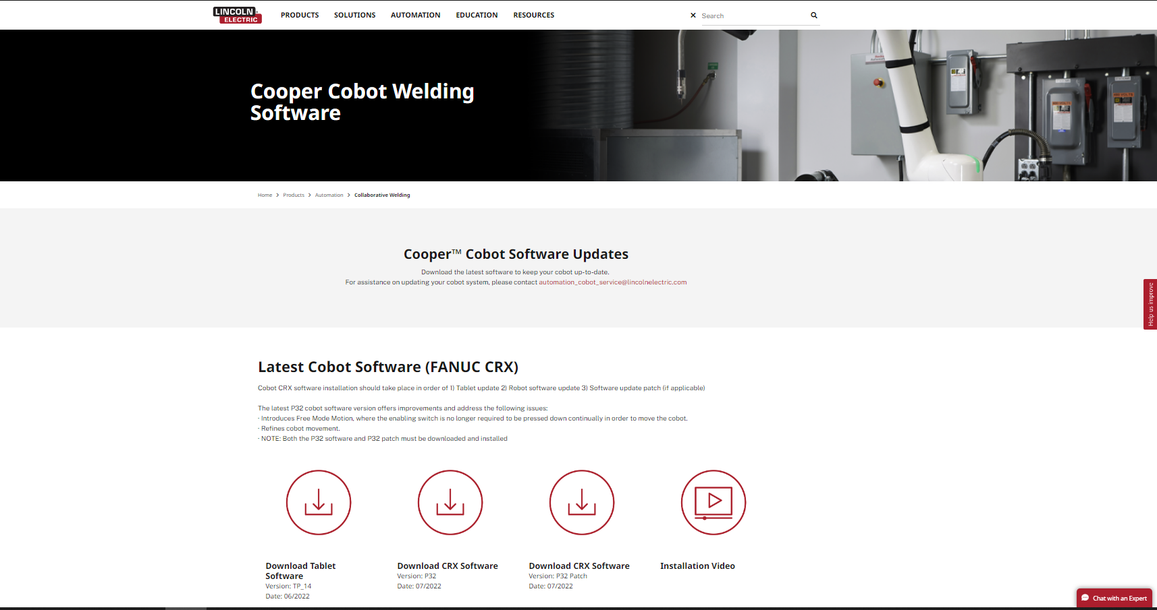

Slide 21
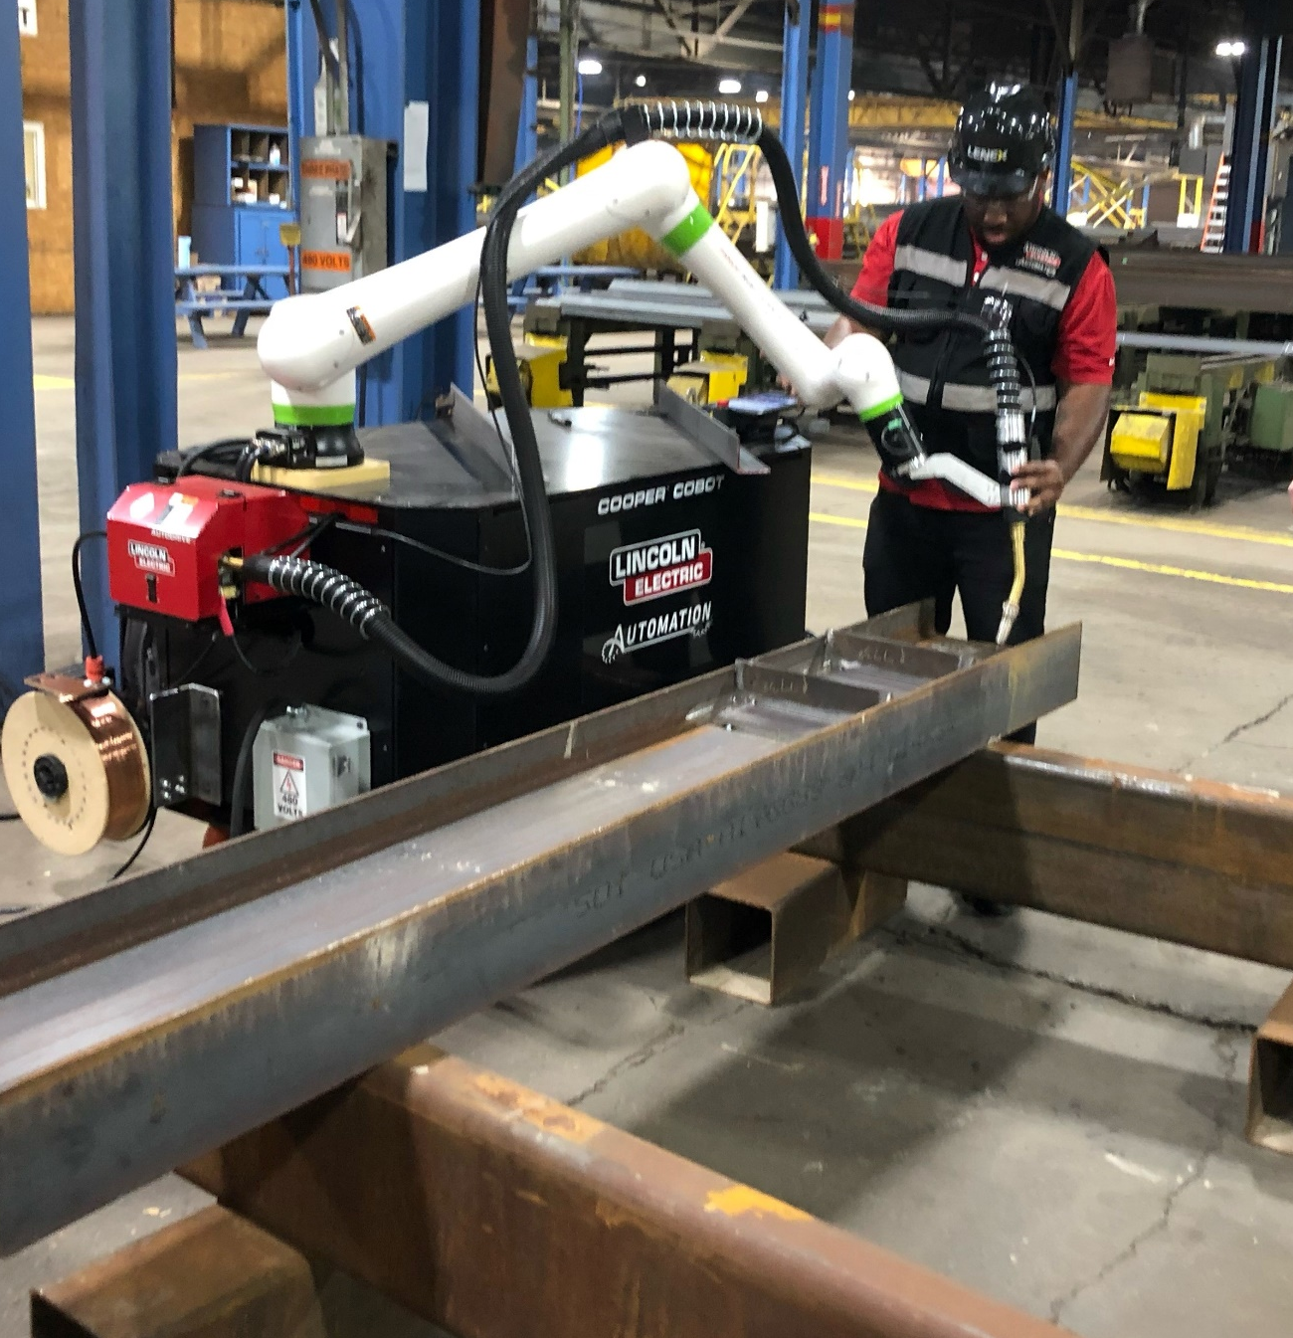
FOR MORE INFORMATION
CALL 888-935-3878
OR VISIT LINCOLNELECTRIC.COM/COBOT
Meet Your New Co-Worker

