Slide 1

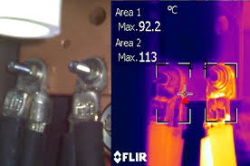
NSRP 2023 Panel Project
DTS Integration into Electrical Plant Controls for Conditions Based Maintenance
Giovanni Tomasi
RSL Fiber Systems, LLC

Slide 2
TABLE OF CONTENTS
PROJECT HISTORY
DTS TECHNOLOGY OVERVIEW
TESTS PERFORMED & LESSONS LEARNED
COMPLEMENTING PROJECTS
2023 NSRP PROJECT OUTLINE
OTHER DTS APPLICATIONS

Slide 3
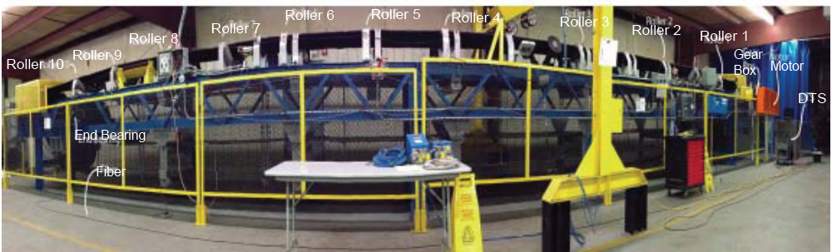
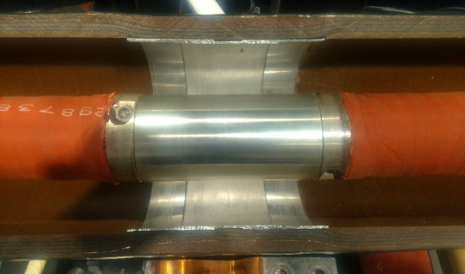
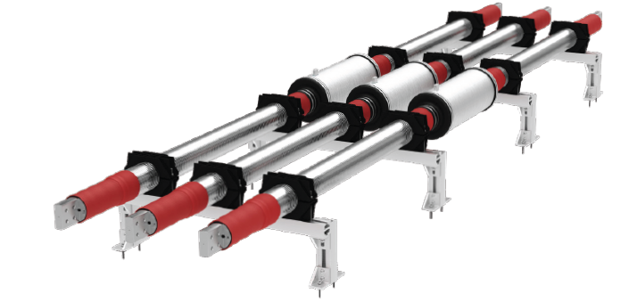
PROJECT HISTORY
Raman DTS used to monitor conveyor belt for Coal Mines in 2012-13 (NIOSH Contract 2012-N-14257)
Raman DTS technology presented at San Diego NSRP meeting in December 2015.
Use of DTS for MV electrical panels first evaluated by Penn State Electro Optics Center in 2017 (Panel Project 2017-422)
  “The proof of concept has demonstrated that these DTS systems are technically feasible to make the required measurements and overcome the limitations of the IR thermography.” (J. Callen, Project Lead)
Raman DTS used to monitor connections of Insulated Bus Pipe and IBP connections to equipment (Hepburn and Sons RA 19-01 and RA 20-01)

Slide 4
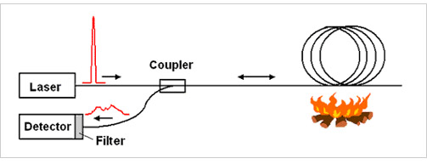

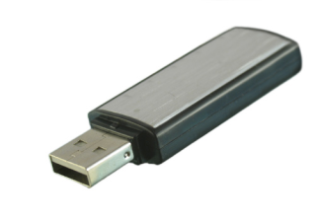


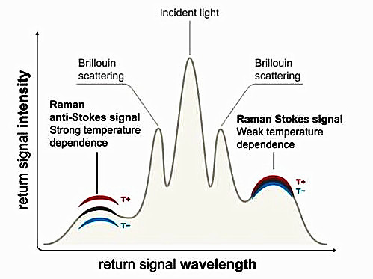
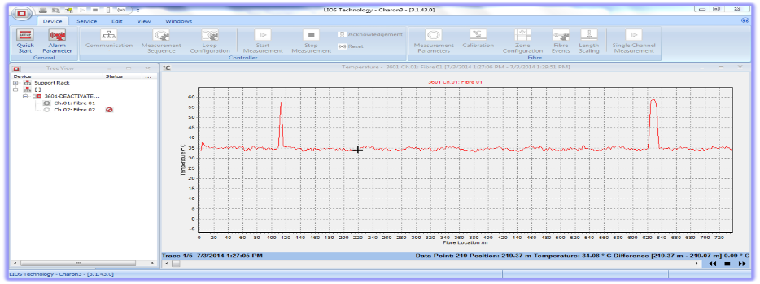
Fiber Optic Distributed Temperature Sensing
Inputs
Outputs
Entire fiber is the sensing unit – over 1000 zones per fiber channel.
Standard MM 50/125, 62.5/125 or SM fiber.
Up to 30 Km MM, 40 Km SM - real time monitoring across entire length.
Temperature rise of 0.5ºC
Spatial Resolution down to 50 cm.
Based on Raman Scattering.
Display Options
Temperature profile
Graphics
Alarm panel
Notes:
A DTS uses the fiber optic cable as a continuous lineal temperature sensor. The fiber cable can be embedded in the power cable or placed over the cable to detect temperature changes.
DTS systems can be configured to the specific application, with distances, sampling intervals, alarms and other parameters customized as needed.

Slide 5
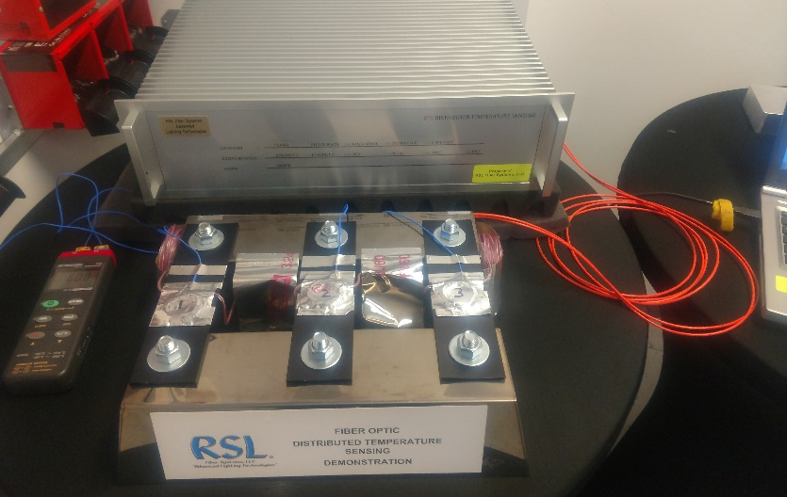
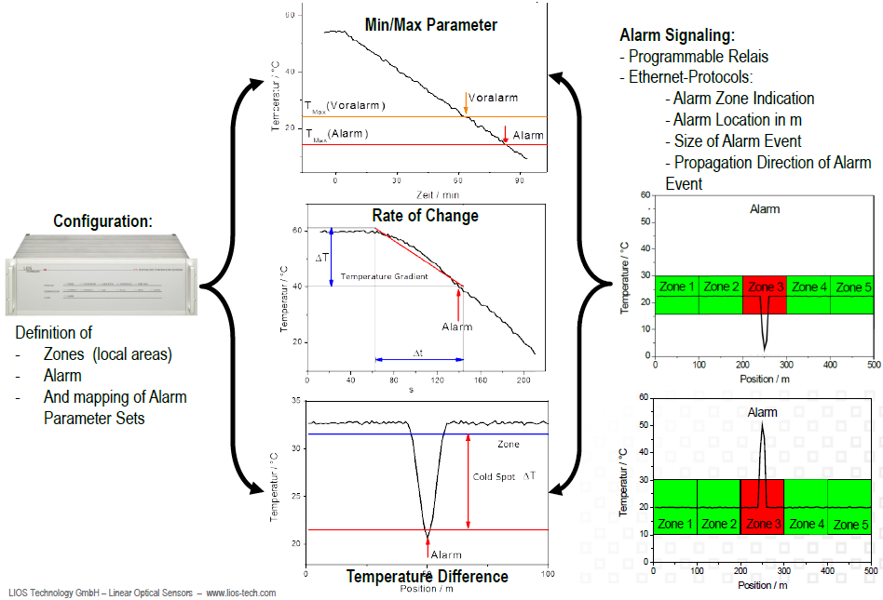
ZONES AND ALARM PARAMETERS
Sensing Zones can overlap and encompass multiple zones.
Sensing Zones can be remotely re-positioned and re-programmed.
Alarms in each individual Zone can be set for:
Exceeding Min / Max operating Temperature range
Rate of change > standard ΔT/ Δt
Difference > T or < T allowed between zones
Notes:
5
DTS alarms can be set based on Min-Max temperature parameters, rate of change, and temperature difference.

Slide 6
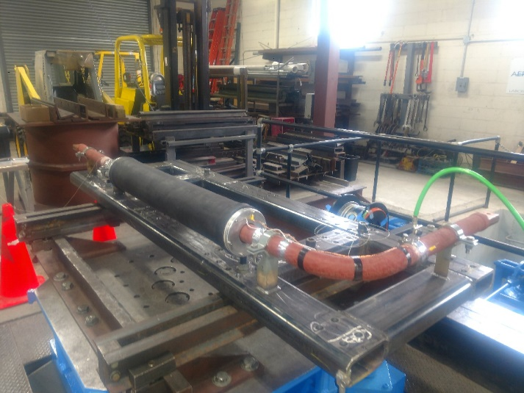
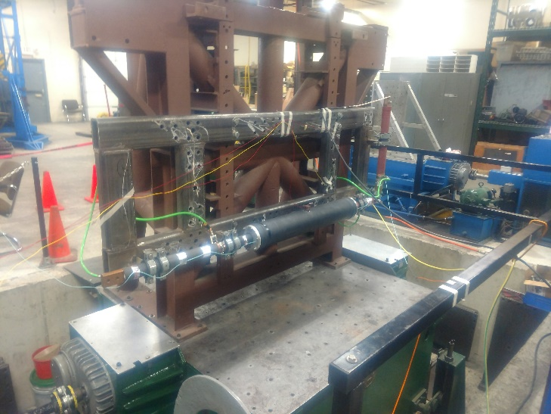
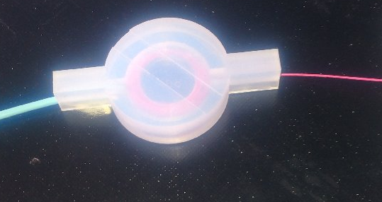
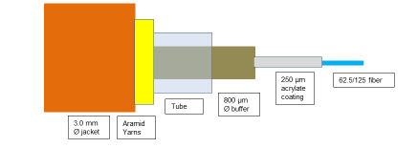
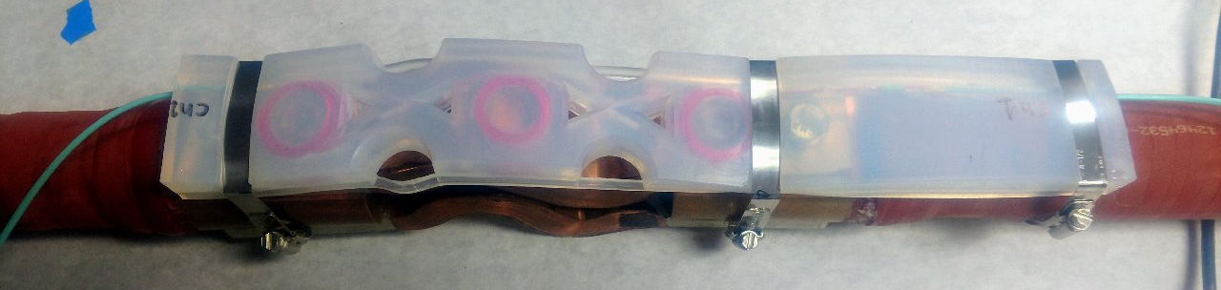
TESTS & LESSONS LEARNED
  Shock and Vibration
  Sensing assembly design
  Sensing cable construction
  Installation methods

Slide 7
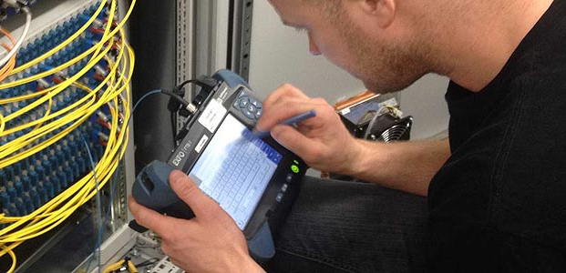

COMPLEMENTING PROJECTS
  FUSION SPLICE ENCLOSURE AT EQUIPMENT (2019 PSU EOC Panel Project 2019-482-002)
  FIBER OPTIC TESTING ENHANCEMENT FOR COST REDUCTION (2019 Kitco Panel Project)
  EVALUATION OF SPLICE-ON CONNECTORS AND TERMINI FOR SHIPBOARD APPLICATIONS (2021 HII – Ingalls Panel Project 2018-453-024)

Slide 8
2023 PANEL PROJECT - DTS Integration into Electrical Plant Controls
OBJECTIVE
[Detect → Isolate → Determine Severity → Define Action]
Methodology to secure the fiber optic sensors to the electrical connections.
Configure the interface between the DTS and the EPCP.
Configure the GUI to display actionable CBM data collected by the DTS.
Create baseline specifications to qualify and implement DTS on Navy vessels.
Provide baseline for project to finalize development and qualify DTS system for MV panels monitoring.
TEAM MEMBERS
Prime/Lead: RSL Fiber Systems, LLC
Team Members: Penn State University – ARL, General Dynamics – Bath Iron Works, DV7 Engineering, NAVSEA, NSWCPD.
ROI
Reduce labor costs by eliminating the need for annual inspection of electrical connections.
Eliminate the safety hazards involved in visually inspecting electrical panels.
Eliminate the risk of fire and conductors’ damage resulting from loose electrical connections.
PROGRAM FUNDS
$ 150,000
DURATION
12 Months
DISTRIBUTION STATEMENT A. Approved for public release: distribution unlimited.

Slide 9
2023 PANEL PROJECT - DTS Integration into Electrical Plant Controls
TASKS AND SCHEDULE
DESCRIPTION | Date
CONTRACT AWARD | 3/24/2023
Project Plan & Schedule | 4/4/2023
TASK 1: Review DTS tests performed and previous related work
Q1 Project Status Report | 5/16/2023
TASK 2: Method(s) to apply sensors in panels and mods to DTS for MIL specs
TASK 3: El conditions hierarchy, method to access info, & display of warn/alarms
Q2 Project Status Report | 9/12/2023
TASK 4: Data interface, cyber security, and comms protocols to integrate DTS into ERM. GUI for DTS data.
TASK 5: Sampling rates, rates of temp change, operating temp & temp diff, data retention for CBM
Q3 Project Status Report | 12/12/2023
TASK 6: DTS system design: FO cable, sensors, controller, and interface. Outline specs with qual tests
Final Report with Recommendations | 3/11/2024

Slide 10
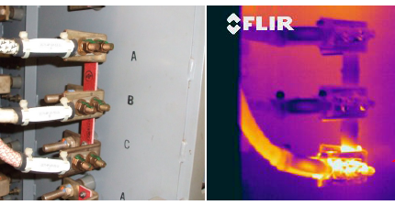
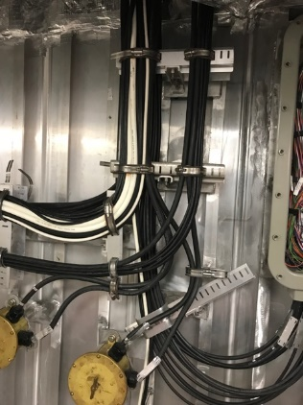
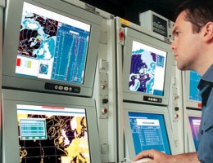
DTS SHIPBOARD IMPLEMENTATION
Real Time Monitoring to:
DETECT
ISOLATE
DETERMINE SEVERITY
DEFINE ACTIONS
Route Fiber Cable to Electrical Devices
Integration
Into ship control & monitoring system*
Apply Fiber to Devices Monitored
Configure Sensing Zones
Set Alarm Parameters
ZONE | START | END | Alarm @ Temp (°C)
1 | 47 | 49.5 | Start + 2
2 | 52 | 55 | Start + 2
3 | 47 | 55 | Δ2
4 | 33 | 49.5 | Start + 2
5 | 52 | 68 | Start + 2
6 | 33 | 68 | Start + 2, Δ2
Data displayed on Integrated Bridge System Controller
* 2023 NSRP Panel Project
Notes:
10

Slide 11
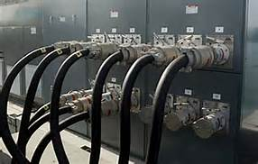
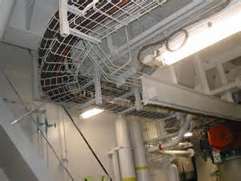

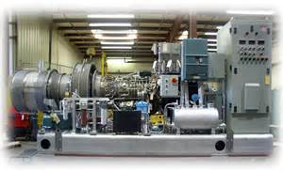
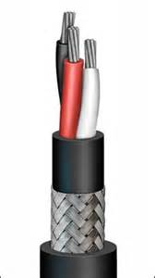
DTS – Possible Shipboard Applications
Insulated Bus Pipe Connections
Fire detection
MV and HV electrical panels monitoring
Machinery health monitoring
Cabling systems health monitoring
Food storage spaces
Others…
Single DTS and single cable for multiple functions
Data displayed on Integrated Bridge System Controller

Slide 12
QUESTIONS?
Giovanni Tomasi
RSL Fiber Systems, LLC
860-282-4930 x-4929
gptomasi@rslfibersystems.com

