Slide 1

SHIPBOARD FIBER OPTIC CABLES JACKETS PERFORMANCE ENHANCEMENTS
Giovanni Tomasi
NSRP 2023 All Panels Meeting
Data Category B: GOVERNMENT PURPOSE RIGHTS
DISTRIBUTION STATEMENT A. Approved for public release: distribution unlimited.

Slide 2
TABLE OF CONTENTS
PROJECT HISTORY
CABLE JACKET MANUFACTURING OVERVIEW
2023 NSRP PROJECT OUTLINE
PROPOSED TESTS

Slide 3
PROJECT HISTORY - 2019 SHIPBOARD FIBER OPTIC CABLES
DESIGN ENHANCEMENTS PROJECT (Panel Project 2019-477)
CONCLUSIONS
Baseline cable designs are suited for shipboard environment.
Most of rework is caused by on-ship fiber terminations.
Jacket abrasion described as a cause of damage at installation.
Improvements can be made with no impact on physical design:
  Facilitate terminations with improved buffer strippability.
  Fusion splice pre-terminated connectors.
  Increase jacket resistance to abrasion/cut-through with more durable compounds.
Resistance to hot fluids (98-100°C) ranked lowest priority by project participants.
  Hot fluids immersion requirements prevent the use of thermoplastic jackets.
Thermoset jackets may have been preferred for perceived vs. actual abrasion resistance.
Thermoplastic jackets have potential to:
  Improve abrasion resistance.
  Decrease material cost.
  Decrease fiber damage.
  Lower TOC of fiber optic shipboard systems.
DISTRIBUTION STATEMENT A. Approved for public release: distribution unlimited.

Slide 4
OUTER JACKET PERFORMANCE
PROJECT HISTORY - 2019 SHIPBOARD FIBER OPTIC CABLES
DESIGN ENHANCEMENTS PROJECT (Panel Project 2019-477)
Use of Thermoset jacket driven primarily by fluids’ immersion temperature requirements.
Temperatures taken from MIL-C-24643 power cables specifications.
Hot Fluids’ immersion performance ranked lowest by all participants.
Thermoplastic materials are very similar to Thermosets in many areas of interest.
Thermoplastic materials eliminate one (1) or two (2) manufacturing processes.
Fluid | Temperature | % T&E Retention
Fuel Oil | 98°C – 100°C | ≥ 50%
Turbine Fuel | 48°C – 50°C | ≥ 50%
Lubricating Oil | 98°C – 100°C | ≥ 50%
Jacketing Compounds Used for Shipboard and Marine Applications |  |  |  |  |  |  | Oil (4 hrs @ 70°C) |  | Diesel (24 hrs @ 25°C)
Process | Tensile (psi) | Elongation (%) | Tear (lb-in) | Durometer | Low Temp Brittle Point (°C) | O2 Index (%) | Tensile Ret (%) | Elong Ret (%) | Tensile Ret (%) | Elong Ret (%)
Tplastic | 2000 | 225 | 40 | 95 | -53 | 37 | 73 | 97 | 56 | 62
Radiation | 1750 | 180 | 42 | 90 | -31 | 38 | 69 | 60 | 63 | 60
Mold Cure | 1800 | 200 | 45 | 96 | -26 | 38 | 98 | 94 | 58 | 80
DISTRIBUTION STATEMENT A. Approved for public release: distribution unlimited.

Slide 5
2020 OUTER JACKET SCRAPE ABRASION TEST
PROJECT HISTORY - 2019 SHIPBOARD FIBER OPTIC CABLES
DESIGN ENHANCEMENTS PROJECT (Panel Project 2019-477)
MIL-PRF-85045/MIL-STD-1678-3 specifies 454 grams (1 lb.) weight, 500 cycles.
Actual conditions at installation are likely:
  Higher force / Less cycles.
Test performed at Intertek to failure point of jacket:
  4.45 Kg (10 lbs.)
  Up to 250 cycles
Three (3) Cables Tested:
Sample | Type | Jacket Type | Cable Outer Dia. (mm) | Avg. Wall Thick. (mm) | Results (Scrapes to Failure per mm thickness)
1 | M85045/18 | Tset (Radiation) | 8.0 | 1.165 | 40%
2 | M85045/18 | Tset (Mold Cure) | 8.2 | 1.39 | 94%
3 | RSL 118052 | Tplastic | 10.2 | 1.77 | 100%
Results indicate that Irradiation x-linked sample does not have a fully cured jacket
DISTRIBUTION STATEMENT A. Approved for public release: distribution unlimited.

Slide 6
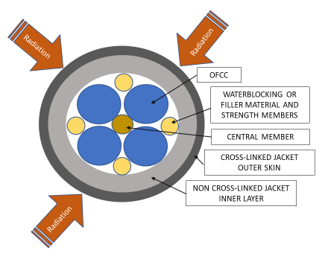
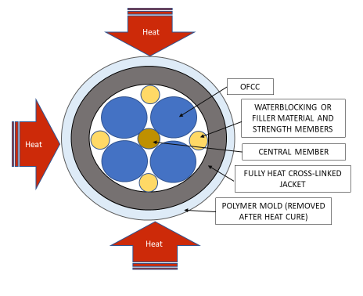
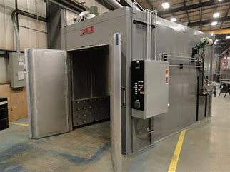
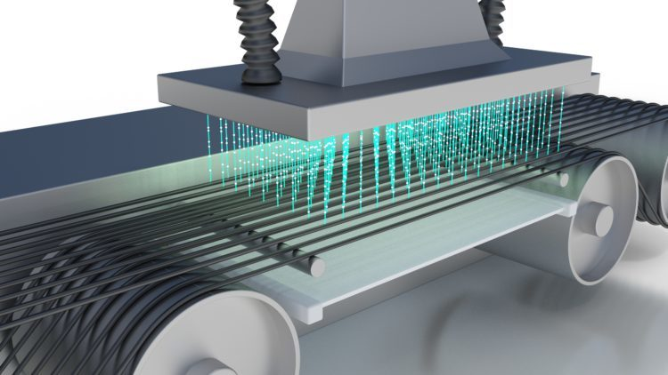
CABLE JACKET CROSS LINKING METHODS
Heat Activated x-linking (Mold Curing)
Polymer “mold” is applied in co-extrusion process with outer jacket.
Entire cable is placed in oven for jacket curing.
Polymer mold is removed after cure process.
Cure temperature may exceed inner components’ max. operating temperature.
Heat process limits the materials that can be used for the inner components.
Irradiation x-linking
Jacketed cable exposed to electron beam.
May not fully penetrate jacket thickness.
Affects fiber attenuation.
Requires recovery period of up to 30 days.
Irradiation effects limit the fiber selection.
DISTRIBUTION STATEMENT A. Approved for public release: distribution unlimited.

Slide 7
2023 – SHIPBOARD FIBER OPTIC CABLES JACKETS PERFORMANCE ENHANCEMENTS
OBJECTIVE
Identify new jacketing materials:
  Enhance performance.
  Decrease manufacturing cost.
  Increase the potential sources of supply.
  Increase cable design options.
  Lower TOC of fiber optic systems.
Recommend enhancements that:
  Can be used to revise the existing MIL-PRF-85045 shipboard cable sheets or
  Used to create new sheets.
TEAM MEMBERS
Prime/Lead: RSL Fiber Systems, LLC
Team Members: Huntington Ingalls – Ingalls Shipbuilding, U.S. Navy – SUPSHIP Gulf Coast, ChemPro Technologies LLC
ESTIMATED ROI
Savings from Thermoset to Thermoplastic: $ 6.3M /year
Thermoplastic w/50% reduction in damage: $ 11.6M / year
PROGRAM FUNDS
$ 150,000
DURATION
12 Months
DISTRIBUTION STATEMENT A. Approved for public release: distribution unlimited.

Slide 8
2023 – SHIPBOARD FIBER OPTIC CABLES JACKETS PERFORMANCE ENHANCEMENTS
TASKS AND SCHEDULE
DESCRIPTION | Date
CONTRACT AWARD TO RSL | 3/20/2023
Project Plan & Schedule | 3/31/2023
TASK 1: Compare T-plastic to T-sets. Identify commercial T-plastic FO cables similar to M85045/17 & /18.
TASK 2: Identify tests in the M85045 to evaluate T-plastics selected. Add / modify tests as required.
Tasks 1 and 2 Report / Q1 Report | 5/26/2023
TASK 3: Obtain samples of M85045/17 and /18 cables T-set jackets (irradiation and mold cure).
TASK 3A (If Req): Manufacture length(s) of FO cable(s) with T-plastic jacket compound(s) for evaluation.
Task 3 Report / Q2 Report: Update on samples and testing to date. | 9/1/2023
TASK 4: Tests at a NRTL. Testing may start before completion of collection of all samples.
Task 4 Report / Q3 Report: Update Tests and preliminary results on jacketing materials under evaluation. | 12/1/2023
Task 5 / Final Report: Evaluation of jacketing materials, tests performed, and ranking. | 3/1/2024

Slide 9
2023 – SHIPBOARD FIBER OPTIC CABLES JACKETS PERFORMANCE ENHANCEMENTS
NON – NEGOTIABLE REQUIREMENTS
MIL-PRF-85045G CABLE SAFETY REQUIREMENTS
TEST DESCRIPTION | Test Std | Requirements (M85045)
Flame Test - Flame Travel (inches) | IEEE 383 | 96 (Max)
Flame Test - Smoke (Total/MRR) |  | 95/0.25
Smoke Index - Jacket | NES 711 | 25 (Max)
Acid Gas Equivalent - Complete cable (%) | M85045 4.8.1 | 2.0 (Max)
Toxicity Index | NES 713 | 5.0 (Max)
Halogen Content (%) | M85045 4.8.2 | 0.2 (Max)

Slide 10
2023 – SHIPBOARD FIBER OPTIC CABLES JACKETS PERFORMANCE ENHANCEMENTS
MODIFIED TEST - JACKET SCRAPE RESISTANCE
MIL-STD-1678-3 – Jacket Scrape Resistance
The scrape cycles for shipboard cables defined in MIL-PRF-85045/17 and /18:
  500 cycles with 454 grams (1 lb.) of weight on the cable sample.
Modified Jacket Scrape Resistance
Increase weight to 4.45 Kg (10 lbs.).
Run test to jacket failure.
  Exposure of inner cable components = Failure
Results will indicate number of cycle to specify for enhanced design.

Slide 11
2023 – SHIPBOARD FIBER OPTIC CABLES JACKETS PERFORMANCE ENHANCEMENTS
ADDITIONAL TEST – JACKET DUROMETER
ASTM D2240 – Shore A Hardness Test
The Shore A Hardness Scale measures the hardness of rubbers ranging from very soft and flexible, through medium and somewhat flexible, to hard with almost no flexibility at all.
Perform test on outer and inner portion of jacket.
Identify variability in jacketing compounds’ performance.
Identify variability in jacket materials’ processing methods.
Define possible requirement for jacket hardness.

Slide 12
QUESTIONS?
Giovanni Tomasi
RSL Fiber Systems, LLC
860-282-4930 x-4929
gptomasi@rslfibersystems.com

