Slide 1
IR Window Overview

Slide 2
Preview
Standards and Best Practices
Options Available
Exiscan

Slide 3
Standards & Practices

Slide 4
Electrical Safety
NFPA 70E:
Emphasis on Deenergized or Closed-Panel
Normal Operating Condition
…Properly Maintained (per NFPA 70B)

Slide 5
Electrical Condition Monitoring
NFPA 70B:
IR is Most Efficient Way to Detect Electrical Faults
Annual IR Scans

Slide 6
Conduct Safe Inspections
NFPA 70E:
Hierarchy of Risk Controls (mandatory)
Priority on Highest Order Controls Possible
Not Just “Select PPE”
Safety by Design
Not Just Priority on Highest

Slide 7
Hierarchy of Risk Control
Hazard Elimination
Substitution
Engineering Controls
Warnings
Administrative Controls
PPE
Higher Order Controls
Lower Order Controls
Notes:
ANSI Z10 is a foundational document at the heart of practically all safety standards. It is referenced throughout NFPA 70E and CSA Z462.
-- One of the things it seeks to do is systematize safety and make it a “manageable” science
-- The Hierarchy of Risk Controls (in ANSI Z10 & referenced in 70E Annexes) is a systematic method of controlling risks to protect personnel
-- Note it is a HIERARCHY of Risk Control – not a random list
-- That means that the higher order controls are MORE EFFECTIVE at controlling risk than are lower orders
-- It lists these controls from most effective (coincidently most proactive), to least effective (coincidently more reactive)
-- This is not to say that any of the controls are more or less IMPORTANT than the others, even the lowest order of control, while least effective, is critically important if it is your last line of defense.
OK – So what is the most effective way NOT to get injured a car crash with that girl? That’s right – Don’t get in the car!!! We call that “ELIMINATING THE HAZARD”
-- What do we call this in the world of electrical safety? Deenergize, that’s right… turn the gear OFF. It’s actually the first and most important (and overlooked) directive in 70E.
Now if you can’t Eliminate the hazard, you are going to use a suite of the following 5 controls, with emphasis on the higher orders where possible.
#2: We can’t stay in bed our whole lives though, can we? No. We need to drive to work. So when we do, we substitute the hazard with a lower form of the hazard. When we are in the city or around neighborhoods we have higher likelihood of a crash so do we drive faster or slower – we drive slower because in the even the we release the hazard, it will be a lower crash energy.
-- In our business we Substitute by using AUTOMATED RACKING & UNRACKING, right. That way we can set the robot up in front of the breaker, walk 50 feet to the end of the line-up, and rack or unrack – a very dangerous task. But by increasing working distance we decrease energy exposure, right?
#3: The third most effective way to mitigate risk is with engineering controls. What are these in your car? Crumple zones to redirect energy, seatbelt, airbags, anti-lock breaks, etc. Now engineering controls are not as sure-fire as reducing speed, but they are no less important.
-- What are some examples of this in our world? Arc resistant switchgear, current limiting fuses, high-speed relays, high-resistance grounding…
#4: Less effective, but no less important are warnings – speed limits, curve ahead, yield…
-- Anyone see these Arc Flash Risk Assessment Labels going up on all the electrical equipment now, warning of the hazards?
#5: Administrative controls – we send our kids to Driver’s Ed classes, we have traffic laws, etc
-- In the electrical world, we have Energized Work Permits, 70E, arc flash classes, etc
#6: So what’s the LEAST effective way to protect yourself? PPE. Nascar drivers wear PPE because they are driving at high risk, right? And we use PPE when we have to work energized. But it the least proactive method, basically saying “OK arc flash, give me everything you’ve got, I have my magic fabric to protect me.” Now don’t get me wrong – PPE is critically important… as your LAST LINE of DEFENSE. It saves lives every day, but wouldn’t you be better off avoiding the hazard by eliminating it?
Now let me ask you – where did your company spend it’s money 1st? (PPE)
And then they probably paid for training?
And then the arc flash stickers?
Why are we starting at the bottom when we are supposed to use top order controls?

Slide 8
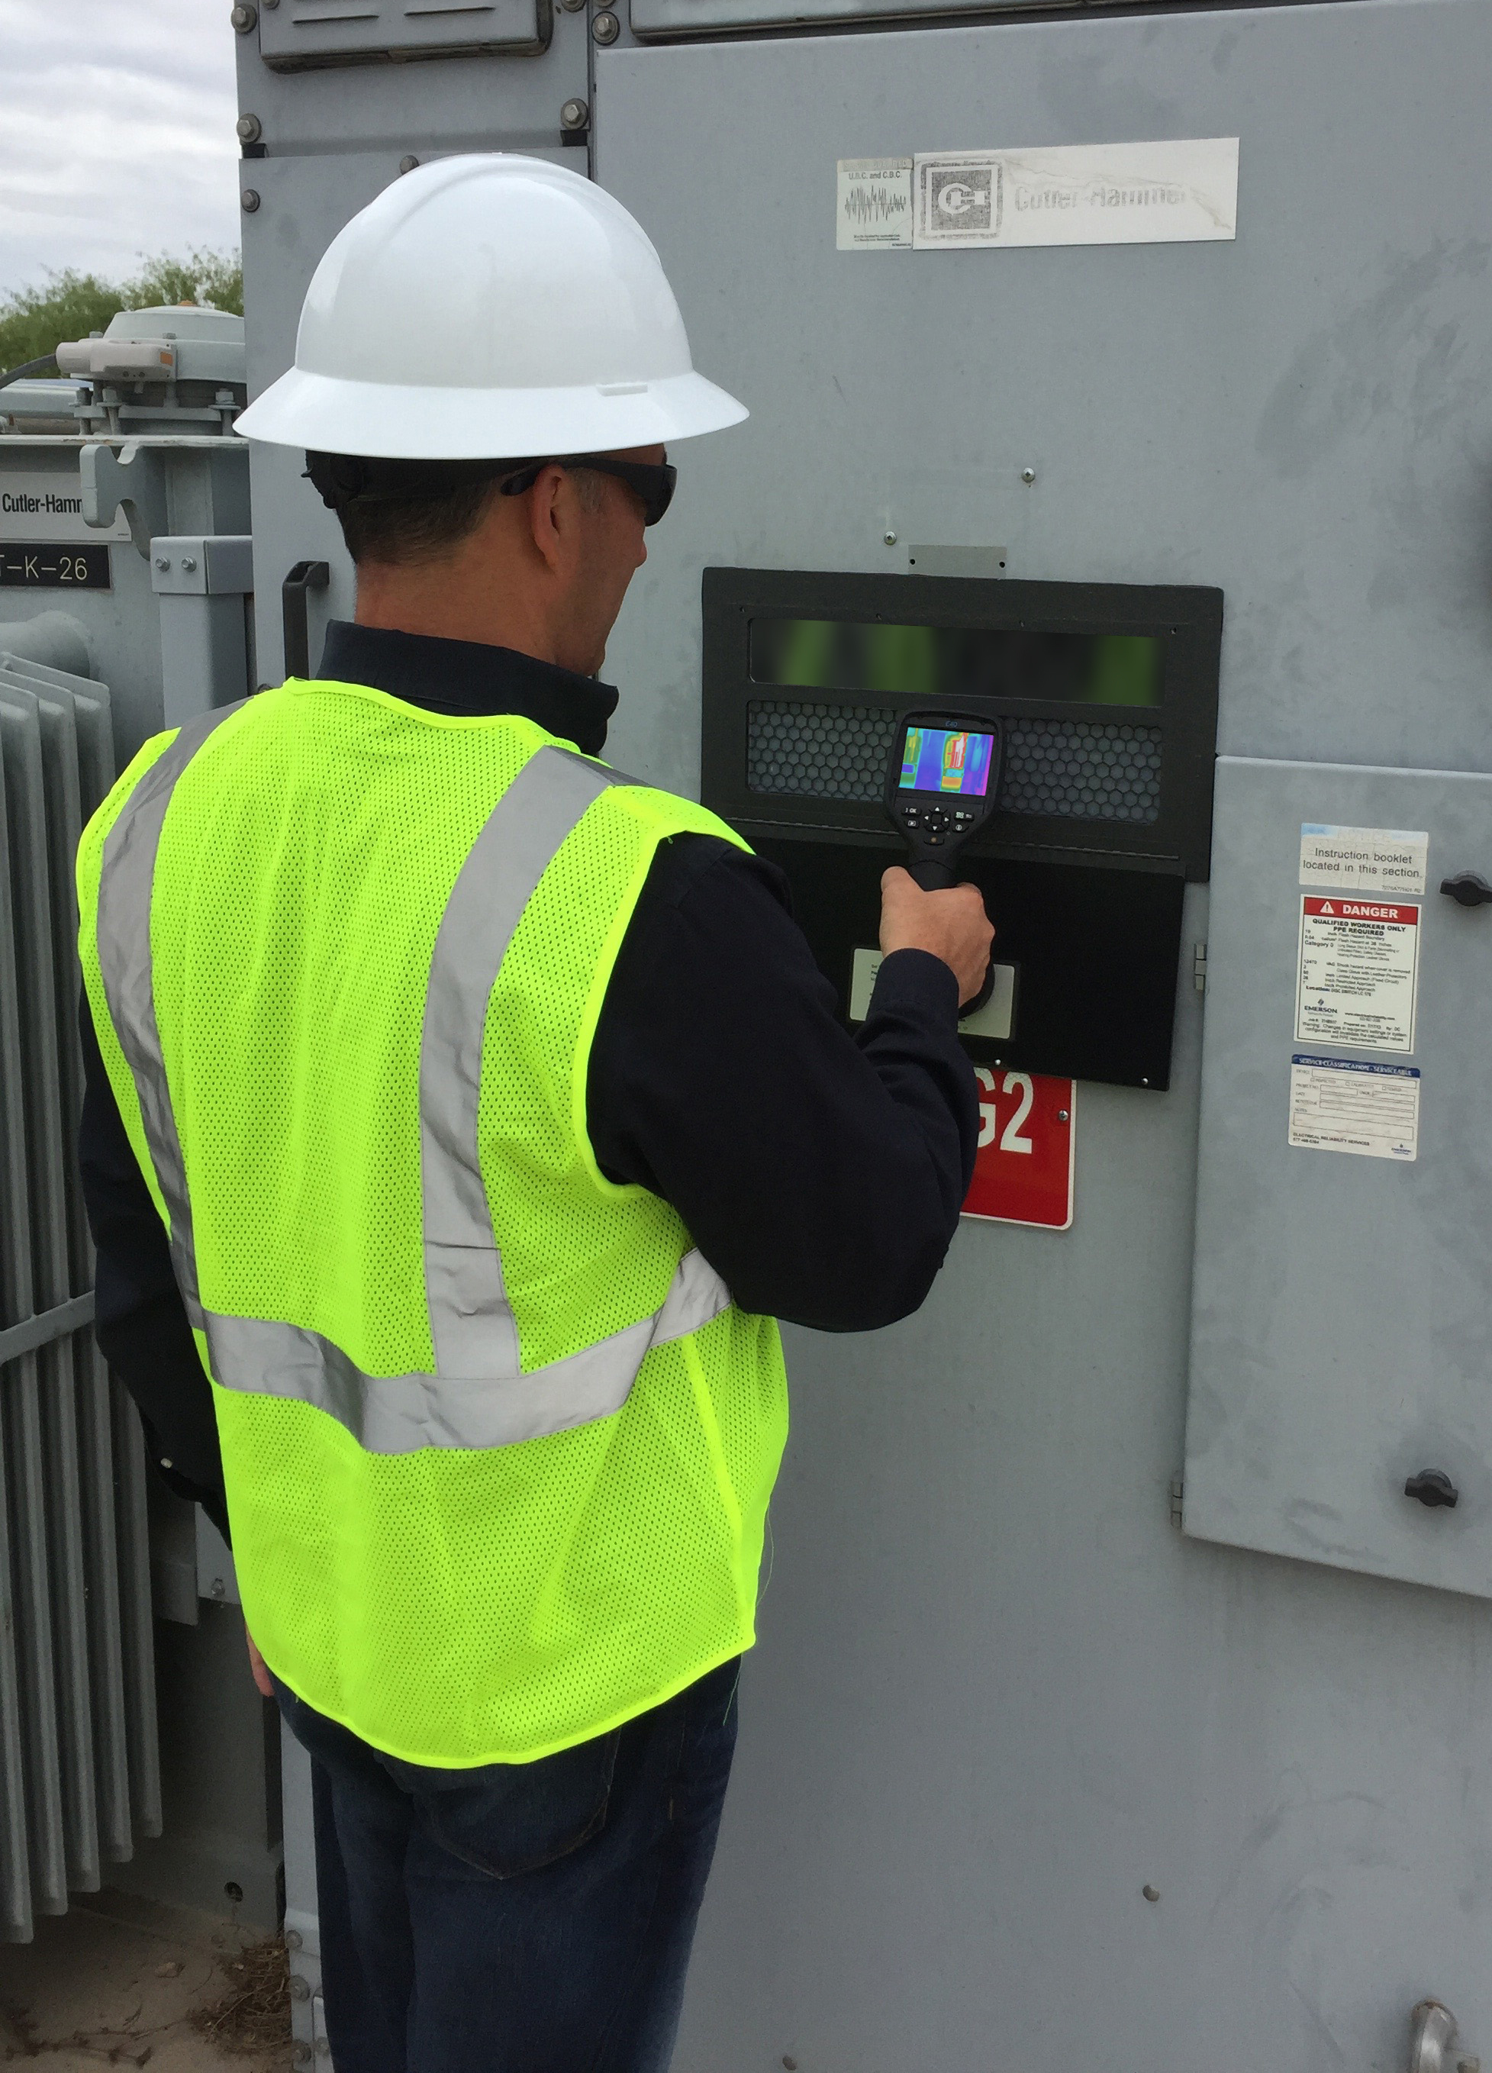
Closed-Panel Inspection
Hazardous Task Eliminated:
Standards Compliant
Process is De-Risked

Slide 9
Benefits Inspection Windows
Eliminates Time-Wasting Activity:
Closed-Panel Inspection Saves Time
Inspect Assets Otherwise Missed
Deeper Dives on Critical Assets
Notes:
The process of closed panel-inspection saves roughly 95$% of man-hours required to complete a scan of a facility.
-- Open-panel inspection requires two or three guys
-- Everyone is dressed up in PPE so there are multiple dress-up and dress-down periods with manitory rest time (due to working in the hot PPE)
-- time studies of Open-panel inspections put each enclosure at roughly 1 to 1.5 man-hours of labor.
-- Closed-panel inspections using IR windows typically takes less than 4 minutes per point, allowing thermographers to deliver a more complete inspection, and a more allows them to spend more time on critical assets.
-- the simpler, de-risked process also makes it easier to inspec critical assets more frequently under ideal, full-load condition

Slide 10
Options
Notes:
There are some option in the IR window marketplace

Slide 11
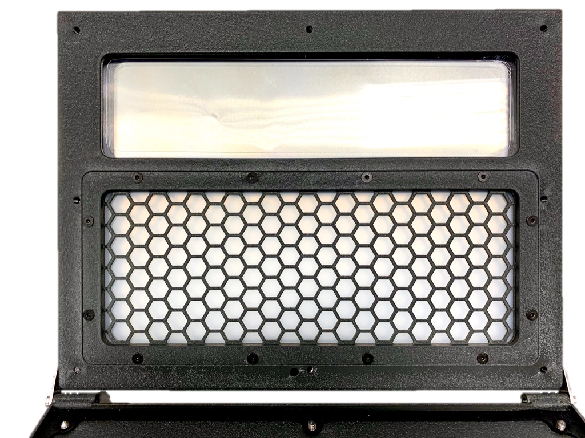
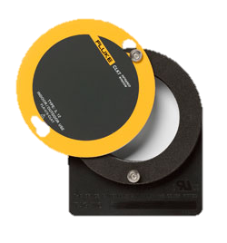
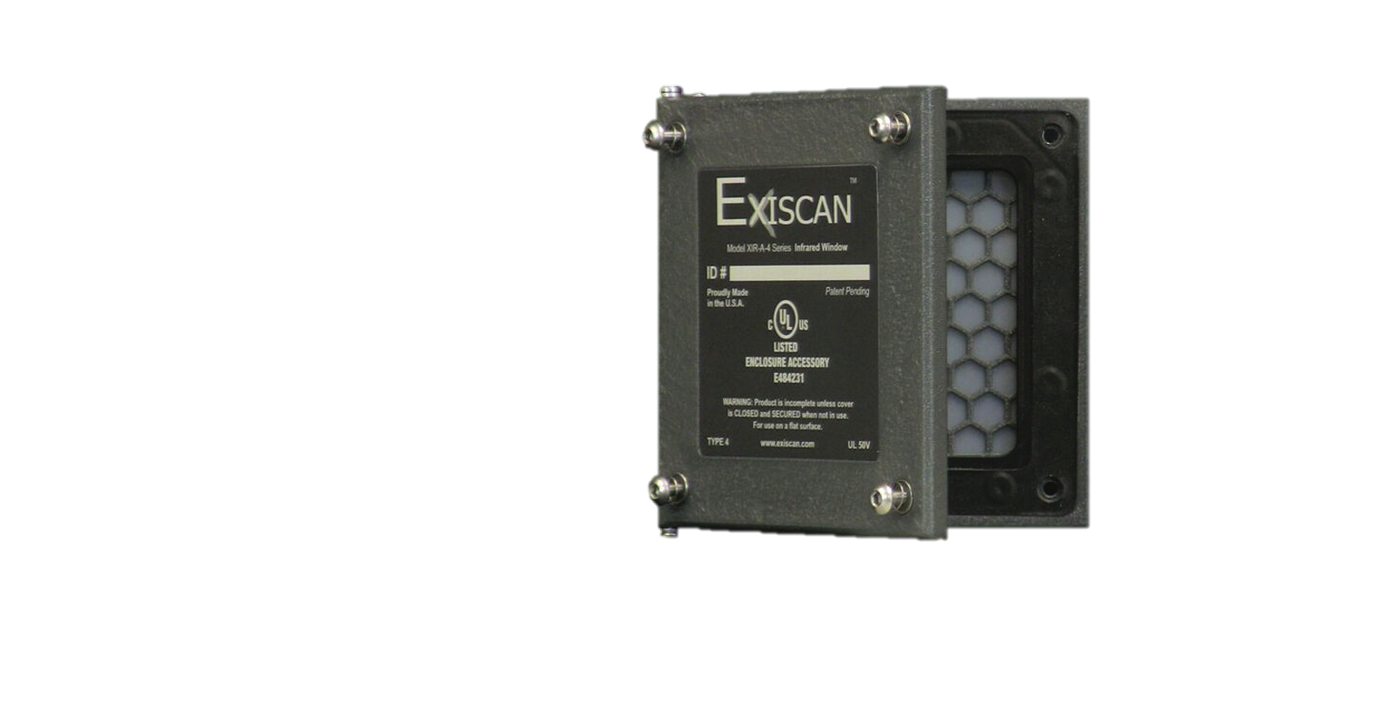
Industrial Polymers v/ Crystals

Slide 12
Industrial-Grade Tools
Exiscan™:
Superior Structural Integrity
Superior Field-of-View
Superior Data Accuracy
Superior Value

Slide 13
Thank You for Your Time!

