Slide 1
23-15 Ultra Heat Resistant Primer
Surface Preparation & Coatings
PROJECT INFORMATION | OBJECTIVE
Prime/Lead: Fincantieri Marinette Marine Team Members: Northern Coatings and Chemical, Elinor Coatings, LLC Duration: 12 Months | Erection and other hotwork during construction require costly and time consuming coating touch-up. This project will develop and test an Ultra Heat Resistant Primer that can withstand the temperature of welding on the opposite side of a steel plate.
DELIVERABLES/BENEFITS/ROI | FINANCIAL
Reduce 2200 hours of masking and coating touch-up of overhead erection joints per vessel. Optimize the structural design and remove landing bars. Improve schedule by up to 4 months Final reports to NSRP and Public Shipyards | Program Funds: $150K

Slide 2
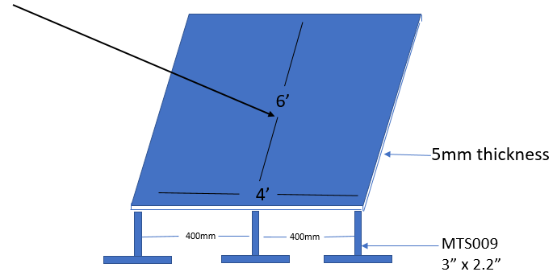
Previous Study at FMM
Vertical plate (simulating bulkhead) to be welded to the top of the plate

Slide 3
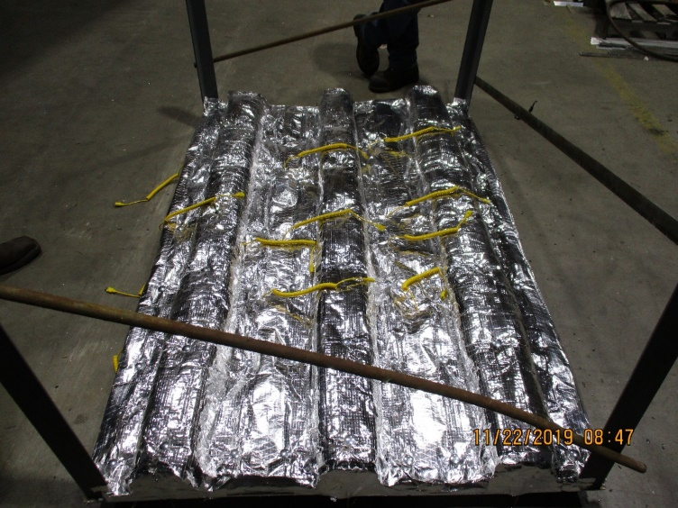
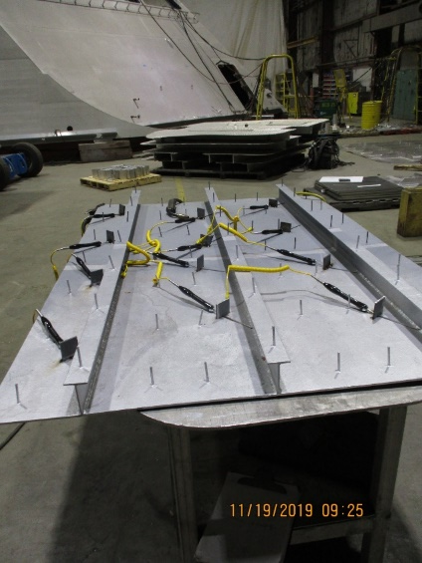
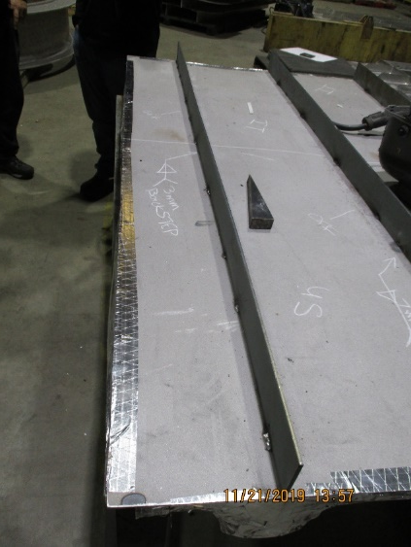
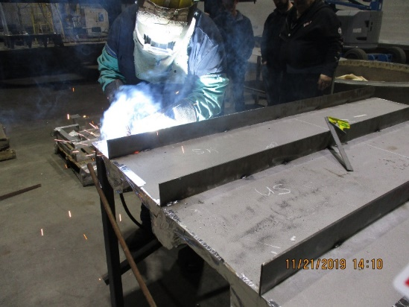
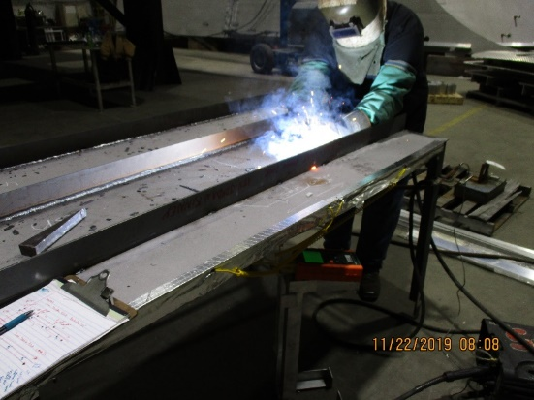
Previous Study at FMM

Slide 4
Previous Study at FMM
Test Case 1: Best Case Scenario
3mm double fillet weld
Max temperature: 521ºF
Test Case 2: Worst Case Scenario
7mm double fillet weld, long dwell time
Max temperature: 772ºF
Test Case 3: Average Scenario
5mm double fillet
Max temperature: 658ºF

Slide 5
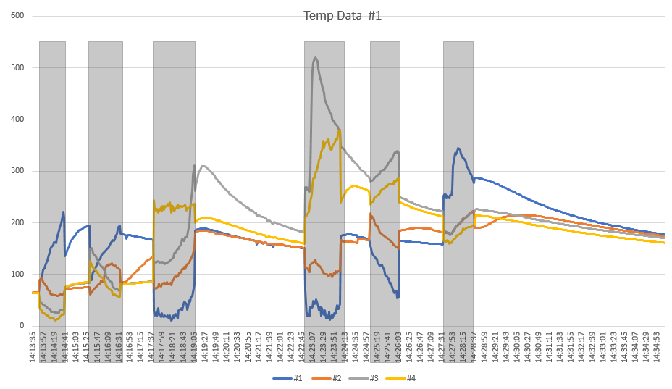
Previous Study at FMM

Slide 6
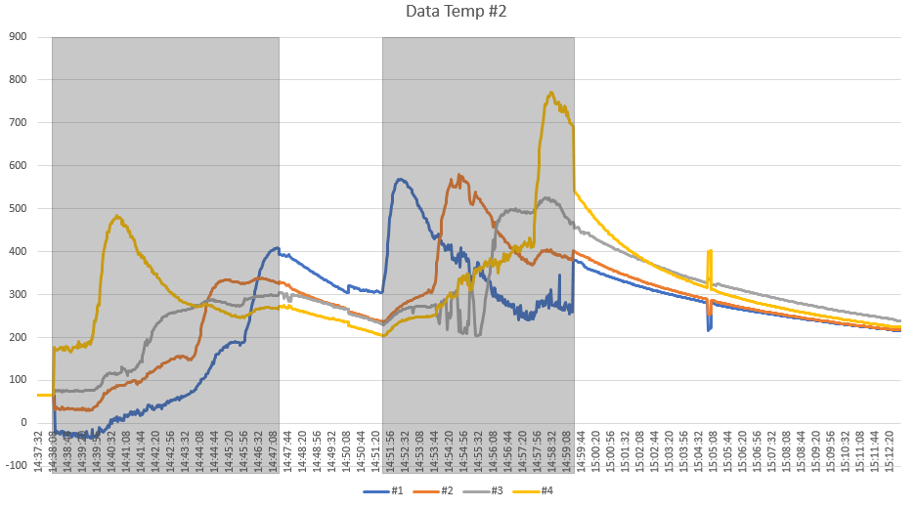
Previous Study at FMM

Slide 7
Previous Study at FMM

