Slide 1
Leak Detection and Location in Tanks
Dr. Steve Ziola
Antech Systems
March 14, 2024

Slide 2
Bio
Steve Ziola
Nearly 40 years in non-destructive testing
Vice-president Engineering/President of Digital Wave Corporation
Sold in 2018 to Hexagon Composites
Completed tech transfer in 2019, moved on to Antech Systems in August of 2019
Antech Systems’ main customer is NAVSEA 09M

Slide 3
Leak Detection in Tanks
Normally occurs in welds
Access to tanks can be difficult
Leaks are small, and locating the leak with conventional methods is difficult, time consuming and requires that a tank be opened.
How can this be addressed for better inspection efficiency?

Slide 4
Other Development
CRADA with NNSY
  Access to NNSY assets
Passive monitoring system on Military Sealift Command aluminum hulled ships
NASA SBIR to improve sensitivity of electronic hardware and sensors
Pipeline Research Council International
Working with other government agencies
Currently four years into development of sensors, hardware and software

Slide 5
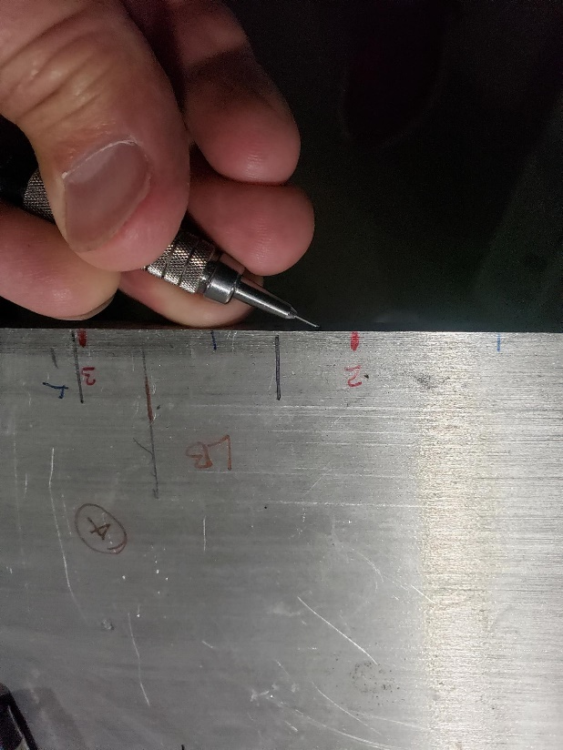
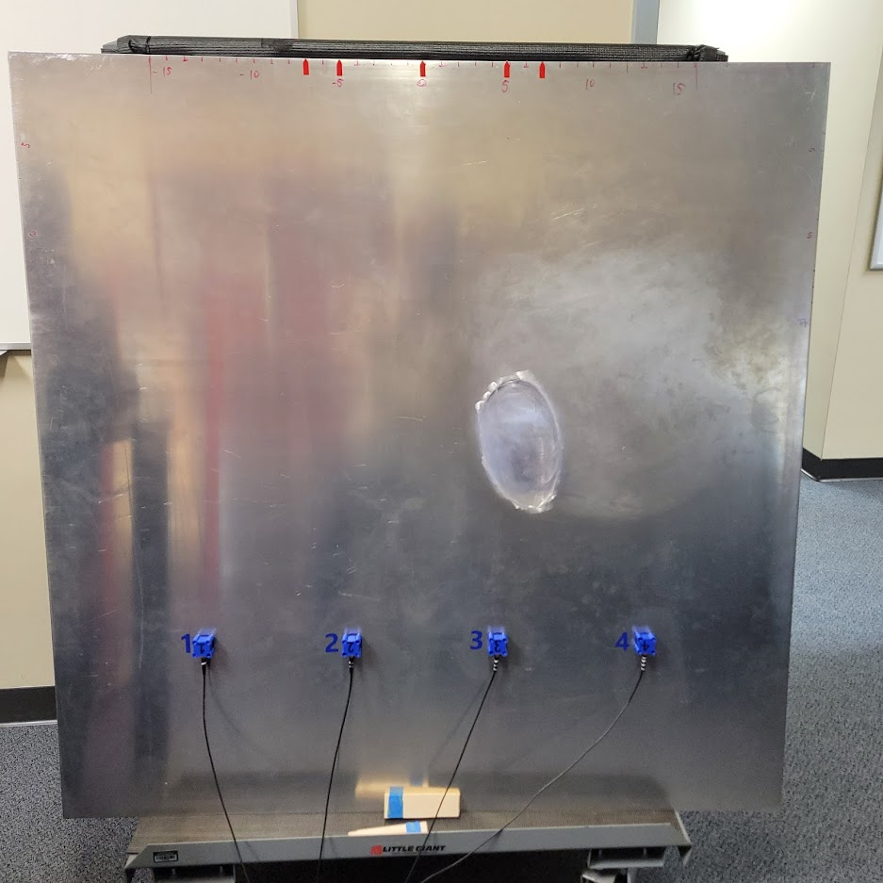
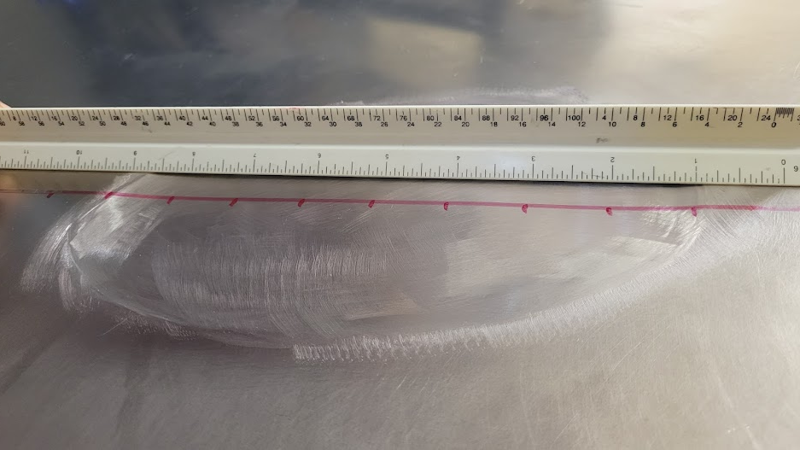
Demonstration
¼” thick aluminum plate
Ground out area
Lead break ultrasound source – wideband, multiple modes
Correlation of theoretical dispersion curves and wavelet transforms of signals to determine thickness
No gates, thresholds, special sensors or wedges
5

Slide 6
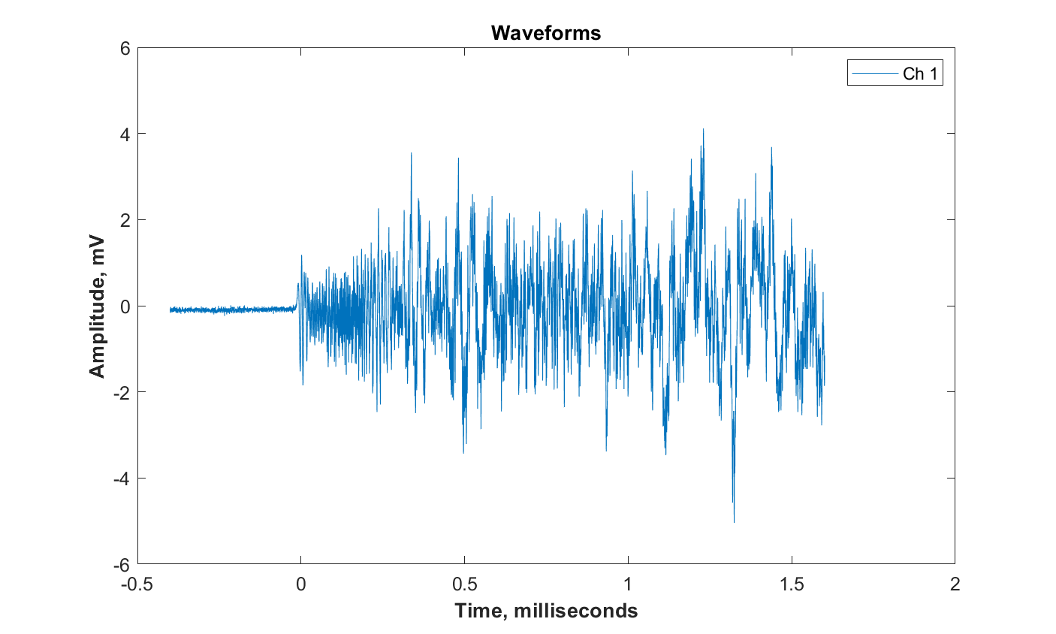
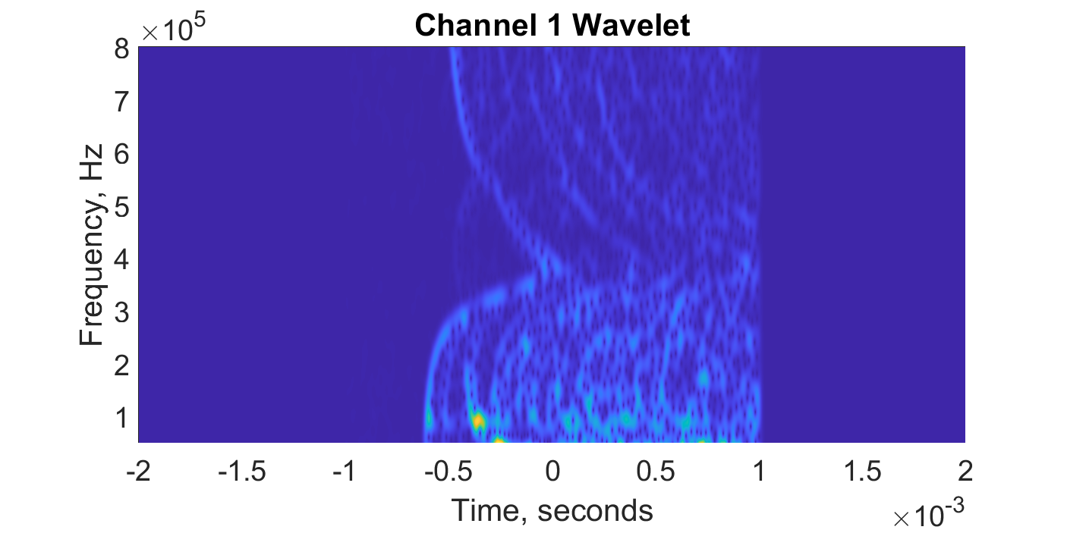
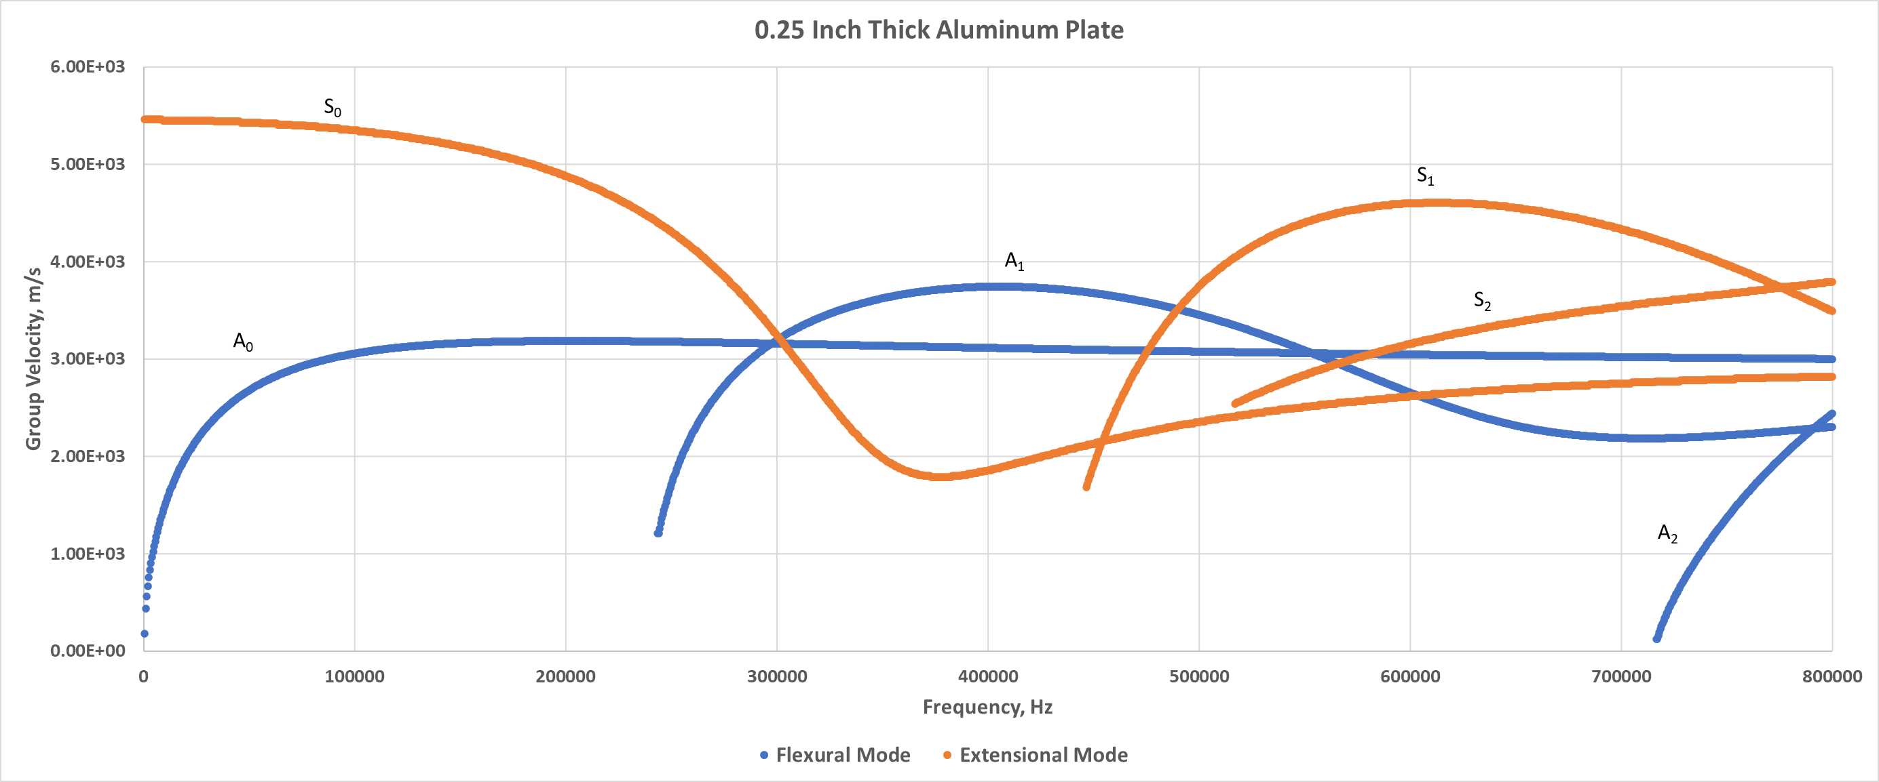
Image Analysis
This approach takes incomprehensible waves and turns them into identifiable patterns – no assumptions
These modes ID the source (whale vs sub) – FEA modeling
Robust automation has never been performed
How is the process automated?
A₁
Broadband guided waves are very complex and difficult to analyze – dispersion, multiple modes, reflections, attenuation
S₂
S₀
A₀
S₀
Plot 1 - Wavelet Transform
Time/Frequency/Amplitude
(SONAR waterfall plot – pattern recognition)
Plot 2 - Lamb mode theory dispersion curves

Slide 7
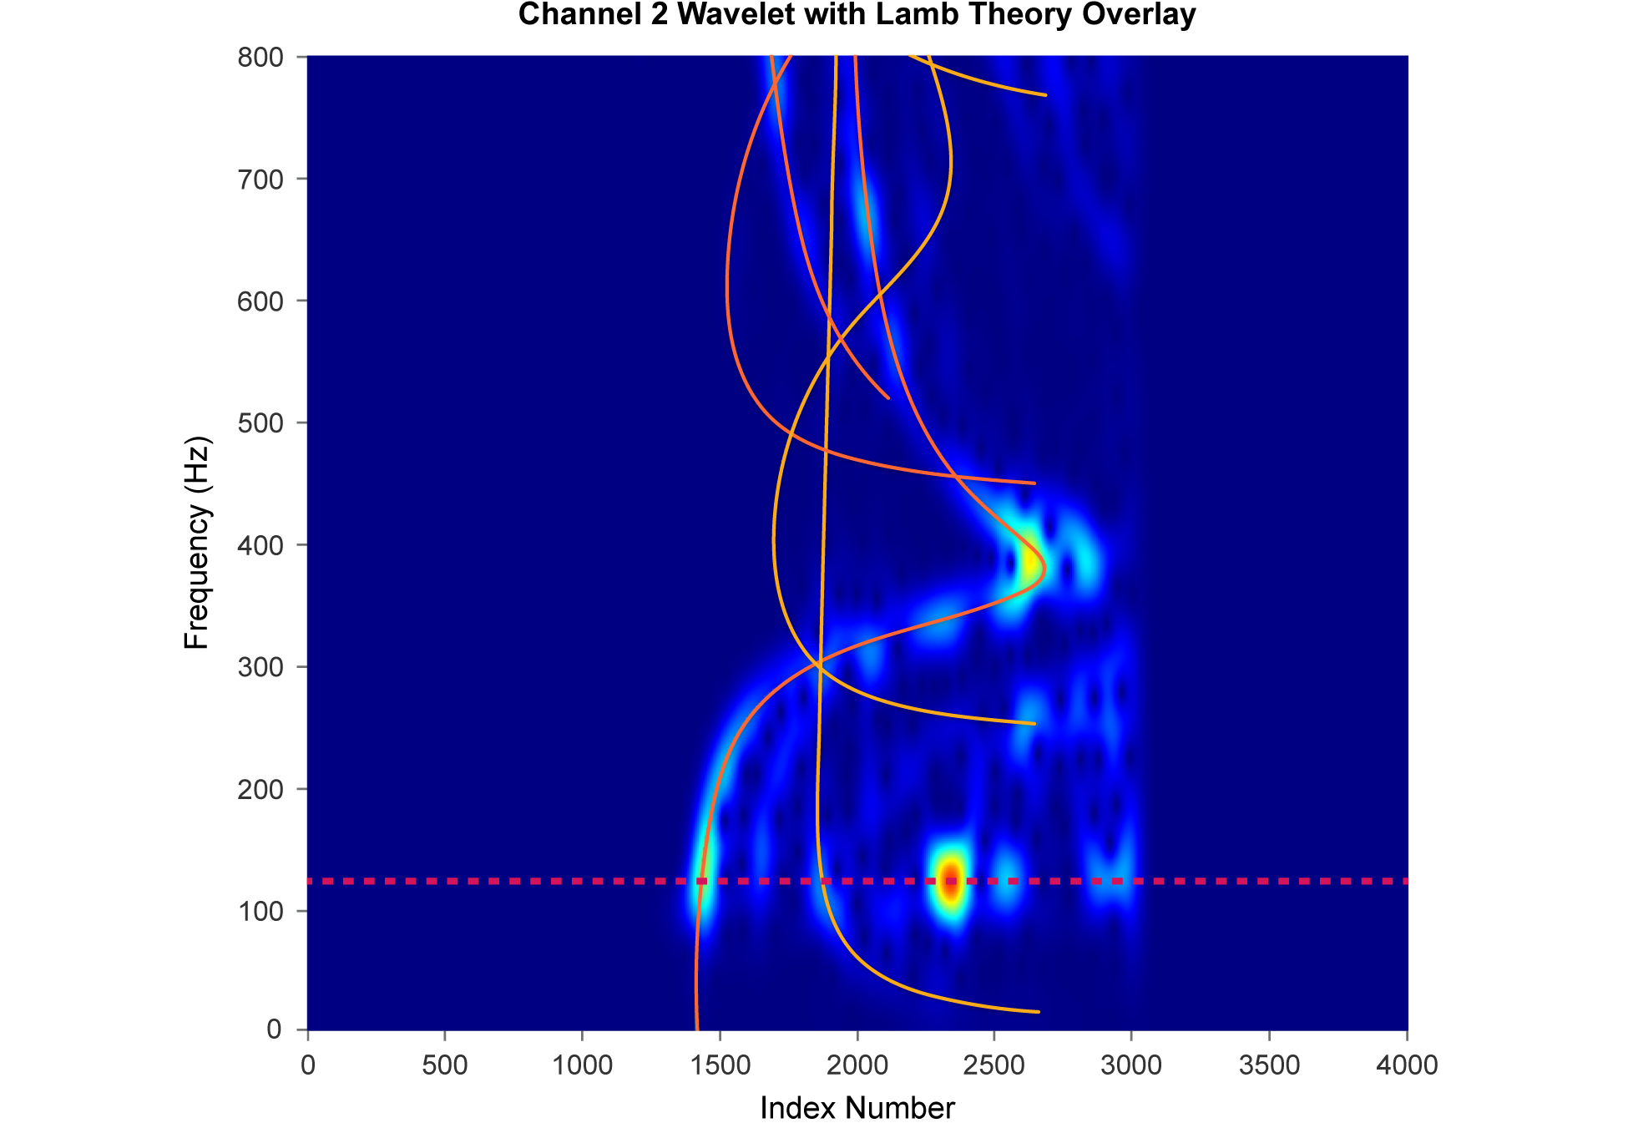
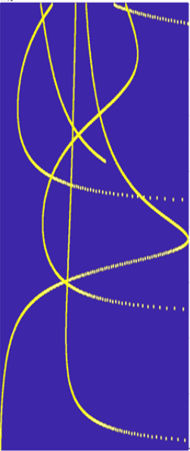
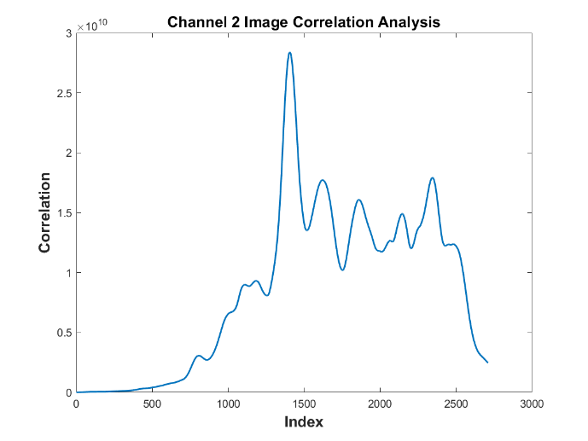
Analysis Automation
Create image of theory
Contains complex wave propagation math
Create image of waveform using the wavelet transform
Contains flaw information
Computer correlates the two images
Turns the very complex waveform into a peak search to determine the signal content with a high degree of accuracy
This is the new idea
Maximum correlation (Wave arrival)
No Threshold Required
This will make piping inspection work at the tech level
Correlation with a reflection
Small correlation
No correlation

Slide 8
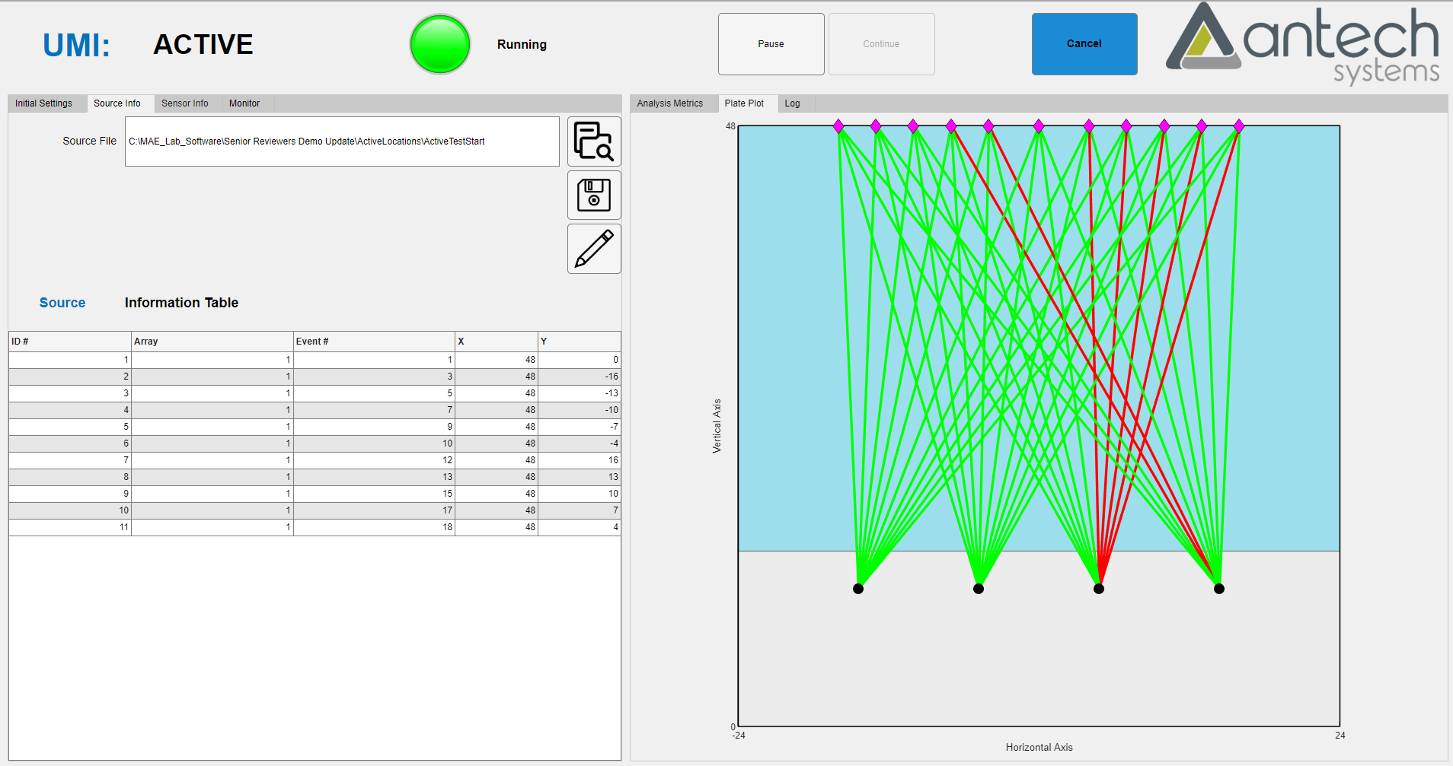
UMI Thickness Scan Results
Correlation to find thickness
Scan large areas quickly/accurately

Slide 9
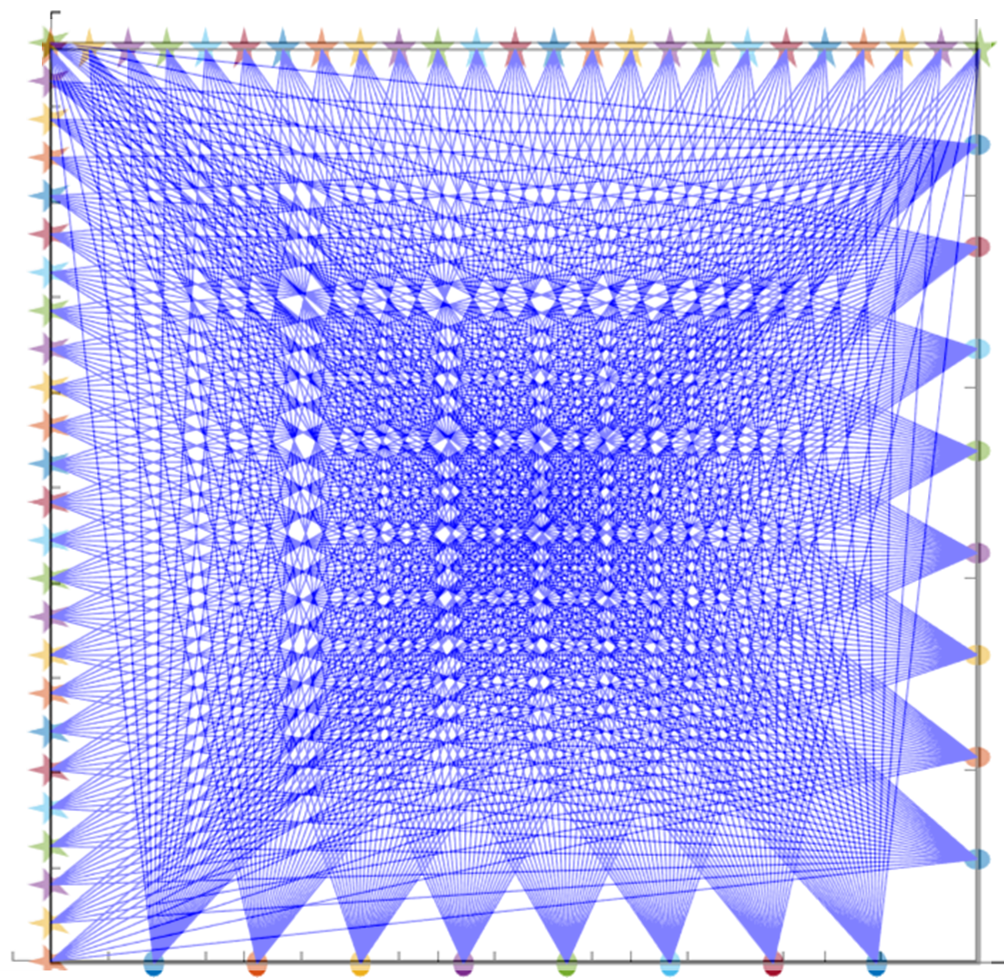
Improved Large Structure Inspection
4x4 foot aluminum plate
0.25-inch thick
25 lead breaks and 8 receiving transducers per scan direction

Slide 10
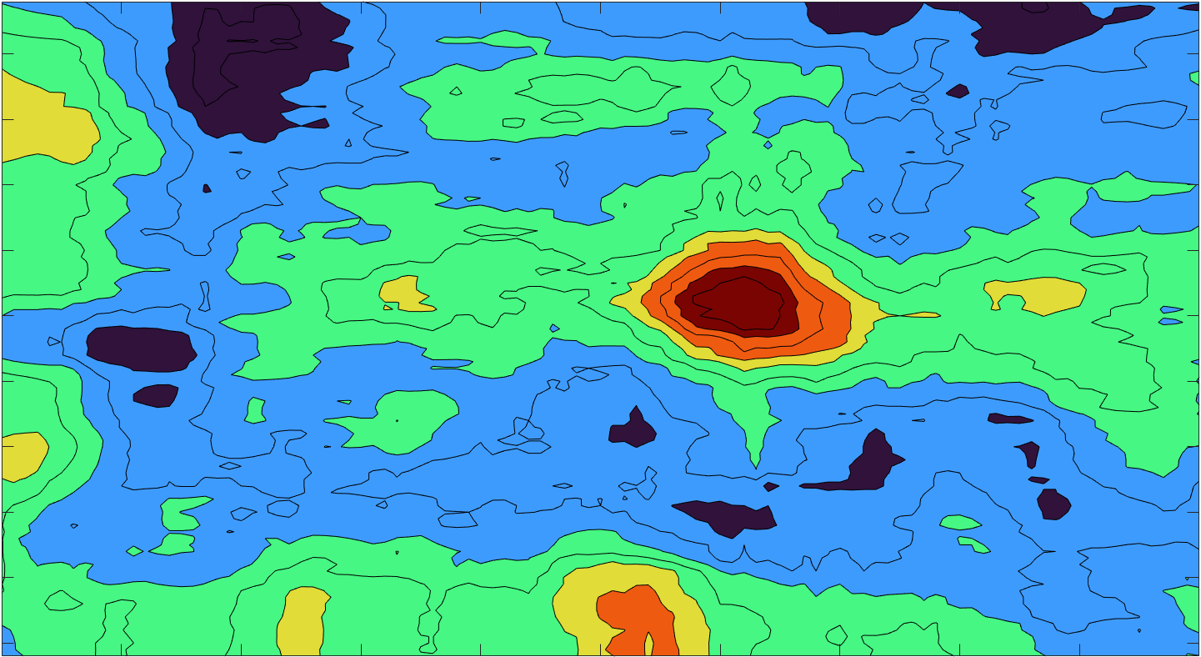
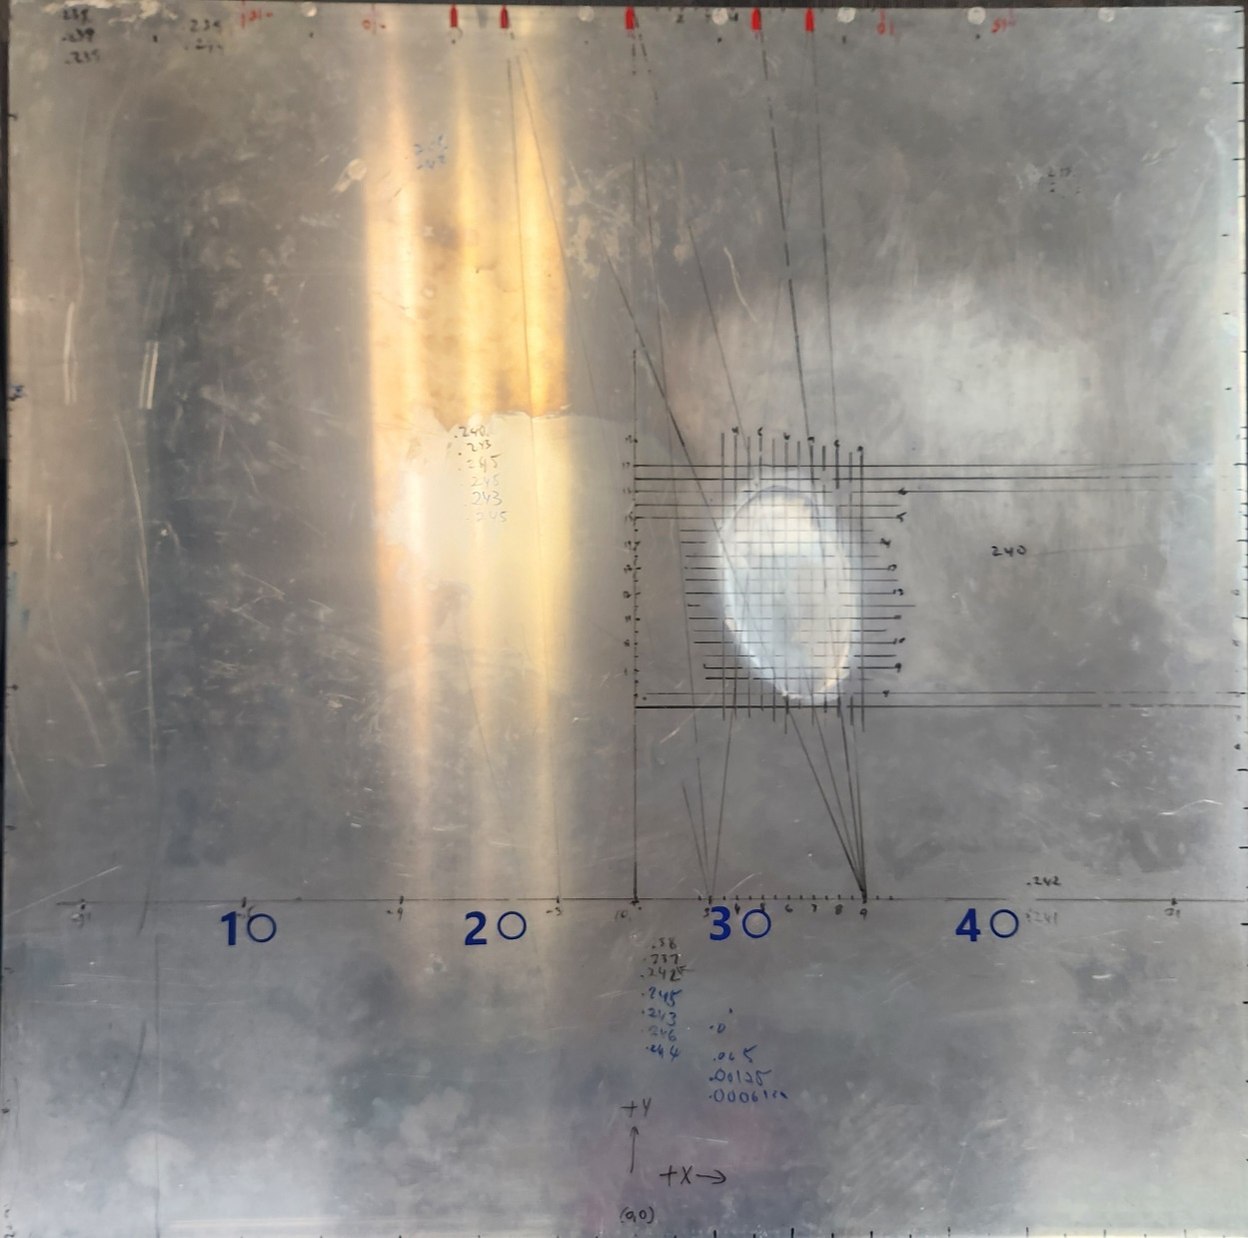
Plate Scan Results
2304 square inches scanned

Slide 11
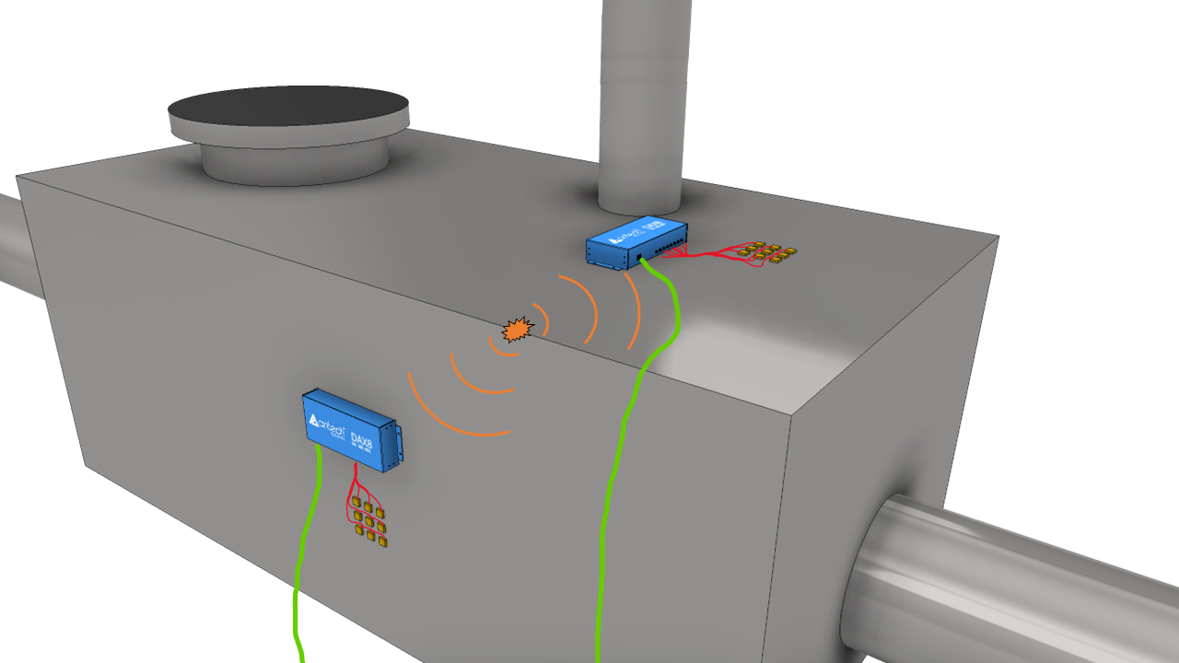
Tank Schematic – Proposed Inspection
Sensor array and acquisition electronics

Slide 12
Leak Detection Approach
Monitoring systems are coupled to accessible locations on tank
Tank is emptied
Tank is pressurized – several psi
Air passing through small crack causes turbulence
Turbulence excites a propagating wave
Difference in arrival times of signal at sensors in array allows the calculation of the incidence angle of the source
Intersection of two incidence angles from two sensors gives location

Slide 13
Impulsive Source
1
x
2
3
1
2
3
4
4
5
6
5
6

Slide 14
Continuous Source
1
No distinct ‘first arrival’
Have to find same phase point in each signal
Difficult due to dispersion and multiple modes that occur when waves propagate in plate-like structures
Will require sensor specifically designed for flat frequency and linear phase response
  PVDF film sensors have this response
2
3
4
5
6

Slide 15
Unknowns
Does pressurization at a few psi create turbulent flow?
Is the turbulent flow impulsive or continuous
Leaks in fittings and valves are easily found when testing pressure vessels
Work in heat exchanges has shown the ability to detect leaks at tube sheet weld interfaces at low pressures

Slide 16
NASA NESB SBIR Development
System Sensitivity for Leak Detection
Low noise/high sensitivity electronics development
Higher sensitivity sensors
Increases ability to detect small signals

Slide 17
Leak Detection System Development
System can be tuned for leak detection frequency range
  Electronics
  Sensors
    Sensor design
    Array design
SONAR locates on continuous signals
  Adapt for dispersive wave propagation in structures
Software analysis development

Slide 18
Conclusions
Remote detection and location of leaks
Easy to use
Pier side or at sea operation
Tanks are not required to be opened
Conventional NDT associated with leak/crack repair can be targeted to specific locations

Slide 19
Questions?
Thank You
Steve Ziola steve.ziola@antechsystems.com

Slide 20
Backup Slides

Slide 21

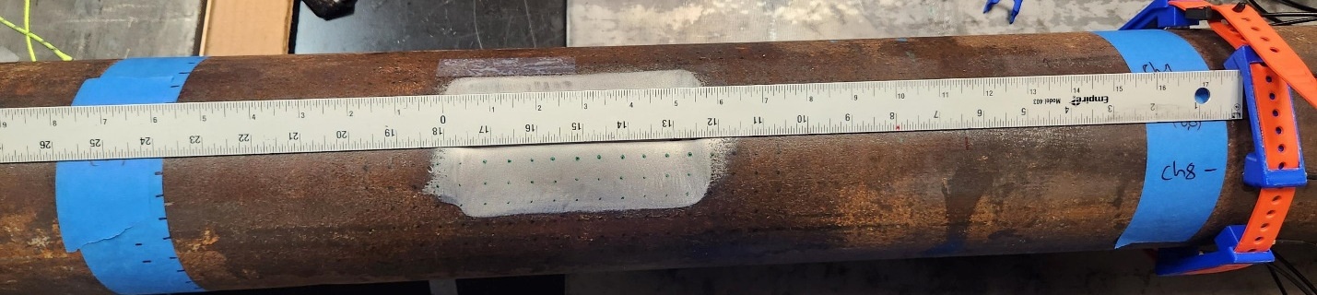
Pipe Inspection – Direct Wave Imaging
30% wall loss

Slide 22
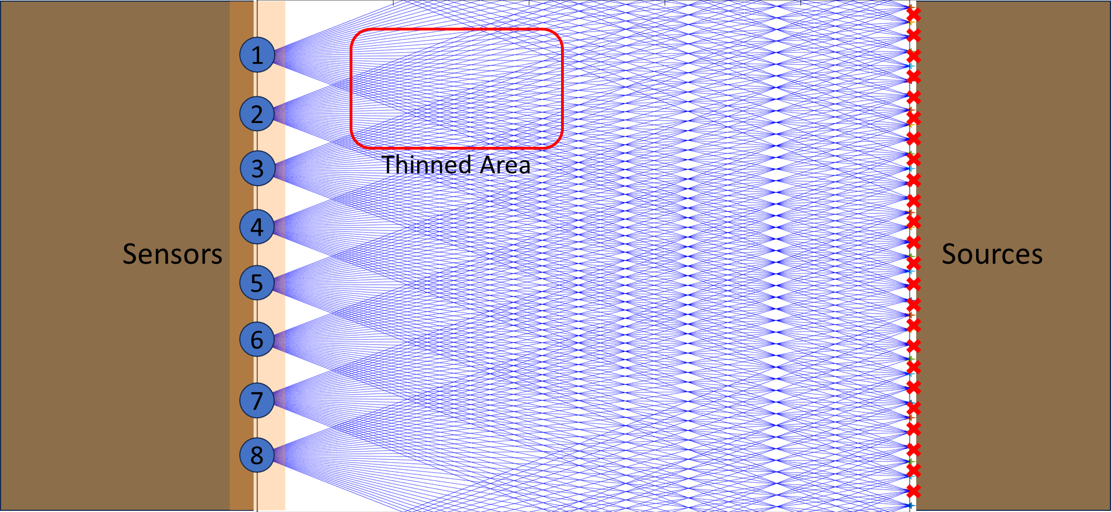
Initial Pipe Inspection – No Wraps

Slide 23
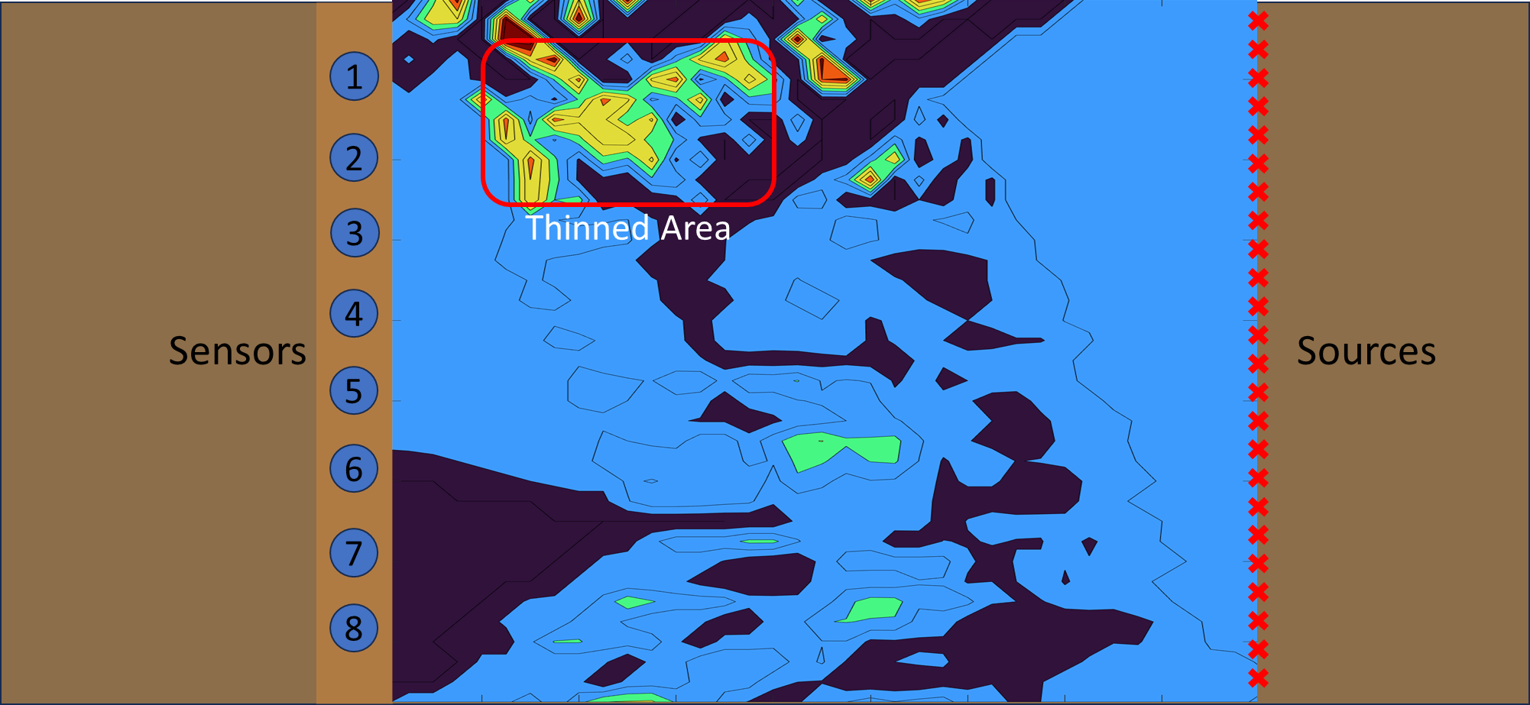
Flaw Image
17.5”
378 square inches scanned with 8 sensors and a lead pencil

Slide 24
Pipe Inspection Using Wraps
More information in each signal
Direct arrival dispersion curve plus 4 wrap arrivals
Direct and wrap distance corrected dispersion curves correlated simultaneously to improve arrival detection
Frequency, Hz
Time, seconds

Slide 25
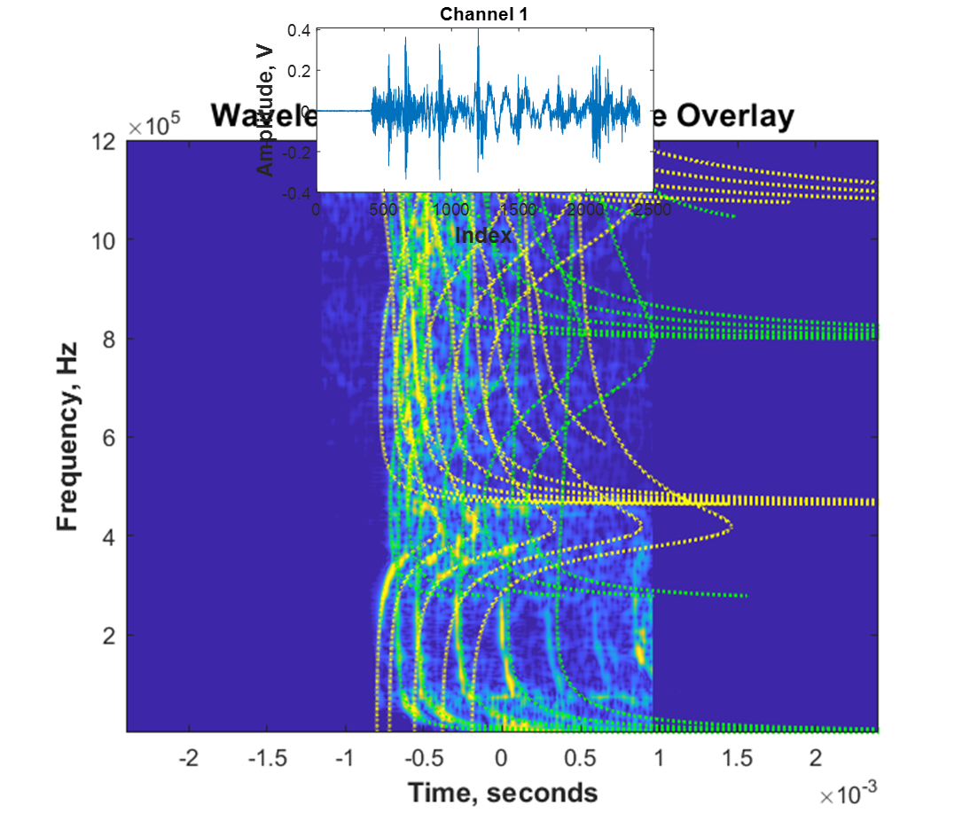
Mode and Wrap ID
Pipeline Research Council International data
  Petrochem funded research entity
Multiple wave arrivals identified
Each arrival is analyzed independently for mode shifts due to flaws
  Software being developed
Used in tomography
Note – it can be seen that the diameter used was wrong

Slide 26
Antech Systems Development
Image based processing for source identification
AI image analysis for filtering and analysis of signals
Image enhancement of wavelet transforms
FEA modeling to predict wave mode formation for training of AI model
Tomography imaging software development
Application software

