Slide 1
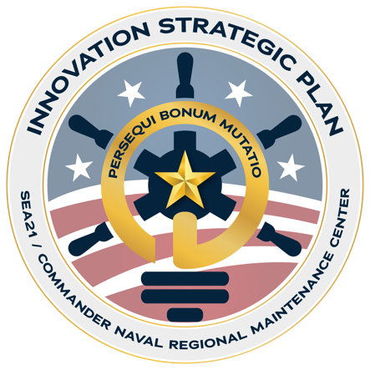
Innovation Plan Update
March 2024
Kirk Jenne
CTR Support to Transformation/Innovation
Gordan Van Hook
SEA 21T, Director of Transformation

Slide 2
Innovation Campaign
SEA21/CNRMC Innovation Strategic Plan guides Organize, Man, Train, Equip
Innovation for sustainment: Implementing changes in technologies, processes, business and policy to be faster and better at our mission to fix ships
MARMC/SWRMC/SERMC are ONR-approved Navy Transition Activity
Each activity has an ‘ORTA’ (Office of Research and Technology Agency) Rep
ORTAs are POCs for new ideas (spin in/spin out)
Focus is on Additive Manufacturing for broken parts
SEA 21/CNRMC developed Innovation and Experimentation Campaign Plan (IECP) to accomplish the goal
Established 7 Lines of Effort (LOE) via discussions
Aligned to NAVSEA Strategy
Used to communicate with potential partners
Significant progress is being made to reduce DoMD; challenging to tie to specific innovation projects and P2P
* Empower Innovation Leaders to Act and Perform

Slide 3
Innovation and Experimentation Campaign Plan
Approach
Interviewed workers, managers, directors to understand pain points and opportunities
Organize that info into Lines of Effort (LOE)
The recommended plan schedule priorities and Innovation Lines of Effort (LOE):
Plan Priority 1
LOE 1: Digital Transformation, Waterfront Execution
LOE 2: Digital Transformation, Planning Accuracy
LOE 3: Automation of Reports
Plan Priority 2
LOE 4: Structural Health and Assessments
LOE 5: Additive & Advanced Manufacturing
Plan Priority 3
LOE 6: Marine Manufacturing and Systems Engineering
Apply innovation to drive days of maintenance duration downward 10% by eoCY24 Develop/Test innovative ideas to make the workforce more effective/efficient in Avail execution work contributing to delays in maintenance

Slide 4
Innovation LOE Proposed Leads & Concepts
LOE 1: Digital Transformation, Waterfront Execution
Utilize available technologies to optimize managing and matching resources
Devices | BYOD, deploy ruggedized laptops and tablets
Software | Data Structuring, visualization, APPs with drop-down menus
Wireless Infrastructure | Wireless Connectivity (4/5+ G) at piers, I-Level and ships AR/VR
LOE 2: Digital Transformation, Planning Accuracy
Integrated Production Schedule | Better understanding of Maintenance and Modernization work integration pre-solicitation. Increase IPS SAT on first pass to 75%. Increase effectiveness of Schedule Mode Review.
Increase Collaboration with Contractor Pre-start | Prioritize settlement of known contract changes
Improve "Bidders Questions" process | Increase NMD functionality to manage bidder questions and leverage industries feedback on solicited work specs. Direct feedback to lessons learned. Navy and Industry investment
Enhanced Work Spec Reviews | Explore opportunities to leverage artificial intelligence / machine learning (AI/ML) to leverage historical CFR and RCC data and compare to the work specification/ review process (i.e., automated review vs manual review)
Enhance Shipcheck Process | Leverage virtual reality/video and ships force to enhance shipcheck process

Slide 5
Innovation LOE Proposed Leads & Concepts
LOE 3: Automation of Reports
Automated Mission Execution Review | Finance & resources deployment, status
Automated Brain Book | Transfer from SharePoint to SMDII
Limit Change Allowed on Contracts | Limit contract changes for growth work
Automated I-Level Activity | Align 900 data management across RMCs
Improve delivery of workforce training | Expedite training and tracking for project teams
LOE 4: Structural Health and Assessments
Inspection/Detection | Apply sensor capability to ROV/UAVs/UUVs,
Expedited Repair | Preparations: Laser ablation, Plasma blast, Containerized Blast System
Corrosion Mitigation | Coatings/Processes Polysiloxane, Composites, Laser Shock Peening, Friction Stir welding, etc.

Slide 6
Innovation LOE Proposed Leads & Concepts
LOE 5: Additive & Advanced Manufacturing
3D printing | Speedy printing and approval of non-critical parts in I-Level
Computer Numerical Control (CNC) | Digital download of parts files (relates to digital transformation)
Cold spray | Speed up repair of damaged parts
LOE 6: Marine Manufacturing and Systems Engineering
Replace LCS Waterjet | Waterborne replacement engineering solution to reduce time and risk
Shafts and Stern tube seal | Replacement/repair expedience
Propellers/CPP hubs | Expedited disassembly/repair
Rudder Bearings and Post Seal | Increase ease of assessment/replacement/repair
Sonar transducers | Increase ease of assessment/replacement/repair
Slewing Arm Davit (SLAD) Repair | Increase self-sufficiency and parts availability
Expectation = Average Maintenance Duration Reduced by > 28 Days!

Slide 7
Innovation Plan Thoughts
We have made progress…
Leadership is adopting an innovation mindset, a culture change, for the enterprise (Show Me Anything)
Growing opportunities to collaborate with other organizations (NSRP, NRL, ONR NavalX, NPS…)
Recognize we have more to do…
We need to collaborate with industry more!
Adopt/communicate a sense of urgency
Formalize a transformation and technology transition process (IT3)
Maintain Focus…
Goal: Facilitate innovation to drive days of maintenance duration down by more than 10% (>25 days)
Allow proper time to Develop/Test/Deploy innovative ideas for more effective and efficiency in Availabilities
Formalize a process for confidence in defining impact of innovation efforts

Slide 8
Innovation Campaign
Questions and Discussion

