Slide 1
Electrical Technologies Panel
Summer Panel Meeting
July 19-20, 2023
General Atomics EMS
San Diego, CA

Slide 2
Meeting Agenda
Times listed are Pacific Time Zone
Wednesday, July 19, 2023
Time* | Presentation | Speaker
8:00 am | Convene Meeting – Begin Webinar
8:00 am | Introductions and Welcome | Jason Farmer, Panel Chair | Jason Farmer, Panel Chair
8:30 | Welcome to General Atomics & GA Capabilities Overview | Roger Camp, General Atomics | Roger Camp, General Atomics
9:00 | Tour of General Atomics Electromagnetic Systems *Must be pre-registered to attend | Roger Camp, General Atomics | Roger Camp, General Atomics
12:00 pm | Lunch
1:15 | NSRP Update | Nick Laney, ATI | Nick Laney, ATI
1:45 | IR Windows: Considerations for Standards, Technologies and Placement | Tim Rohrer, Exiscan | Tim Rohrer, Exiscan
2:15 | Break
2:30 | NAVSEA 05Z3 Update | Chris Nemarich, NAVSEA 05Z33 | Chris Nemarich, NAVSEA 05Z33
3:15 | Splice-On Connectors and Termini for Shipboard Applications | Jason Farmer, Ingalls Mark Joseph, Amphenol Rick Kuepfer, AFSI | Jason Farmer, Ingalls Mark Joseph, Amphenol Rick Kuepfer, AFSI
3:45 | Navy Fiber Optic Update | Chris Good, NSWC Dahlgren Division | Chris Good, NSWC Dahlgren Division
4:15 | Action Items & Wrap-Up | Walt Skalniak, Panel Vice-Chair | Walt Skalniak, Panel Vice-Chair
4:30 | Adjourn

Slide 3
Meeting Agenda
Times listed are Pacific Time Zone
Thursday, July 20, 2023
Time* | Presentation | Speaker
8:00 am | Convene Meeting – Begin Webinar
8:00 | Introductions and Welcome | Jason Farmer, Panel Chair
8:30 | FY23 Panel Project Updates | Project Leads
9:00 | Overview of General Atomics Electro-Magnetic Systems | Scott Forney, President GA-EMS
10:00 | DTS Integration into Ship Electrical Plant Monitoring & Controls for Conditions Based Maintenance | Gio Tomasi, RSL Fiber Systems
10:30 | High-Density Ribbon Fiber Optic Cable & Tooling | Jason Farmer
11:00 | Shipboard Fiber Optic Cables Jacket Performance Enhancements | Gio Tomasi
11:30 | Lunch
12:30 pm | FY24 Panel Project White Paper Presentations | Project Leads
2:15 | Break
2:30 | FY24 Panel Project White Paper Presentations | Project Leads
4:00 | For the Good of the Panel/Open Discussion | All
4:45 | Action Items & Wrap-Up | Walt Skalniak, Panel Vice-Chair
5:00 | Adjourn

Slide 4
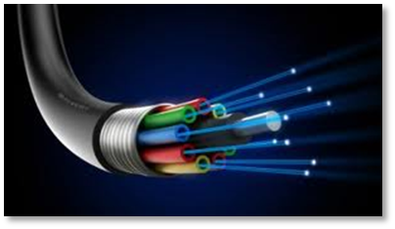
Electrical Technologies Panel
Purpose
Evaluate & transition improved electrical system technologies, installation processes, and electrical system specifications.
Facilitate collaboration with the Navy and industry to identify & implement electrical technologies, processes, and best practices.
Goal
The goal of the Electrical Technologies Panel is to improve shipboard electrical systems and installation processes to achieve reduced cost, improved performance, and improved safety.
Focus Areas: The panel’s focus is to identify and implement technologies and processes that improve:
  Total Ownership Cost
  Energy Efficiency
  Electrical System Performance
  Safety of Workforce and Ship’s Crew

Slide 5
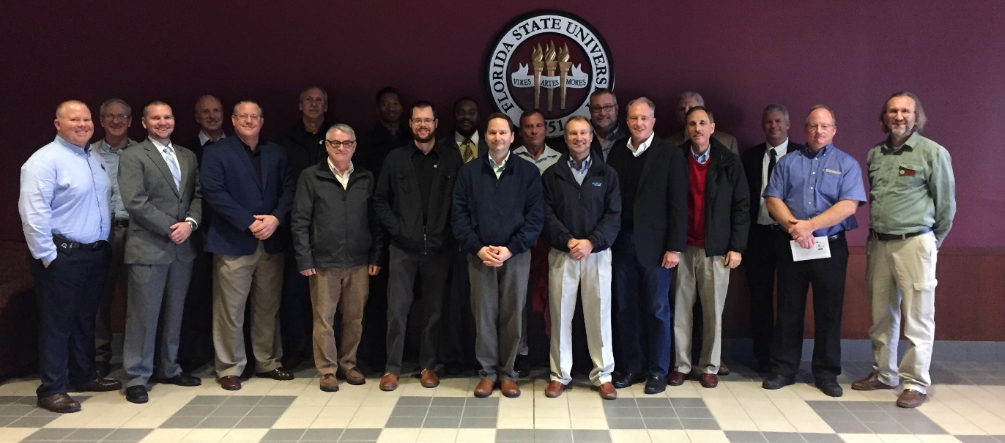
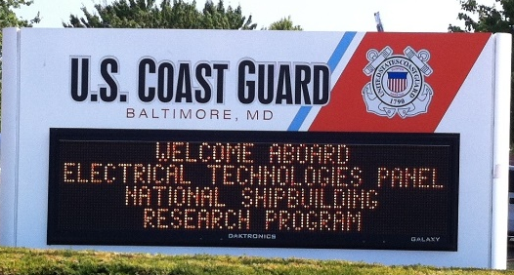
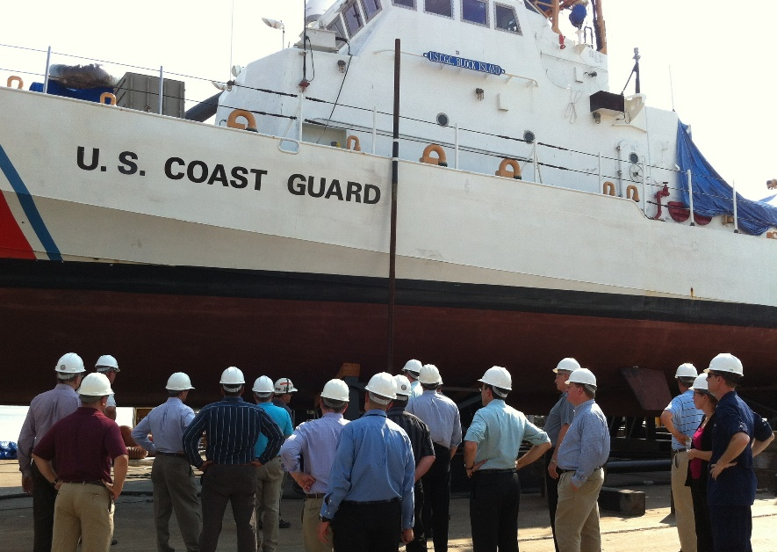
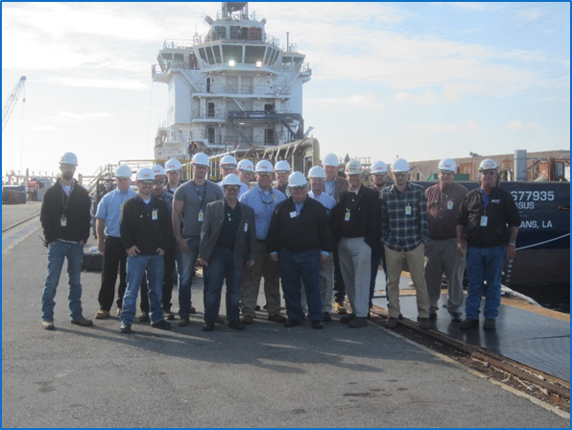
Electrical Technologies Panel Overview
Typically hold 3 meetings/year
  Collaboration with other Panels
  Technology Area Meetings focus
  Facility Tours where available
Areas of Interest
  Electrical Installation & Testing
  Fiber Optics
  Solid State Lighting
  Switchgear Inspection
  High Temperature Insulated Bus Pipe
2022 Panel Meeting Recap
  Spring Meeting
    April 28, 2022
    Virtual Format
  Summer Meeting
    Aug 10-11, 2022
    University of Connecticut (Storrs, CT)
    Tours: UConn Research Park and CCAT
  Winter Meeting
    December 13, 2022
    Virtual Format
www.nsrp.org/electrical-technologies-panel

Slide 6
Panel Activities
Panel Projects: ETP Projects address many areas of shipboard electrical systems
  Electrical Connections & Testing Methods
  Cableways and Cable Installation
  Fiber Optic Networks
  Lighting Systems
Industry Events: Panel members participate in industry events in support of Technology Transfer
  SNAME Maritime Convention
  MFPT Annual Meeting
  NAVSEA Working Groups
  NSRP Day at NAVSEA
  NSRP Panel Meetings
  ShipTech

Slide 7
Questions?

Slide 8
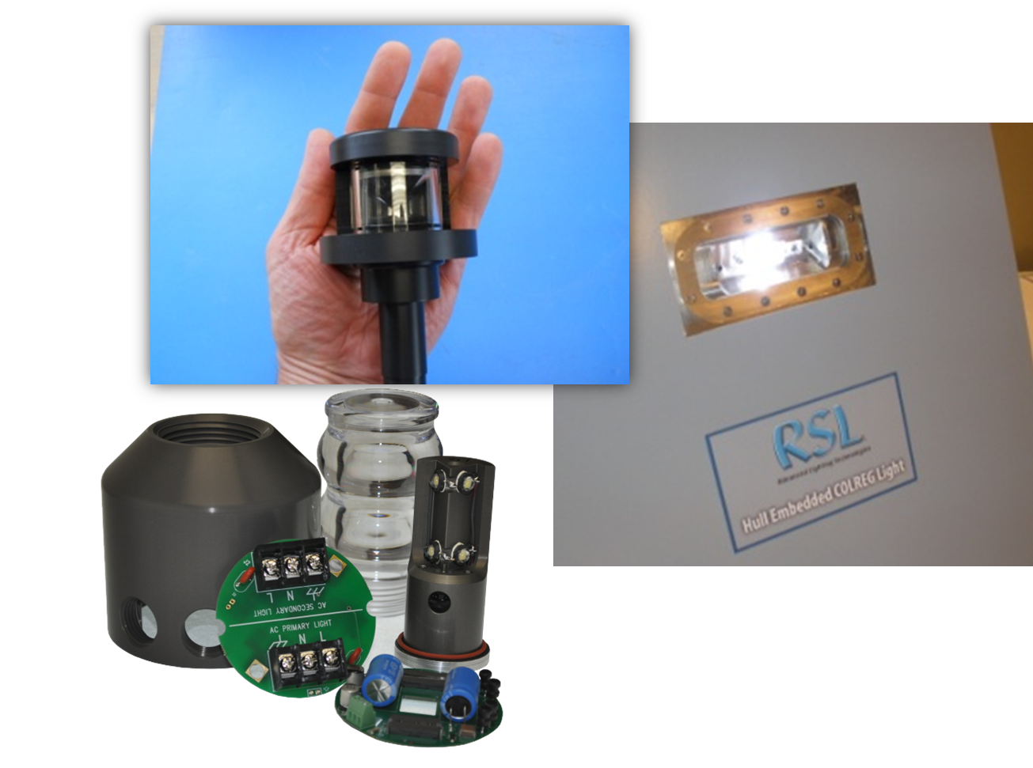
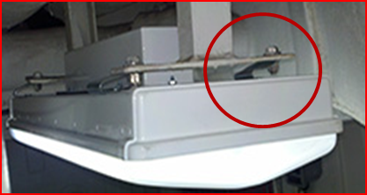
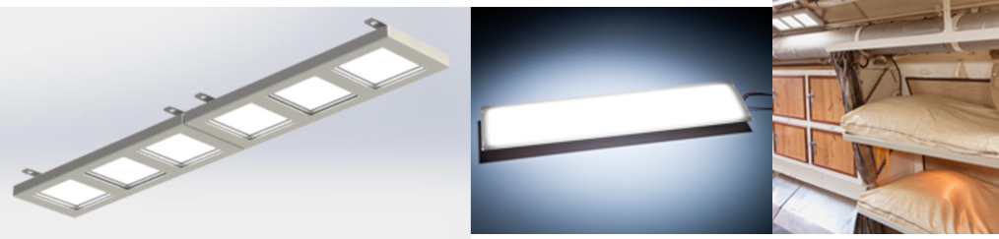
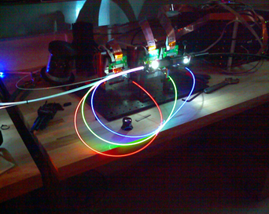
Lighting
Panel Projects
  Advanced Topside Lighting System
  Low Voltage Lighting Feasibility
  OLED, Low Voltage Shipyard Lighting

Slide 9
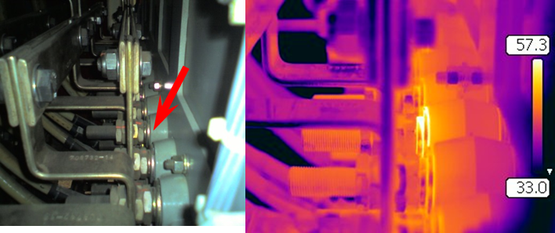
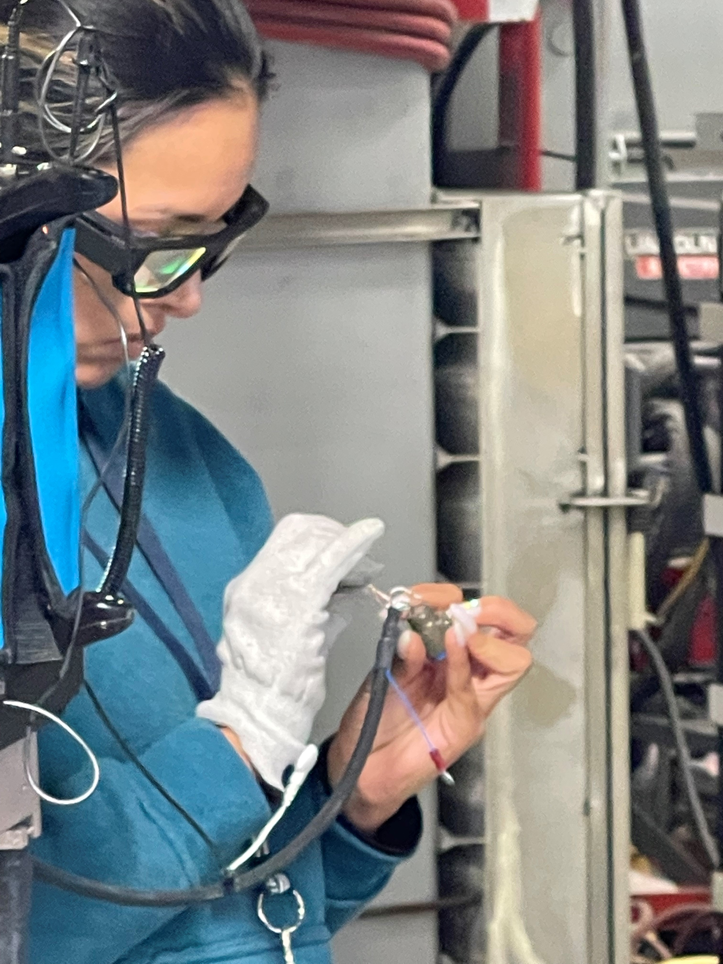
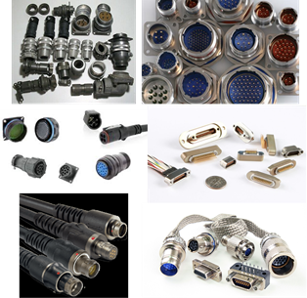
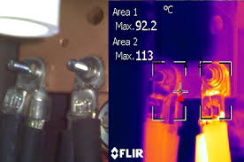
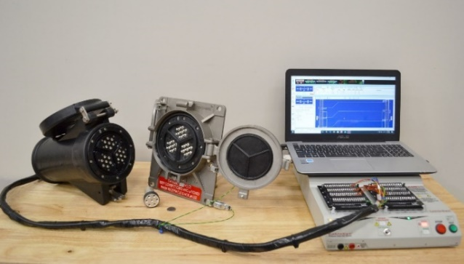
Electrical Connections
Panel Projects
  Improved Methods for Bonding & Grounding
  Materials & Components for Exterior Electrical Connections
  Safer Inspection of MV-HV Systems
  Electrical Connector Standardization
  Shore Power Connector Testing
  AMUET 4.0 (2022 RAP Project)
  DTS Integration Into Ship Electrical Plant Monitoring & Controls

Slide 10
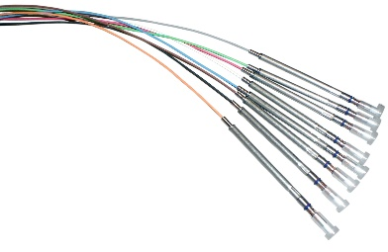

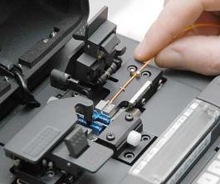
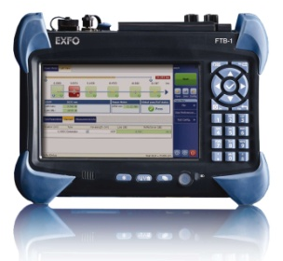
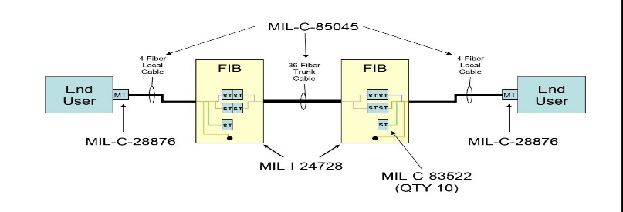
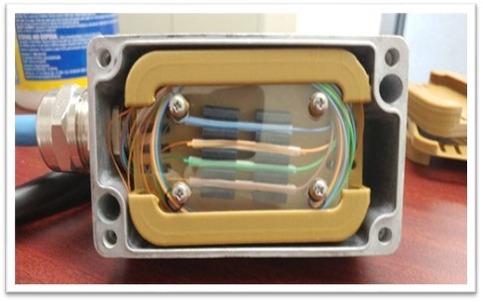
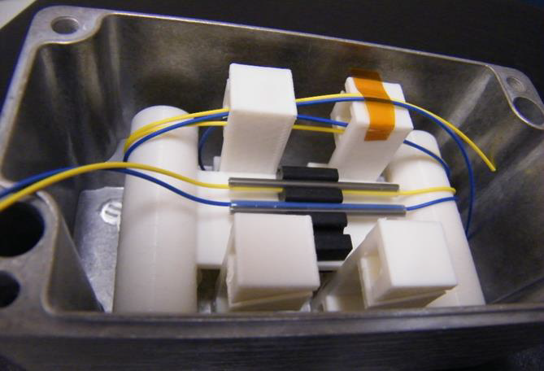
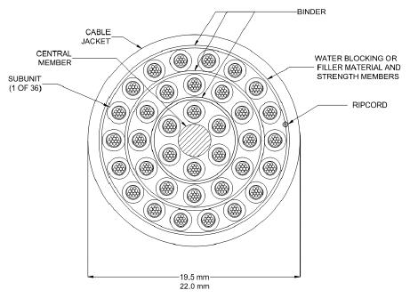
Fiber Optics
Panel Projects
  Alternatives to Fiber Optic Connectors
  Fiber Optic Testing Enhancement for Cost Reduction
  Fusion Splice Enclosure at Equipment
  Splice-On Fiber Optic Connectors and Termini
  High-Density Ribbon Fiber Optic Cable & Tooling

Slide 11
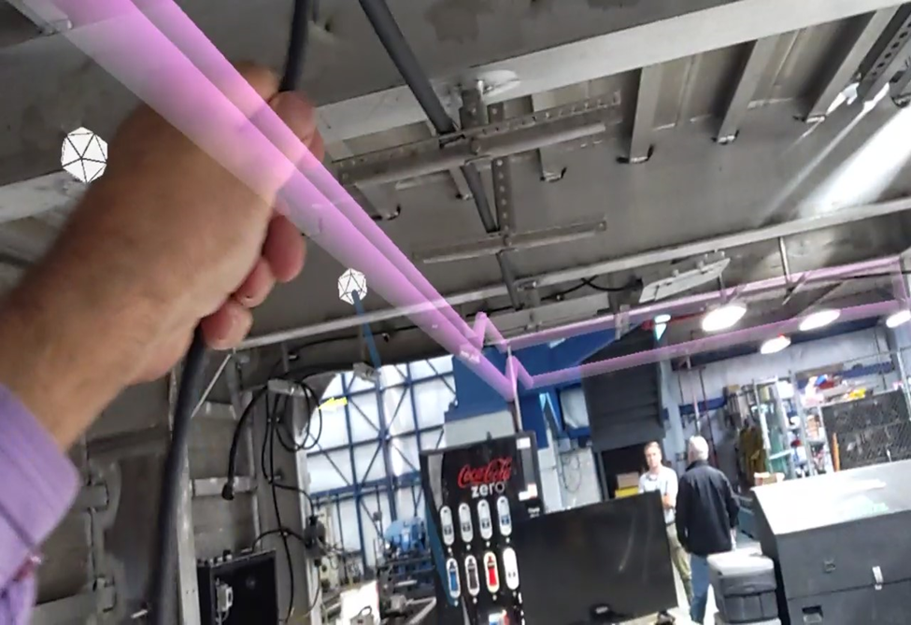
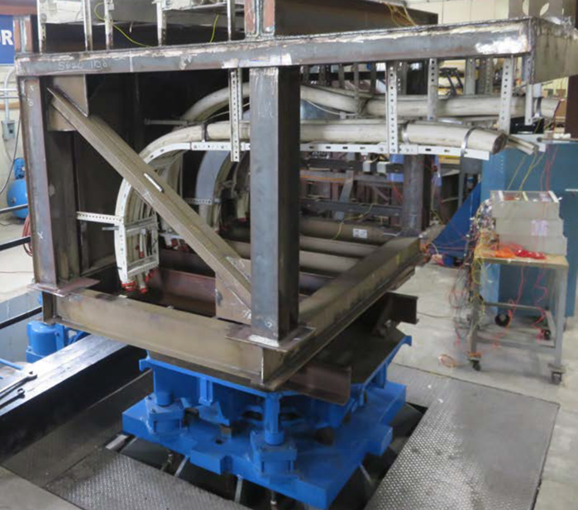
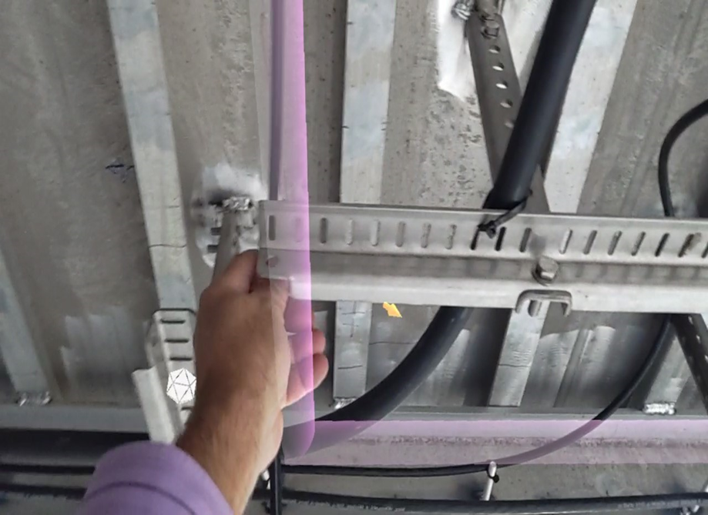
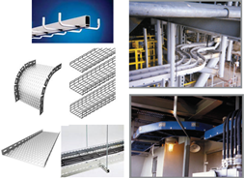
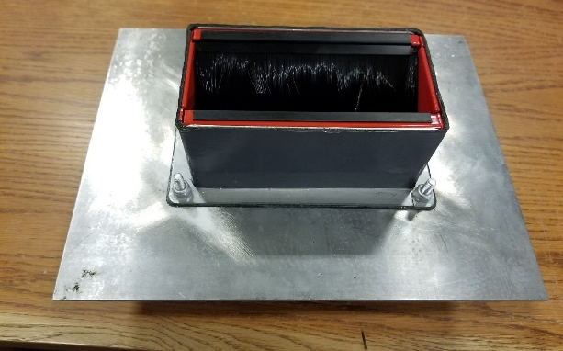
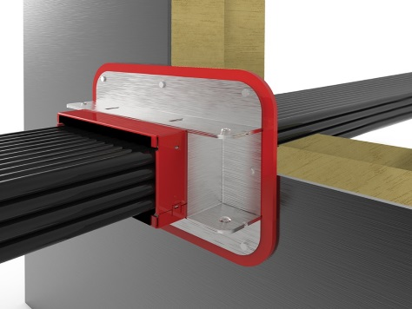
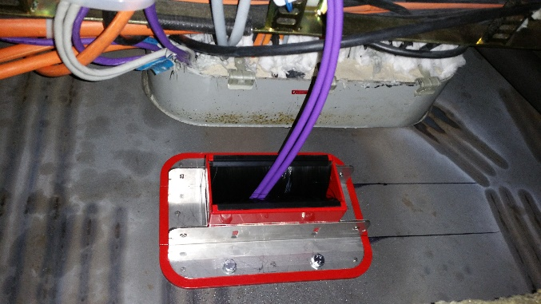
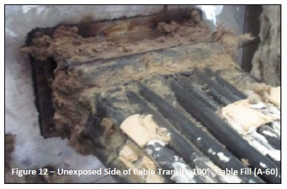
Cableways & Installation
Panel Projects
  Shipboard Cable Trays
  Shipboard Fiber Optic Cables Design Enhancements
  Evaluation of Efficacy of Self-Sealing Cable Transit Devices for Aluminum Bulkheads and Decks in Non-Watertight Boundaries
  AMUET 4.0 (2022 RAP Project)

