Slide 1
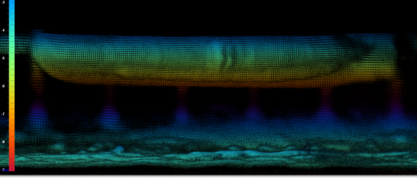
Research Announcement Project: Ship Hull Inspection
Technical PoC: Jack Ramsey
331-213-8963
Jackson.Ramsey@swri.org
robotics.swri.org
TRL Target 5-7
Description
Prior to dry docking, keel and side blocks must be placed and shaped to support the ship. For ships without documented hull shape or retrofits that alter the hull's shape, placing the blocks is a trial-and-error process that requires divers to adjust the bocks until they fit. This process is tedious and expensive. Existing robotic inspection methods can create digital twins of ship hulls but have difficulty correcting for ship movement and are not sufficiently accurate. Improving existing subsea 3D scanning methods will allow ship hulls to be accurately modeled and provide better information for docking block shape and position.
Enables
Rapid creation of 3D model of ship hull while ship is submerged
Identification of optimal locations for support blocks
Reduced duration of dry docking process
Faster, safer, and less expensive dry docking
Survey-class ROV by Deep Trekker
Example Ship Hull Model Provided by Coda Octopus
Technical Approach
Identify candidate robotic platforms (ROVs)
Implement candidate scanning sensors
Side-scanning sonar, operable in fixed-mount and articulated configurations
Inertial Measurement Unit (IMU), on ship and ROV
Stereo camera
Record scan data of representative ship hulls at partner shipyards
Reconstruct 3D model of hull using sensor data and candidate algorithms:
Fixed-mount sonar scan alignment via IMU localization estimate
Stereo camera-based photogrammetry reconstruction, with sonar visualization for coarse mapping
Stereo camera and articulated sonar-based simultaneous localization and mapping (SLAM) algorithm
Articulated sonar aggregation and point cloud SLAM
Modify and improve
Design keel and side block placement algorithm that operates on resultant 3D model
Key Outcomes
Identification of suitable robotic platforms and 3D scanning technologies
Evaluation of 3D map accuracy and determination of viability
Process software to determine optimal block placement
Prototype system, including all hardware and software, and documentation to enable rapid adoption of technology
Report on use cases expected performance, limitations, and estimated cost savings

