Slide 1
Introduction to Softing Inc.
Get Connected Stay Connected
March 2023

Slide 2
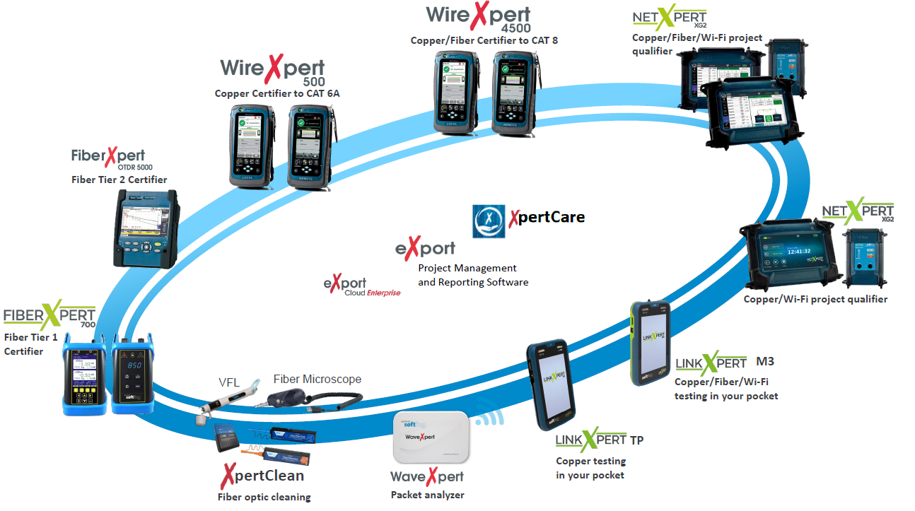

Slide 3
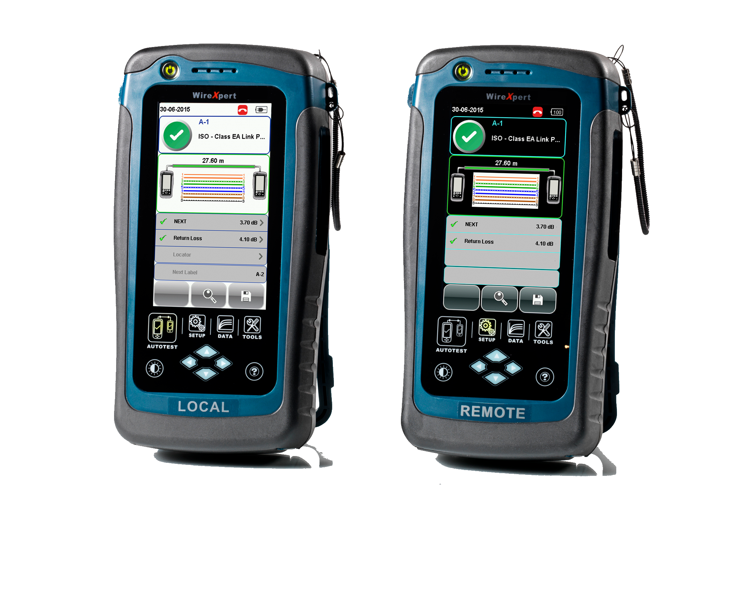
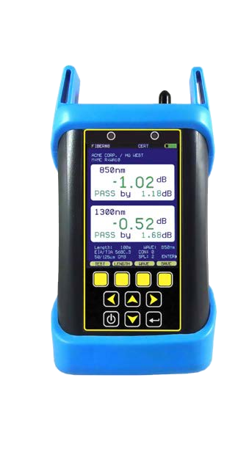
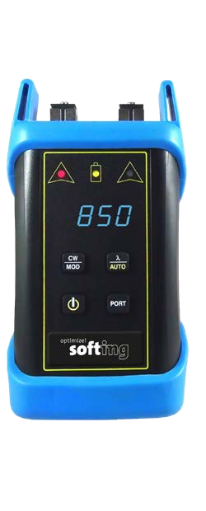
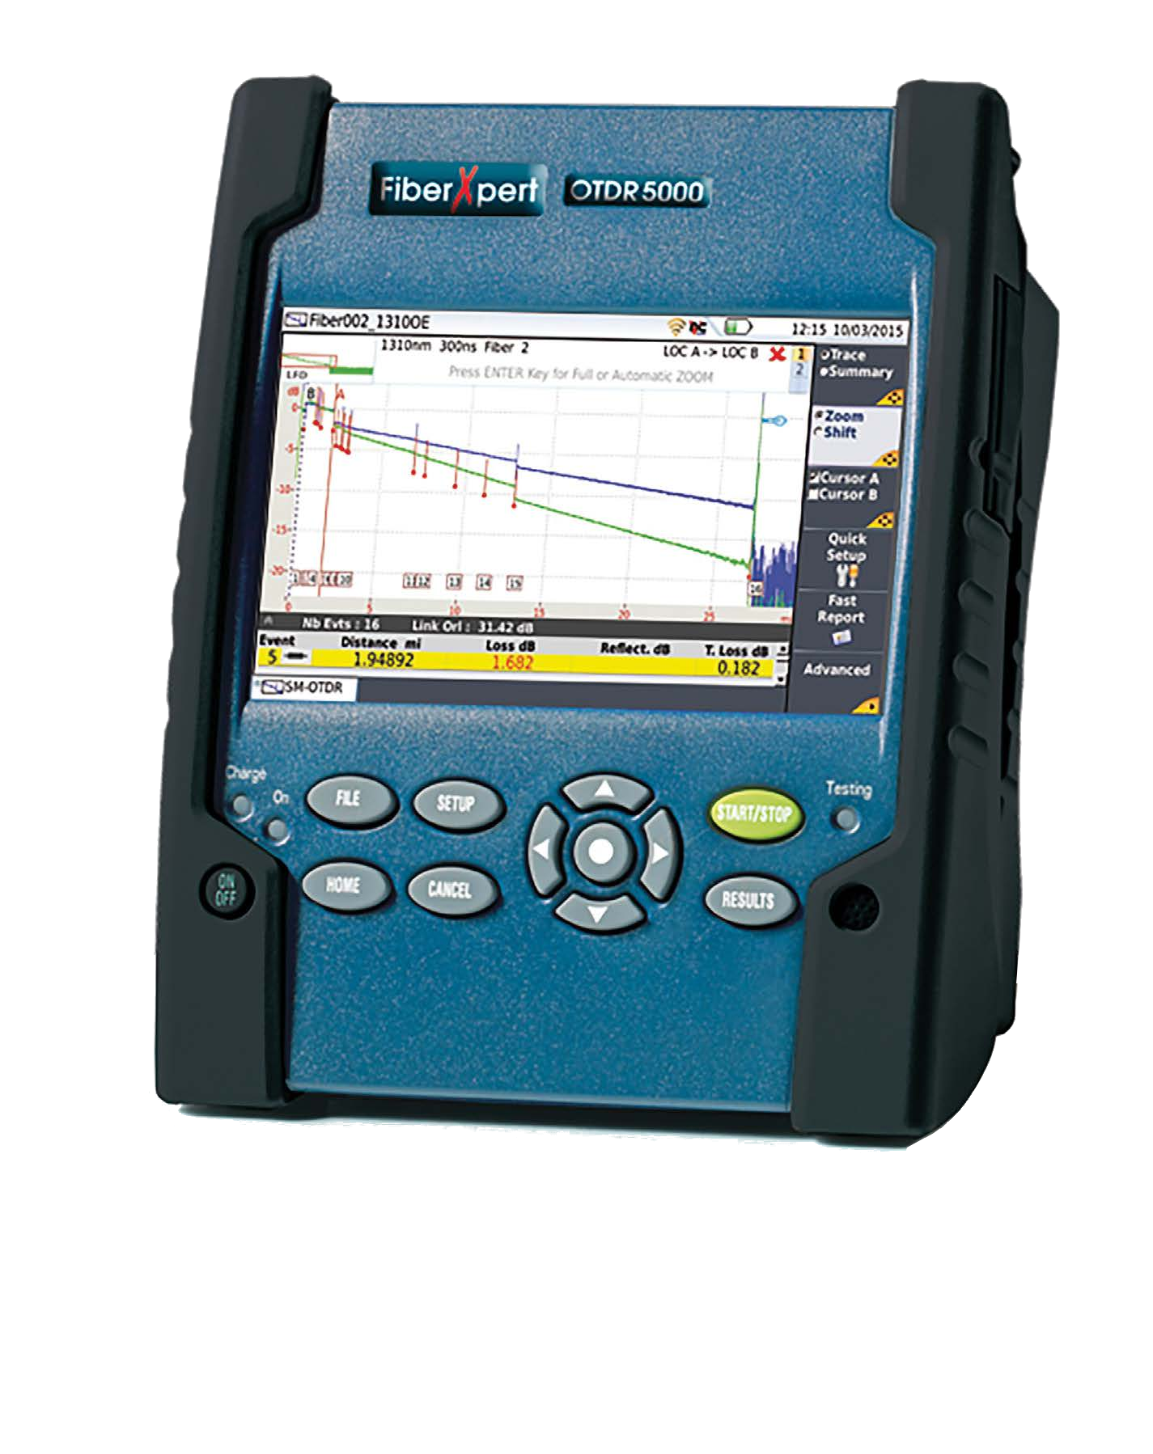
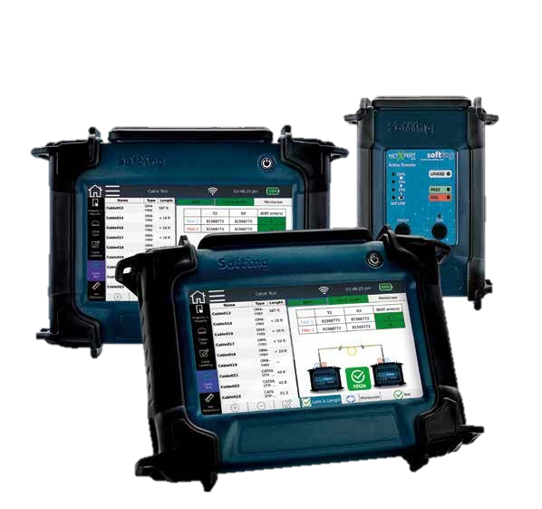
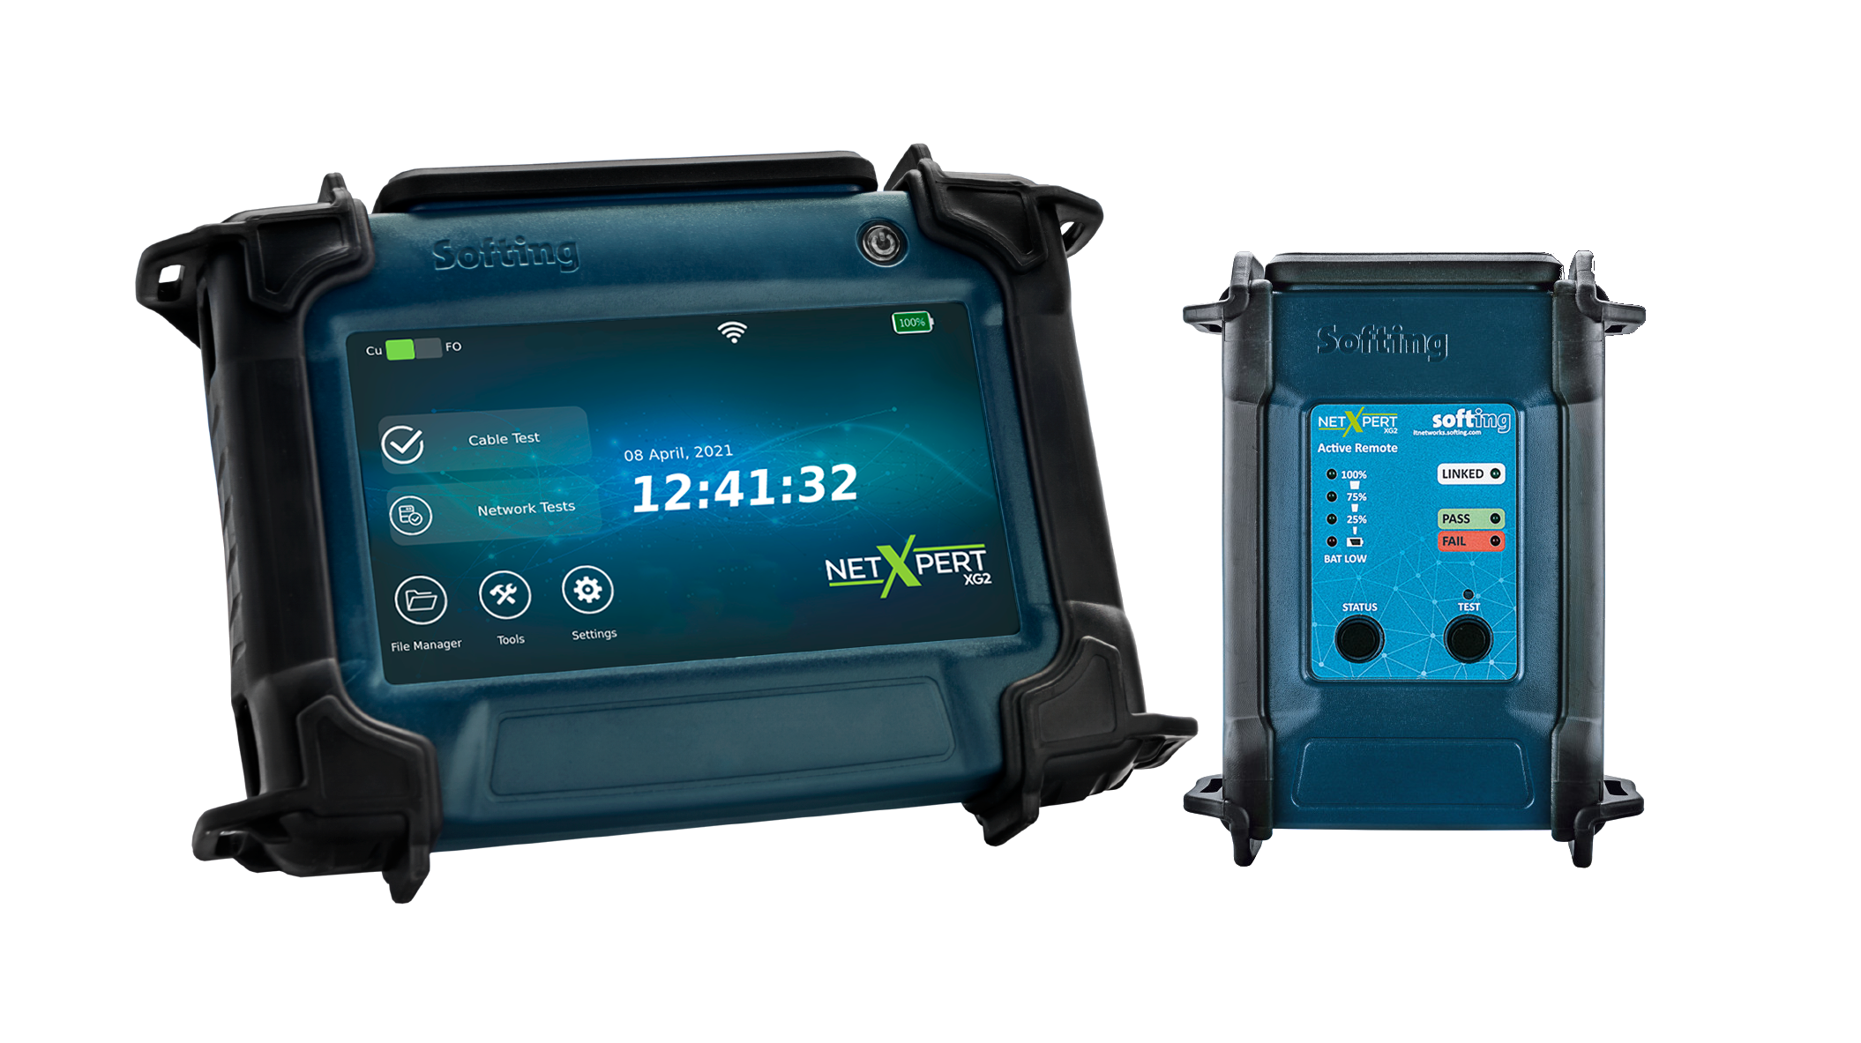
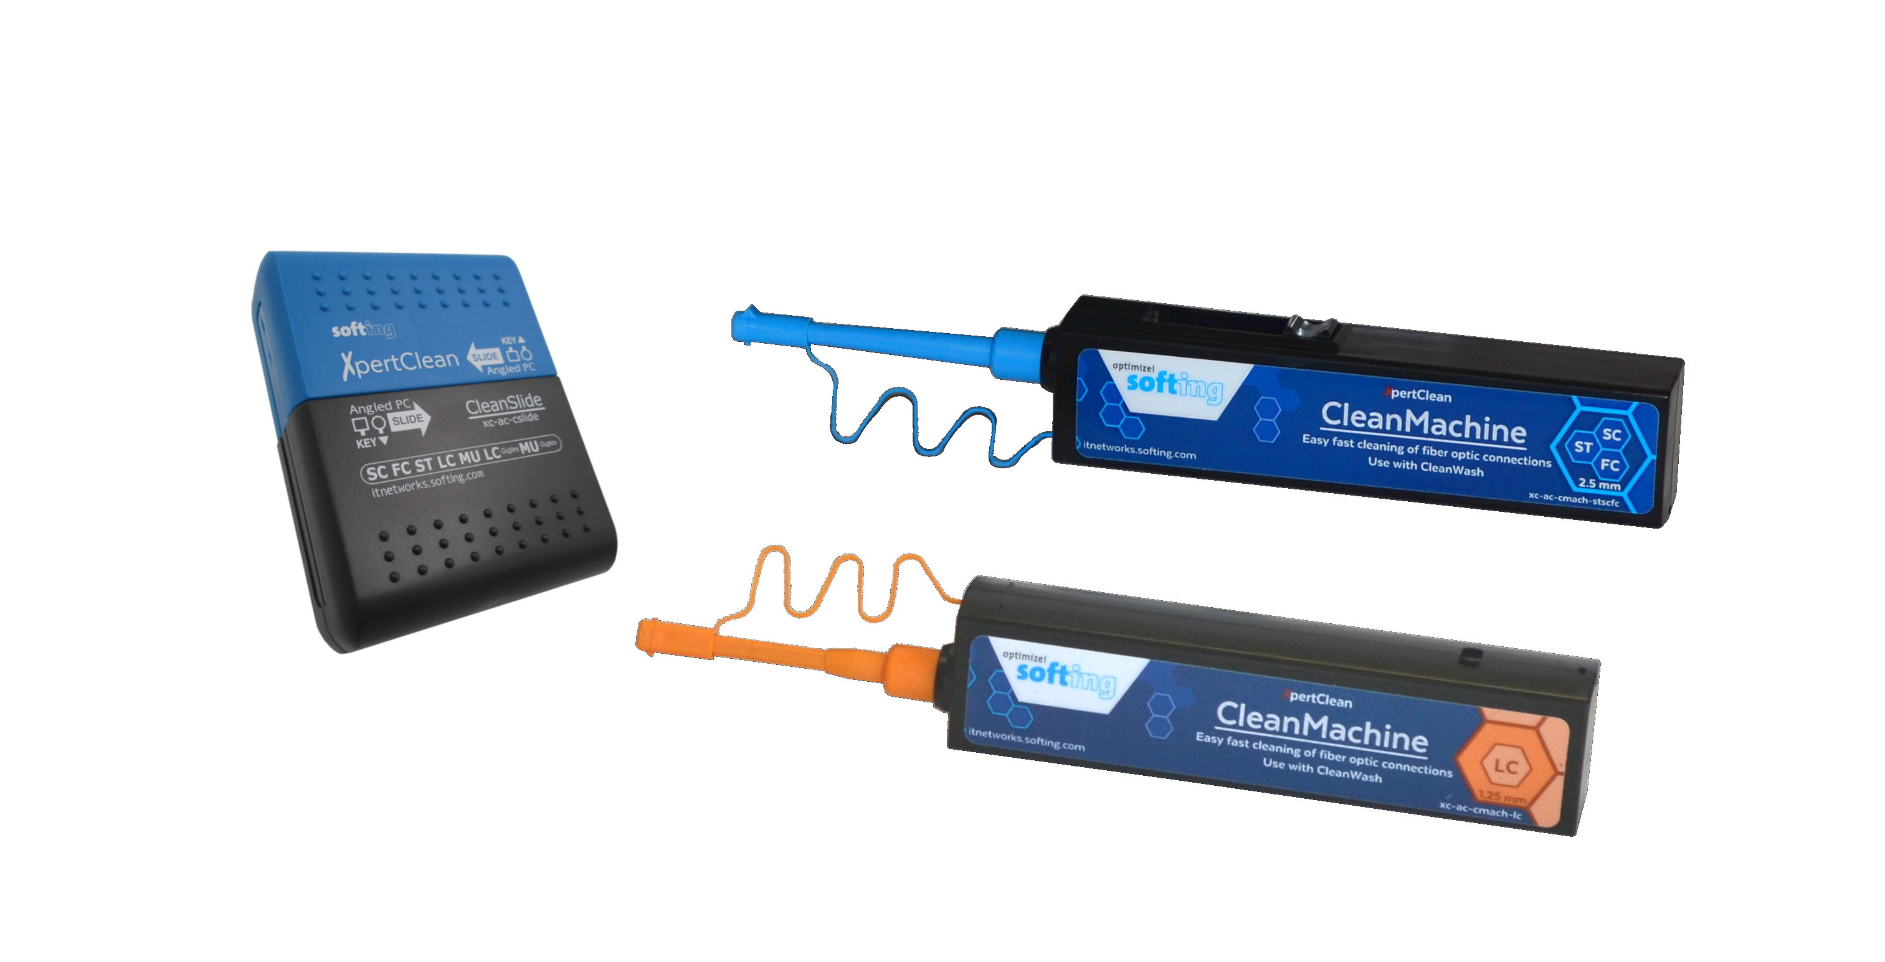
Copper and fiber certifier
Copper Certifier to CAT 6A
Copper/Fiber Certifier to CAT 8
Fiber Tier 1 Certifier
Fiber Tier 2 Certifier
Verification Qualification Certification
Wi-Fi
Packet analyzer
Copper/Wi-Fi project qualifier
Copper/Fiber/Wi-Fi project qualifier
Fiber Microscope, Cleaning kits
TP
M3
Copper testing in your pocket
Copper/Fiber/Wi-Fi testing in your pocket
Accessories

Slide 4
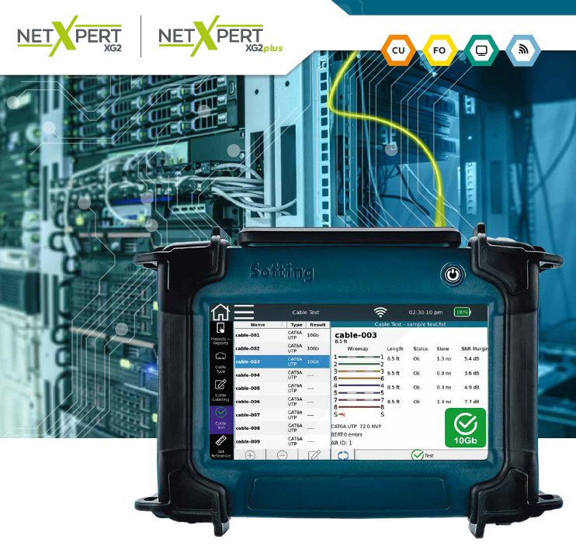
Qualification Tests
IP Discovery
Ping Testing
Tone Generator
POE Tests
CDP and LLDP
Trace Route
Wifi troubleshooting

Slide 5
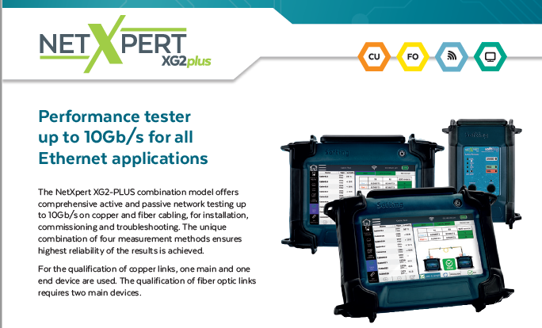

Slide 6
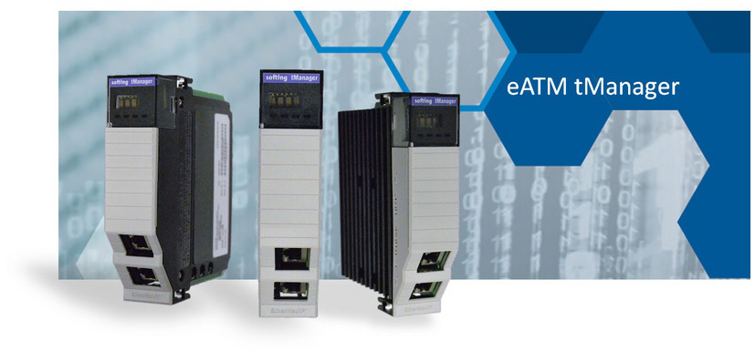

Slide 7
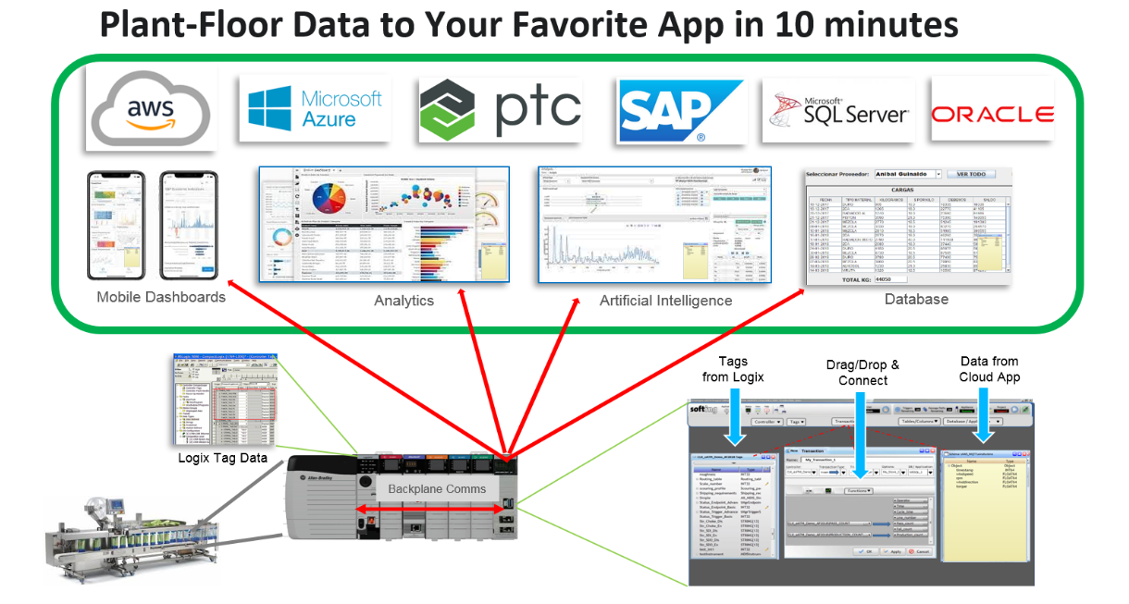

Slide 8
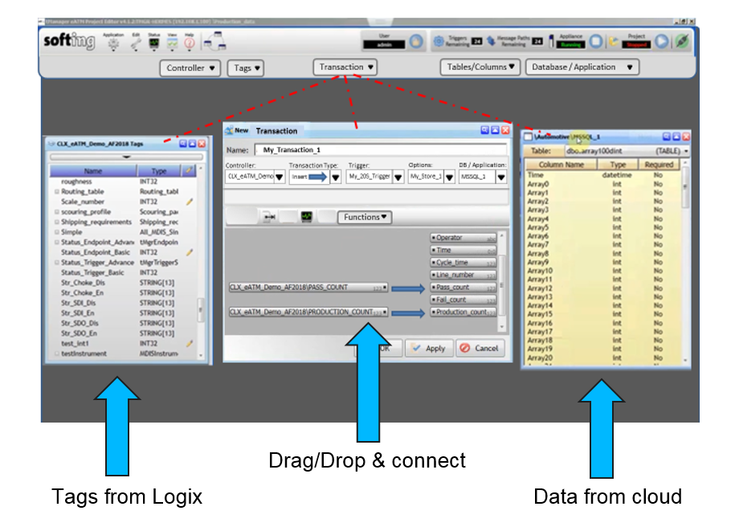

Slide 9
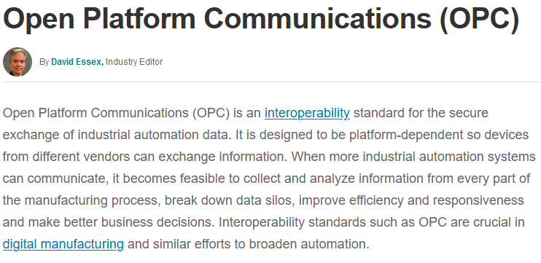
dataFEED OPC Suite The “all in one” Data Integration Solution
Notes:
Put in referring
Product name + version
Product picture
In contrast to the Customer Product Presentation, the Sales Enabling Presentation shall not be limited to a specific quantity of slides.
Actually the objective to enable our Sales Force (including) Distribution Partners at best level and comprehensively defines the number of slides required to reach this objective.
---------------------------------------------------------------------------------------------------

Slide 10
The “All-in-one” Data Integration Solution
OPC Classic
OPC Classic Client
Controller / PLC
PLC Protocol
OPC Tunnel Client
OPC Tunnel
OPC Classic Server
OPC Classic
dataFEED OPC Suite
OPC UA
OPC UA Client
OPC Tunnel Server
OPC Tunnel
MQTT
MQTT Broker
Data Source (DS)
Data Destination (DD)
OPC UA Server
OPC UA
Preprocessing Engine
MindSphere API
MindSphere
MQTT Publisher
MQTT
Exchange
REST
REST Server
MQTT Broker
MQTT
Database API
NoSQL Database
StoreAnd-
Forward
ODBC
SQL Database
SQL Database
ODBC
Local Items
File Access
Data File
Flexible
Easy-to-use
Multi-standard

Slide 11
How to sell dataFEED OPC Suite
Customers – Solutions Groups
Key Customers (Historical Softing/INAT) typically OPC Server or Easy Connect (OPC Tunnel) Customers
Machine Builder
Automation System Integrators/ Application Manufacturer
End Customers
Newer Customers
IT System Integrators / Application Manufacture
End Customers
Small Customers
Mainly End Customers
System Integrators

Slide 17
Industrial Ethernet switches that are pre-programmed from the factory. No IT skills needed.

Slide 18
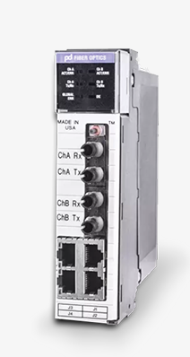
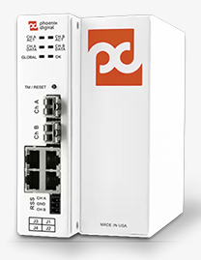
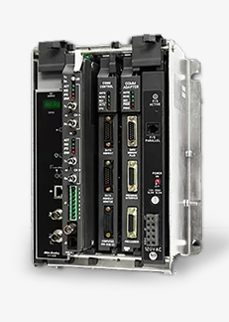
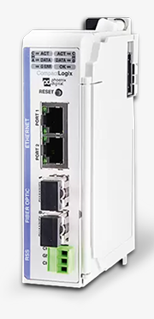
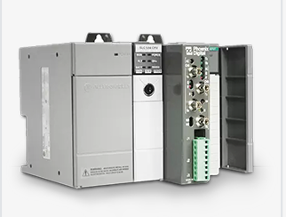

Slide 19
Questions?
Want to set up an online demo?
Joel Austin
602-909-6315
Joel.austin@softing.us

