Slide 1
Alternate Blocking Materials
NSRP Panel Project PP 23-018
Final Presentation
12 March 2024

Slide 2
Rights & Technology Transfer
Category B Funding:
Data developed partially with funding from project participants that was not charged to a government contract, and partially with government funding.
Distribution:
Distribution unlimited.
2

Slide 3
Outline
DM Consulting Introduction
Introduction to Drydocking
Traditional Methods of Block Construction
Proposed New Materials
Other Research and Examples
Cost Comparison
Implementation
Conclusion

Slide 4
DM Consulting – Dry Dock Experts
Established 2000
Certified Dock Masters
Training
Consulting
Dry Dock Acquisitions
Dry Dock Modernization
Block Contact Indicator System
Dock Master Software Development
Underwater 3D Scanning
Syncrolift Shiplifts and Fast Docking System
IDAC West Floating Dry Dock Control System

Slide 5
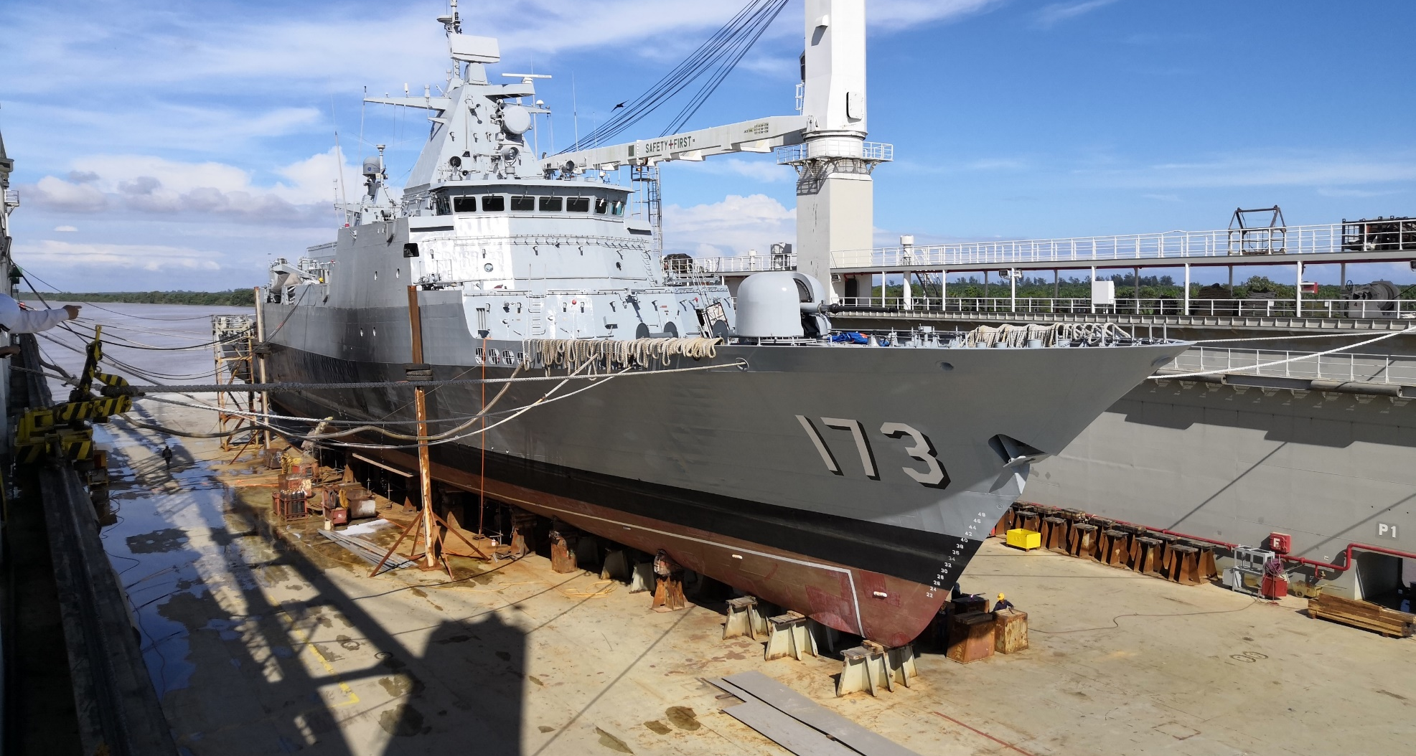
Drydocking
5

Slide 6
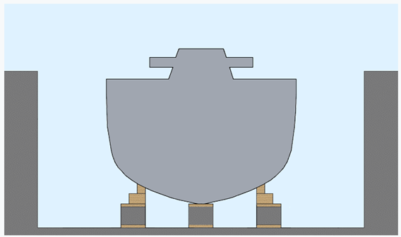
Drydocking
Keel Blocks
Support most of a ship’s weight
6

Slide 7
Drydocking
Side Blocks
Keep vessel upright

Slide 8
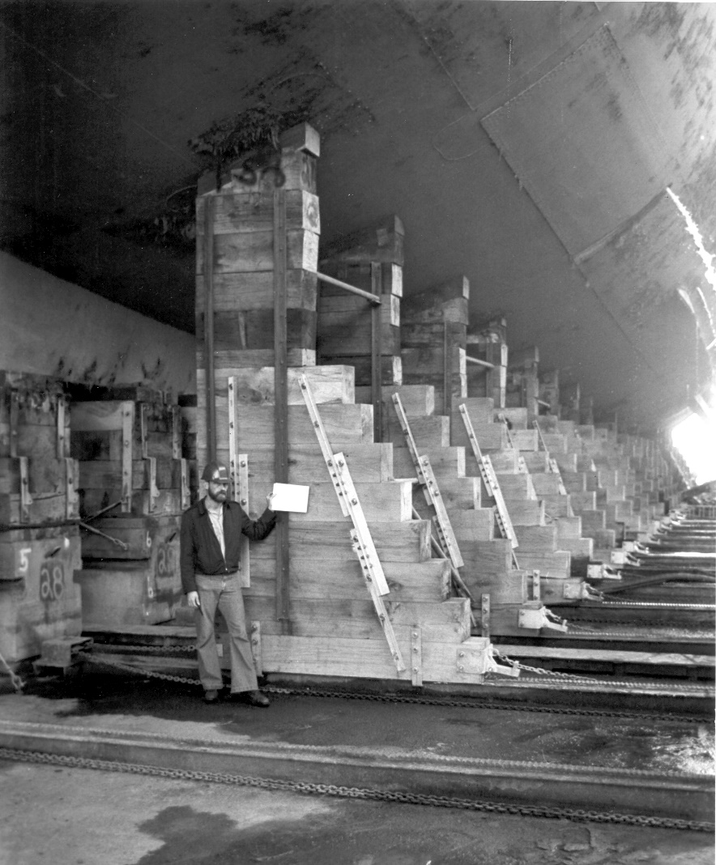
Drydocking
8
8

Slide 9
Example of Wood Used (DDG)
7.5 ft block height (shaft removal)
5.5 ft base block + 2 ft of soft wood
80 Blocks total (KB + SBs)
Max SB height = 5 ft
~2600 ft³
Softwood lifespan = 2 years
Rubber lifespan = 10 years
9
9

Slide 10
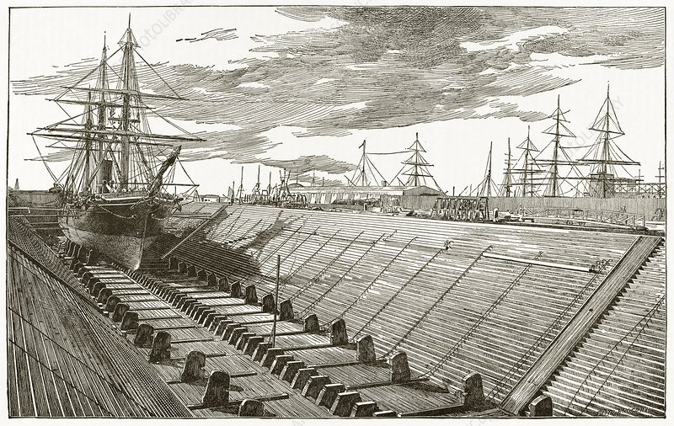
Block Construction History
10
10

Slide 11
New Materials
High Density Polyethylene (HDPE)
Goal is to replace soft wood caps
Neoprene Pads
Goal is to replace soft wood caps
Fiber Reinforced Concrete Blocks
Goal is to replace traditional steel reinforced concrete blocks

Slide 12
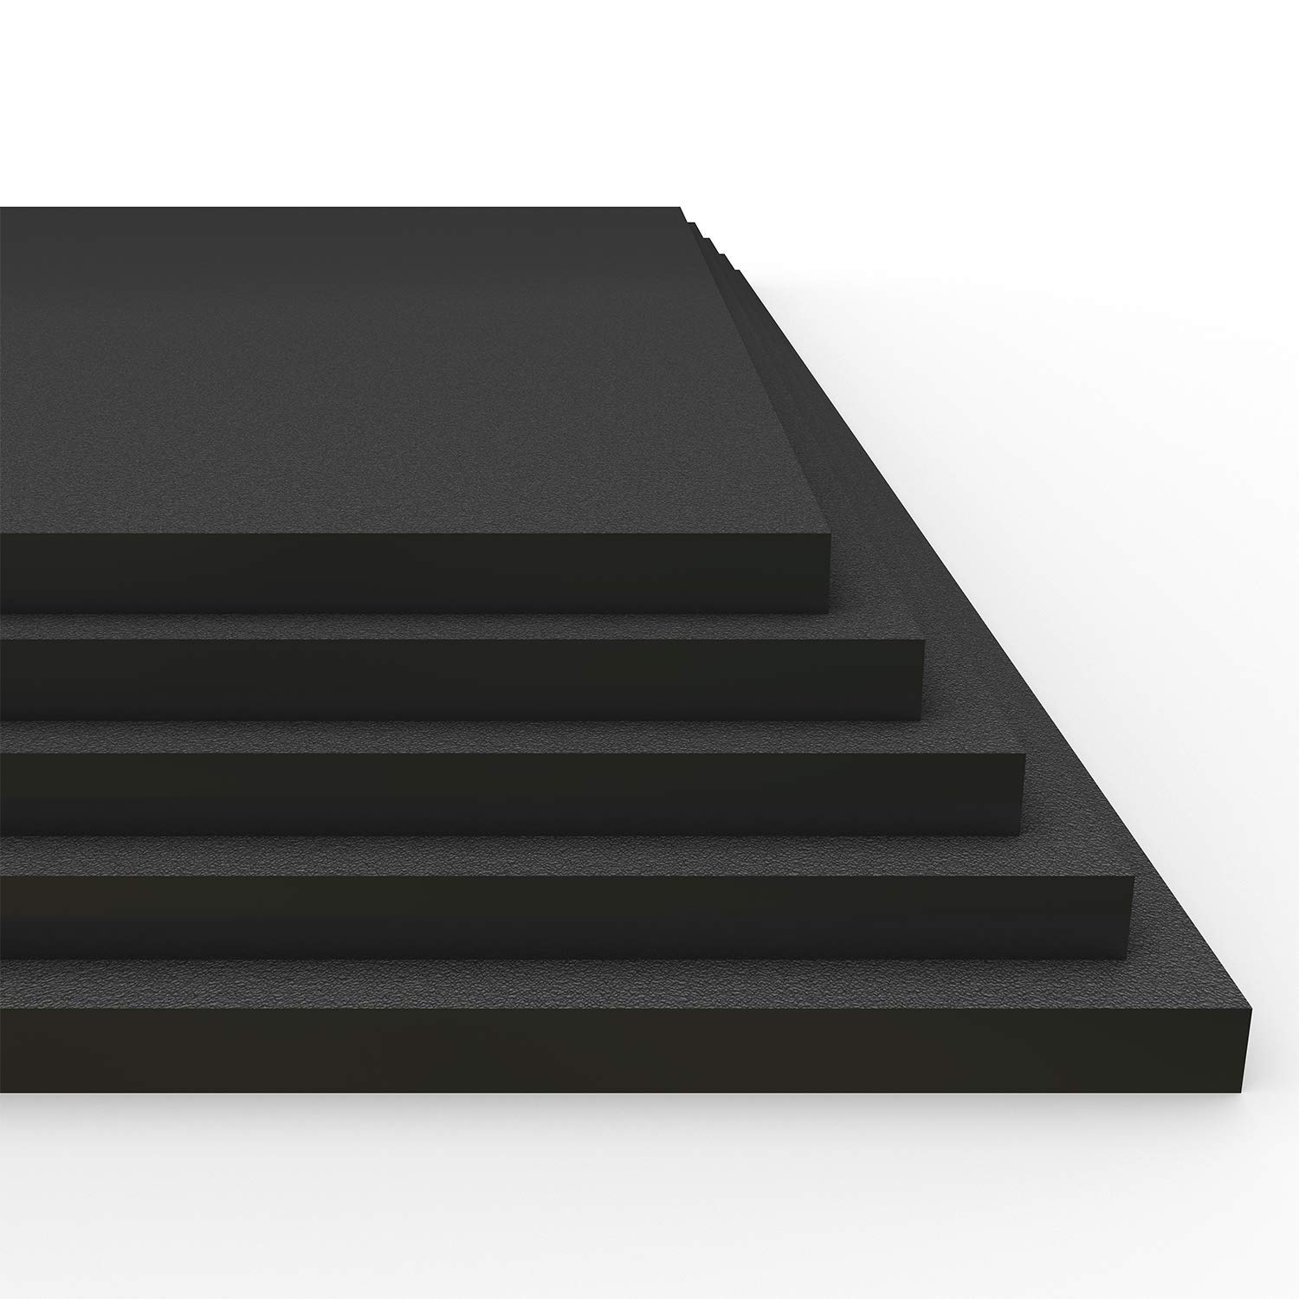
HDPE
Similar to wood in strength, construction, & density
Completely waterproof & UV Stabilized
Will not rot
Can be easily repaired without having to be replaced.
Can be constructed from recycled plastic and can be recycled at end of useful life.
12

Slide 13
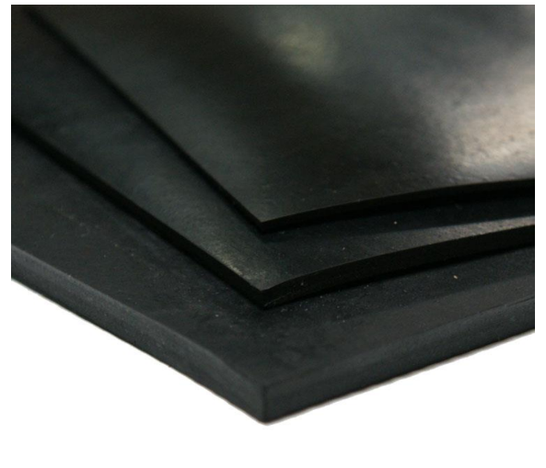
Neoprene Pads
Readily available world wide
Will provide better flexibility than wood
Will not rot
When bonded with steel plates top and bottom, should have an expected service life of 20 years.
13

Slide 14
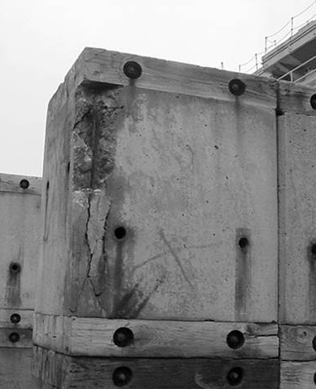
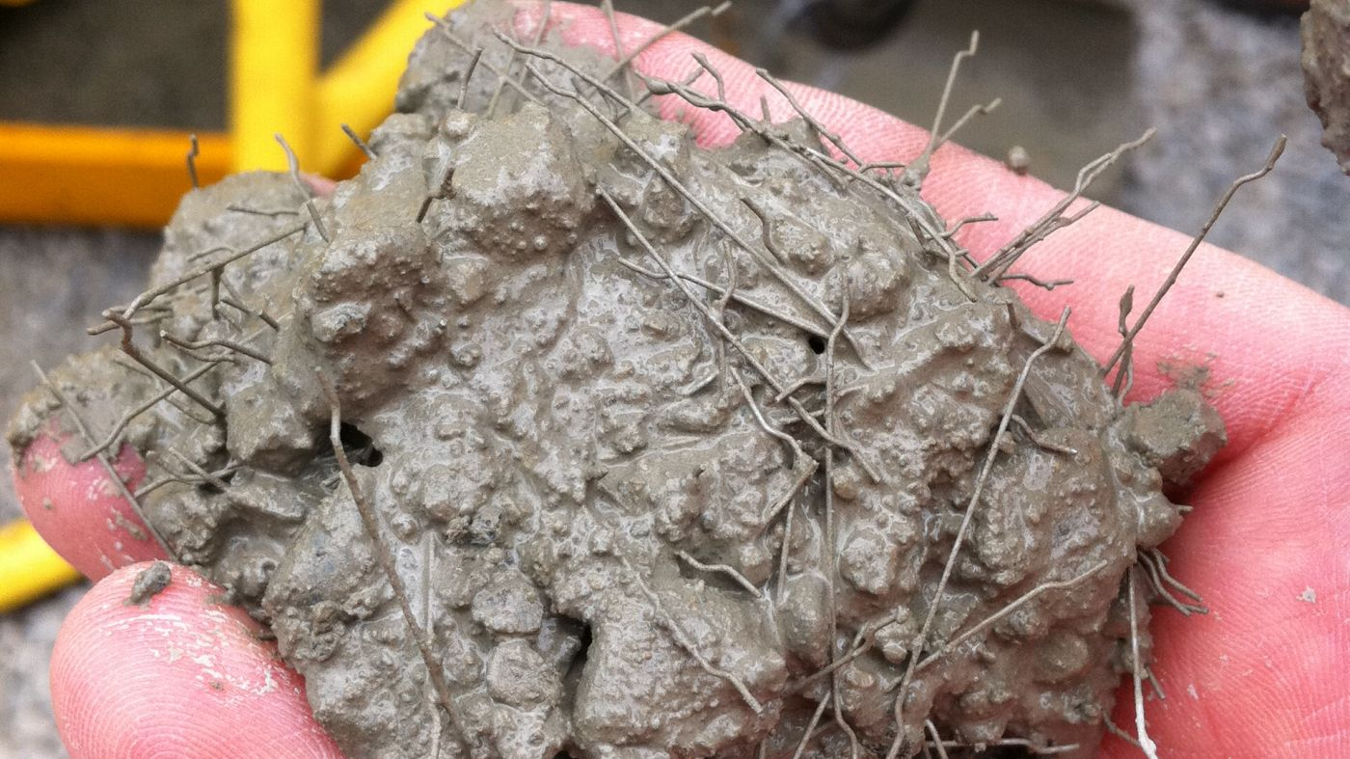
Fiber Reinforced Concrete Blocks
Quicker to produce blocks
Blocks tend to spall less, lengthening service life
Same or better strength for same value
Typical Concrete block spalling due to steel reinforcement
Fiber concrete mix
14

Slide 15
Benefits
All materials are expected to have a longer service life (expected approx. 5 times soft wood)
All materials can be recycled at the end of their service life
All materials are expected to have similar or better mechanical properties than current technology
The proposed materials are new to our industry, but they are not new materials
15

Slide 16
Other Research Projects
Docking Block Revolution Presentation
By the Docking Office at JRMC Yokosuka, JP
Idea was use it for curved blocks without cutting to shape
Undefined material make up
Undefined block flexibility effects on other aspects of analysis

Slide 17
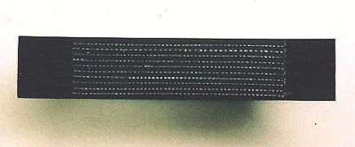
Other Research Projects
Fiber-Reinforced Rubber Blocks Presentation
By Shibata - a fender manufacturer
Conforms to hull, fiber adds rigidity
Undefined material make up
Undefined block flexibility effects on other aspects of analysis
Fiber-reinforced rubber block section

Slide 18
Other Research Projects
Engineering and Economic Feasibility of Using Rubber Soft Caps For Drydocking of Naval Vessels
By LCDR Vincent C. Watson, FL
Engineering behind use for curved blocks without cutting to shape
Undefined material make up
Undefined block flexibility effects on other aspects of analysis

Slide 19
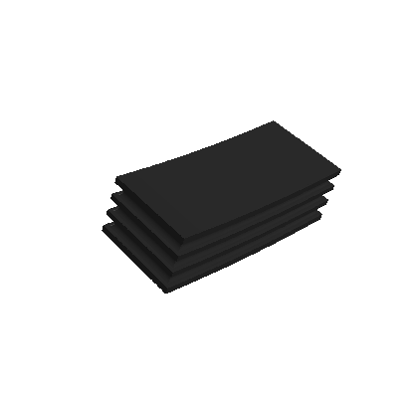
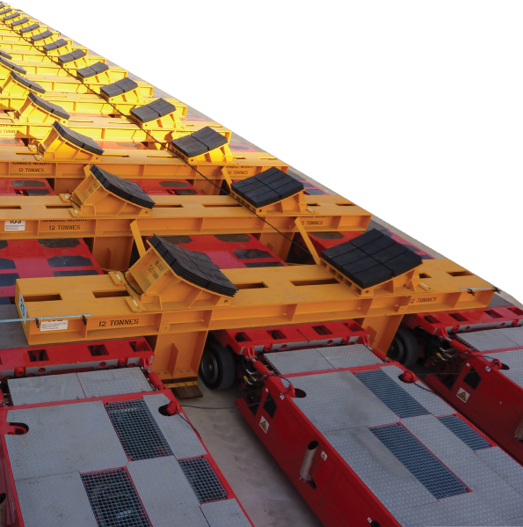
Other Known Use Cases
Based in Australia
No longer in business under this name.

Slide 20
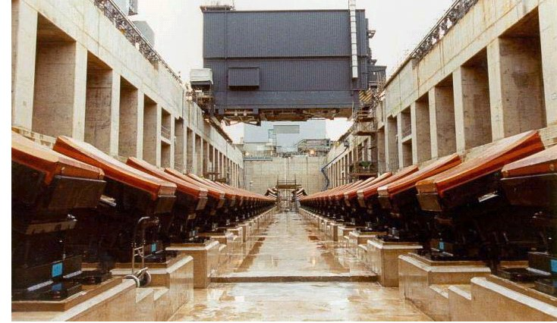
Other Known Use Cases
UK Navy
Submarine Facility

Slide 21
Other Known Use Cases

Slide 22
Cost Comparisons
Example Case of Using HDPE or Neoprene instead of soft wood for the soft cap
60 Concrete blocks, topped with hard wood and a soft wood cap
Block length = 3.5’
Block Width = 4’
Soft Cap = 2”
Soft Cap Vol = 210 cu ft
Assume 6 dockings per year
Assume 1 hour for a crew of 3 at $40 / hour labor
22
22

Slide 23
Cost Comparisons
Description | Wood 2x4x8 Yellow Pine | HDPE 54x48x1/2 Marine Grade | Neoprene Pads
Volume per Piece (cu ft) | 1.5” x 7.5” x 8’ = 0.292 cu ft | 54” x 48” x ½” = 0.75 cu ft | 1 per block
Quantity | 720 | 280 | 60
Unit Cost | $3.35 | $256 | $2,538
Extended Cost (Initial Cost) | $2,412 | $71,680 | $152,280
Labor Cost | $7,200 | $7,200 | $7,200
Install Cost | $9,612 | $78,880 | $159,480
% Replacement per Docking | 100% | 5% | 2%
Annual Maintenance Cost | $57,672 | $23,664 | $19,138
10 Year Cost | $586,332 | $315,520 | $350,856
23
23

Slide 24
Cost Comparison
Fiber Reinforced blocks will cost approximately the same as traditional blocks.
Expected life span 33% more than traditional reinforced blocks (15 yrs vs. 20 yrs)
24
24

Slide 25
Implementation
Gulf Copper Shipyards, Port Arthur and Galveston, TX
Testing HDPE & neoprene caps
Tug
Offshore Work Vessel
USACE Vessel
Mare Island Dry Dock, Vallejo, CA
Testing fiber reinforce concrete blocks
Coast Guard Vessel
25
25

Slide 26
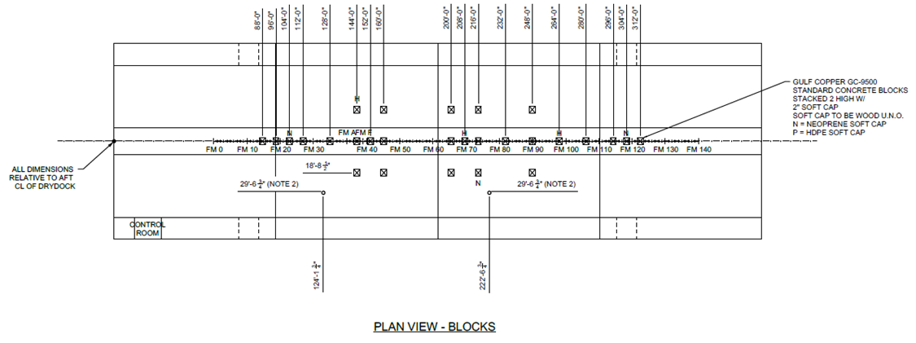
Material Testing
HDPE/Neoprene – Offshore Work Vessel

Slide 27
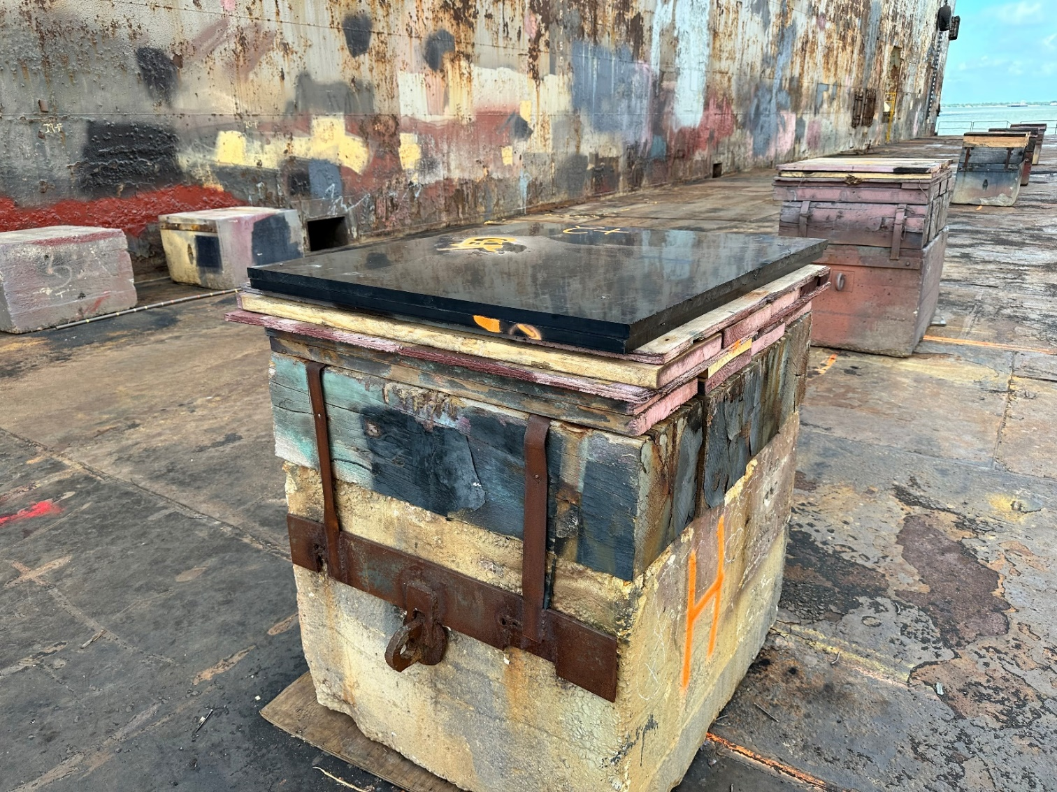
Material Testing
HDPE/Neoprene – HDPE Block
Notes:
HDPE

Slide 28
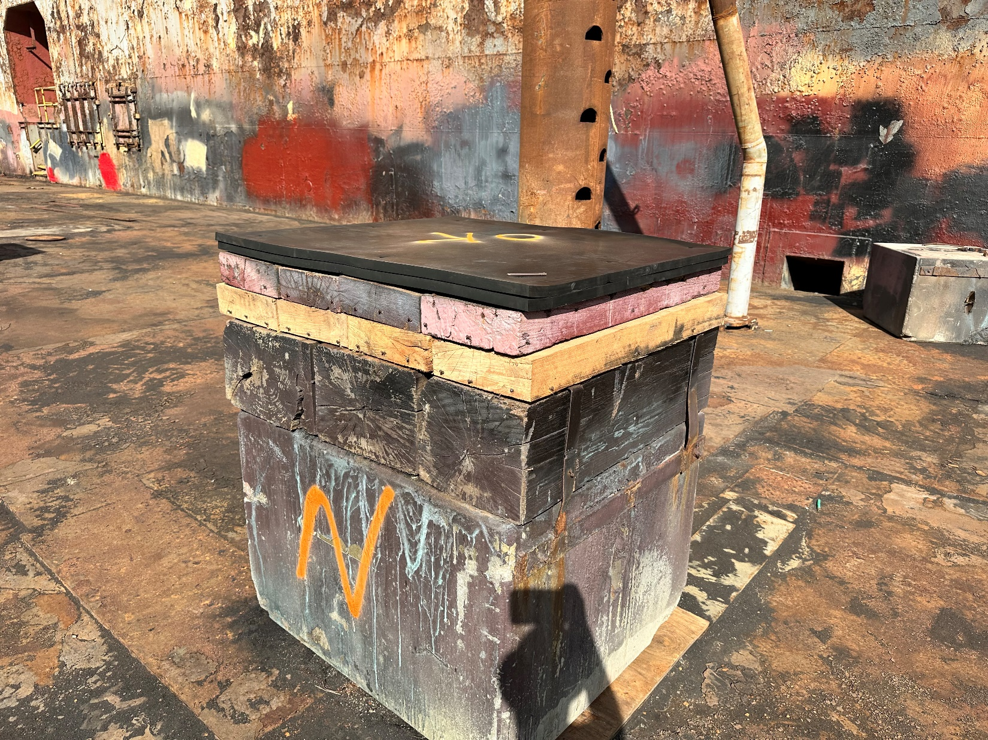
Material Testing
HDPE/Neoprene – Neoprene Block
Notes:
Neoprene

Slide 29
Material Testing
HDPE/Neoprene – Strength Testing
HDPE Material Testing Results
Nominal Material Thickness | Yield Strength (Control) | Yield Strength (Post Dockings)
1/2 inch | 870 psi | 1,100 psi
3/4 inch | 780 psi | 1,080 psi
1 inch | 960 psi | 1,120 psi
29

Slide 30
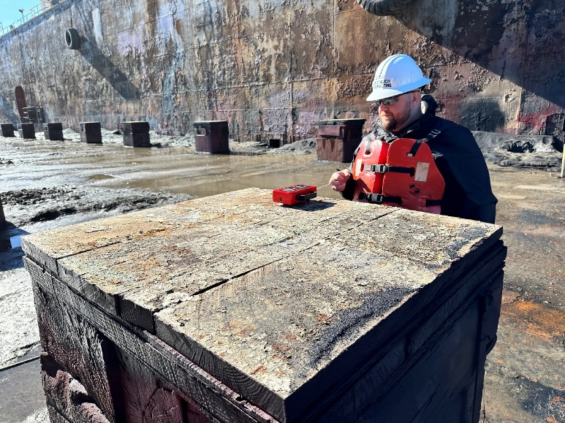
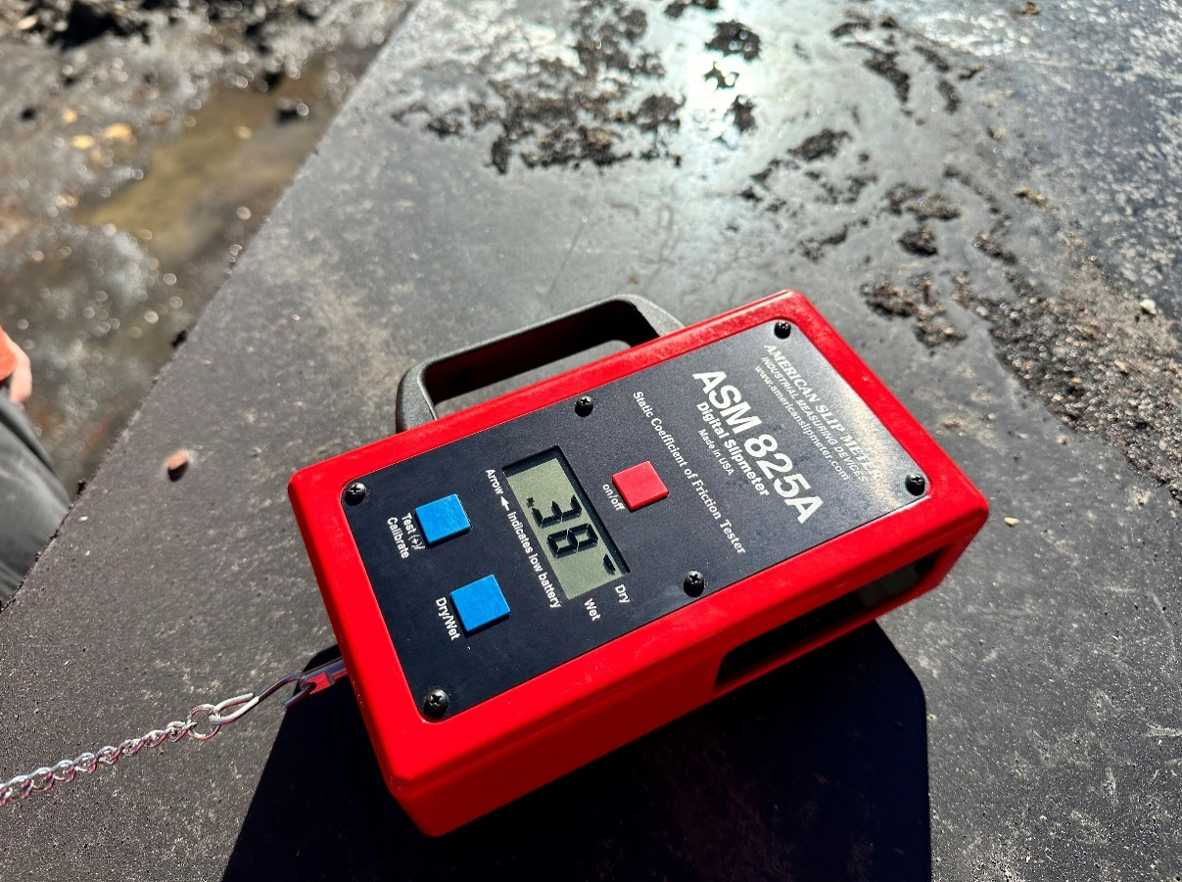
Material Testing
HDPE/Neoprene – Friction Testing
30

Slide 31
Material Testing
HDPE/Neoprene – Friction Testing Results
Friction testing of HDPE yielded 50% friction coefficient of wood in some test conditions.
HDPE manufacturer stated a friction coefficient of 0.2 for both a greased and ungreased surfaces.
Neoprene friction testing yielded similar results to wood.
31

Slide 32
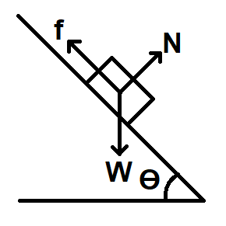
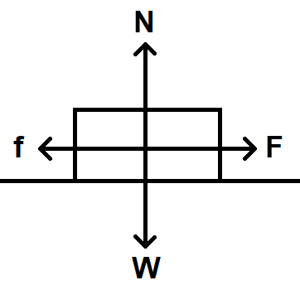
Material Testing
HDPE/Neoprene – Friction Engineering Analysis
Results
µ | ϴ [deg]
0.05 | 2.9
0.10 | 5.7
0.15 | 8.5
0.20 | 11.3
0.25 | 14.0
0.30 | 16.7
Seismic Overturning Force
Reference: US Standard Drydocking Calculations from NSTM 997
EAF = 0.2
µ = 0.2
32

Slide 33
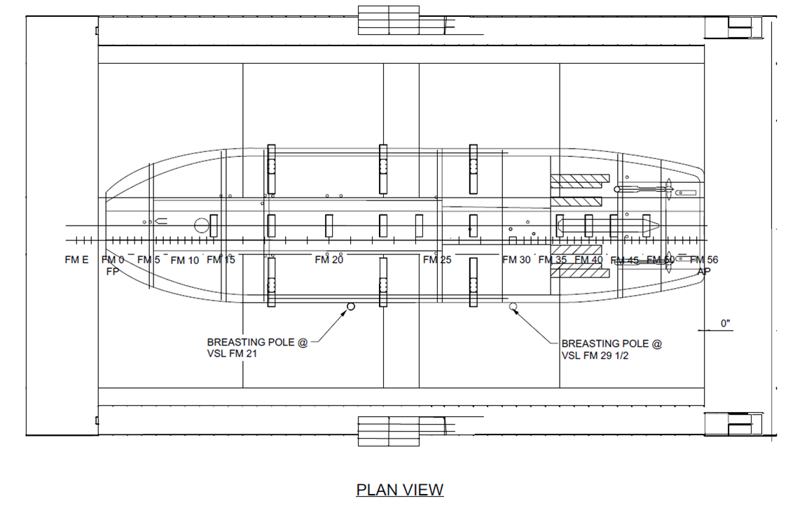
Material Testing
HDPE/Neoprene – USACE Vessel Blocking Plan

Slide 34
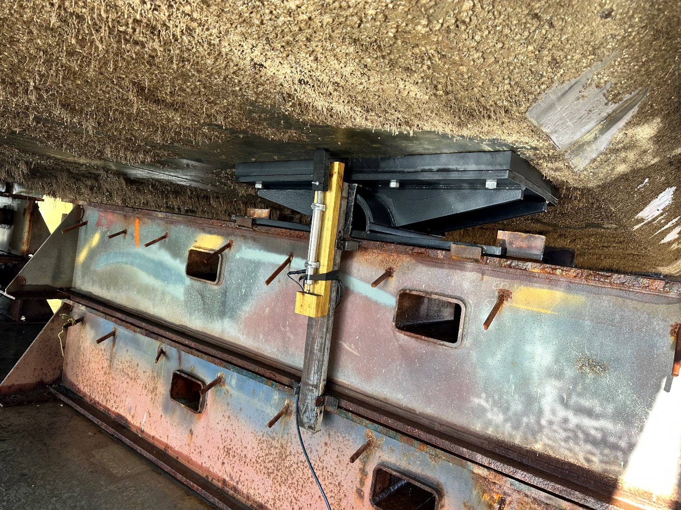
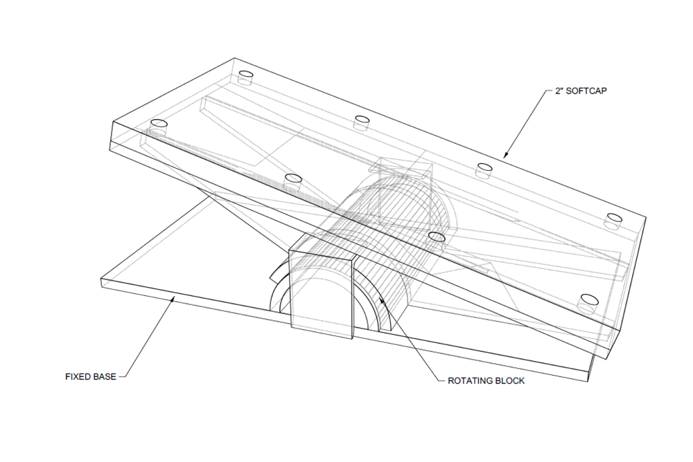
Material Testing
HDPE – Example use
HDPE used with Rotating Side Block
Block Contact Indicator System seen here
Notes:
Neoprene

Slide 35
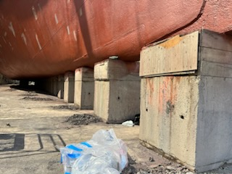
Material Testing
Fiber Reinforced Concrete Blocks – Example use
Fiber block under a
US Coast Guard Vessel
35

Slide 36
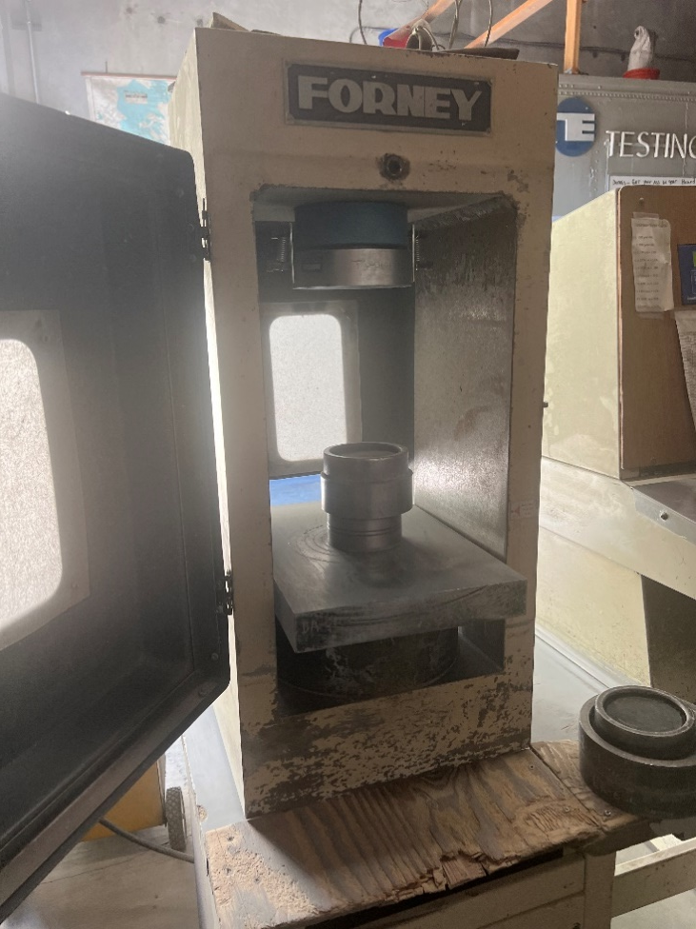
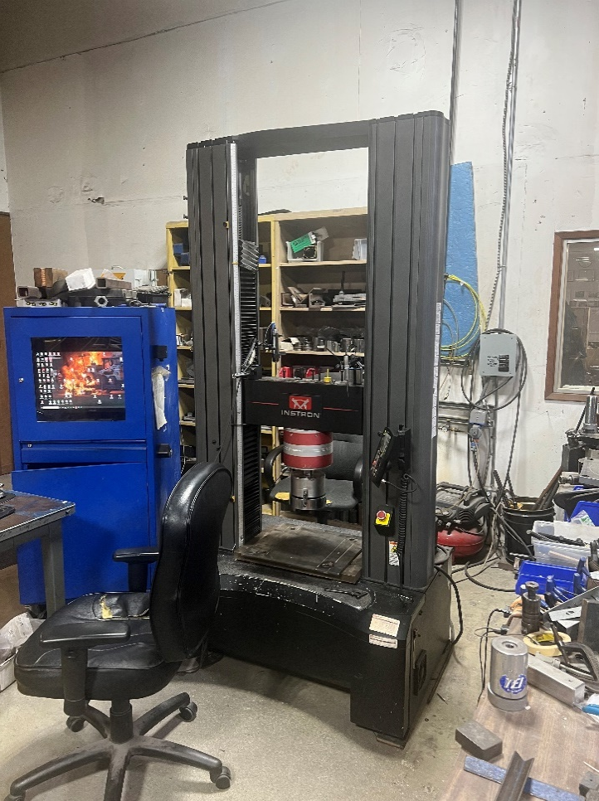
Material Testing
Fiber Reinforced Concrete Blocks – Testing
Testing completed by independent material testing laboratory:
Testing Engineers, CA
36

Slide 37
Material Testing
Fiber Reinforced Concrete Blocks – Viability
 | Compressive Strength |  | Splitting Tensile Strength
 | [PSI] |  | [PSI]
Old Navy | 7500 |  | 548
New Fiber | 8970 |  | 902
Old Fiber | 7850 |  | 662
37

Slide 38
Project Challenges
Lead time of material ordering presented challenges.
Navy drydocking canceled at NBSD after dry dock reorganization. However, Coast Guard and USACE Vessel
vessels were involved.
2 separate government agencies showed interested, but ultimately couldn’t engage with the project within the panel project time frame.
Calculating carbon footprint due to inconsistent measuring techniques.
38

Slide 39
Conclusion
Neoprene – More testing and research needed
Material is difficult to work with compared to wood. Special tooling/fasteners required.
Cost is much higher than HDPE or wood.
Not recommended as tested.
May require special NAVSEA approval for use on Navy operations.
39

Slide 40
Conclusion
HDPE – Proceed with restrictions
Good workable substitute for softwood.
Monitor and replace damaged HDPE as normal. Regular testing/inspections recommended.
Potential friction hazard. Recommend limit 25% unscored HDPE per docking. Not recommended for use in earthquake prone areas until additional research completed.
Currently available in sheets, not serviceable for curved side blocks, however industry adoption could change this.
May require special NAVSEA approval for use on Navy operations
40

Slide 41
Conclusion
Fiber Reinforced Concrete – Ready to implement
Utilized in many structural projects in other industries.
Utilize engineered design for fiber reinforced construction.
Expert help to determine the right fiber/concrete mix.
Test sample to verify compression strength and inspect at regular intervals.
May require special NAVSEA approval for use on Navy operations.
41

Slide 42
Recommendations Future Testing
HDPE/Neoprene
Yield strength increase post-docking.
Friction analysis.
Hot work environments. So far, no issues.
Extreme cold weather. Untested, not anticipated.
42

Slide 43
Additional Information
Please see our final paper for more in-depth analysis.
Available on:
DM Consulting Website:
DryDockTraining.com/Alternate-Blocking-Materials.html
43

Slide 44
Thank you
Acknowledgements
Gulf Copper Shipyard, TX – Neoprene and HDPE Testing
Mare Island Dry Dock, CA – Fiber Reinforced Blocks Testing
Kirsten Walkup, GD BIW, ME, Sustainment Panel Chair
Kaipo Crowell, Sustainment Panel vice-chair/PTR
Jim House, ATI Project Manager
Mark Smitherman, ATI Deputy Director
ATI Contracts Team
NBSD Graving Dock, CA – Navy Sponsor
Austal USA, CA – ECB Sponsor

