Slide 1
High Productivity Reduced Emissions Arc Gouging Process NSRP Project Manager: Mark Smitherman NSRP PTR: Vicky Dlugokecki
NSRP Weld Panel Meeting – August 2023

Slide 2
Project Team
EWI (prime)
Jason Rausch (PI), Paul Blomquist (Technical/BD Support)
Katie Hardin (PM), Mark Schimming (VP Govt Business)
NSRP Program Technical Representative (PTR)
Vicky Dlugokecki – Naval Architect / Marine Engineer
Participant
Vigor – Ken Johnson
BSI EHS – Daniel Chute, Rich Hubner
CSK Mechanical – Charlie Klangos
Approved for Public Release; distribution is unlimited

Slide 3
Background
At present, shipyards use carbon arc gouging (CAG) for weld and metal removal:
Requires extensive protection of large areas
Generates huge quantities of hot slag that may start fires
Leaves debris that takes time to clean up
Even after cleanup, operations typically leave residual carbon dust that could foul electronics and other equipment.
No other personnel can work in adjacent areas!
Approved for Public Release; distribution is unlimited

Slide 4
WeldVac Potential
It is entirely possible to eliminate 75% of the labor and materials for “protection” that now must be used to prevent damage to adjacent equipment where CAG is performed.
Significant schedule improvement will accrue. Adjacent operations can be scheduled for work due to the quiet and clean nature of the process.
WeldVac is sufficiently quiet that other operations may proceed nearby. WeldVac tests may demonstrate sound levels below OSHA 90 dBA noise limits, sufficiently quiet that hearing protection would not be mandatory from process operation. Hearing protection may in many cases be mandated by other adjacent metalworking operations or company policies.
WeldVac produces very low levels of smoke and fume. The level of fume generated may well be below existing opacity limits, allowing adjacent operations to be performed, with little need for respirators (unless mandated by other operations or company policy).
Cost of cleanup will be reduced due to capture of nearly all slag and dust.
Another advantage is that a high-pressure air supply is not needed.
Approved for Public Release; distribution is unlimited

Slide 5
What is WeldVac?
A new approach to gouging and metal removal
Combines a heat source and a vacuum to:
Melt the material and vacuum out the pool
Capture the extracted material by water entrainment
Provide further filtration of effluent if needed or desired
Currently in “Alpha Prototype” stage of development
Uses standard GTAW power source – other heat sources can be used
Uses typical shop vacuum – during gouging that’s ALL you hear!
Demonstrated on carbon, stainless steel, and aluminum
Should work on any conductive material
Approved for Public Release; distribution is unlimited

Slide 6
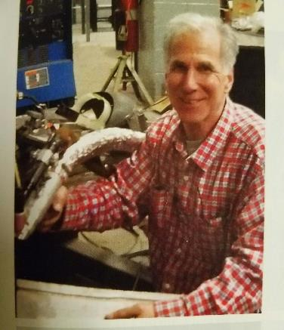
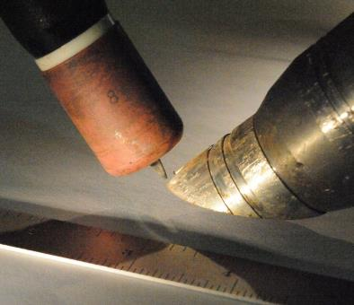
Charles Klangos, WeldVac Inventor
WeldVac - Alpha Prototype
Approved for Public Release; distribution is unlimited

Slide 7
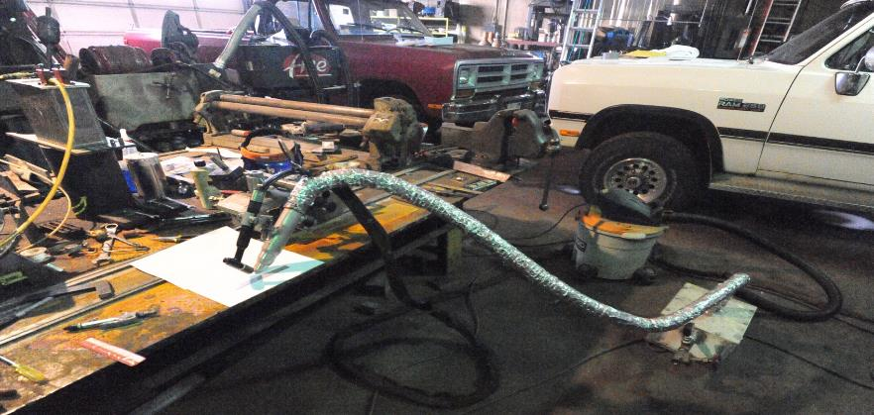
WeldVac Alpha Prototype
B2
A
B1
C
Key: A-Heat Source, B1-Vacuum Nozzle, B2-Vacuum,
C-Capture Chamber
Approved for Public Release; distribution is unlimited

Slide 8
Alpha Prototype in Operation
This is a video but I removed it to compress this file to send over email
Video shot using Visible Welding V2016-Z WeldWatch camera system (www.VisibleWelding.com).
Approved for Public Release; distribution is unlimited

Slide 9
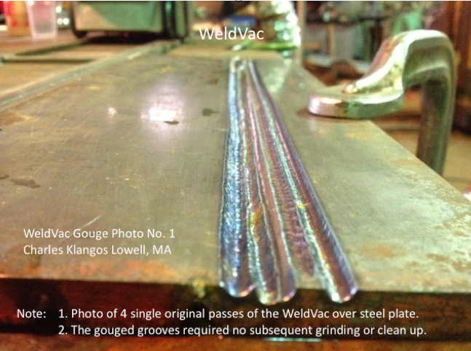
WeldVac Shop Gouge Tests
Approved for Public Release; distribution is unlimited

Slide 10
Objectives
Goal - Reduce the cost and time associated with weld and other metal removal tasks, including new construction, overhaul, maintenance, and repair operations.
Verify that WeldVac methods can produce satisfactory metal removal rates for welds and other materials in U.S. Navy and/or ABS steels and consistently meet the OSHA and other environmental regulations.
Approved for Public Release; distribution is unlimited

Slide 11
Task 2 – Identification of WeldVac Parameter Sets
I think we should delete the last 2 major bullets since the comparison won’t happen
A WeldVac system will be set up at EWI.
Vigor will provide welded test coupons for the target application.
Parameters for removing the welds for the target application in the selected positions will be developed.
Metal removal rates, heat inputs, and other data to inform a clear business case analysis will be documented.
A CAG system will be set up at EWI.
CAG procedures provided by Vigor will be used to remove the welds on the target application in the selected positions.
Metal removal rates, heat inputs, and other data for the business case will be documented.
Trials will be performed to compare the environmental impact of WeldVac process with the CAG process for the target application.
BSI Group will be at EWI for these trials and will perform the analysis.
Trials will be performed with each metal removal process.
Environmental data will be measured:
Noise in and around the work area.
Air monitoring including personal breathing zone and area air sampled for calculation of total weld fume and respirable particulates.
Approved for Public Release; distribution is unlimited

Slide 12
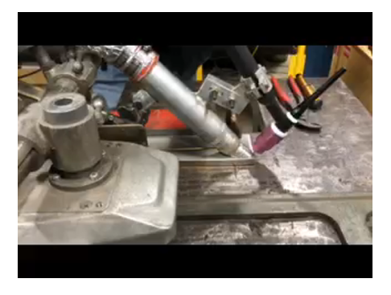
Video from Setup/Training at EWI
This is a video but I removed it to compress this file to send over email
Approved for Public Release; distribution is unlimited

Slide 13
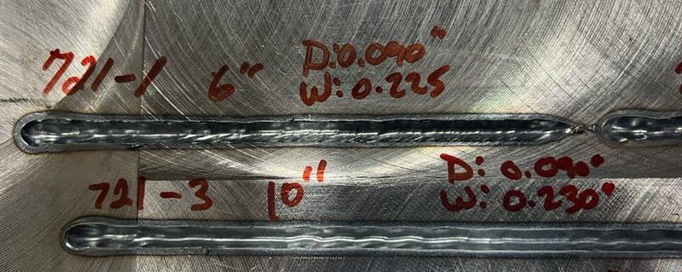
Progress
Successful gouge lengths of 6” to 21”
220 AMP / 30-35 IPM
Approved for Public Release; distribution is unlimited

Slide 14
Technical Difficulties to Work Through
Slag buildup in aluminum hose
Consistently clogging the nozzle to result in stopping weld to clean out
Aluminum nozzle
Design – working with inventor to determine best design for this nozzle
Steps inside barrel – potentially contributing to slag buildup
EWI having a one-piece barrel made with the same diameter as the vacuum hose
Approved for Public Release; distribution is unlimited

Slide 15
Task 3 – Shipyard Demonstration
The WeldVac system will be shipped to Vigor and set up in the shipyard’s Weld School.
Trials will be performed by shipyard personnel using the parameters developed in Task 2 for the target application.
Demonstration of the WeldVac system will be performed for project participants.
A description of the trials, metal removal rates, and other relevant data will be documented.
Feedback from shipyard personnel who attend the demonstrations will be documented.
Approved for Public Release; distribution is unlimited

Slide 16
Task 4 – Technology Transfer and Reporting
Brief NSRP Environmental, Health, and Safety Panel
Quarterly reports
Final written report - documents background, technical approach, results and conclusions
Approved for Public Release; distribution is unlimited

Slide 17
Questions?

