Slide 1
Surface Preparation & Coatings
White Paper Projects
Rapid Adoption Projects
Notes:
Introduction

Slide 2
Surface Preparation & Coatings
White Paper Project
Cleanable Nonskid Deck Covering
Brian Thiele – Bath Iron Works
Notes:
Introduction

Slide 3
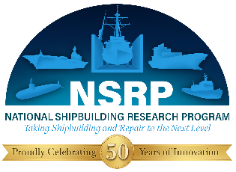
Cleanable Nonskid Deck Covering
Surface Preparation & Coatings
PROJECT INFORMATION | OBJECTIVE
Prime/Lead: GD-Bath Iron Works Team Members: GD-NASSCO Duration: 12 Months | Identify typical Navy shipbuilder contract requirement for nonskid cleanliness Verify if polysiloxane based, deck gray MIL-PRF 24667 Type I nonskid can be kept clean through standard care and protection Verify if polysiloxane based, deck gray MIL-PRF 24667 Type I nonskid can be cleaned to an acceptable level of cleanliness as defined in goal 1 Develop cleaning methods for nonskid
DELIVERABLES/BENEFITS/ROI | FINANCIAL
Reduce the necessary rework in high traffic areas Reduce a labor intensive task Reduce ship construction and material costs Final reports to NSRP and Public Shipyards | Program Funds: $150K
“Q”

Slide 4
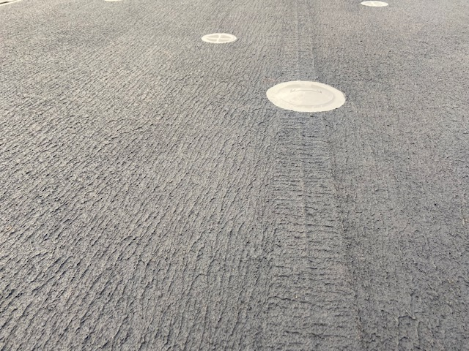
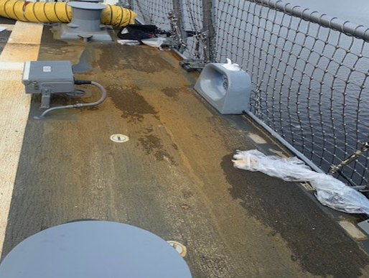
Cleanable Nonskid Deck Covering
Care and protected nonskid one month after completion.
Care and protected nonskid one year after completion.

Slide 5

Questions?

Slide 6
Surface Preparation & Coatings
White Paper Project
Ultra Heat Resistant Primer
Sean Smith & Justin Steinfeldt Marinette Marine
Notes:
Introduction

Slide 7
23-15 Ultra Heat Resistant Primer
Surface Preparation & Coatings
PROJECT INFORMATION | OBJECTIVE
Prime/Lead: Fincantieri Marinette Marine Team Members: Northern Coatings and Chemical, Elinor Coatings, LLC Duration: 12 Months | Erection and other hotwork during construction require costly and time consuming coating touch-up. This project will develop and test an Ultra Heat Resistant Primer that can withstand the temperature of welding on the opposite side of a steel plate.
DELIVERABLES/BENEFITS/ROI | FINANCIAL
Reduce 2200 hours of masking and coating touch-up of overhead erection joints per vessel. Optimize the structural design and remove landing bars. Improve schedule by up to 4 months Final reports to NSRP and Public Shipyards | Program Funds: $150K

Slide 8
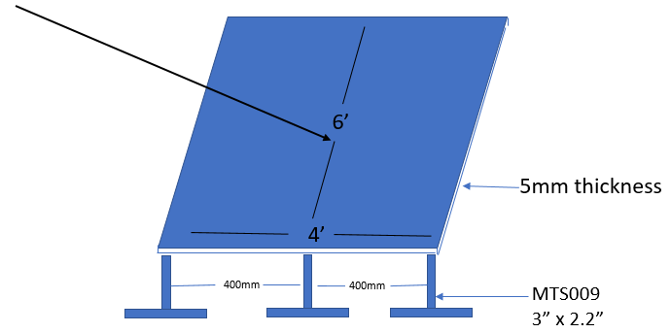
Previous Study at FMM
Vertical plate (simulating bulkhead) to be welded to the top of the plate

Slide 9
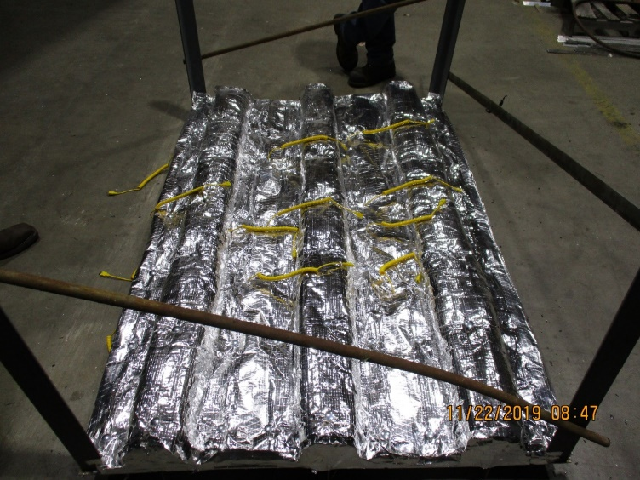
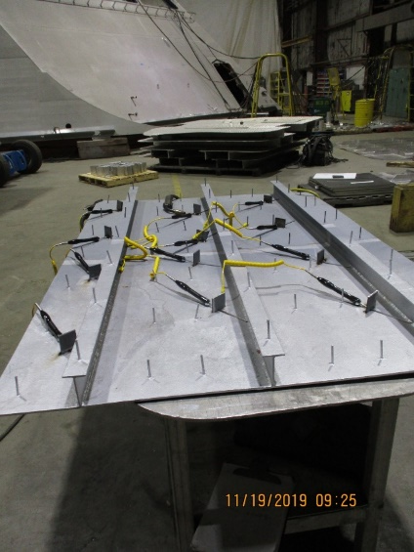
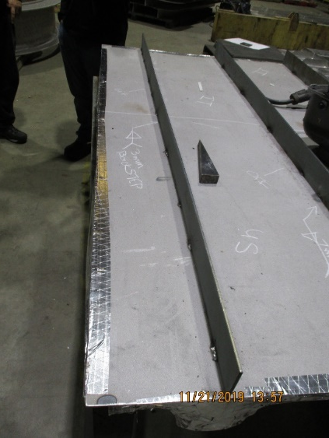
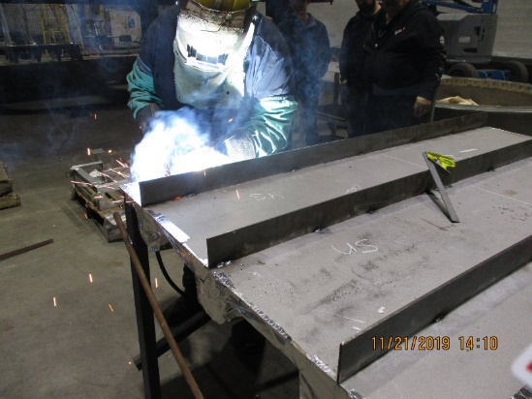
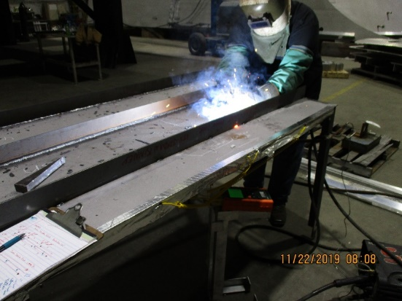
Previous Study at FMM

Slide 10
Previous Study at FMM
Test Case 1: Best Case Scenario
  3mm double fillet weld
  Max temperature: 521ºF
Test Case 2: Worst Case Scenario
  7mm double fillet weld, long dwell time
  Max temperature: 772ºF
Test Case 3: Average Scenario
  5mm double fillet
  Max temperature: 658ºF

Slide 11
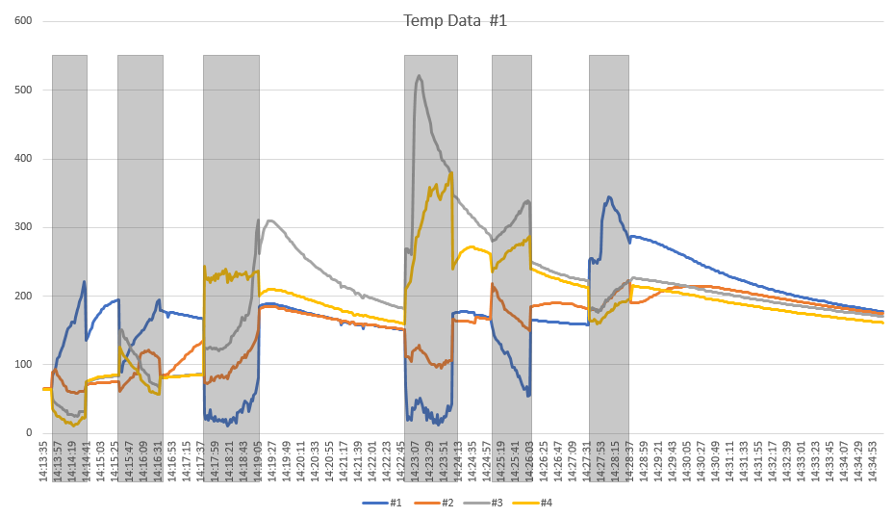
Previous Study at FMM

Slide 12
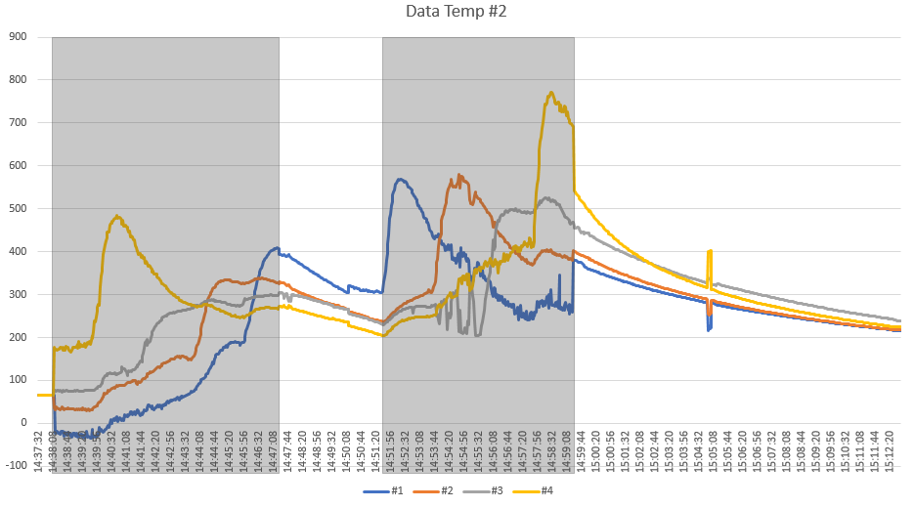
Previous Study at FMM

Slide 13
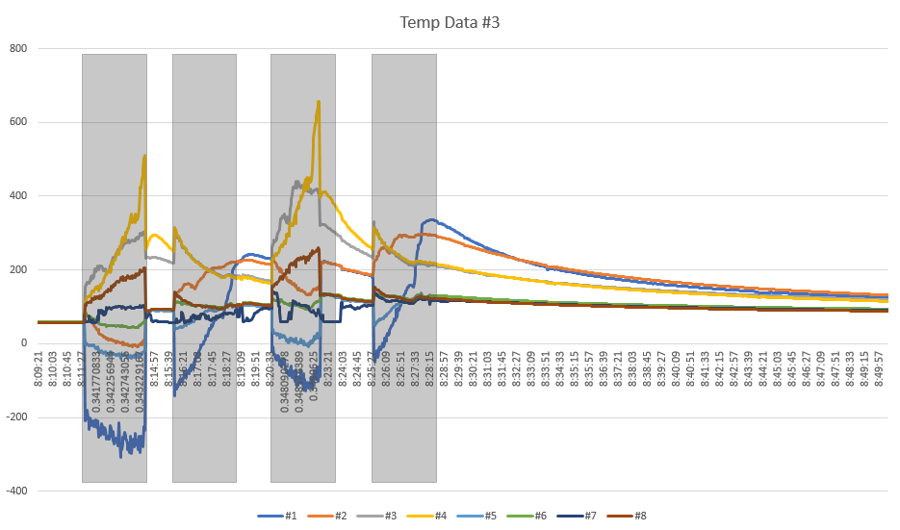
Previous Study at FMM

Slide 14

Questions?

Slide 15
Surface Preparation & Coatings
White Paper Project
Zinc-Rich Coatings Over High Strength Steel
Eric Shoyer – Elzly Technology Corp
Notes:
Introduction

Slide 16
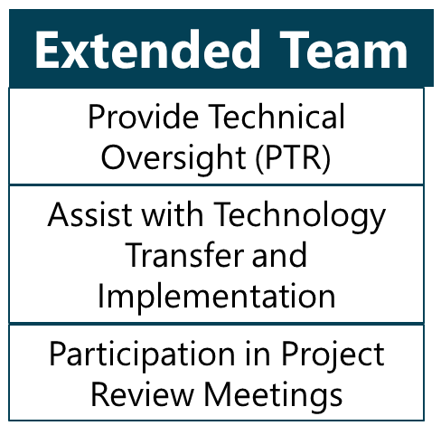
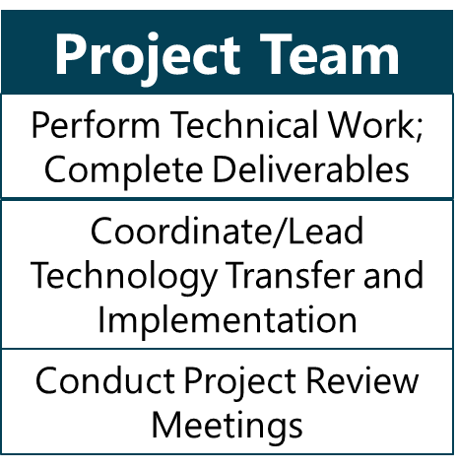
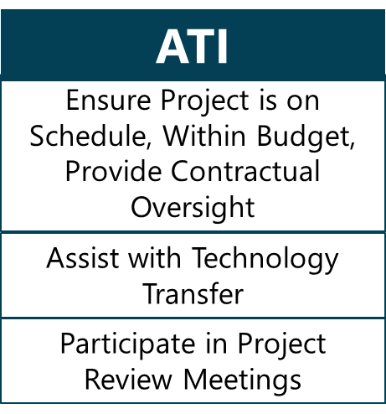
Project Management and Execution

Slide 17
Concept Description
Zinc-rich coatings are often avoided on high strength steels due to long held concerns of hydrogen embrittlement, particularly in heat affected zones
Recent research suggests hydrogen embrittlement may not be an issue with Zn primers, potentially allowing for the use of more effective corrosion barriers throughout ship construction
The team will work with Navy technical advisors to develop requirements and conduct testing to demonstrate the effects of Zn-rich coatings under environmental and hot work conditions in order to pursue future approval for use on Navy ships

Slide 18
Scope of Work
This project will evaluate the effect that Zn-rich coatings have on high strength steel
Goals/Objectives
  Establish a credible testing protocol to assess base metal, Heat-Affected Zone (HAZ), and deposit filler metal susceptibility to reduced properties associated with Zn-rich coatings
  Generate data to understand the relative impact of Zn-rich coatings on high strength steel
  Depending on testing results, provide list of alternative coating systems and appropriate areas of application
  Provide recommendations for shipyard and Navy consideration

Slide 19
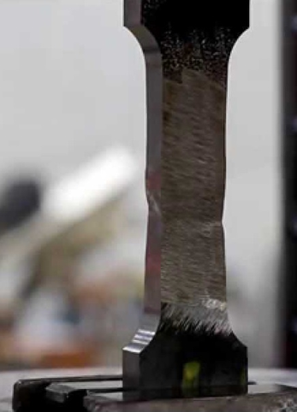
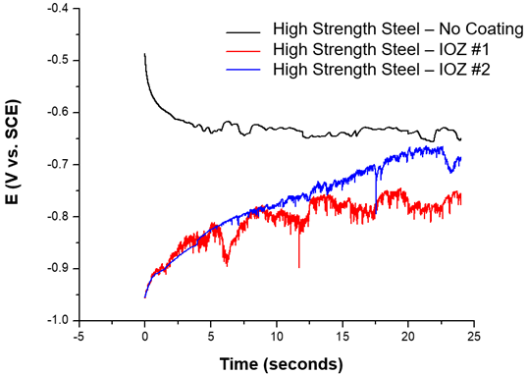
Tasks
Identify Target Applications, Requirements, and Constraints
  Hold kick-off meeting with project team to discuss high value target applications, identify coating types for consideration, and discuss performance testing strategies
Select Candidate Systems, Finalize Test Requirements, and Test Plan
  Team will work with Navy technical advisors to develop test plan
Fabrication of Test Articles and Laboratory Testing
  Test articles will have the appropriate Zn-rich coatings applied in a fashion consistent with shipbuilding operations with a focus on potential worst case situations
Final Report

Slide 20
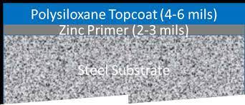
Previous Work
Zinc-rich Coatings for Enhanced performance of Polysiloxane Topside Coatings (2013)
  Research was done previously demonstrating the benefits of Zn-rich coatings with polysiloxane topcoats on Navy vessels. The study showed that the performance of such a system was beneficial overall, but did not examine the possible issue of high strength steel substrate degradation from a Zn coating.
Sacrificial Coatings for the Corrosion Protection of Armor Steel (2013)
  Research showed Zn-rich paint on armor steel offers substantial corrosion benefits. Minimal concern for (Environmentally assisted cracking) EAC on non-loaded high hard armor steel.

Slide 21
Anticipated Benefits
Zn-rich coatings provide additional corrosion protection during downtime and prevent excessive remediation efforts
Inorganic Zn-rich coating have higher thermal stability compared to organic coatings
  Reduction in coating removal
Additional labor savings from avoiding restoration of a near white metal steel surface finish

Slide 22
Path Forward
Obtain contract funding
Hold kick-off meeting
  SEA05P, NSWC-PD, NSWC-CD, NRL, and local Supervisors of Shipbuilding will be invited to participate on the project team, ensuring that any proposed improvements are consistent with Navy requirements
Work through project tasks
  Communicate with Zn-Rich OEMs
  Fabricate test samples
  Begin evaluations

Slide 23

Questions?

Slide 24
Surface Preparation & Coatings
Rapid Adoption Project
Transition of Power Tool Optimization
Eric Shoyer – Elzly Technology Corp
Notes:
Introduction

Slide 25

Transition of Power Tool Optimization
NSPR All Panel Meeting
March 2023
Approved for public release; distribution is unlimited.
Category B Data – Government Purpose Rights.

Slide 26
Project Management and Execution

Slide 27
Scope of Work
Use findings from previous NSRP project “Optimization of Power Tool Surface Preparation” to implement better practices while using a combination of power tools during surface preparation
Goals/Objectives
  Implement better practices for power tool usage
  Distribute novel combinations of tools to achieve various levels of cleanliness
  Instruct shipyard personnel and demonstrate where multiple tools can be more productive during ship maintenance
  Transition data, guidance, and techniques learned in “Optimization of Power Tool Surface Preparation” to shipyard for implementation

Slide 28
Tasks
Assemble Stakeholder Team and Establish Scope
  Define overall scope and how to implement better power tool practices
Distribute Visual Aids and Guidance
  Utilize photos and data from previous work for field guidance and visual aids
Shipyard Instruction and Demonstration
  Visit shipyards and provide on-site instruction with various power tools. Use feedback to update visual aids and guidance.
Publish and Distribute Final Training Documents

Slide 29
Schedule
Draft novel combination and instructions for power tool areas
  Provided at Briefing at Panel Meeting
Provide guidance document to
  HII NNS & Fincantieri
    May
Shipyard visit after 1+ months of using procedure guidance
  HII NNS & Fincantieri
    June/July (3 days on site at each yard)
Deliverable | Due Date
Project Plan & Schedule | 1/15/2023
Briefing at Panel Meeting | March 2023
Visual Aids and Guidance Document | 5/15/2023
Summary of Feedback from Shipyard Personnel | 6/30/2023
Final Report with Recommendations | 8/15/2023

Slide 30
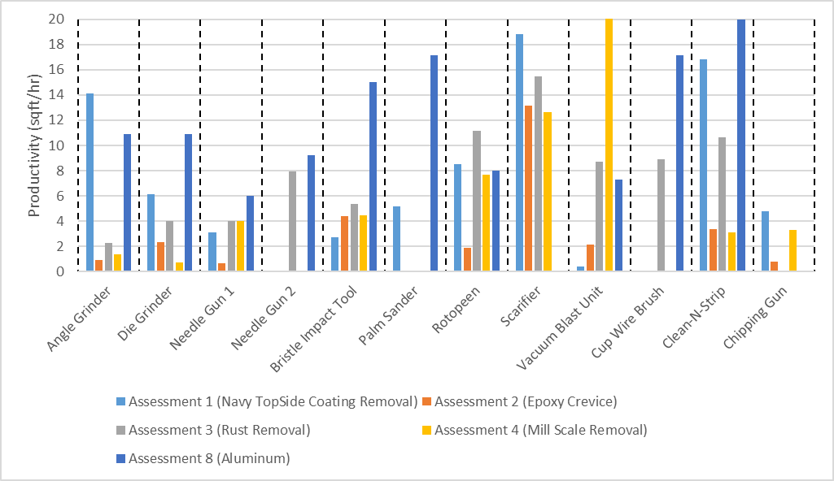
Optimization of Power Tool Surface Preparation (2019 NSRP Project)
Tools vary in performance depending on the surface being prepared or coating being removed​
For a given task, some tools are more applicable than others

Slide 31
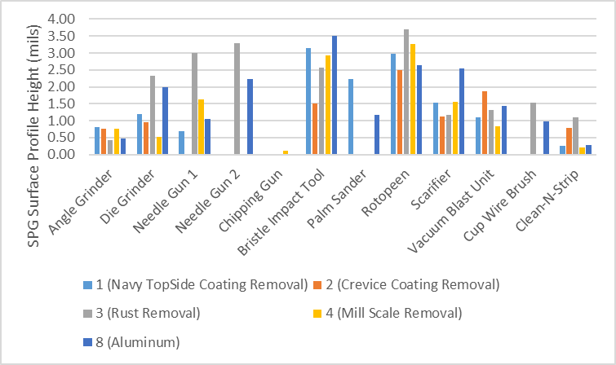
Previous Studies (cont’d)
Surface Profiles can vary greatly from tool to tool and from substrate to substrate. ​
Important to consider these differences and effects when selecting a tool to achieve a target surface profile.

Slide 32
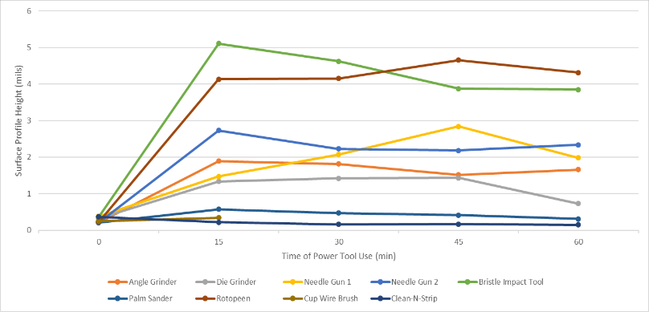
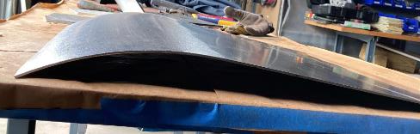
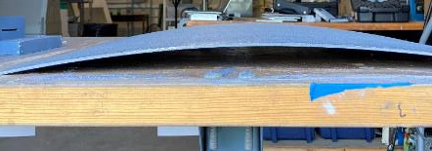
Previous Studies (cont’d)
No real change in surface profile over time seen
Tools wills warp metal instead of creating a greater profile
Scarifiers found to remove metal after extended exposure

Slide 33
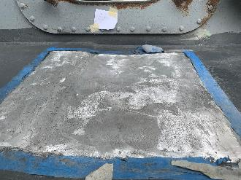
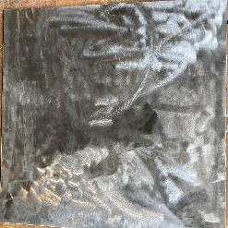
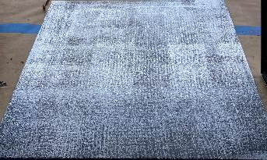
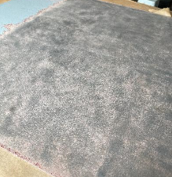
Guide Example – Navy Topside
High Productivity to remove coating system:
  Scarifier (18 sqft/hr)*
  Angle Grinder (14 sqft/hr)
Depending on desired profile use after coating removal:
  Scarifier (2-3 mil)
    Created during single pass
  Rotopeen (3-4 mil)
  Bristle Impact Tool (3.5-4 mil)
  Needle Gun (1.5-2 mil)
  *Scarifiers have ELV Limits

Slide 34
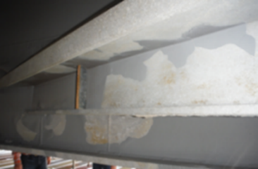
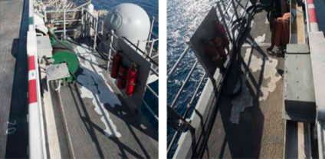


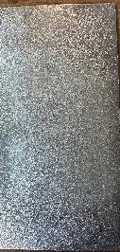

Guide Example - Aluminum
Depending on Desired profile:
  Bristle Impact Tool (3.5-5 mil)
  Rotopeen (2.5-4 mil)
  Needle Gun (2- 3.25)

Slide 35
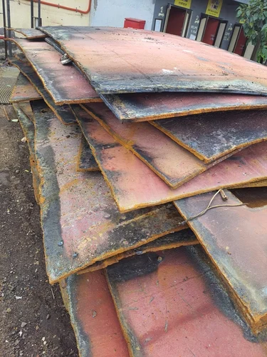

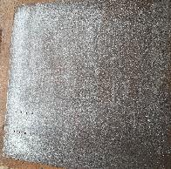
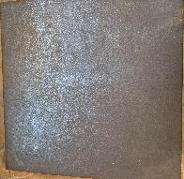
Guide Example - Corrosion
Depending on desired profile, productivity, & finish use:
  Rotopeen (3.5-4.5 mil)
    11 Sqft/hr
    SP-11 Level 1
  Bristle Impact Tool (2.5-35 mil)
    5 Sqft/hr
    SP-11 Level 1
  Needle Gun (3-3.5 mil)
    4 Sqft/hr
    SP-15 / SP-11 Level 3

Slide 36
Path Forward
Continue to review finding from previous NSRP and Navy funding programs and compare current requirements in Navy Specification and Industry specifications
Provide draft guide to demonstrations yards
Provide demo/training to shipyards
Gather feedback from stakeholders in NSRP and industry on draft guide
Provide final guide document

Slide 37

Questions?

Slide 38
Surface Preparation & Coatings
Rapid Adoption Project
Implementation of SP-18
Thorough Spot & Sweep Blast Cleaning for Industrial Coatings
Eric Shoyer – Elzly Technology Corp
Notes:
Introduction

Slide 39
Implementation of SP-18 “Thorough Spot and Sweep Blast Cleaning for Industrial Coating Maintenance” in Shipyard Construction
NSPR All Panel Meeting
Mar 2023
Approved for public release; distribution is unlimited.
Category B Data – Government Purpose Rights.

Slide 40
Project Management and Execution

Slide 41
Scope of Work
Use current training and guidance from other industries and lessons learned from previous projects to implement use of SSPC-SP 18 in shipyards and demonstrate potential cost and time savings for both users and customers
Goals/Objectives
  Implement use of clearly written instructions and visual aids of what acceptable levels of cleanliness are and how to inspect them
  Onsite demos and training to ensure understanding of the standard
  Gather data and feedback to improve training
  Make available the training documents and extend offerings for additional demos

Slide 42
Tasks
Assemble Stakeholders and Establish Necessary Training
  Define scope and overall expectations of the training documents and demos.
Shipyard In-Person Instruction, Demos, and Implementation
  Visit at least two shipyards and provide on-site instruction. Provide copies of visual aids and instructions prior to visits.
Update Visual Guide Tools and SP18 Instruction from feedback
  Use feedback from on-site visits to update aids and instructions. Updated copies to be distributed to yards for implementation.
Shipyard In-Person Follow-up and Lessons Learned
  Visit shipyards again to document benefits of SP18 and lessons learned.
Publish and Distribute Final Training Documents

Slide 43
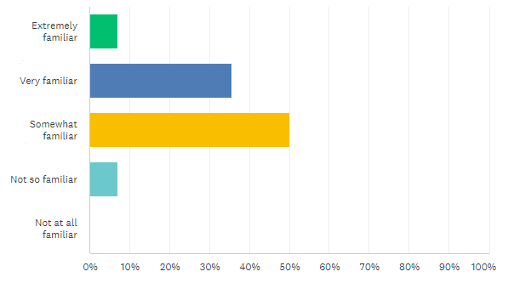
Initial Survey Results
7 partner shipyards were surveyed on their familiarity with SP 18 and any hurdles they may have encountered during implementation
  HII-Ingalls
  HII-NNS
  Electric Boat
  BAE
  Bath Iron Works
  Fincantieri Marine Repair
  Fincantieri Marinette
Results show that half the respondents were at least somewhat familiar with the standard itself

Slide 44
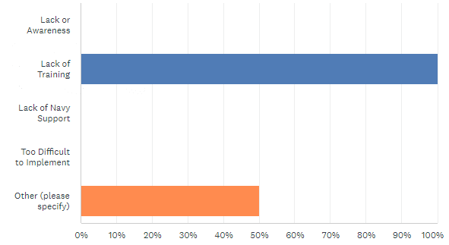
Initial Survey Results
Shipyards were also asked if they were currently using SP18 in production.
  Only one yard stated they are successfully using SP18
Biggest hurdles experienced
  Lack of QA Training
  New process for the Navy

Slide 45
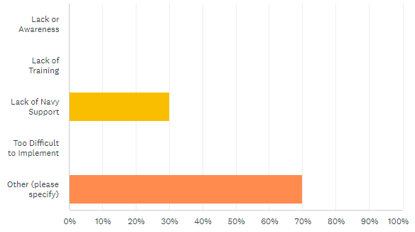
Initial Survey Results
Yards not currently using SP18 in production expressed common reason why
  Not currently specified by Navy
Most yards not currently using SP18 are open to trying

Slide 46
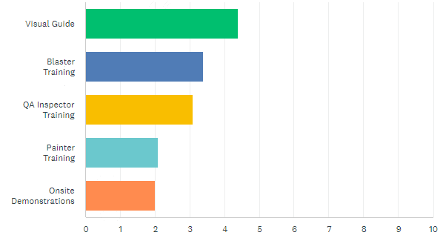
Initial Survey Results
When asked what would be most beneficial from the NSRP community
  Visual Guide was #1 choice
  Blaster and QA Training were close behind

Slide 47
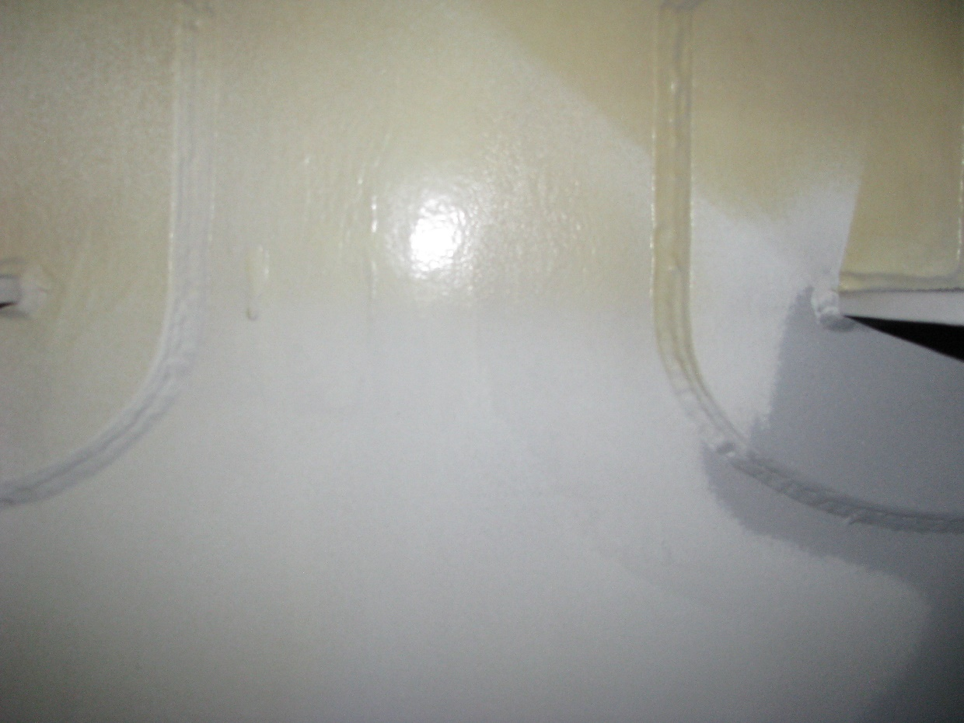
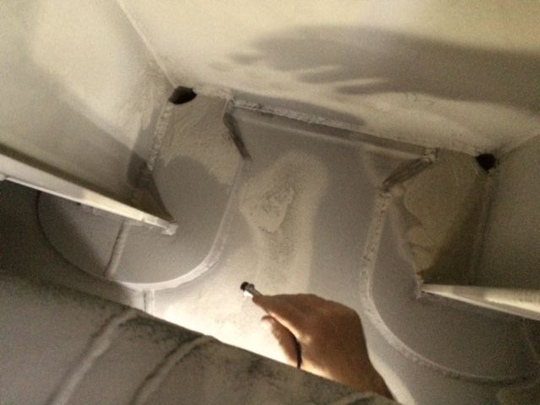
Visual Guide Examples
Bottom is sweep blasted, top is not; Note yellow color and glossy appearance
Once brush blasted, the remaining coating is white and has a roughened appearance

Slide 48
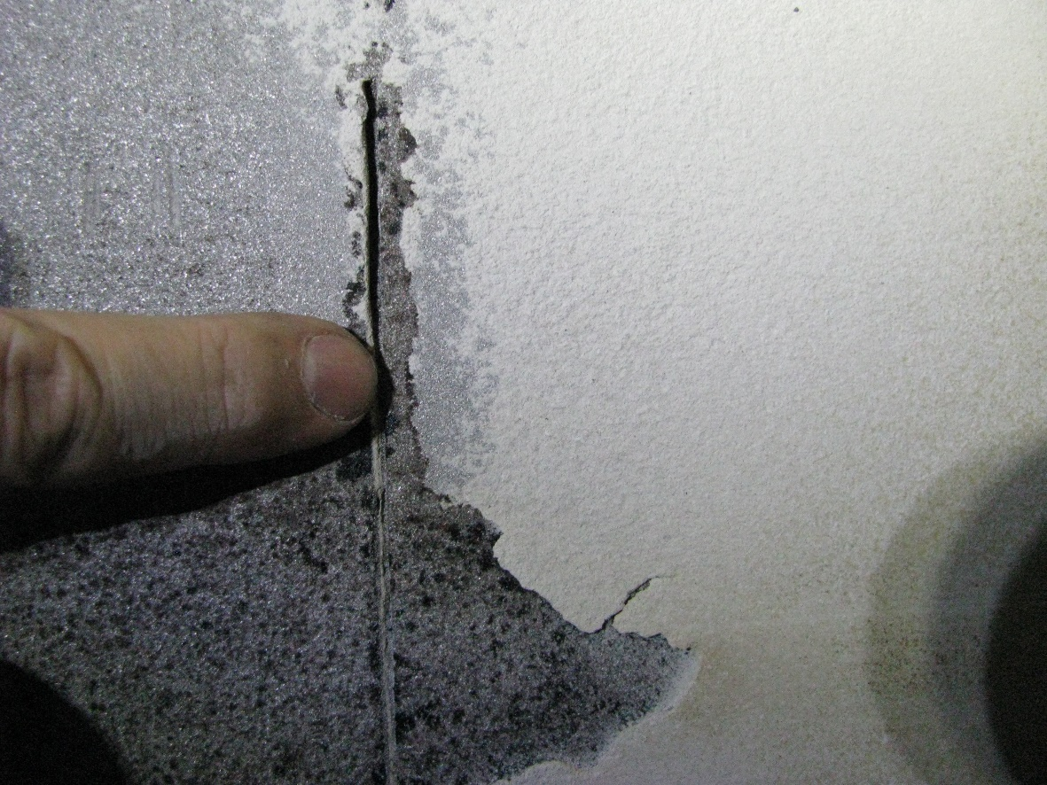
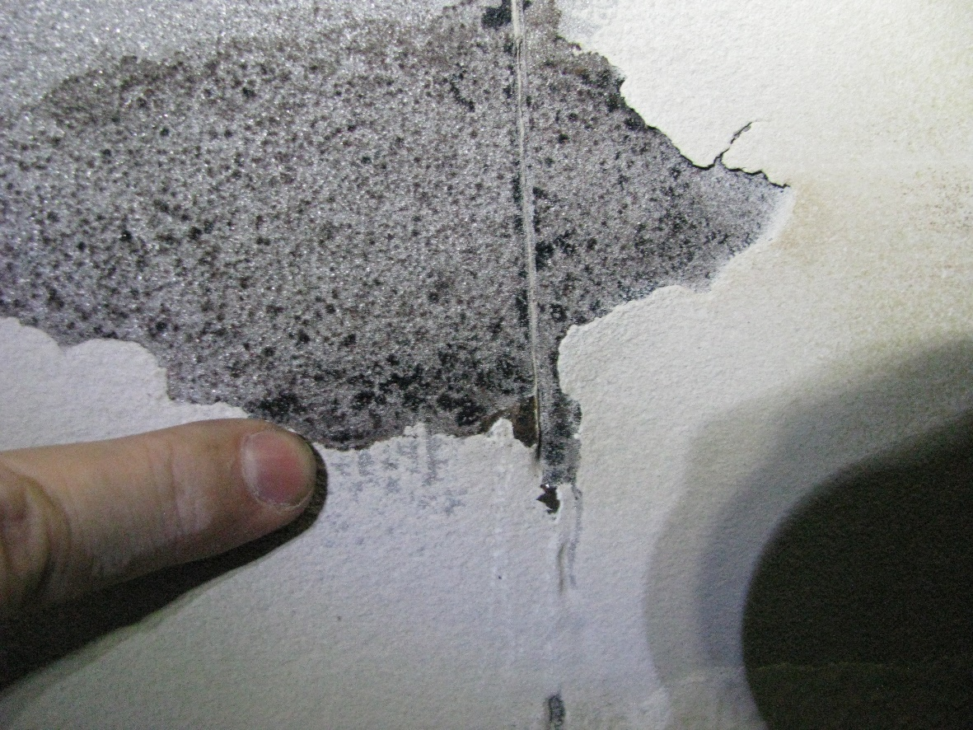
Visual Examples (cont.)
The SP-10 area beyond edge of corrosion suggests the area is more likely to pass the dull putty knife test.
Along these edges, the remaining coating fails the dull putty knife test.
NOTE: Both cases are also unacceptable because the corroded area has not been blasted to an SP-10.

Slide 49
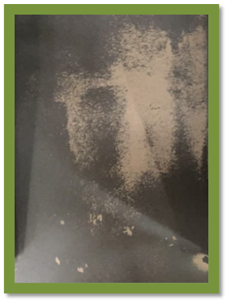
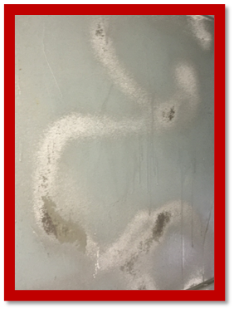
Guidance Provided to Other Industries
Images show surfaces blasted to SP18 during bridge maintenance activities
Green shows an area where uniform passes were made during the sweeping activity
Red area shows areas missed by non-uniform sweep activity

Slide 50
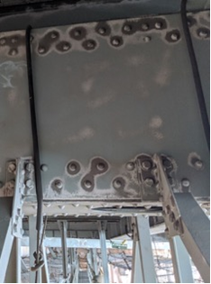
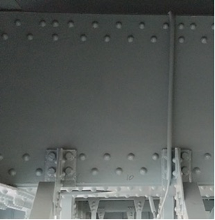
Guidance Provided to Other Industries (cont’d)
Images show surfaces properly blasted to SP 18 and then adequately coated during bridge maintenance

Slide 51
Learning Objectives for Training/Guidance
Provide overview of SSPC-SP 18 aka “partial blast”
Understanding of SSPC-SP 18 in relation to 009-32 and where it can be used
How to accomplish proper SSPC-SP 18 cleanliness
What to look for during inspection of partial blast
Inspection after coating application

Slide 52
Path Forward
Confirm Shipyard availability in April/May time frame
Gather feedback from stakeholders in NSRP and industry
Continue to Review finding from previous NSRP funding programs and Current Naval efforts
Provide demo/training to shipyards

Slide 53

Questions?

