Slide 1
2023 NSRP All Panel Meeting
General Dynamics Bath Iron Works
presents the Navy ManTech Project
S2899 – Virtual Load Out Interference Detection
(A collaboration between ONR, NSAM, GDBIW, and Penn State ARL)
POP February 2023 – February 2025
ATI/NSAM – Project Oversight
GD BIW – Industry Lead
PSU ARL – Technical Lead

Slide 2
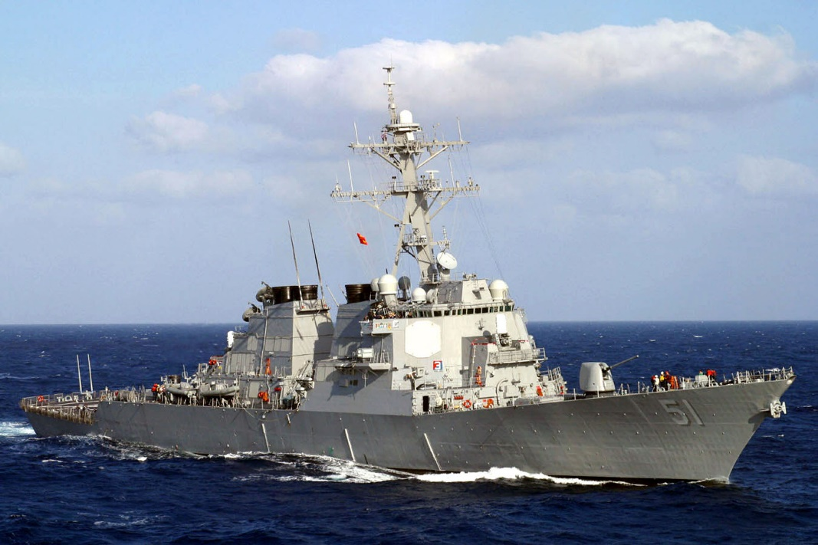
Agenda
Objective
Acknowledgements
Background
Benefits
Results
Issues/Workarounds

Slide 3
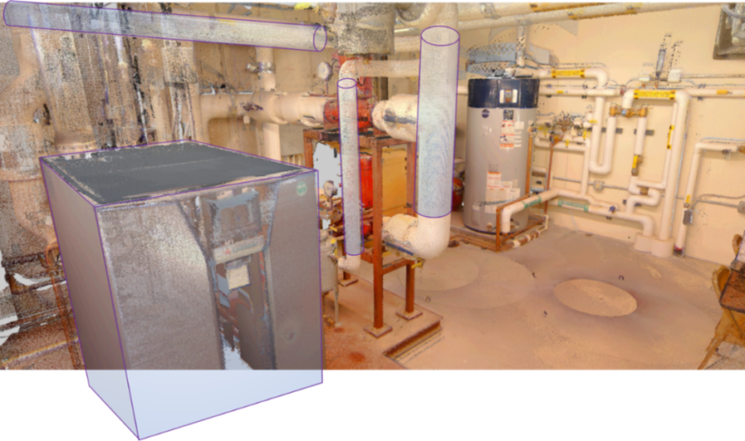
Objective
Develop A.I. software tools to automate the creation of 3D CAD model arrangements from point cloud data which can then be manipulated, attributed, used for interference checking, and subsequent development of 2D technical drawings.

Slide 4
Acknowledgements
Project funding provided by the Office of Naval Research (ONR) Navy ManTech Program
Paul Huang – ONR Program Officer
Navy ManTech program oversight provided by ATI/NSAM
Scott Truitt – Center for Naval Shipbuilding and Advanced Manufacturing Project Manager
General Dynamics Bath Iron Works
Kyle Green – Project Manager
Kirsten Walkup – Technical Lead
Penn State Applied Research Laboratory
Dan Finke – Project Manager
Simon Miller – Technical Lead

Slide 5
Background
GD BIW has PY for DDG51 and 1000 maintenance and modernization
SHIPALT change docs include 2D drawings of WAS/IS design
Old method: Flying designers to home ports to measure, sketch, and otherwise manually document the current condition of the ship
Current method: Adds LiDAR scanning and photogrammetry 3D scans allowing for rapid and accurate capturing of the shipboard condition that can also be transferred to PY home facility in Maine
Despite having 3D scans, developing the 3D model of the SHIPALT is still a time consuming, manual effort

Slide 6
Benefits
Goal 1: Reduce labor associated with modelling activities by automatically identifying 50% of components within a ship space
Goal 2: Reduce labor associated with modelling activities by producing solid model geometry for 50% of structure and distributive systems present
Goal 3: Reduce labor to assemble a 3D graphical CAD file containing the items identified in Goals 1-2 by 50%
Goal 4: Reduce number of LARs, RLARs, and LAR-RCCs by having the ability to create 3D models for all ship spaces and ability to produce more accurate, interference-free design by >20%

Slide 7
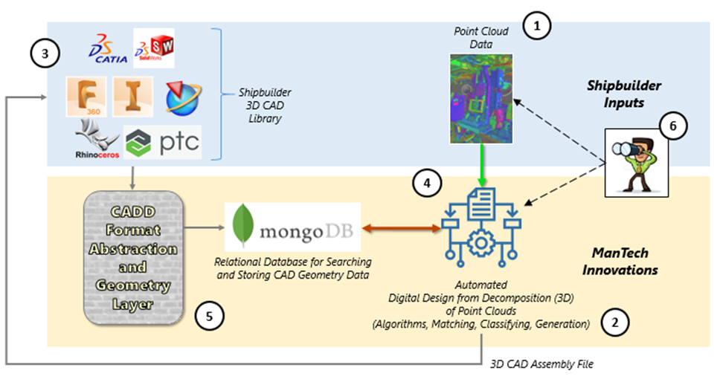
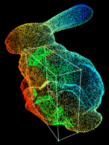
Technical Approach
1. Input LiDAR scan point cloud representing ship as-configured condition
2. Algorithms will segment points into logical clusters
3. AI/ML will compare clusters to existing 3D CAD library
4. Identify best match and insert CAD library part into the ‘Assembly File’, a 3D neutral format (such as STP) CAD model file
5. If no match, point clusters will be utilized to create solid 3D geometry, which will also be placed into the Assembly File
6. Overlay point cloud to Assembly File for visual reference to allow user to confirm design and/or fill in the blanks

Slide 8
Technical Approach
Phase 1: (12 months)
Task 1: Ph1 Project Management
Kick Off, Schedule, Spend Plan, TTP, BiWeeklies, Quarterlies, Tech Transfers
Task 2: Current & Future State Analysis
Investigate current LiDAR Scan process, Market Survey, Map Future State
Task 3: Requirements & Concept Design
Develop Requirements & Use Cases, System Design, Internal Go/No Go
Task 4: Design Architecture & Dev Plan
IT Architecture, Data System Design, Development Plan, Prelim Ph1 ARB
Task 5: Develop Point Cloud Conversion Prototype
Initial Prototype, System Logic, Application, Ph1 ARB, Ph1 Go/No Go Decision

Slide 9
Technical Approach
Phase 2: (12 months)
Task 6: Ph2 Project Management
Revise TTP, Schedule, Spend Plan, BiWeeklies, Quarterlies, Tech Transfers
Task 7: Phase A System Dev (60%)
Build Modules, Developer Unit Testing (alpha), UI Design, Phase A Report
Task 8: Phase A Integration
Scan Data Process, Geometry & MetaData Association, AI Tools, UI Build, Prelim Ph2 ARB
Task 9: Phase A Testing
Test Plan, Shipyard Test Environment, Conduct Test (beta), Document Gaps & Mods
Task 10: Phase B System Dev (90%)
Implement T9 Changes, Iterative Testing (gamma), Configure for UAT
Task 11: Phase C System Finalization & Testing (100%)
End User Test Plan, Conduct Test (delta), End User Feedback Integration, UAT, Ph2 ARB
Task 12: Project Finalization
Document System Specs & Install Manual, Business Case, Implementation Plan, Final Review

Slide 10
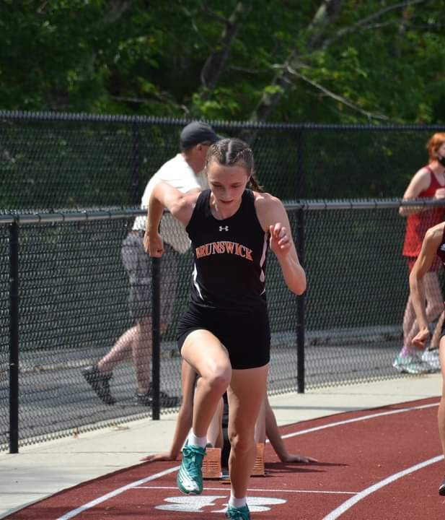
Status
Project has been awarded to NSAM, PSU ARL, and GD BIW
PSU ARL & GD BIW coordinating Master Schedule and Spend Plans
Kick Off to entire IPT in April at GD BIW
Begin technical tasks late April
Off to the races!

Slide 11
Risks
No major risks at this time
Common project risks we are monitoring
TTP timeline often difficult to accomplish
Desired functionality may not be feasible or cost effective
Build effort larger than anticipated
Acceptance testing does not achieve threshold goals
Solution implementation may be larger than anticipated

Slide 12
ROI
BIW 5yr ROI = 2.82
Total Investment: $1.90M
ManTech investment: $1418k
BIW implementation: $478k
Documentation & Training
IT Support & Deployment
Software Maintenance
Return $7.2M over 5yrs on DDG51 program:
$1.44M per year
$360k 3D modelling
$1088k LAR responses
ROI = RETURN – INVESTMENT INVESTMENT
2.82 = ($7,243,369 - $1,896,000) $1,896,000

Slide 13
Questions?

Slide 14
Project Team Contacts
General Dynamics Bath Iron Works
NSRP Sustainment Chair Kirsten Walkup (207) 442-1134
kirsten.walkup@gdbiw.com
General Dynamics Bath Iron Works
Lead IRAD Engineer Kyle Green (207) 442-2781
kyle.green@gdbiw.com
ATI/NSAM
Sr. Project Manager
Scott Truitt
(843) 760-4620
scott.truitt@ati.org
Penn State Applied Research Laboratory
Assistant Research Professor
Simon Miller
(814) 863-5399 swm154@psu.edu

