Slide 1
Maritime Visual Inspector Training Program
Susan Witt, Manager Industrial Training

Slide 2
Problem Statement
How can we help address the workforce challenges with new training techniques?
All industries are experiencing workforce shortages
COVID-19 did not help the workforce challenges
36% harder post-pandemic to find qualified talent*
Training is critical to leaning on our existing workforce to ease the workforce crisis
Notes:
Workforce shortages are not anything new
We have been talking about a skills gap for over 10 years now
As far back as 2010 we were talking about the “gray tsunami”
In 2017 it was estimated that retirements from the Baby Boomer generation would leave 31M job openings
Manufacturing took a hard hit during the COVID 19 pandemic
During the early days manufacturing saw a loss of around 1.4 M jobs- which erased nearly a decade of gains according to a recent Deloitte study
820,000 managed to return by end of 2020 but still a loss of 570,000 jobs
According to a Deliotte study- manufacturing execs say it is 1.4times harder to find qualified talent with the right skills than it was in 2018-
As we try to re-shore more manufacturing- this will only get worse

Slide 3
Solution
Developing Maritime Visual Inspector Training Program (MVTI)
a comprehensive online visual welding inspection program to help train welders in inspection techniques
Asynchronous classes students can take from anywhere
Virtual reality lab
Labs will be used to reinforce the theoretical knowledge and practical competencies needed
Built on our partners CWBs platform with EWIs subject matter experts' knowledge
Notes:
EWI to offer an innovative program to enhance the competency and knowledge of those in the maritime welding industry. Working with our partner CWB, we can offer

Slide 4
MVTI Program Project Overview
Maritime Visual Inspector Training Program will consist of three online courses:
Visual Inspection Concepts and Techniques: This module reviews the wide range of techniques in the inspection of welds, and welded products traditionally used for “visual” inspection.
Weld Faults Inspection and Causes: This module will assist individuals in identifying typical weld defects and explain their causes and the corrective action to resolve defective welds.
Welding Inspector Practical Exercise Simulator Tool: All done in a virtual reality environment, this module will provide individuals with the proper use of common weld inspection tools on a variety of welded samples.

Slide 5
MVTI Program Project Overview
MVTI Program will be adapted to ABS and Mil-Spec specification to better serve the shipyards
Online courses will include:
Digital textbooks that will compliment material and help students learn
Live online tutoring sessions for students who would like additional help
Chapter “Knowledge Checks”
Graded Final Exams
Badges that can be shared on various online platforms (i.e. LinkedIn)
Participating shipyards will receive free seats to the course for employees

Slide 6
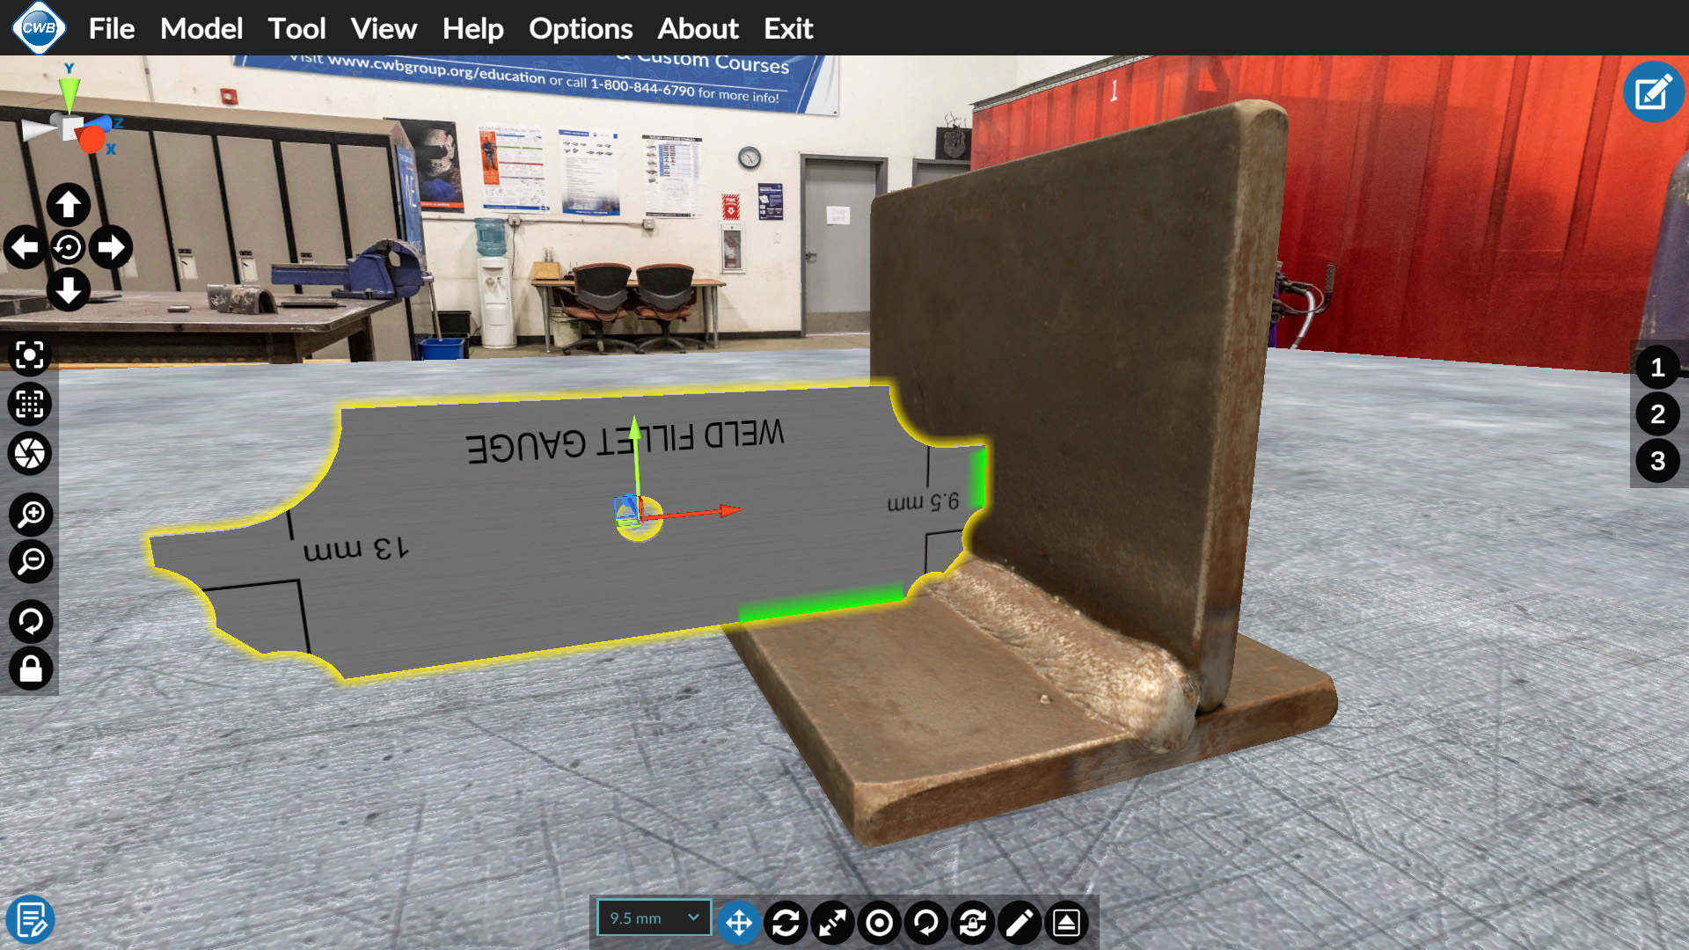

Slide 7
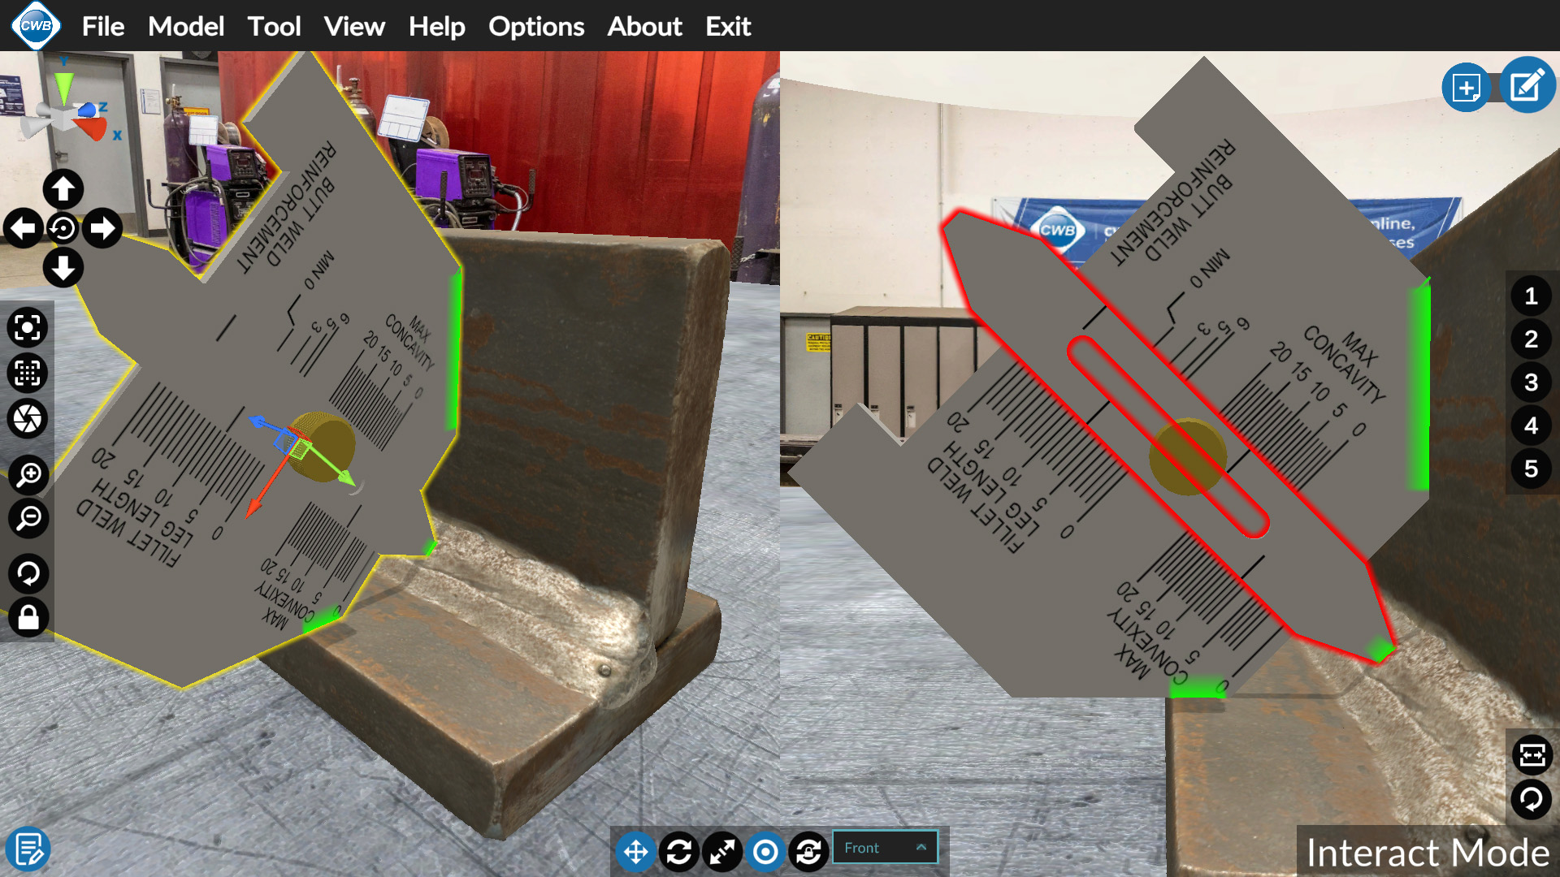

Slide 8
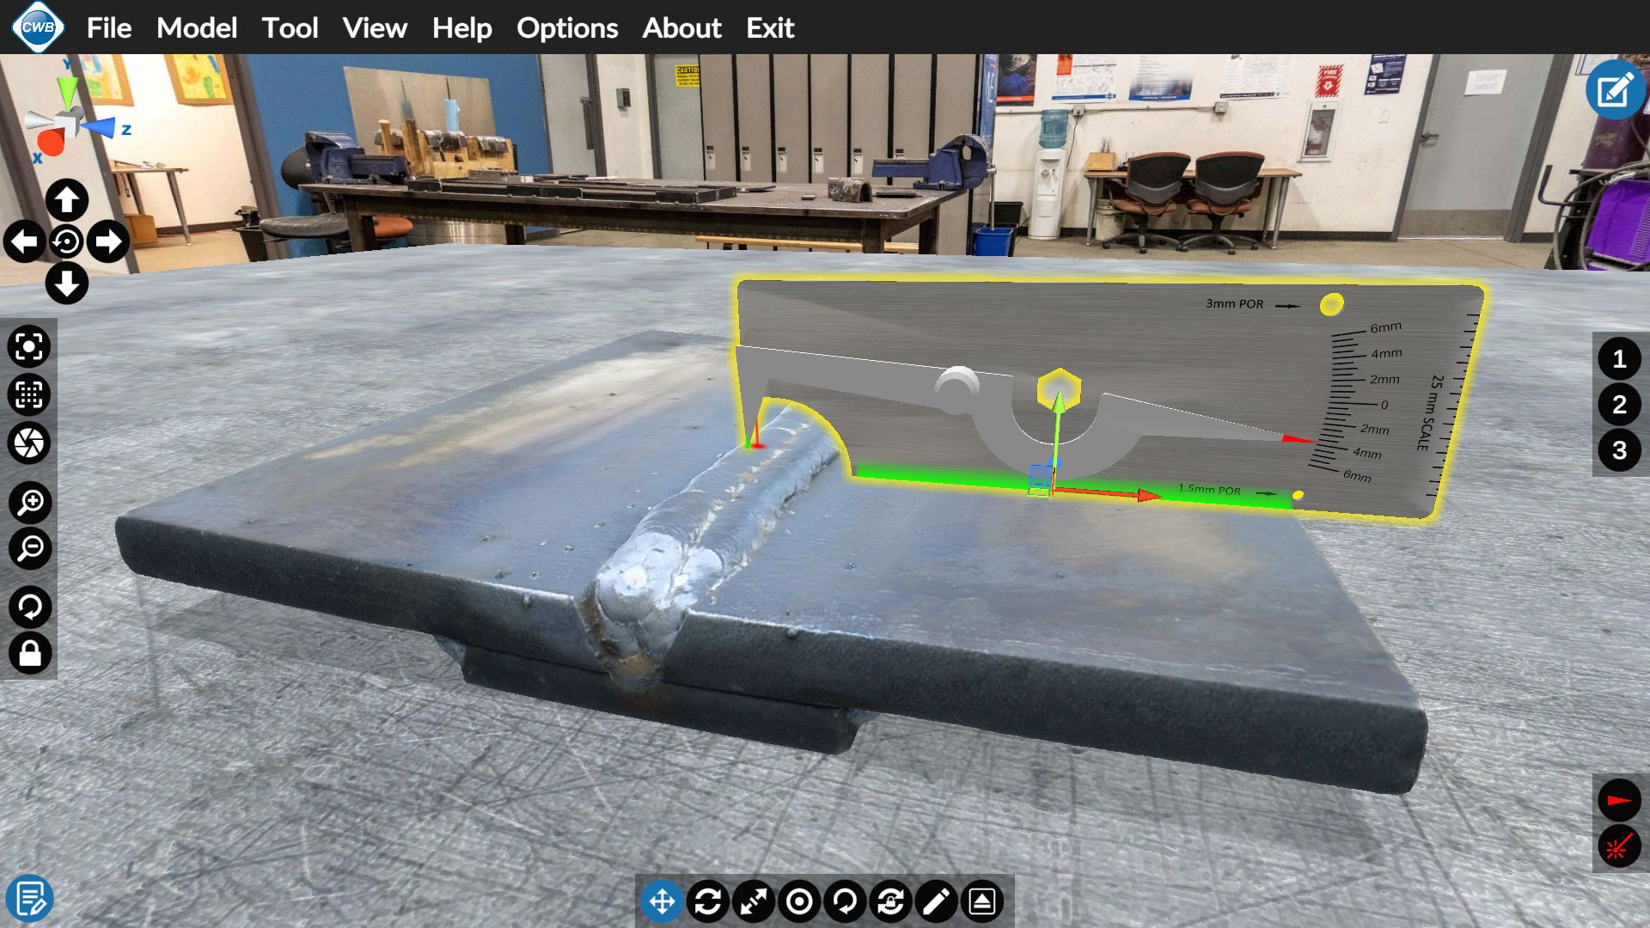

Slide 9
Questions?
Susan Witt
switt@ewi.org
716-710-5538

Slide 10
Thank you
Susan Witt, Manager Industrial Training

