Slide 1
Composite Component Work Cell for Intermediate Level Maintenance Facilities for Reduced Corrosion Related Maintenance
Dr. Maureen E. Foley, William Manning and Brandon Newsome
Materials and Manufacturing Division, Code 617
March 2024
Distribution Statement A: Approved for Public Release

Slide 2
Non-Metallic Components Background
NSWC Carderock has a history of developing and transitioning composite components to the fleet for over 25 years.
  Polymer additively manufactured or 3D printed components have more recently joined the portfolio.
Form, fit and function components can be transitioned via National Stock Number added to the ship class corrosion control APL while others may require Ship change document or maintenance work template/design memo.
Commercially available materials and components are used whenever possible to lower development costs and leverage previous developmental efforts.
This presentation will provide background information on the overall component portfolio and focus on the components that have the potential to be fabricated at intermediate and depot level facilities such as regional maintenance centers and shipyards.
Distribution Statement A: Approved for Public Release
2

Slide 3
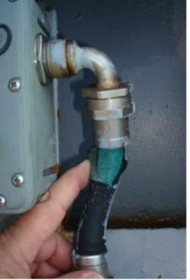
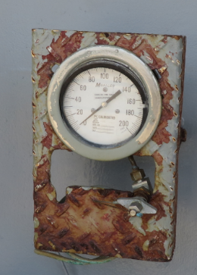
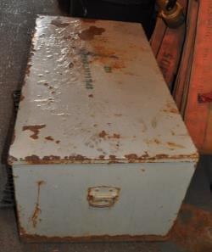
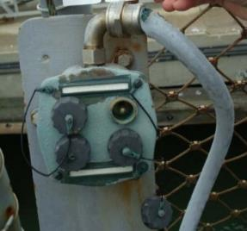
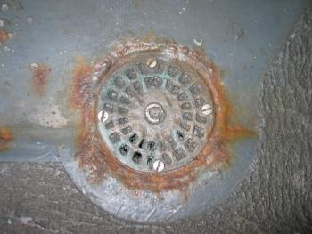
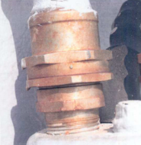
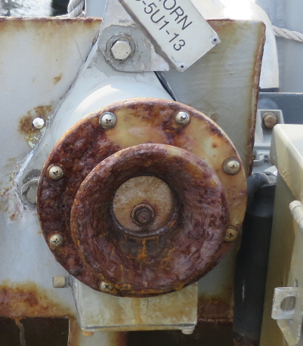
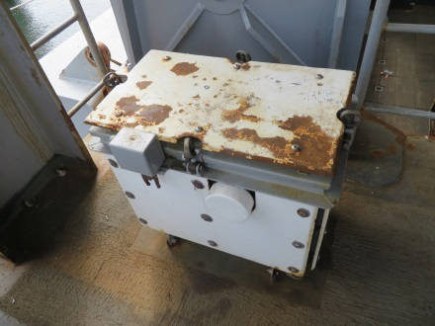
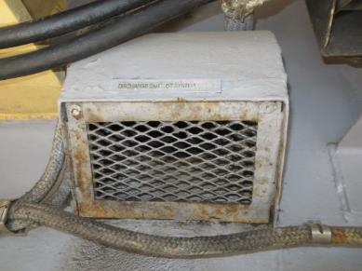
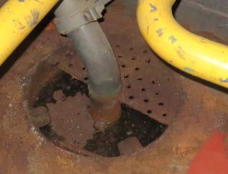
Examples of Corroded Components
Sound Powered Phone Jack Box
Deck Drain
Stowage Box
Conduit Connector
Gauge Panel
LHD well deck
Strainer plate
Vent Screen
Sunshields for Ready Service Lockers
Cease Fire Alarm Horn
Notes:
Here are some examples of components that can be found on surface ships that are known to require frequent maintenance due to corrosion in the maritime environment. These smaller components are typically found in ship topside locations on exposed weather decks, catwalks and on amphibious ships in the vehicle and well deck areas. Machinery spaces can also be considered wet spaces on surface ships. NSWCCD has developed composite solutions for most of these components on this slide. A polymer additive manufactured horn projector cover was developed as a form, fit and function replacement for the steel horn with the same weight and acoustic properties.

Slide 4
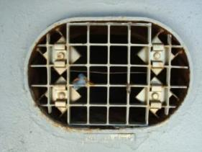
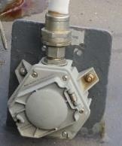
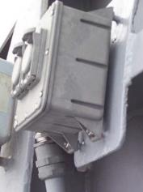
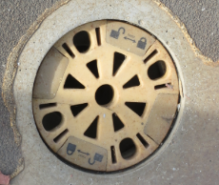
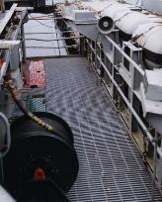
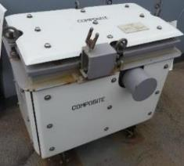
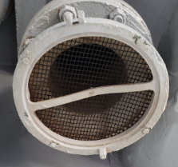
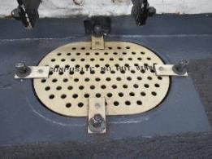
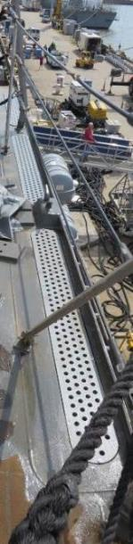
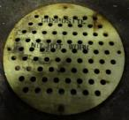
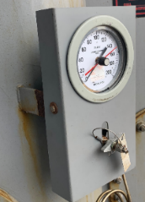
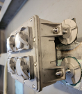
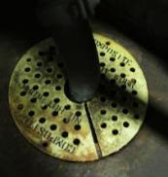
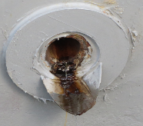
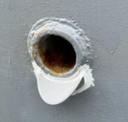
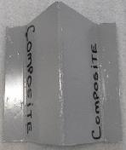
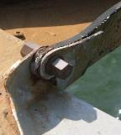
NSWCCD History of Composite Components
2000
Weather Deck Grating
Vent Screens
Electrical Enclosures
MIL-PRF-24758 Lightweight Fittings
Deck Drain Inserts
DDG51 Class Drain Trough Cover Plates
Composite Sunshields for Ready Service Lockers
LPD/LHD Vehicle Deck and CG47 Strainer Plates
Instrument Gauge Panels (DDG 51 class configuration in Demo)
Flame Arrestor Protective Screen
Cease Fire Alarm Horn Corrosion Upgrade Kit
Overboard Discharge Scuppers
Adhesively Bonded Studs for Composite Electrical Boxes
Anti-Siphon Guards
Composite Threaded Rods and Nuts for Deck Scuppers
Transitioned
1
2
3
5
4
7
10
8
8
13
11
9
8
8
Demo
12
15
6
Present
Potential for Fabrication at Intermediate and Depot Level
12
14
Notes:
Here is a list that shows the history of the NSWCCD Composite Components for Corrosion Control that have been developed over the past 25 years. Early work focused on #1 composite weather deck grating for aircraft carriers where there is a 14 tons reduction in weight with the switch to composite in addition to the corrosion reduction. #2 Vent Screens can be cut to any size and installed in front of air ventilation openings. #3 Composite electrical enclosures exist in standard sound powered phone jack box, electrical receptacles configurations and terminal and junction boxes can be used to house a variety of specialty connections, lights, speakers, etc. depending on the application. #4 is the Lightweight fittings used with the EMI/EMP flexible conduit that meet the MIL-PRF-24758 specification. #5 Deck drain inserts are a form, fit and function replacement for Navy standard deck fittings. This design implemented a twist to remove/lock design feature that eliminated the need to remove any fasteners to clean the deck drain. #6 and #8 are cover and strainer plates for drains for external and internal applications respectively. #7 Composite Sunshields for Ready Service Lockers that store ordnance near where it is needed. #11 is the cease fire alarm horn that I previously mentioned. #12 is the 3D printed overboard discharge scuppers that can be installed on hulls or bulkheads to reduce staining due to liquid discharge. That completes the list of the components that have been fully transitioned. #13, #14, and #15 Adhesively Bonded Studs, Anti-siphon guards and composite threaded rods and nuts are still the demonstration phase of development.

Slide 5
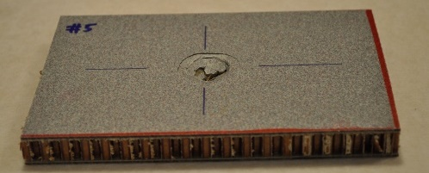
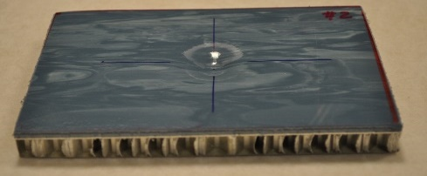
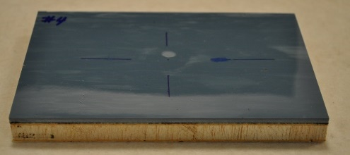
Composite Materials Introduction
Composite materials combine two or more constituent materials to form an overall structure
  Material remain separate and distinct within structure.
Classes
  Metal
  Ceramic
  Polymer
Types
  Solid Laminate
  Sandwich
Multifunctional Design Options
Sandwich Examples
Notes:
First I will provide a brief introduction to composite materials. Composite materials or composites for short combines two or more constituent materials to form an overall structure. The constituent materials remain separate and distinct within the structure distinguishing composites from blends or solid solutions. They are typically defined by the matrix material such as metal, ceramic or polymer based composites. This talk will focus on polymer based materials that are used in surface ship applications. Typically composite materials are defined as solid laminates or sandwich structures. A solid laminate is resin and reinforcement such as layers of glass or small chopped fiber. In a sandwich structure, the solid laminate acts as the bread with a center core that can be materials such as foam, balsa wood or honeycomb aluminum. The slide shows examples of composite sandwich panels used in false deck flooring installations on surface ships. From top to bottom, the cores are nomex honeycomb, aluminum honeycomb and balsa wood cores. The top and bottom examples have glass fiber reinforced phenolic resin laminates and the middle one has aluminum face sheets to complete the structure with a top wear surface material. In the case of the bottom two, while they are very different material constructions they both meet the military performance specification for these installations. This highlights the other design advantage to composite material in that they can incorporate materials that can facilitate multifunctional properties such as lightning strike, electro-magnetic and stealth properties.

Slide 6
Composite Material Design Process
Fiber
Resin-Thermoplastic/Thermoset
Fiber Form
Processing Method
Finishing (pigment/paint)
Quality
  Fiber/Resin fraction
  Void Content
  Density
Inter-related
Notes:
Similar to how a metallurgist selects a metal alloy, manufacturing process and heat treatments, the same type of material and manufacturing process must be defined for composite materials since the resulting material properties depend highly on the reinforcement material and configuration as well as the selection of the resin system. The most common fibers used in surface ship applications are glass, carbon and Kevlar. The most common glass fiber compositions are E-glass and S-Glass. S-glass being chosen for higher strength applications such as ballistic panels. Carbon fiber is chosen over glass where higher stiffness and strength are required. Kevlar fiber is also used in impact or ballistic applications but it’s properties can degrade in a moisture laden environment so this fiber is typically not selected for shipboard usage applications. Any carbon fiber composite that will be joined with a metal part will need to be isolated to prevent galvanic corrosion. Fibers can be incorporated as chopped fibers, woven fabrics, stitched layers and veils depending on the requirements of the application and the manufacturing method. There are two main types of resin systems. Thermoplastic and Thermoset. A thermoset material is analogous to making a cake. Once you mix all the components together and bake you have the finished material and you can’t go back and make changes. Thermoplastics are more like chocolate as that you can heat them to reform and then cool to solidify and repeat this process as necessary to make any changes. Once you have some ideas on the fiber and resin, the manufacturing options can be evaluated as there are many ways of fabricating the finished part. Hand Lay up, Vacuum Assisted Resin Transfer Molding (VARTM), Resin Transfer Molding (RTM), Pultrusion or pre-impregnated material are just some of the options. The composite material design process is typically an iterative approach as the requirements and manufacturing options are traded off to determine the optimum combination that will support the transition approach of the design. Final finishing options need also be considered if there is a seconding bonding or coating process that would require limitations of mold release to the surface. Once all the materials and manufacturing process is finalized, quality inspection criteria need to be developed such as fiber/resin fraction, void content and density to ensure that the material that is designed is what was fabricated. In maybe case, witness panels for samples of larger components can be removed to perform these quality inspections. For example, in the fabrication of rigid hull inflatable boats (RHIBS), the sections of the composite where outfitting is attached to the boat hull can be used to perform these quality tests.

Slide 7
Introduction-Composite Work Cell Concept
NSWCCD is recommending that Intermediate and Depot Level Maintenance stand up a small composite materials based work cell to support small composite component fabrication that are currently fabricated in metal.
Composite components exhibit significantly longer mean time to replace than metal components in maritime environment.
Minimal space and equipment required.
  Access to waterjet (or machining) facility for cutting required blanks.
  Storage of sheet stock
  Heated Wire Table
NSWCCD has purchased materials for 5 composite work cell start up kits to provide to Regional and Intermediate Level facilities.
  MARMC, SERMC, SWRMC, FDRMC ROTA, and Everett as facilities to receive heated wire table and sheet stock material.

Slide 8
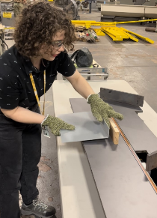
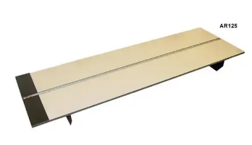
Composite Components Work Cell Requirements
Sheet stock material:
  Phenolic resin glass fiber reinforced sheets
    1/4“ x 48”x 96” thermoset composite sheet
  Polyetherimide resin glass reinforced sheets
    1/8 inch thick sheet stock (12 layers)
      1/8”x 48” x 144” thermoplastic composite sheet
      1/8” x 24” x 144” (other lengths available) - thermoplastic composite sheet
    1/4 inch thick sheet stock (24 layers)
      1/4” x 24” x 144”(other lengths available) - thermoplastic composite sheet
  MIL-PRF-32664 False Deck Panels
    0.56” x 48” x 96”- Vendor A and B
Equipment/space requirements:
  Access to sheet stock storage space and work table (~6ft)
  Access to waterjet (or machining) facility
  Heated Wire Table Top Unit (~4ftx2ft)

Slide 9
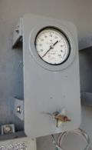
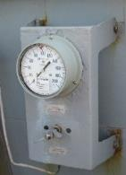
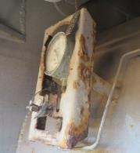
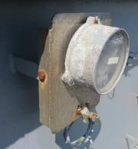
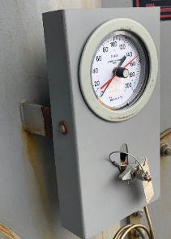
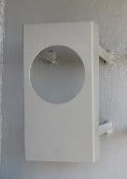
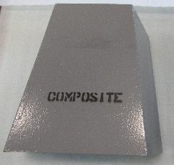
Composite Instrument Gauge Panel
NSWCCD (NAVSEA Drawing 504-8911654) developed a single composite instrument gauge panel that can be a form, fit and function replacement for the configurations shown.
  Flush or surface mounted, 1 or 2 connections per side
  Passed shock and vibration testing
Fabrication Process
  Cut blank from thermoplastic sheet stock (1/8 inch)
  Use heated wire table to heat bend line area (2 times)
    ~5 minutes per bend
  Bend by hand and push against stop for required angle.
  Coat to required color using standard processes
Trapezoidal Gauge Panel Configuration for DDG 51 class is under development in FY23/24.

Slide 10
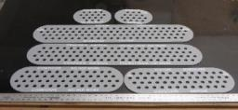
Cover Plates – DDG 51 Class
NSWCCD (NAVSEA Drawing 803-8892049 and 803-8892050) developed composite cover plates for deck drain troughs to be a form, fit and function replacement for the configurations shown.
  03 level and bridge wing installations
Fabrication Process
  Use waterjet to cut profiles from thermoset sheet stock (1/4 inch)
  Coat to required color using standard processes
  Mark per the drawing requirements
Installation
  Potential for RMC/shipyard labor to install.

Slide 11
New Component Flow Chart
Component Requirements Definition Phase
Technology Readiness Level-TRL
4A. Transition Path
ROI Metrics
3. Identify Governing Documentation
5. Stakeholder Concurrence
1. Identify Component
2. Identify Stakeholders
NAVSEA Drawings
Performance Specification
Platform Specifications
Operating Environment
4B. Develop Qualification Requirements
Mechanical, Thermal, Shock, Vibration, Environmental Durability, Signature, Fire Performance, etc.
NAVSEA TWH (05D, 05P, 05Z)
ISEA
End user/ System
Component Development Phase
TRL 3-4
10. Full Scale Component Fabrication
9. Component Drawing Development
8. Lab Scale Testing
7. Initial Prototypes
6. Material and Manufacturing Process Selection
TRL 5-6
Component Demonstration Phase
TRL 7-8
11. First Article Qualification Testing
12. Finalize Transition Plan
13. Prototype Demonstrations
14. Spiral Development
15. Final Configuration
Component Transition Phase
TRL 9
20. Fleet Awareness
19. Update Tech Doc. (NSTM, GSO, CWT, etc.)
18. Update APL and PMS
17. NSN Application
16. Publish Drawing/Technical Data Package

Slide 12
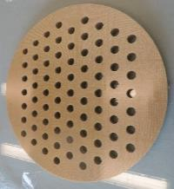
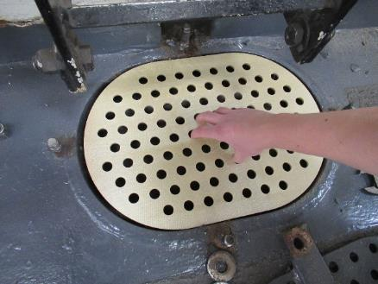
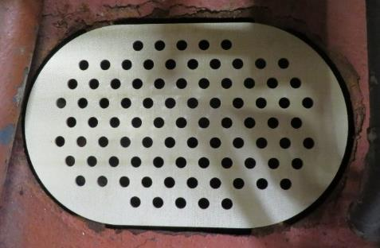
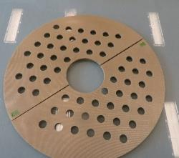
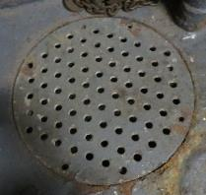
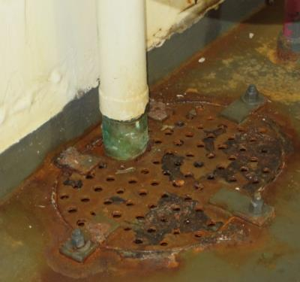
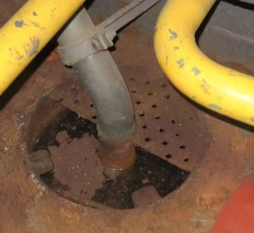
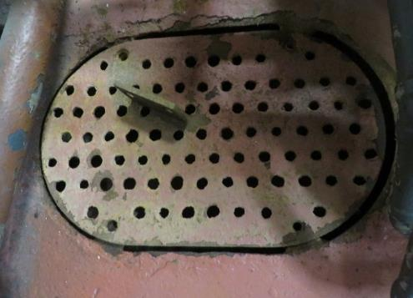
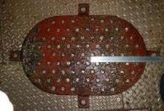
Strainer Plates
Five Internal Strainer Plates in Sump & Bilge Areas for LPD17 class (1), CG47 class (2) and LHD1 class (3)
LHD
CG
LPD

Slide 13
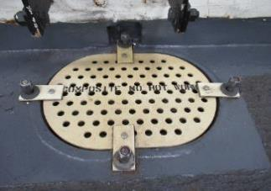


Strainer Plates – LPD17 and LHD1 Classes
NSWCCD (NAVSEA Drawing 529-8911656) developed composite strainer plates for internal applications.
  Drawing contains dimensions for LPD 17 class, LHD1 class and CG47 class strainer plates as well as an option for a generic plate that can be adopted to additional configurations.
Fabrication Process
  Use waterjet to cut profiles from thermoset sheet stock
  Coat to required color using standard processes
  Mark per the drawing callouts
Installation
  Potential for RMC/Shipyard labor to install.
LPD17 class
LHD1 class
Distribution Statement A: Approved for Public Release
13

Slide 14





False Deck Panel Materials for Electronic Spaces
NSWCCD spearheaded the development and publication of MIL-PRF-32664, Performance Specification Deck Panels, False, Composite to capture the requirements for the panels used in raised floor installation on Navy ships.
  New materials have significantly reduced installation requirements-no edge treatment.
  Potential for RMC to be able to provide small scale installations of panels.
  Fabrication Process
  Use waterjet to cut profiles from MIL-PRF-32664 sheet stock
  Template location of mounting holes using current broken Nomex panel
  Adhesively bond in plastic ferrules to mounting holes.
  Provide to ship as form, fit and function replacement for broken panel.
Installation
  Potential for RMC/Shipyard labor to install.
Impact Test Results
Legacy-Nomex Core
Vendor 1-Aluminum Core
Vendor 2-Balsa Core

Slide 15









Potential Future Components
After successful stand up of composite instrument gauge panel cover/strainer plates and false deck panels, additional components can be brought forward that use similar materials and fabrication methods.
  Anti-siphon guards
  Stowage boxes
  Bilge sump cover boxes
  Drip Pans

Slide 16














Polymer Additively Manufactured Components
NSWCCD has also developed and transitioned polymer additively manufactured components that could be leveraged by intermediate facilities to reduce corrosion related maintenance.
Overboard Discharge Scuppers
Deck Drain Coamings for Composite Deck Drain Inserts
Deck Fittings
Cease Fire Alarm Horn

Slide 17
Summary
NSWCCD is recommending that intermediate and depot level maintenance facilities stand up a small composite materials based work cell to support small composite component fabrication that have been approved to reduce corrosion related maintenance.
Minimal investment in space, materials and equipment would improve ship’s readiness and facilitate the transition of these components to the fleet.
NSWCCD will be providing materials/equipment for 5 composite work cell start up kits to Intermediate Level facilities in FY24.
  MARMC, SERMC, SWRMC, FDRMC Rota, Spain, Pearl Harbor and Everett as facilities to receive heated wire bend table and sheet stock of thermoplastic and thermoset material.
Polymer additively manufactured components can also be printed by additive manufacturing facilities.

Slide 18
Acknowledgements
The work presented during this presentation has been funded by a variety of different organizations:
  NAVSEA 05P Painting Center of Excellence (PCoE)
  NAVSEA 05T (Cross Platform Systems Development and Additive Manufacturing)
  NAVSEA PMS 501/505R/321 LCS Readiness
  NAVSEA 443 Readiness
  COMNAVAIRPAC (In-Service Carriers, N43)
  PMS 312 (In-Service Carriers)
  NSWCCD NISE (Internal R&D) Composite Innovation Transition

Slide 19

References and Contact Information
References
  NAVSEA Composite Component Technical Manual in process (S9078-AC-GYD-010), publication expected in FY24
  Based on NSWCCD Technical Report Composite Material Based Component for Corrosion Control Technical Manual, (NSWCCD-61-TM-2023/1) that has been posted on Defense Technical Information Center (www.dtic.mil) (AD1197061).
Contact Information
  Dr. Maureen E. Foley
  Code 617, Composites Team Lead
  maureen.e.foley4.civ@us.navy.mil l

