Slide 1
NSRP SP&C Panel 30 March 2023 Charleston SC
Dave Evans - Director, QP & Coatings Credentialing | Business Development

Slide 2
AMPP Origins
A Brief Overview

Slide 3
NACE & SSPC - Legacy Organizations
NACE International, The Corrosion Society
Established in 1943 as National Association of Corrosion Engineers
HQ in U.S. (Houston, Texas), and offices in 7 Countries
SSPC: The Society for Protective Coatings
Founded in 1950 as the Steel Structures Painting Council
HQ in U.S. (Pittsburgh, PA)

Slide 4
Association for Materials Protection and Performance
Combines 145 years of NACE and SSPC’s corrosion control and protective coatings expertise, resources, and member services
Single point for industry’s leading certification programs
Built to serve global membership
Expanded membership brings opportunities for more collaborative efforts and advocacy influence

Slide 5
AMPP Mission and Vision
Mission
Advancing materials performance to protect society, assets, and the environment.
Vision
A world built and protected with safe, reliable, sustainable materials.

Slide 6
AMPP Certification Updates

Slide 7
Coatings Inspector
NACE CIP and SSPC PCI certification have transitioned to AMPP Coatings Inspector Program (CIP)
The new AMPP coatings inspection certification program will maintain the CIP brand and will have three levels
CIP/PCI Level 1 = Basic coatings inspector
CIP/PCI Level 2 = Certified coatings inspector
CIP/PCI Level 3 = Senior certified coatings inspector
All cardholders in good standing (active status) have been grandfathered into the equivalent highest level achieved
AMPP will continue to recognize legacy PCI and CIP card holder credentials until industry has adopted AMPP CIP within current specifications
Renewal requirement = every 3 years

Slide 8
Coatings Inspector What do cardholders need to do?
Keep your existing certifications current using existing renewal processes.
Card holders who hold both PCI and CIP credentials will only be required to pay for one renewal however they will be required to complete the individual program requirements. Pay once – complete the necessary requirements for PCI and CIP when renewals are due.
Once you receive your new AMPP CIP credential, you will only be required to maintain your AMPP CIP credentials.
Renewing your future AMPP credentials will automatically update your legacy SSPC and NACE credentials.
New AMPP branded CIP credentials were issued at the end of March 2022

Slide 9
Craftworker Credentials
SSPC C-Certifications (e.g., C-7, C-12, C-13, C-14) and NACE CCA certifications are transitioning to an AMPP Coatings Applicator program.
AMPP will continue to recognize legacy SSPC C-certification card holder credentials until industry has adopted AMPP C-certifications within current specifications.
Because it will take time to execute “AMPP C-Certifications” branding with a multitude of stakeholders, “SSPC CAS, C7, C12 and C14” will be the brand that is visible in AMPP materials.

Slide 10
Protective Coating Specialist (PCS)
Legacy NACE and SSPC PCS certifications
For now, both will remain as standalone certifications*
Educational and testing materials currently being rewritten
Will be combined into one AMPP PCS certification when rewrite has been completed.
*Under Certification Committee Review

Slide 11
Education and Training
What’s New!

Slide 12
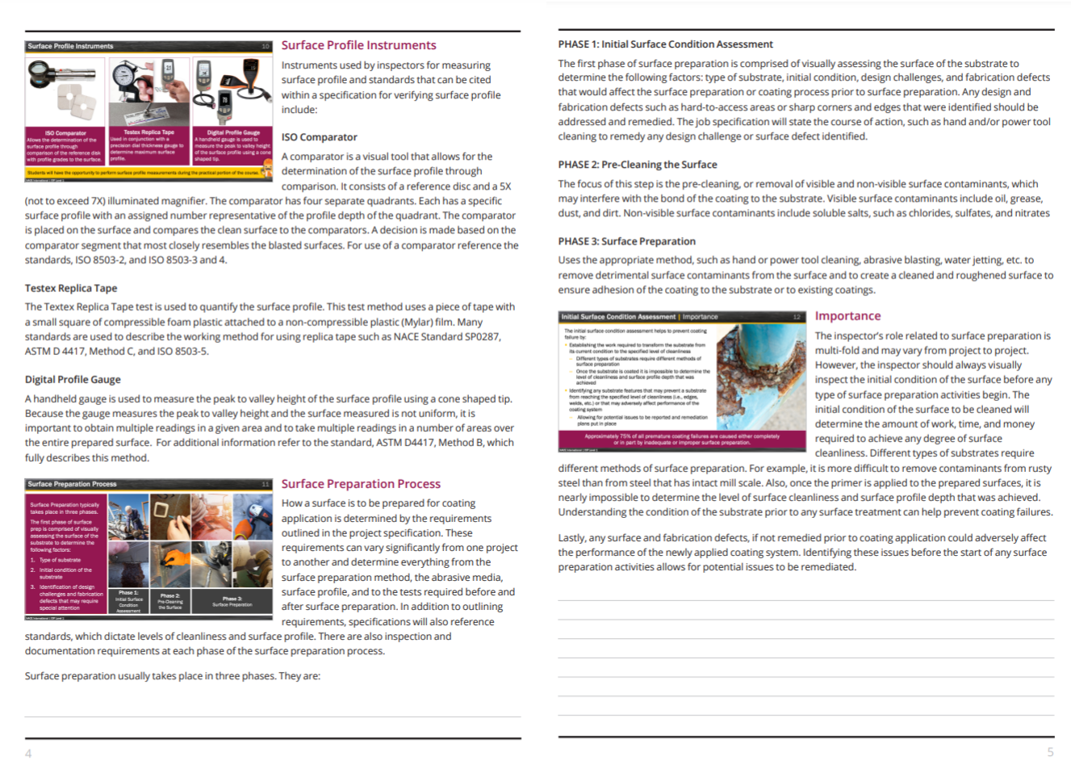
Education Programs - Brand New Look & Feel
Student manual features a workbook format with:
Lined areas for note-taking
Slides integrated into the textbook
Full color slides and photos
Larger graphics
Notes:
The entire course will feature a brand-new look and feel for both the slides and the student manual, including new photos, animations, illustrative drawings, and videos. In addition, multiple activities, case studies, and knowledge checks are incorporated throughout each of the slide decks to further student engagement and retention of the content.
The student manual has been designed as a workbook with specific areas for students to take notes and complete their activities and knowledge checks. Each slide is placed in a side-by-side format with the accompanying text associated with that slide for ease of student use during class and self-study. This enhanced layout eliminates the need for students to continuously flip back and forth from the slides to the chapter text as with the current CIP format. All pages in the workbook will be printed in color.

Slide 13
Courses - Updates and Rewrites
CIP-1 Coating Inspection
C3 Lead Paint Removal
C5 Lead Paint Removal Refresher
C7 Abrasive Blaster Certification
C12 Spray Application Certification
C13 Waterjetting Program

Slide 14
AMPP Standards Overview

Slide 15
Current State of the Program
AMPP Standards Program
Governed by Standards Program Committee (SPC)
25 Standards Committees (SC)
SPC has 15 voting members/Each SC has a Chair/Vice Chair
Document Project Managers are approved by the SC Chairs and lead standards development within SCs
Standards Committee Chair approves initiation of new standards within their Standards Committee (SC)
SC serves as voting entity for all standards within SC jurisdiction
3 interest classifications (user, producer, general interest)
AMPP membership optional – Nonmembers are all welcome to participate!
Participation as either Observer or Voting Member
Notes:
Legacy NACE had 28 Specific Technology Groups (STGs), over 200 Task Groups that developed standards, canvass ballot to establish consensus body for every TG/document, multiple interest classifications, membership required to participate

Slide 16
Idea for Standard Submitted via New Project Request Form
Standards Committee (SC) Chair Approves
SC Ballot Comments Adjudicated; May Revise Draft
Reballot Conducted If Technical Changes are Made
Standard Published once Approved by SPC
Document Project Manager(DPM) Appointed
Draft Prepared by Project Team
Ballot Issued to SC
Ballot Approved if:
>50% SC Votes and
≥75% Vote Affirmative
Ballot Issued to Standards Program Committee (SPC)
AMPP STANDARDS DEVELOPMENT PROCESS
23
Notes:
16

Slide 17
Specifying AMPP Standards

Slide 18
AMPP’s Position on Specifications
Realizing that industry and government agency documents frequently invoke AMPP’s standards by reference, AMPP has no intention to modify the unique, original/legacy identifiers of published NACE and SSPC standards.
All published NACE and SSPC standards will retain their current alpha numeric designation.

Slide 19
Revision of Published Standards
When an SSPC or NACE document is revised, its date of publication will be updated, but its designation will not change.
The document will have a new format containing an AMPP logo and copyright but will retain the legacy numbering system.
For example:
ANSI/NACE MR0175-2021/ISO 15156:2020
NACE SP0205
NACE WJ-1/SSPC-SP WJ-1
SSPC-Guide 6
SSPC-Paint 29

Slide 20
Newly Published AMPP Standards
New standards (Post Merger) created under the AMPP standards development process will utilize an AMPP designation.
For example:
AMPP TM21510

Slide 21
AMPP – SSPC Standard Projects & Committee Updates

Slide 22
Surface Preparation Related Documents
Current Projects
SP21511
Laser Ablation for Metallic Surface Preparation
SP21514
Dry Ice Blasting on Metallic and Nonmetallic Substrates
SP21523
Non-thermal Plasma Surface Preparation
of Metals
SP21528
Power Tool Cleaning of Non-Ferrous Metals, Stainless Steels, and Galvanized Steels
Recently Published Documents
SSPC-Guide 6
Guide for Containing Surface Preparation Debris Generated During Paint Removal Operations
Waterjetting Standards
WJ-1, 2, 3 & 4
SSPC-SP 18
Thorough Spot and Sweep Blast Cleaning for Industrial Coatings Maintenance

Slide 23
Maritime/Defense/QP Related Documents
Current Projects
SP21541
Recommendations for Material Selection and Welding for the Optimum Corrosion Resistance in Washwater Discharge Piping in Exhaust Gas Cleaning Systems (Scrubbers) for Marine Ships
QP21536
QP BASE: Standard Procedure for Evaluating General Qualifications of Contractors Seeking QP Accreditation
TR21517
Remote Inspection of Ship Hull Surfaces
Recently Published Documents
SP21487
Inspecting and Reporting Biofouling and Antifouling Systems’ Condition during Underwater Inspections on Ships
TR21448
Corrosion Prevention and Control for Marine Scrubbers
SP0616
Standard for Hull Roughness Measurements on Ship Hulls in Dry Dock
TM21510
Potentiodynamic Scans: Material Preparation, Data Acquisition and Analysis

Slide 24
Technical Committees
Technical Committee for Defense
With a number of Technical Communities of Interest focused on technical subject matter relating to corrosion of military assets.
Led by Patrick Cassidy

Slide 25
AMPP QP Accreditation Program

Slide 26
Industry-Leading QP Accreditation Program
The best just keeps getting better.
The "QP" brand will be retained by AMPP and the SSPC QP program will serve as the basis Quality Accreditation Program
Asset owners can turn to the AMPP QP Program when looking to prequalify coating companies and reduce risk.
For contractors, earning an AMPP QP accreditation demonstrates a commitment to high quality performance and environmental and safety standards.

Slide 27
Current QP Program Statistics
459 QP Accredited Contractors Globally
Approx 650 QP Audits scheduled for 2023
331 QP 1 Accredited Contractors
200 QP 2 Accredited Contractors
131 QP 3 Accredited Paint Shops
9 New Accreditations Awarded YTD
2 Existing Contractors added new QP Program Accreditations
25 active new applications in progress

Slide 28
QP Contractor Field and Shop Accreditations Painting of Steel Structures/Components Field (QP-1) or Shop (QP-3)
QP 1 & QP 3 have transitioned over to AMPP from SSPC without significant changes.
QP 1 is based on the current SSPC QP 1 standard revised in 2019.
QP 3 is based on AISC 420.10/QP 3. Update of QP 3 in process.

Slide 29
QP Accreditation: Skill Changes and Requirements for Contractor Certifications

Slide 30
Craftworker Certifications
Simplifying C7, C12 and CAS certification based on key contractor feedback
Focused on exams, fulfillment and simplifying renewal process
New AMPP “Craftworker Team” being launched to provide focused support for craftworker certifications and training needs based on contractor feedback.

Slide 31
Certification Program Improvements
CAS Level 2 “full”
Refresh theory exam
Remove irrelevant questions – e.g.) Inspection focused
CAS Level 2 “interim”
Will no longer be offered
Existing CAS “interim” card holders can renew for one cycle in order to gain necessary work experience
Will move to “full” status when work experience requirement is met – NO additional requirements
C7 and C12
Refresh exam items
Practical exams are a subset of CAS Level 2

Slide 32
Contractor Engagement

Slide 33
Contractor Engagement
Contractor Focus Groups
Face-to-face and virtual
Gain key insights into QP program benefits, membership, marketing and requirements (this is beyond contractor/auditor discussions at audits)
Held 4 contractor events in 2021
Held one event July 26th in Hanover, MD
Output drives key improvements to Programs, Products and Services
AMPP Contractor Council
Provides long term planning insight to the BOD’s
Contractors from all around to work, numerous industry focuses.
Business Development and Marketing Focus

Slide 34
Questions?

Slide 35
For more information, contact us at: ampp.org Dave Evans dave.evans@ampp.org or QPInfo@ampp.org
Notes:
Kyle

Slide 36
THANK YOU!

