Slide 1
Equipment Sight/Site Validation Tool
Sustainment Panel Meeting
March 2024

Slide 2
Problem Statement
Timely and accurate reporting of the as-built configuration is imperative throughout the ship’s life
Sight validation is used to verify ship’s configuration at any stage
Current shipyard sight validation data collection processes are designed to interface with Configuration Data Managers Database – Open Architecture (CDMD-OA) system
Navy is transitioning to Model-Based Product Support (MBPS) as the Configuration Status Account (CSA) tool of record
Current digital tools will be obsolete
Paper-based sight validation data collection increases cost

Slide 3
Goals and Long-Term Objective
Goals:
Explore current capabilities of existing electronic tools and software that could meet shipyard sight validation requirements
Develop software and hardware requirements for a digital sight validation tool that interfaces with MBPS
Long-term objective:
Deploy the digital sight validation tool that provides data to MBPS at reasonable cost without use of paper validation aids

Slide 4
Project Team
HII Ingalls Shipbuilding
Project lead
Paula Lacharite, Becky Sparkman, Joann Sullivan, Randy Gurley, David Furr, John Walks
General Dynamics Bath Iron Works
Collaborating shipyard
Andy Blackman, Michael Goodine, Daniel LaPointe
ATI (NSRP Program Administrator)
Jim House, Project Manager
Kakou Professional Development
Kaipo Crowell, Program Technical Representative

Slide 5
Team Responsibilities
Task | HII Ingalls | GD BIW
Task 1: Develop Shipbuilder and CDM requirements for software | Lead | Collaborate
Task 2: Develop Shipbuilder and CDM requirements for hardware | Lead | Collaborate
Task 3: Identify and Assess Existing Tools | Lead | Collaborate
Task 4: Determine if Market Tools Work | Lead | Collaborate
Task 5: Final Report | Lead | Collaborate

Slide 6
Project Tasks
Task 1: Develop Shipbuilder and Configuration Data Manager (CDM) requirements for software – Completed
Conduct a Kick-Off Meeting
Develop software requirements based on stakeholder needs
Task 2: Develop Shipbuilder and CDM requirements for hardware – Completed
Develop hardware requirements based on stakeholder needs
Task 3: Identify and Assess Existing Tools – Completed
Perform a market survey of existing hardware and software options
Task 4: Determine if Market Tools Work – (3/22/24)
Determine if one or more of the existing tools on the market can support the above requirements
Task 5: Final Report – (3/28/24)
Prepare final report with conclusions and recommendations

Slide 7
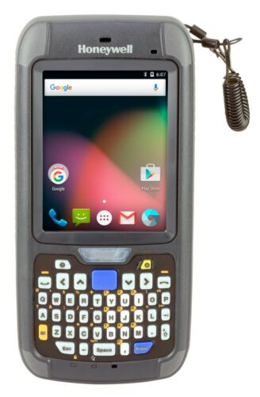
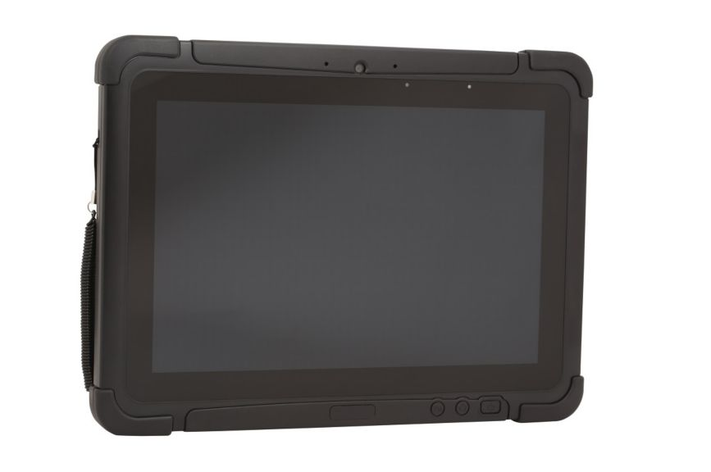
Hardware Options
Handheld computer Rugged Laptop (shown without optional strap)

Slide 8
Collaboration with NAVSEA
MBPS data input needs formed a significant part of the system requirements effort in Tasks 1 and 2
Project team benefitted from MBPS pilot activity (funded by the Navy) to understand data input requirements
Project team has pursued dialogue with NAVSEA throughout project execution, but they have been busy with MBPS software changes

Slide 9
Summary
Status: Project nearing completion
Software requirements are well-defined from MBPS pilot testing
Two primary hardware options are established (handheld computer or rugged tablet with optional strap)
No market tool is a perfect fit “out of the box” to meet shipyard needs
Task 4 report and final report will be completed this month
Next steps
Follow-on funding for software development will be sought

Slide 10
Questions?

