Slide 1
Stainless Steel, Push-Fit Drainage Systems

Slide 2
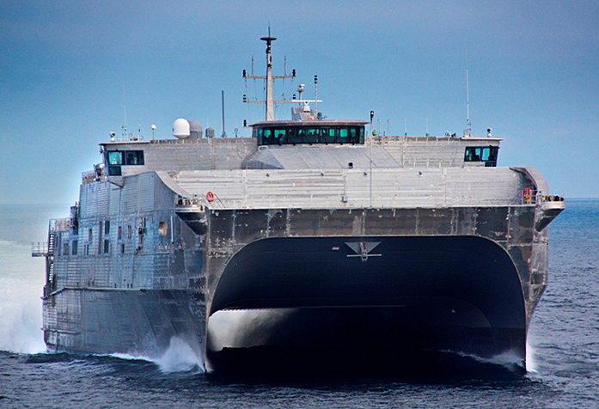
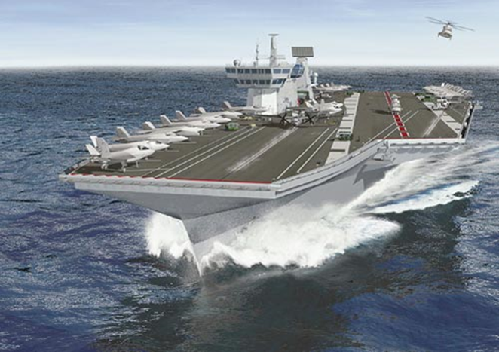
Success stories
EPF (formally JHSV)
Queen Elizabeth & Prince of Wales
What do these two vessels have in common (as well as 3000+ others)?
What would convince designers to move away from tried and tested solutions?

Slide 3
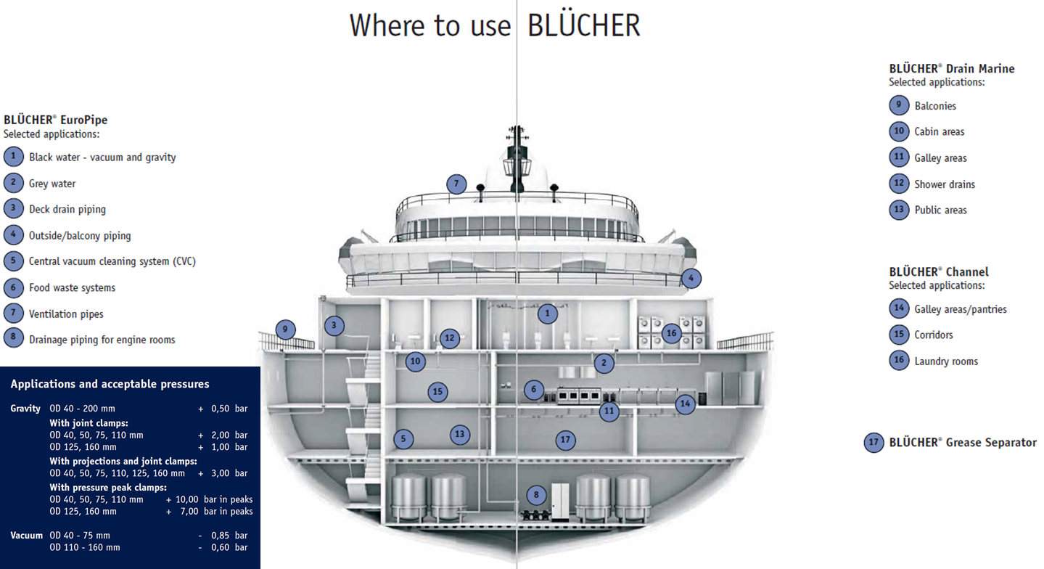
The Solution
The Blücher System

Slide 4
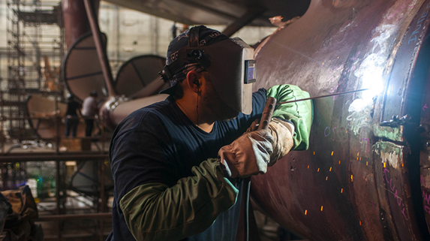
Why?
Shipbuilding current challenges
Reduce design complexity
Lack of skilled labor
Push for commercial off-the-shelf products
Reduce cost (installed and lifetime)
EHS focus (shipyard and onboard)
Reduce weight
Potential for refit/repair

Slide 5
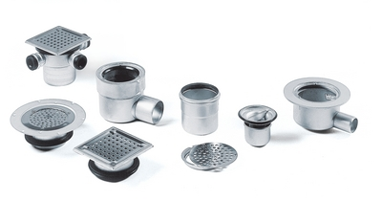
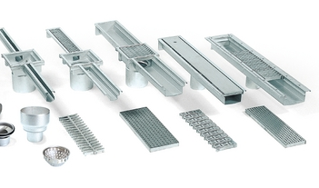
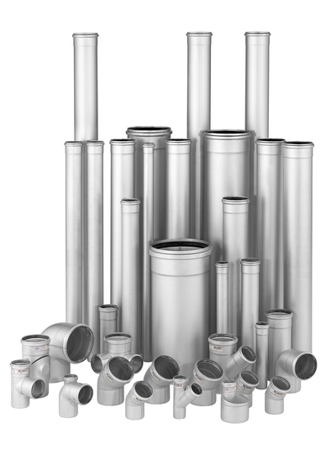
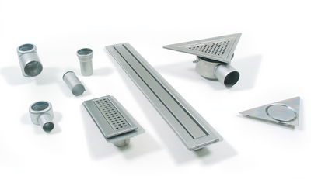
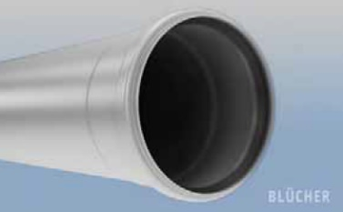
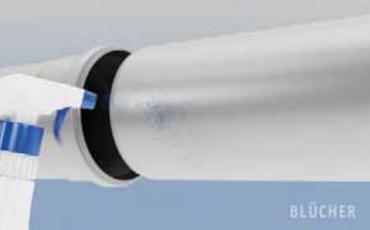
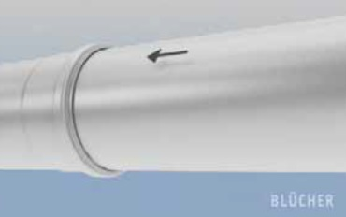
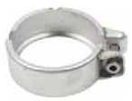
How/What?
The Blücher System
BLÜCHER® Drain
BLÜCHER® Channel
BLÜCHER® EuroPipe
Push-fit technology with optional clamps

Slide 6
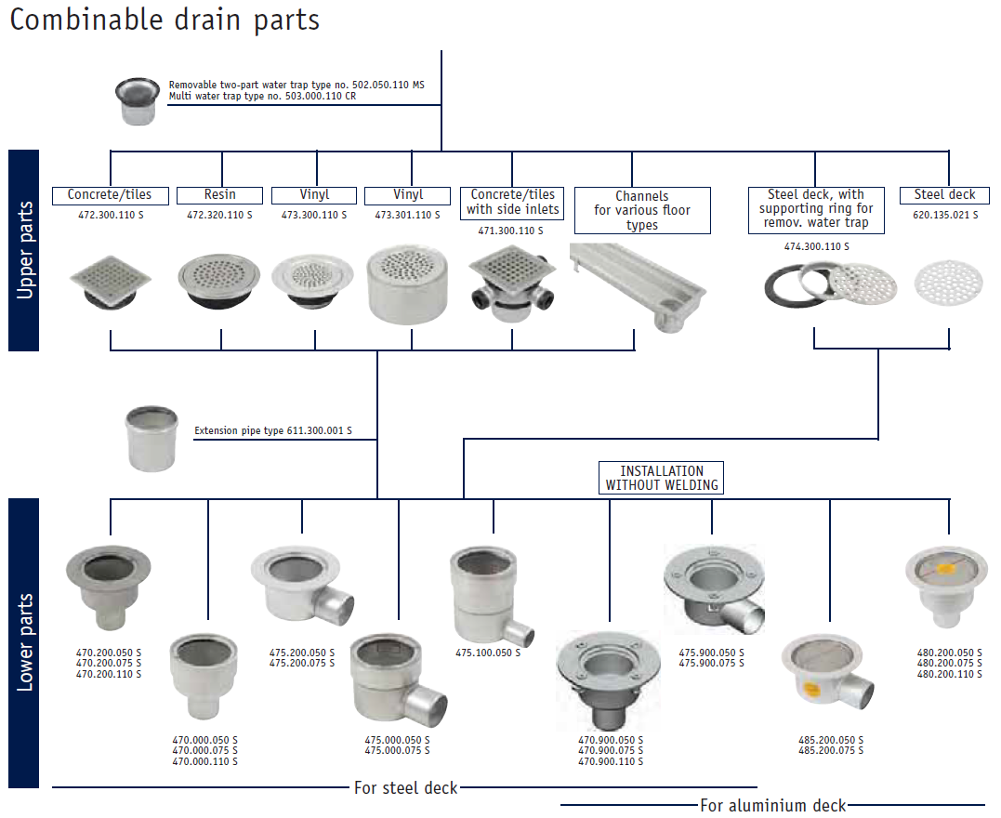
How/What?
The Blücher System

Slide 7
How/What?
How does Blücher address the focus areas?
Reduce design complexity
All components in 3D CAD (Aveva)
Complete system
Single source
Supports gravity and vacuum systems
Carries all required certifications (inc. ABS, Lloyd’s, TNO – NATO shock and vibe etc., working on MIL shock and vibe)
Lack of skilled labor
Only unskilled labor required for install
Push for commercial off-the-shelf products
Blücher is stocked locally in Spindale, NC and Sparks, NV. Made in Denmark.
Reduce cost (installed and lifetime)
Significant labor and training cost savings for installation versus welding
All 316L stainless steel
Designed for easy retrofit and repair

Slide 8
How/What?
How does Blücher address the focus areas?
EHS focus (shipyard and onboard)
No welding for all joints = no hot work permits, no fumes/UV (ref. 2017 IARC declaration).
Both welded and non-welded options available for penetrations
Lightweight (see tables below) = fewer strain /impact recordables
Hygienic – less corrosion = fewer sites to harbor dangerous bacteria
Reduce weight
Lightweight (approx. 1/3 that of carbon steel) – significant weight savings over carbon steel add up quickly
Potential for refit/repair
The system is designed to be easily interchangeable
Nominal Diameter | SCH. 40 Black Iron (kg/m) | Blucher 316L SS (kg/m) | % Savings
2" (50mm) | 5.44 | 1.25 | 77%
3" (75mm) | 11.29 | 1.95 | 83%
4" (110mm) | 16.07 | 2.85 | 82%
5" (125mm) | 21.77 | 3.32 | 85%
6" (160mm) | 28.26 | 5.48 | 81%
8" (200mm) | 42.55 | 8.32 | 80%
Nominal Diameter | Cupronickel (kg/m) | Blucher 316L SS (kg/m) | % Savings
2" (50mm) | 3.45 | 1.25 | 64%
3" (75mm) | 5.85 | 1.95 | 67%
4" (110mm) | 8.68 | 2.85 | 67%
5" (125mm) | 12.34 | 3.32 | 73%
6" (160mm) | 15.75 | 5.48 | 65%
8" (200mm) | 20.6 | 8.32 | 60%

Slide 9
Impact - Cost
Case Study – Keppel Shipyard (Singapore)
Project scope and assumptions
FPSO conversion requiring piping installation in accommodation for black and grey water piping system
Comparison based on pipes and fittings.
7000 connections planned for both black and grey water system
Project to be completed within 180 days
8 working hours per day (breaks and meal times excluded)
Manpower costs US$ 4.26 per man hour
Project carried out in Singapore.
All prices, wages and other costs converted to USD from SGD

Slide 10
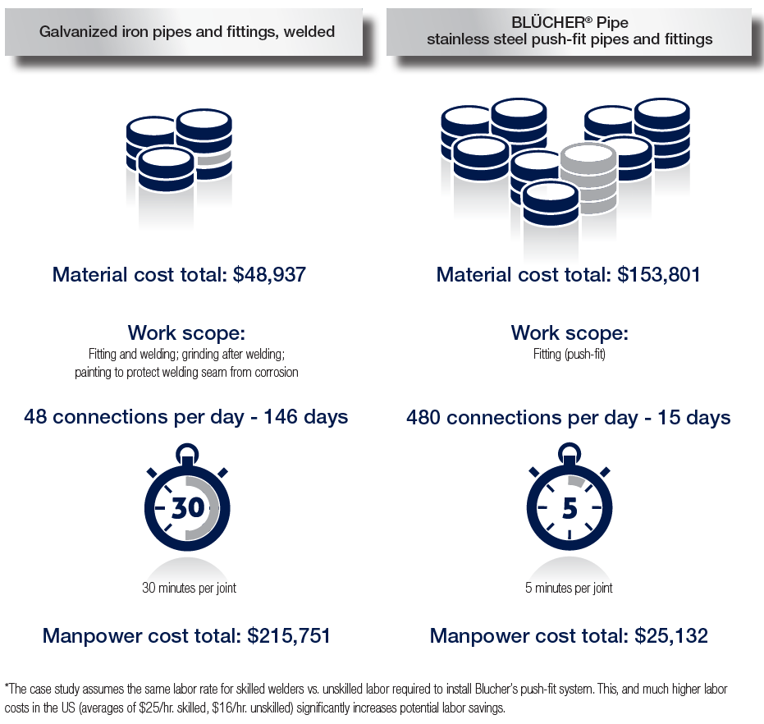
Impact - Cost
Case Study – Keppel Shipyard (Singapore)

Slide 11
Impact - Cost
Case Study – Keppel Shipyard (Singapore)

Slide 12
What next?
NSRP
Goal: to receive NAVSEA approval to use Blücher on all surface combat and support vessels for as wide an application range as possible (including but not limited to CVN, DDG, LCS, FFG, etc.)
Current Status
Hi-Test labs contracted to perform shock and vibration testing
How can you help?
Looking for shipyard partners to help define rigorous and thorough test set-up to ensure worst-case scenario testing

Slide 13
Summary
Welded drainage systems are no longer necessary when better solutions exist
Work with us as we take marine drainage into the future!
Further information:
http://www.blucher-marine.com
Alexander.Green@wattswater.com
417 459 1993
Blücher: a safe, proven solution saving time and money

