Slide 1
Shipyard Infrastructure Optimization Plan
Michael Mazzenga

Slide 2
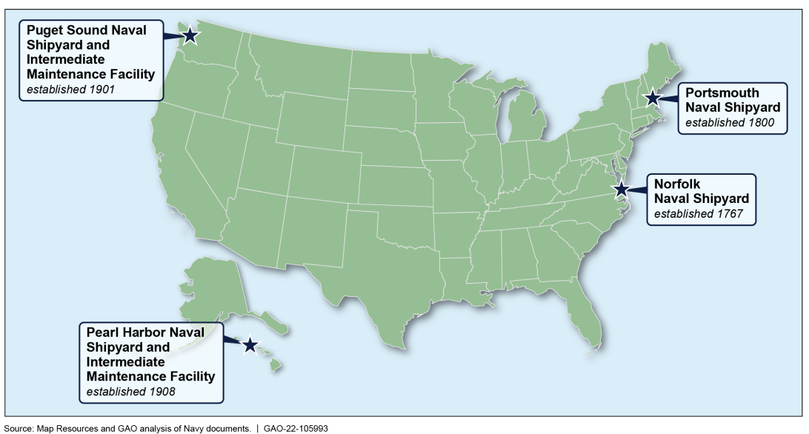
Naval Shipyards
The naval shipyards were originally designed to build wind- and steam powered ships, and range in age from 114 years to 255 years

Slide 3
Impact of Shipyard Maintenance Delays
Delays in shipyard maintenance directly affect the Navy’s readiness
2015 thru 2019
Aircraft Carriers
1128 days of delay (ship not operational)
Equal to losing .5 of a carrier for a year
Submarines
6296 days of delay
Equal to losing 3 submarines for each year

Slide 4
Shipyard Infrastructure Optimization Plan (SIOP)
February 2018, the Navy issued a plan to address infrastructure deficiencies at the public shipyards known as the (SIOP)
Calls for the replacement or modernization of critical shipyard infrastructure with a focus on
Dry docks
Facilities
Capital equipment

Slide 5
Major Areas for Improvement Identified in the Navy’s Shipyard Infrastructure Optimization Plan

Slide 6
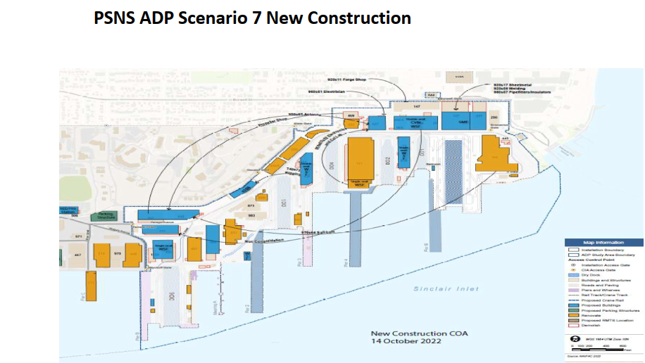
Puget Sound Naval Shipyard- Plant Simulation Modeling Example

Slide 7
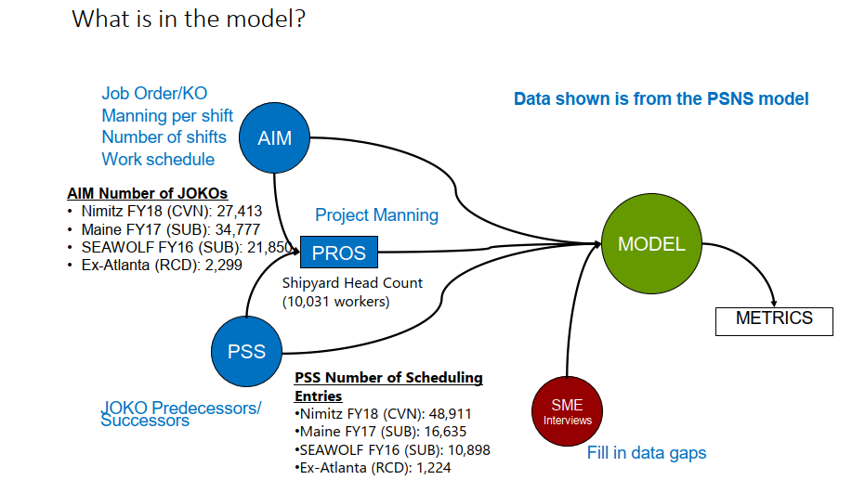
Data Input

Slide 8
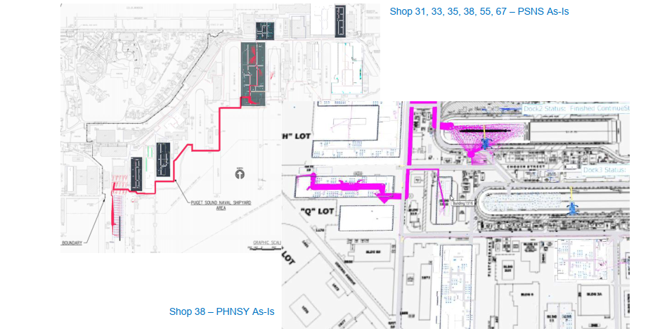
Worker Movement-Sankey Diagram

Slide 9
Current Status
Restricted | © Siemens 2023

Slide 10
Questions ?
Restricted | © Siemens 2023

