Slide 1


Slide 2

ASTM F1387 (MAFs) – MegaPress® CuNi
Workforce 2023 Update by Jesus I. Herrero, Viega LLC
NSRP Workforce 2023 Update – ASTM F1387 – MegaPress CuNi August 2, 2023
Notes:
As of today, only couplings ½” thru 2” are included in the NAVSEA letter. However, Shock Extensions for additional shapes are in the works by Gibbs and Cox for the FFG-62 program and we expect those results very soon resulting in the extension of the NAVSEA approval for additional shapes. So a much more complete product offering available for use on Surface Combatants, USCG and wherever MIL-STD-777 is invoked.

Slide 3
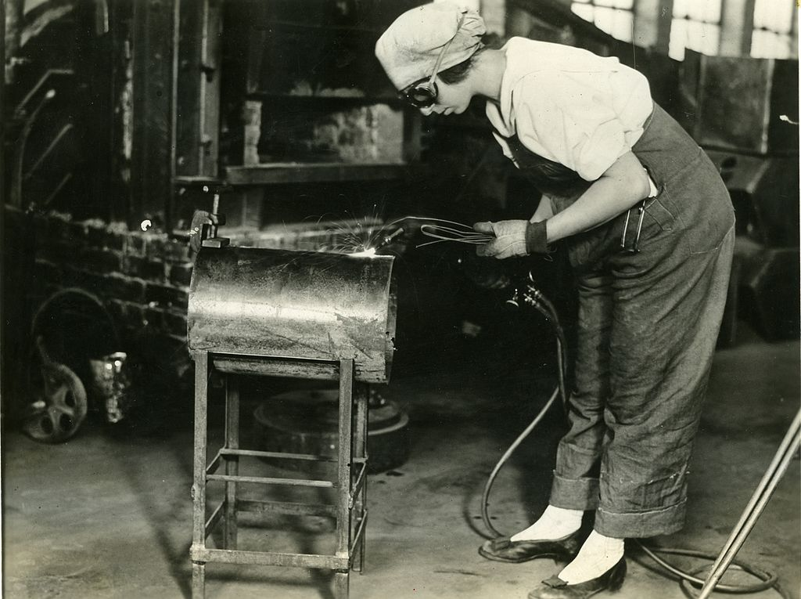
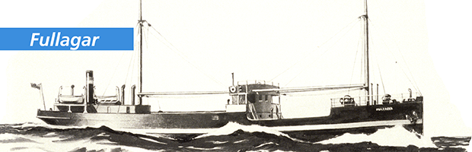
History of Welding and Brazing
There are 100 years' worth of paperwork justifying welding/brazing as the ideal method for shipbuilding.
In 1920, the first all welded hull was launched, HMS Fullagar.
However, welding is the most expensive and time-consuming component of the shipbuilding manufacturing process.
600+ Ship fires documented in three (3) years –Greater than 50% were attributed to hot work. Navy looses one ship to fire every seven years on average.
NSRP Workforce 2023 Update – ASTM F1387 – MegaPress CuNi August 2, 2023
Notes:
As of today, only couplings ½” thru 2” are included in the NAVSEA letter. However, Shock Extensions for additional shapes are in the works by Gibbs and Cox for the FFG-62 program and we expect those results very soon resulting in the extension of the NAVSEA approval for additional shapes. So a much more complete product offering available for use on Surface Combatants, USCG and wherever MIL-STD-777 is invoked.

Slide 4
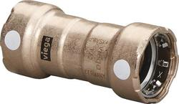
History of Viega MegaPress Systems
The press-connect joining method (sometimes called press-fit) was patented in Europe in the late 1950s. This is an interference fit. It forms the basis for MegaPress connection systems.
Press technology incorporates a pressed(crimped) connection to form a mechanical attachment to pipe and an elastomeric sealing element to seal whatever fluid is inside (or outside) from leaking. It is governed by ASTM F3226.
22M+ MegaPress fittings sold
2,500+ Applications
NSRP Workforce 2023 Update – ASTM F1387 – MegaPress CuNi August 2, 2023
Notes:
As of today, only couplings ½” thru 2” are included in the NAVSEA letter. However, Shock Extensions for additional shapes are in the works by Gibbs and Cox for the FFG-62 program and we expect those results very soon resulting in the extension of the NAVSEA approval for additional shapes. So a much more complete product offering available for use on Surface Combatants, USCG and wherever MIL-STD-777 is invoked.

Slide 5
NSRP Project History – Qualification to a higher standard ASTM F1387
2018 – funding for first set of tests, Shock and evaluation of other tests necessary to qualify the system to the higher ASTM F1387 Standard.
2020 – funding for second set of tests
March 2021 NAVSEA Letter for ½” ProPress coupling
May 2021 NAVSEA Letter for MegaPress CuNi ½” thru 2” couplings
Cost Comparison (MegaPress CuNi vs CuNi socket weld) – 56%
April 2022 NAVSEA Letter for MegaPress CuNi Couplings, Elbows (90s & 45s), TEEs
2022 – funding for NAVSEA specific Train the Trainer program development and training
11 participants from 2 shipyards and SUPSHIP-BATH were qualified as trainers.
NSRP Workforce 2023 Update – ASTM F1387 – MegaPress CuNi August 2, 2023
Notes:
As of today, only couplings ½” thru 2” are included in the NAVSEA letter. However, Shock Extensions for additional shapes are in the works by Gibbs and Cox for the FFG-62 program and we expect those results very soon resulting in the extension of the NAVSEA approval for additional shapes. So a much more complete product offering available for use on Surface Combatants, USCG and wherever MIL-STD-777 is invoked.

Slide 6
RAP: Implementation of Press Connect Fittings (Train the Trainer)
Prime/Lead: GD-Bath Iron Works
  Team members:
    GD Bath Iron Works
    Fincantieri Marinette Marine
    SUPSHIP-BATH
    Viega LLC
  3 Days
  7 Assemblies
  Lots of fun and learning
NSRP Workforce 2023 Update – ASTM F1387 – MegaPress CuNi August 2, 2023
Notes:
As of today, only couplings ½” thru 2” are included in the NAVSEA letter. However, Shock Extensions for additional shapes are in the works by Gibbs and Cox for the FFG-62 program and we expect those results very soon resulting in the extension of the NAVSEA approval for additional shapes. So a much more complete product offering available for use on Surface Combatants, USCG and wherever MIL-STD-777 is invoked.

Slide 7
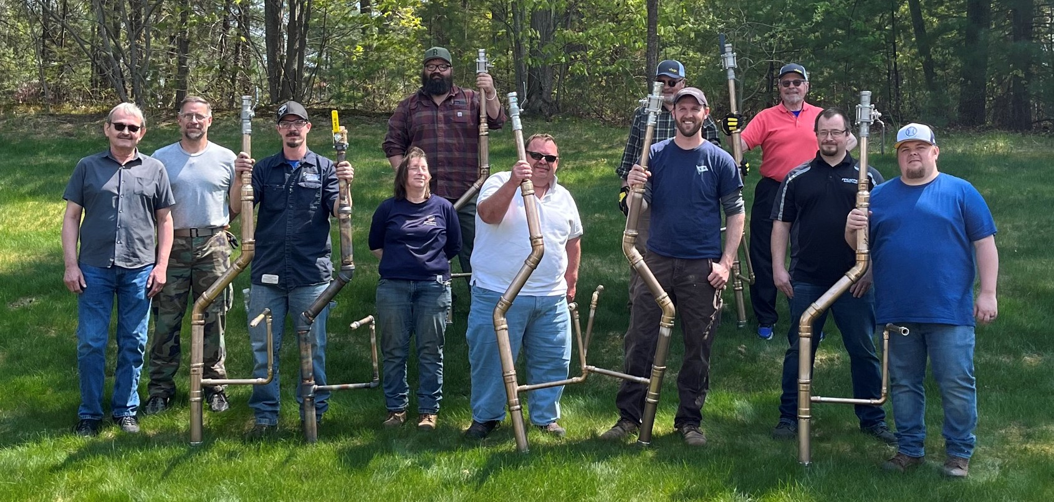
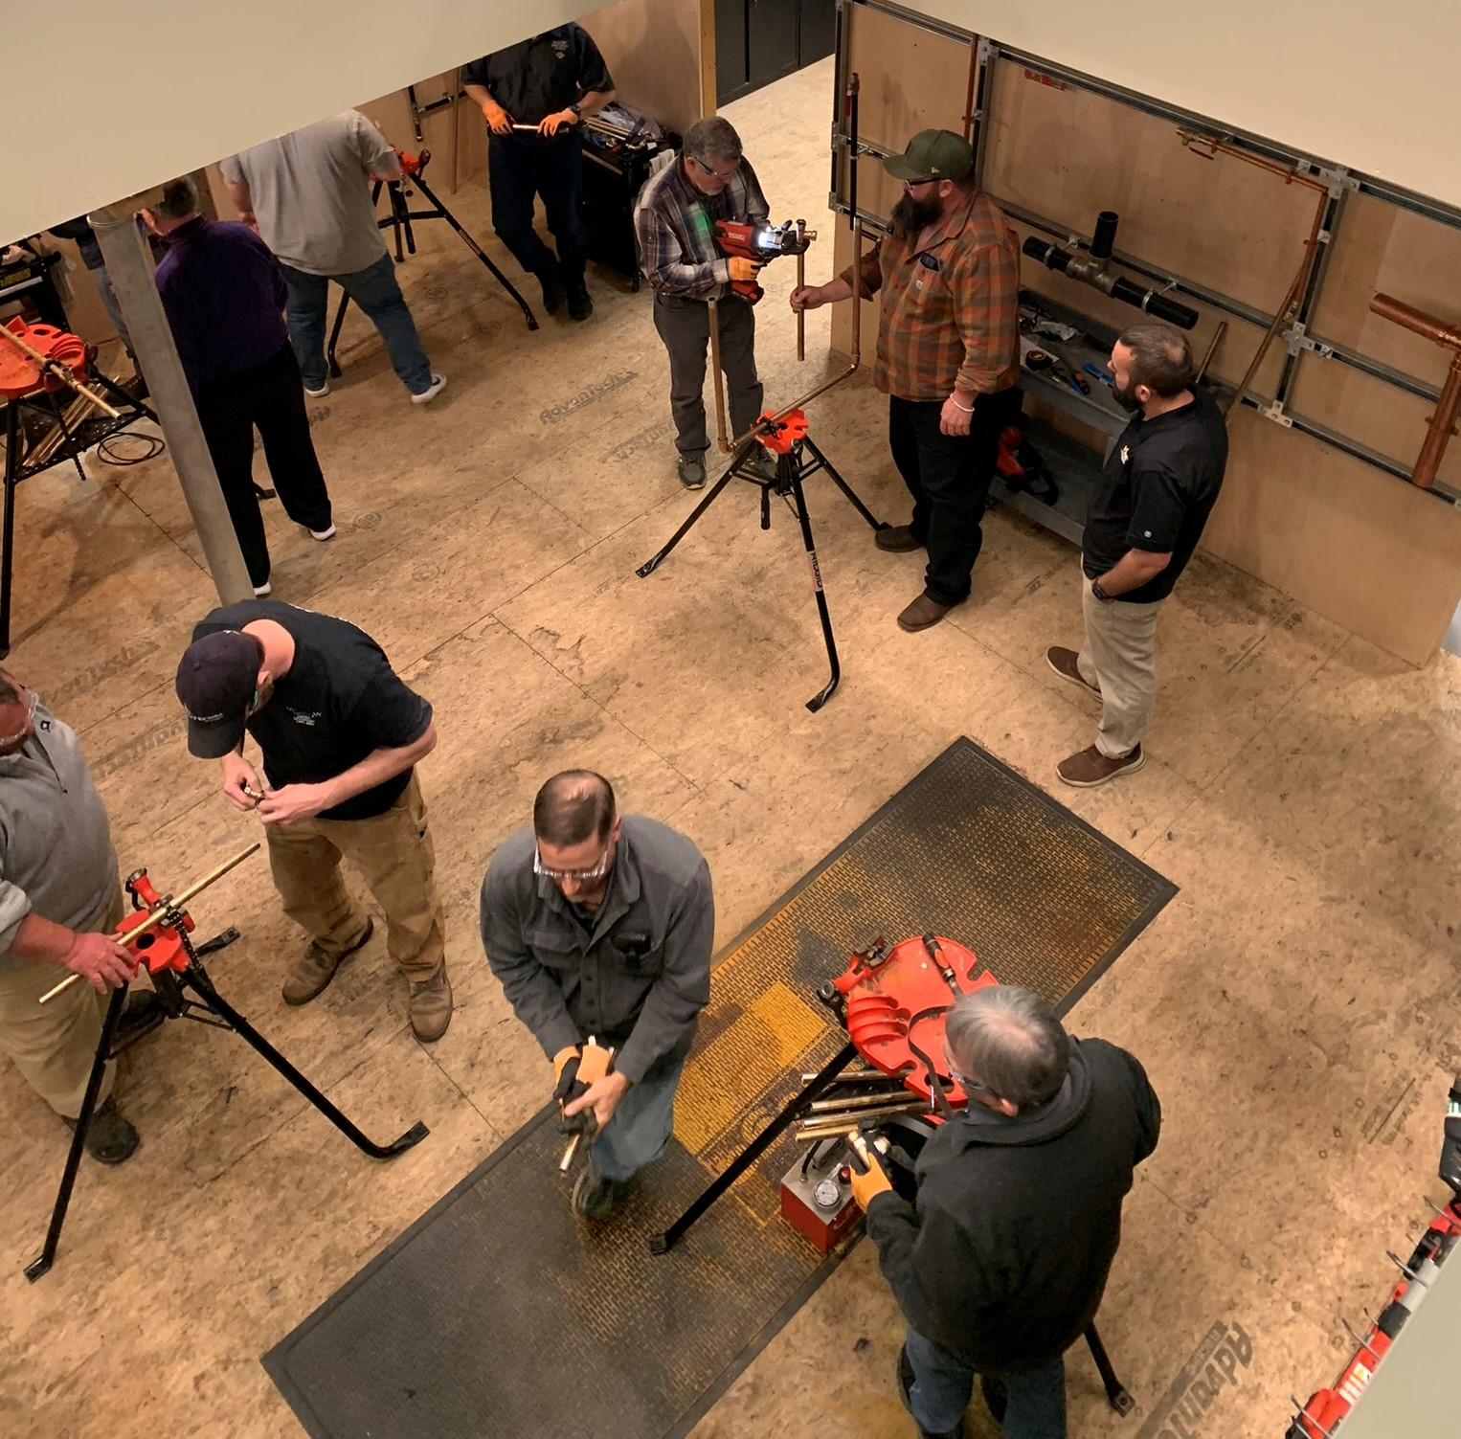
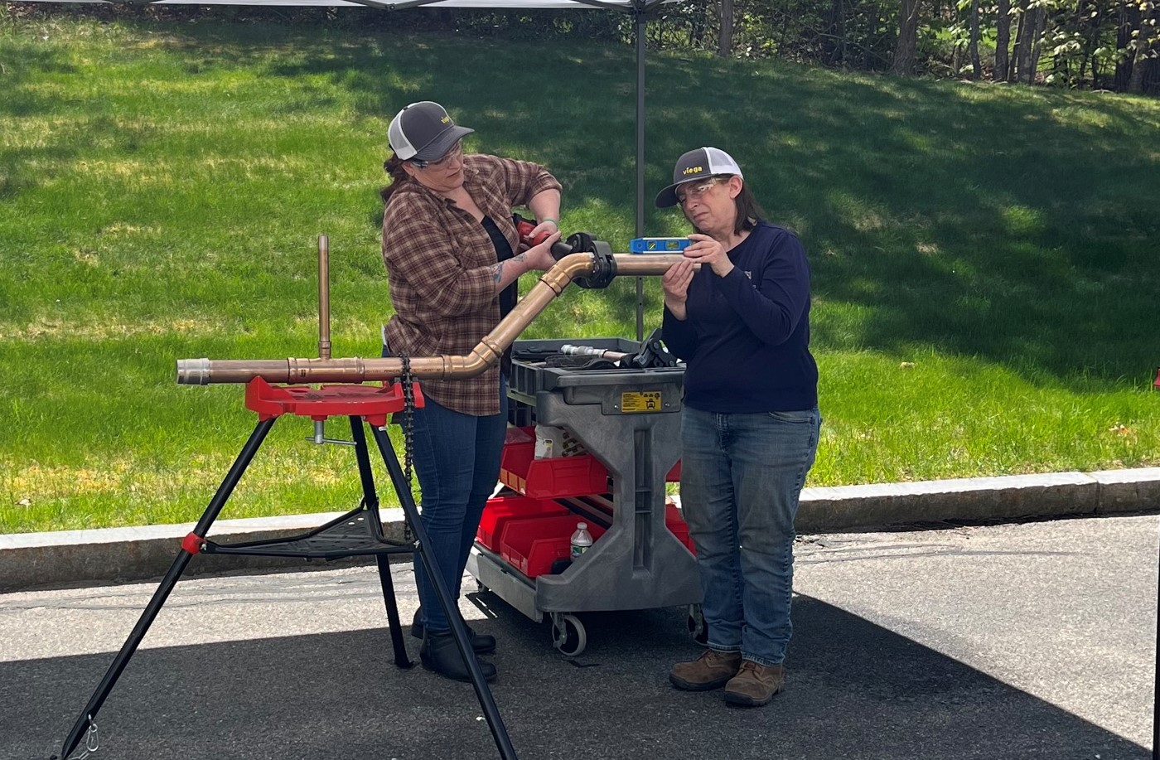
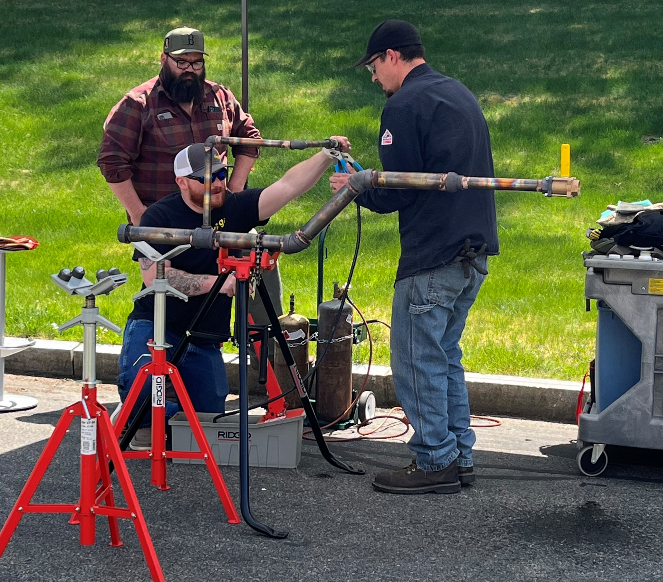
RAP: Implementation of Press Connect Fittings
NSRP Workforce 2023 Update – ASTM F1387 – MegaPress CuNi August 2, 2023
Notes:
As of today, only couplings ½” thru 2” are included in the NAVSEA letter. However, Shock Extensions for additional shapes are in the works by Gibbs and Cox for the FFG-62 program and we expect those results very soon resulting in the extension of the NAVSEA approval for additional shapes. So a much more complete product offering available for use on Surface Combatants, USCG and wherever MIL-STD-777 is invoked.

Slide 8
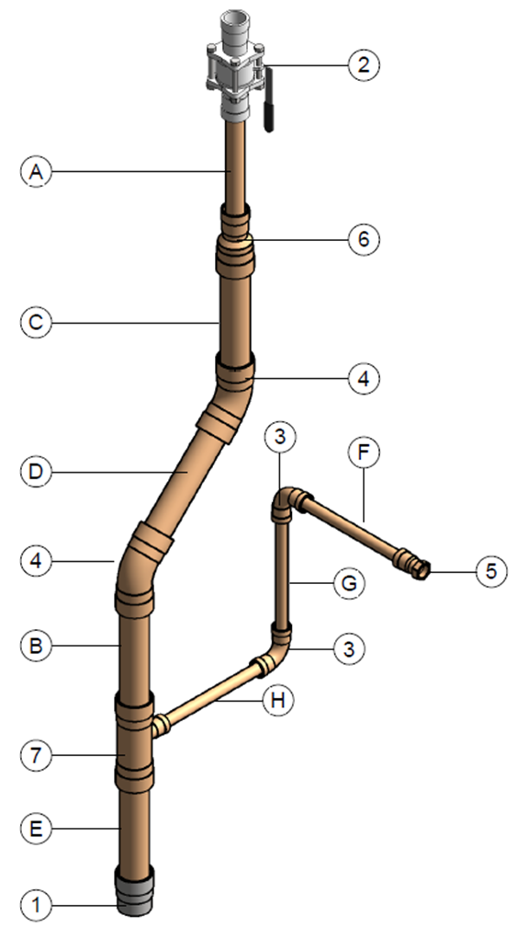
What did we build?
The Final Assembly consisted of:
16 connections
  8 ea 2”
  2 ea 1-1/4”
  6 ea ¾”
7 assemblies
  Two person teams on four assemblies
  Two, one person teams on a competition for the fastest individual time
  One Silver-Brazed assembly built alongside the other teams…
NSRP Workforce 2023 Update – ASTM F1387 – MegaPress CuNi August 2, 2023
Notes:
As of today, only couplings ½” thru 2” are included in the NAVSEA letter. However, Shock Extensions for additional shapes are in the works by Gibbs and Cox for the FFG-62 program and we expect those results very soon resulting in the extension of the NAVSEA approval for additional shapes. So a much more complete product offering available for use on Surface Combatants, USCG and wherever MIL-STD-777 is invoked.

Slide 9
Let’s see how the teams did
Insert Teams Video Here
NSRP SDMT 2023 – ASTM F1387 – Mechanically Attached Fittings (MAFs) – 2023 Update July 13, 2023
Notes:
As of today, only couplings ½” thru 2” are included in the NAVSEA letter. However, Shock Extensions for additional shapes are in the works by Gibbs and Cox for the FFG-62 program and we expect those results very soon resulting in the extension of the NAVSEA approval for additional shapes. So a much more complete product offering available for use on Surface Combatants, USCG and wherever MIL-STD-777 is invoked.

Slide 10
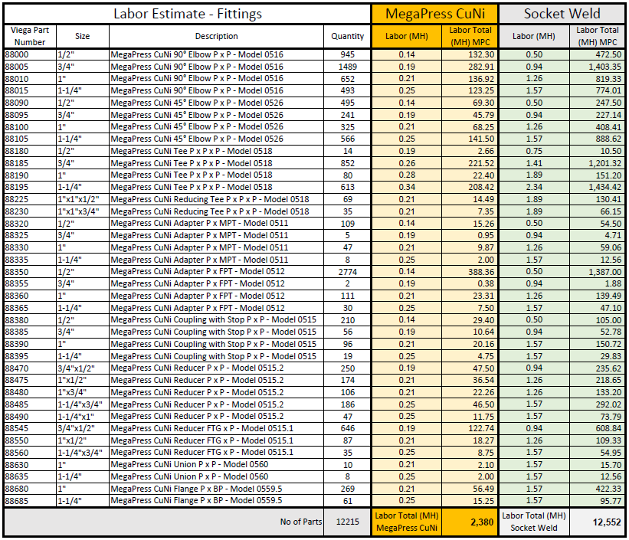
Let’s review a simple estimate.
Actual takeoff
Industry Standard Labor Data for MegaPress CuNi
NAVSEA Labor data for Socket Weld
6X Faster
NSRP SDMT 2023 – ASTM F1387 – Mechanically Attached Fittings (MAFs) – 2023 Update July 13, 2023
Notes:
As of today, only couplings ½” thru 2” are included in the NAVSEA letter. However, Shock Extensions for additional shapes are in the works by Gibbs and Cox for the FFG-62 program and we expect those results very soon resulting in the extension of the NAVSEA approval for additional shapes. So a much more complete product offering available for use on Surface Combatants, USCG and wherever MIL-STD-777 is invoked.

Slide 11
Workforce Panel – How does it affect the workforce?
NAVSEA Cost Study indicates 56% Cost Savings (First Installed Cost)
  Labor reduction due to speed of install - Less Man-Hours/No Rework
Reduce RISK
  No Hot Work
  No Inert Gas
  No Toxic Fumes and UV Rays
  No wires or gas lines on the floor (battery operated tool)
  Clean installation
Near Zero Failures allow for Commissioning on the 1st Round
  No flushing required (MAFs)/No disposal of waste flushing solution
  Reduce or eliminate rework
  Reduce Test Crew Time and Strain
NSRP Workforce 2023 Update – ASTM F1387 – MegaPress CuNi August 2, 2023
Notes:
As of today, only couplings ½” thru 2” are included in the NAVSEA letter. However, Shock Extensions for additional shapes are in the works by Gibbs and Cox for the FFG-62 program and we expect those results very soon resulting in the extension of the NAVSEA approval for additional shapes. So a much more complete product offering available for use on Surface Combatants, USCG and wherever MIL-STD-777 is invoked.

Slide 12
Let’s watch a Side-by-Side of MegaPress CuNi vs Silver Braze
https://www.youtube.com/watch?v=XhqhzL6RxuY&list=PPSV
NSRP SDMT 2023 – ASTM F1387 – Mechanically Attached Fittings (MAFs) – 2023 Update July 13, 2023
Notes:
As of today, only couplings ½” thru 2” are included in the NAVSEA letter. However, Shock Extensions for additional shapes are in the works by Gibbs and Cox for the FFG-62 program and we expect those results very soon resulting in the extension of the NAVSEA approval for additional shapes. So a much more complete product offering available for use on Surface Combatants, USCG and wherever MIL-STD-777 is invoked.

Slide 13
MegaPress Systems deliver Streamlined Construction/Higher Quality
MegaPress CuNi
No Hot Work, No Chemist
Fast (15:26/125:17 Greater than 8X efficiency)
Commission on 1st Round (Near zero failures)
Clean, no flushing required
Lead free
Improve delivery schedule
Bronze Silver Brazed
Firewatch (RISK & Labor)
Inert Gas (RISK & Labor) – chemist & ventilation to prevent suffocation at the bottom of the ship
Typical 5%-30% Failures
Tarnish and Flux - Cleaning and Flushing required
Multiple round commissioning
Delays
Improve your bottom line
NSRP Workforce 2023 Update – ASTM F1387 – MegaPress CuNi August 2, 2023
Notes:
As of today, only couplings ½” thru 2” are included in the NAVSEA letter. However, Shock Extensions for additional shapes are in the works by Gibbs and Cox for the FFG-62 program and we expect those results very soon resulting in the extension of the NAVSEA approval for additional shapes. So a much more complete product offering available for use on Surface Combatants, USCG and wherever MIL-STD-777 is invoked.

Slide 14
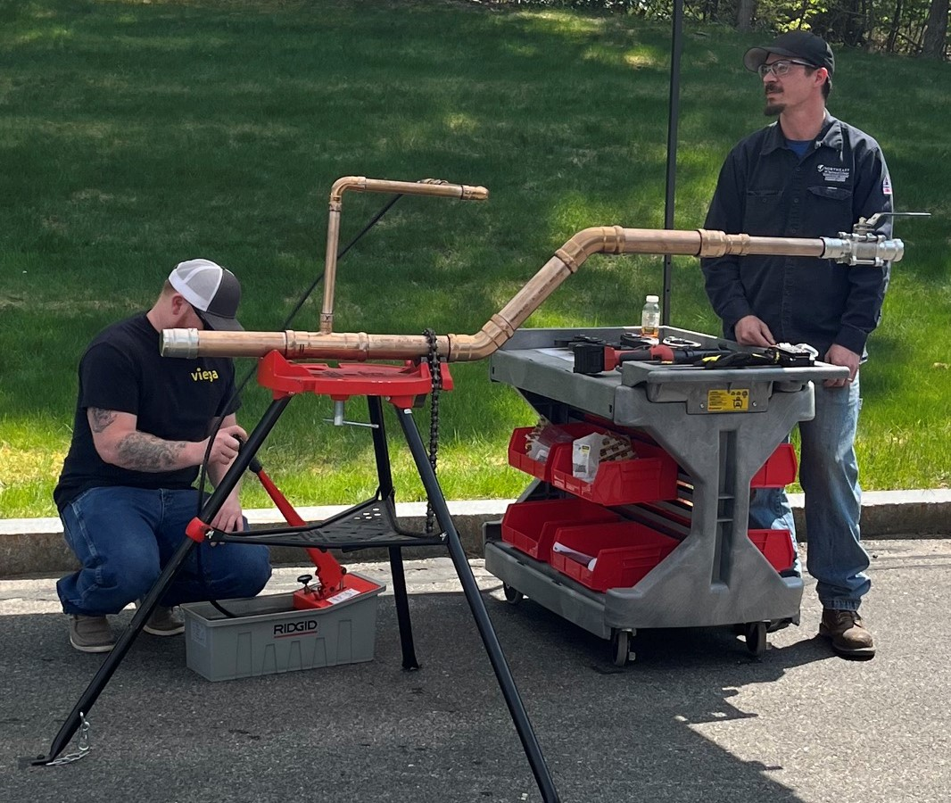
Questions?
NSRP Workforce 2023 Update – ASTM F1387 – MegaPress CuNi August 2, 2023
Notes:
As of today, only couplings ½” thru 2” are included in the NAVSEA letter. However, Shock Extensions for additional shapes are in the works by Gibbs and Cox for the FFG-62 program and we expect those results very soon resulting in the extension of the NAVSEA approval for additional shapes. So a much more complete product offering available for use on Surface Combatants, USCG and wherever MIL-STD-777 is invoked.

Slide 15
Current Standing
We have made great progress since April of 2022 (NAVSEA letter):
  Currently specified on several systems on FFG 62 program
  Approved on DDG 51 Class – already on DDG(122)
    The BIW pipe fitters implemented the training from the class on DDG 122. They were extremely happy with the results. They needed to do a pipe repair in a space that had already had its Government Inspection (GI) completed. At BIW, spaces are locked after GI. It was found that it took longer to get in the GI completed space, than it did to do the repair using the MegaPress CuNi fittings.
  Scheduled for a Barge Shock Test in Q4 for XL Sizes and MegaPress 316
  We have already trained the 1st group of Trainers along with SUPSHIP
    Six spools were pressed, by the class participants, while experienced braizers built a single brazed assembly. The time trial was recorded on video.
    ... A seventh pipe spool was built during the class. This spool was pressurized to the maximum test pressure of the MegaPress CuNi fittings (600 psig) and then was distorted to show that even with unacceptable care of the fittings and spool the joints held, and the fitting was not distorted.
NSRP Workforce 2023 Update – ASTM F1387 – MegaPress CuNi August 2, 2023
Notes:
As of today, only couplings ½” thru 2” are included in the NAVSEA letter. However, Shock Extensions for additional shapes are in the works by Gibbs and Cox for the FFG-62 program and we expect those results very soon resulting in the extension of the NAVSEA approval for additional shapes. So a much more complete product offering available for use on Surface Combatants, USCG and wherever MIL-STD-777 is invoked.

Slide 16
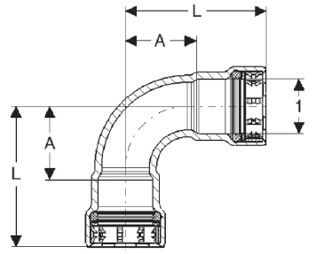
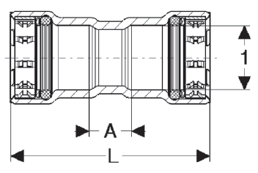
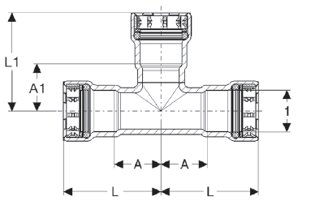
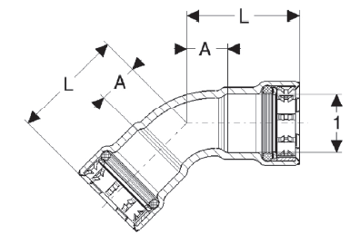
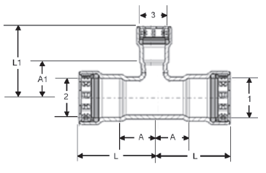
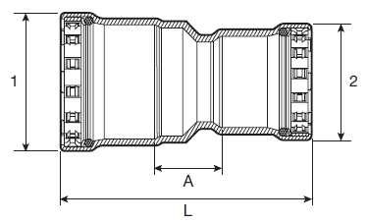
Approved Configurations
Couplings ½” thru 2”
45 elbow
90 elbow
Reducer Couplings
TEEs
Reducing TEEs
NSRP Workforce 2023 Update – ASTM F1387 – MegaPress CuNi August 2, 2023
Notes:
As of today, only couplings ½” thru 2” are included in the NAVSEA letter. However, Shock Extensions for additional shapes are in the works by Gibbs and Cox for the FFG-62 program and we expect those results very soon resulting in the extension of the NAVSEA approval for additional shapes. So a much more complete product offering available for use on Surface Combatants, USCG and wherever MIL-STD-777 is invoked.

Slide 17
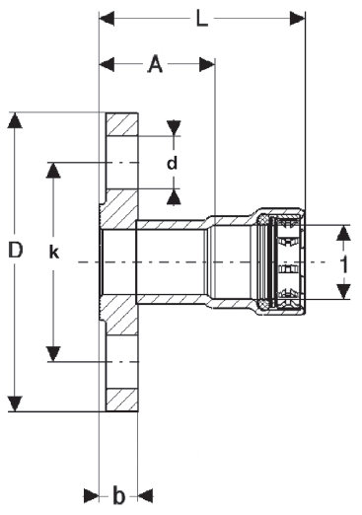
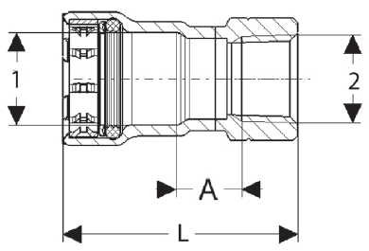
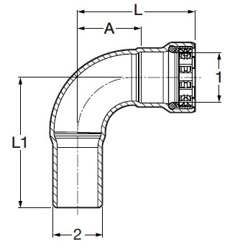
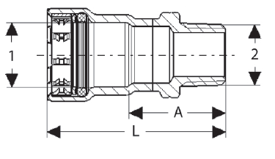
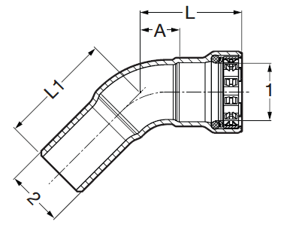
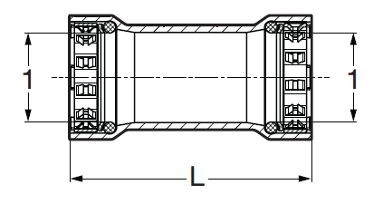
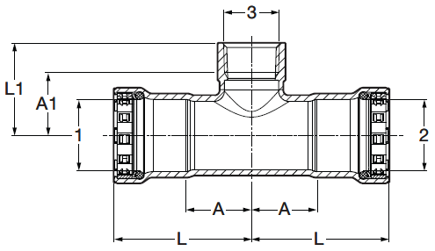
Configurations (Pending Shock Extensions)
No stop Couplings
Flanges 1” up
Adapters ½” thru 2” (MPT/FPT)
Threaded reducing tees FPT
Street Fittings
XL sizes 2-1/2” thru 4” with Barge Test
NSRP Workforce 2023 Update – ASTM F1387 – MegaPress CuNi August 2, 2023
Notes:
As of today, only couplings ½” thru 2” are included in the NAVSEA letter. However, Shock Extensions for additional shapes are in the works by Gibbs and Cox for the FFG-62 program and we expect those results very soon resulting in the extension of the NAVSEA approval for additional shapes. So a much more complete product offering available for use on Surface Combatants, USCG and wherever MIL-STD-777 is invoked.

