Slide 1
NSRP Program Overview Sustainment Panel Meeting, March 12-13, 2024 Steve Gaschler, ATI/NSRP Representative

Slide 2
Anti-Trust Rules
Regarding your company’s and/or your competitor’s product & services:
Do not discuss current or future prices.
Do not discuss any increase or decrease in price.
Do not discuss pricing procedures.
Do not discuss standardizing or stabilizing prices.
Do not discuss controlling sales or allocating markets for any product.
Do not discuss future design or marketing strategies.

Slide 3
Anti-Trust Rules
Regarding your company’s and/or your competitors’ selection of their supplier companies:
Do not discuss refusing to deal with a company because of its pricing or distribution practices.
Do not discuss strategies or plans to award business to remove business from a specific company.
Regarding your company’s and/or competitors’ trade secrets:
Do not discuss trade secrets or confidential information of your company or any other participant.

Slide 4
NSRP Mission
The mission of the National Shipbuilding Research Program (NSRP) is to employ a unique collaborative framework to research, develop, mature, and implement industry-relevant shipbuilding and sustainment technologies and processes, improving efficiency across the U.S. shipyard industrial base and meeting future demand.

Slide 5
NSRP Collaboration

Slide 6
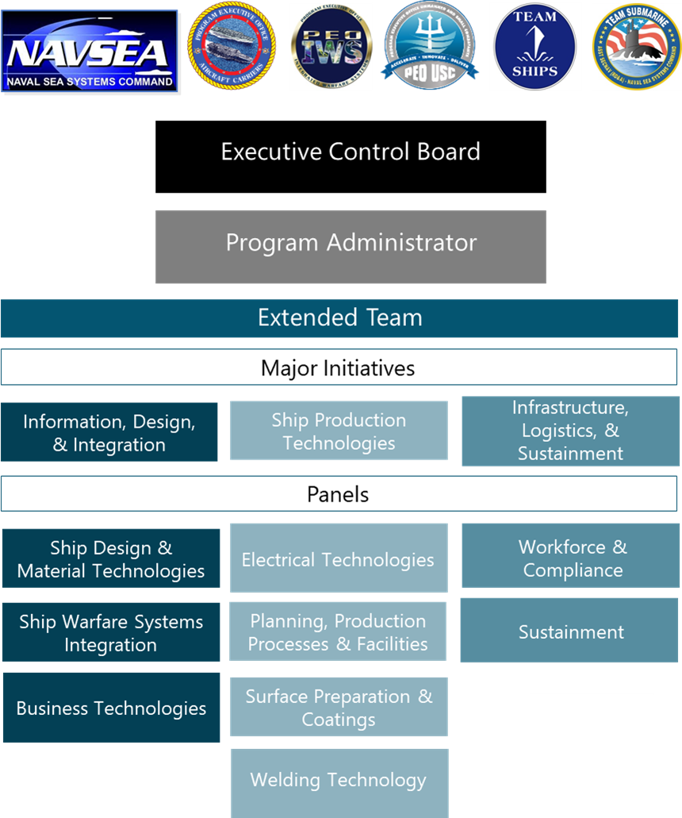
Organization

Slide 7
Major Initiative Teams
Structure
From NSRP member yard
Relevant shipbuilding experience
Responsibilities
Provide technical oversight on projects aligned with Major Initiative
Engage in technology transfer activities
Provide input/feedback on Program documents
Stay abreast of shipyard/industry issues
Information, Design, & Integration
Ship Production Technologies
Infrastructure, Logistics, & Support
MITL-At-Large
Dan Sfiligoi (NASSCO)
Michael Gerardi (BIW)
Craig Haverly (EB)
Pat Kitchel (BAE Ship Repair)
Alicia Harmon (NNS)
Dru Khaira (BIW)
Vacant
Gary Zimak (NNS)
Adam Sprecace (EB)
Vacant

Slide 8
Panel Leadership
Information, Design, & Integration
Ship Production Technologies
Infrastructure, Logistics, & Support
Ship Design & Material Technologies
Electrical Technologies
Workforce & Compliance
Chair: Jason Farmer (Ingalls)
Vice Chair: Walter Skalniak (Ashby)
Chair: Ean Greene (NNS)
Vice Chair: Maurissa D’Angelo (D’Angelo Technologies)
Chair: Monika Skowronska (NASSCO)
Vice Chair: Victoria Dlugokecki (Consultant)
Planning, Production Processes & Facilities
Sustainment
Ship Warfare
Systems
Integration
Chair: Ben Dorris (FMM)
Vice Chair: Pat Cahill (Cahill Consulting)
Chair: Kirsten Walkup (BIW)
Vice Chair: Kaipo Crowell
(Kakou Professional Development)
Chair: Perry Haymon (Ingalls)
Vice Chair: Harold Howard (NNS)
Surface Preparation & Coatings
Chair: Conlan Hsu (NNS)
Vice Chair: Angel Zepeda (NASSCO)
Business Technologies
Chair: Jamie Breakfield (Ingalls)
Vice Chair: Patrick Roberts (ShipConstructor)
Welding Technology
Chair: Kevin Roossinck (Ingalls)
Vice Chair: Cody Whitele (NASSCO)

Slide 9
Operations

Slide 10
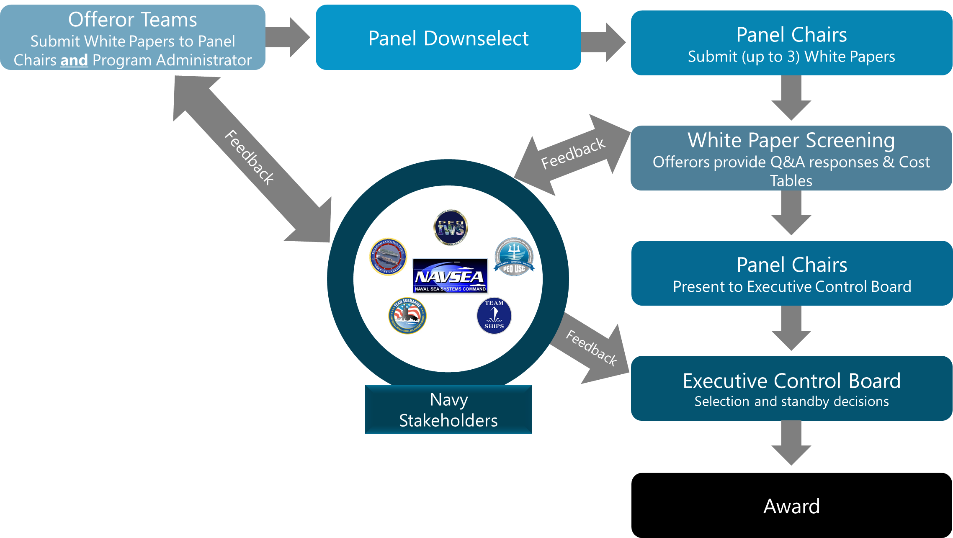
Panel Project Proposal Process

Slide 11
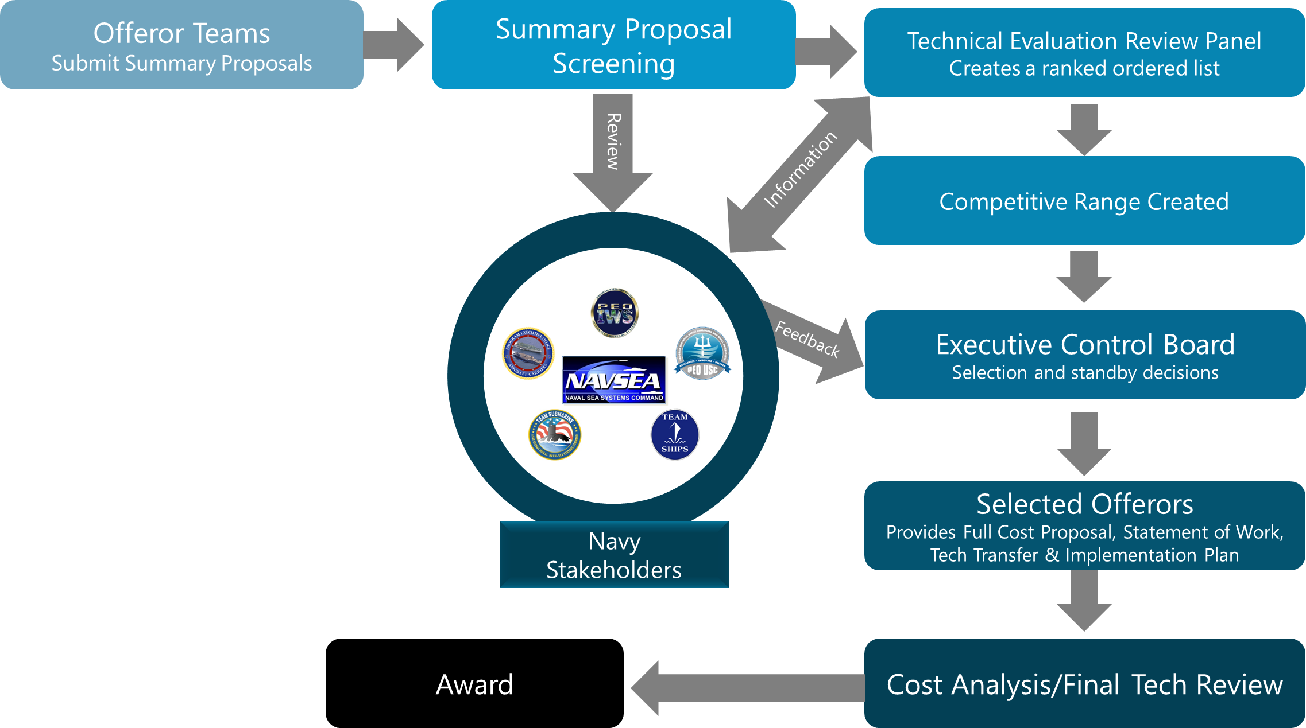
Research Announcement Proposal Process

Slide 12
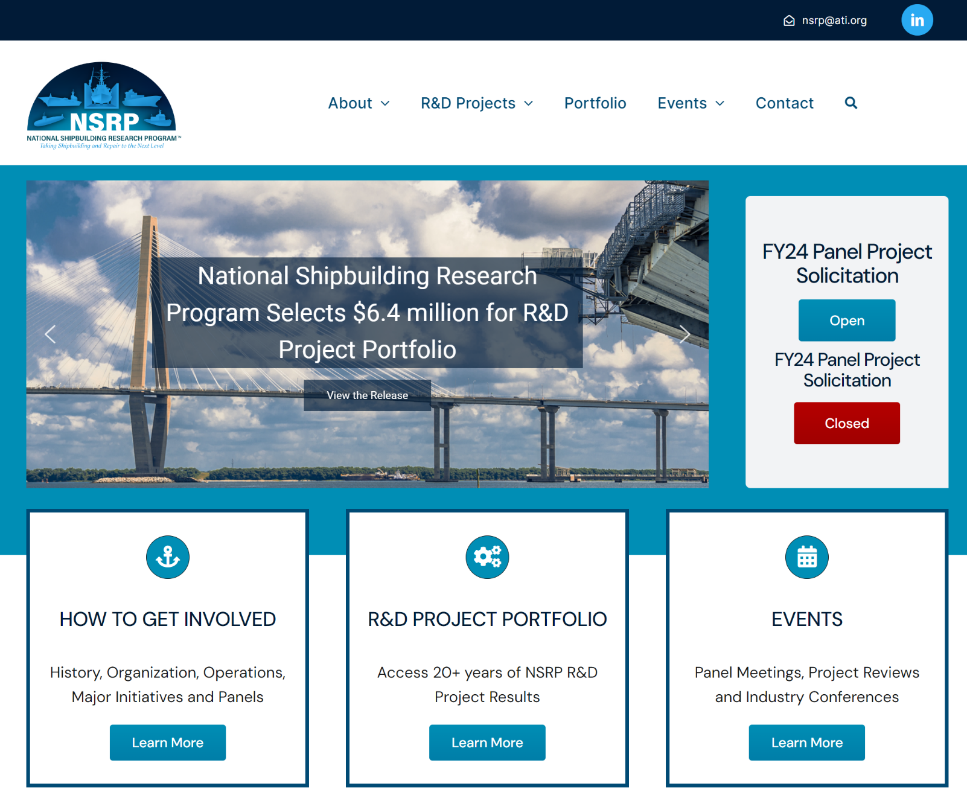
NSRP Latest Info and Project Portfolio
NSRP.org

Slide 13
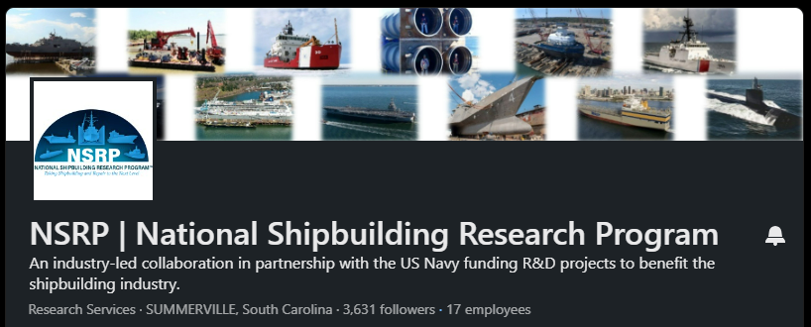
NSRP LinkedIn Page and Mailing Lists
Follow NSRP on LinkedIn to get the latest Program updates, event notifications, shipyard updates, and networking opportunities.
Email NSRP@ati.org to subscribe to the NSRP General Info mailing lists or individual panel mailings lists.
NSRP LinkedIn Page

Slide 14
NSRP YouTube Page
NSRP YouTube Page

Slide 15
Questions?

