Slide 1
3D Technical Data in the DoD Supply Chain
A DLA perspective
Ben Kassel
14 March 2019
Cleared for Release

Slide 2
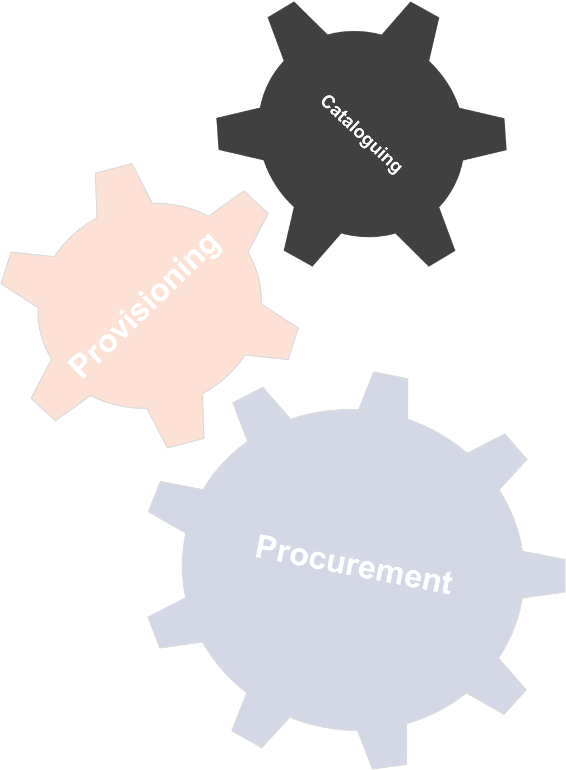
Sustainment Processes
… Catalouging
Cataloguing is the method by which the Defense Logistics Agency (DLA) creates and maintains a standardized record for products and parts that the Department of Defense (DoD) and other federal civilian agencies distribute, store, and procure on a recurring basis.
Evaluate the item’s form, fit, and function.
A complete technical data package would allow the cataloguer to determine the spring’s form, for example, as it would contain information on physical features such as material, wire size, length, wire type, load, etc.
Cleared for Release

Slide 3
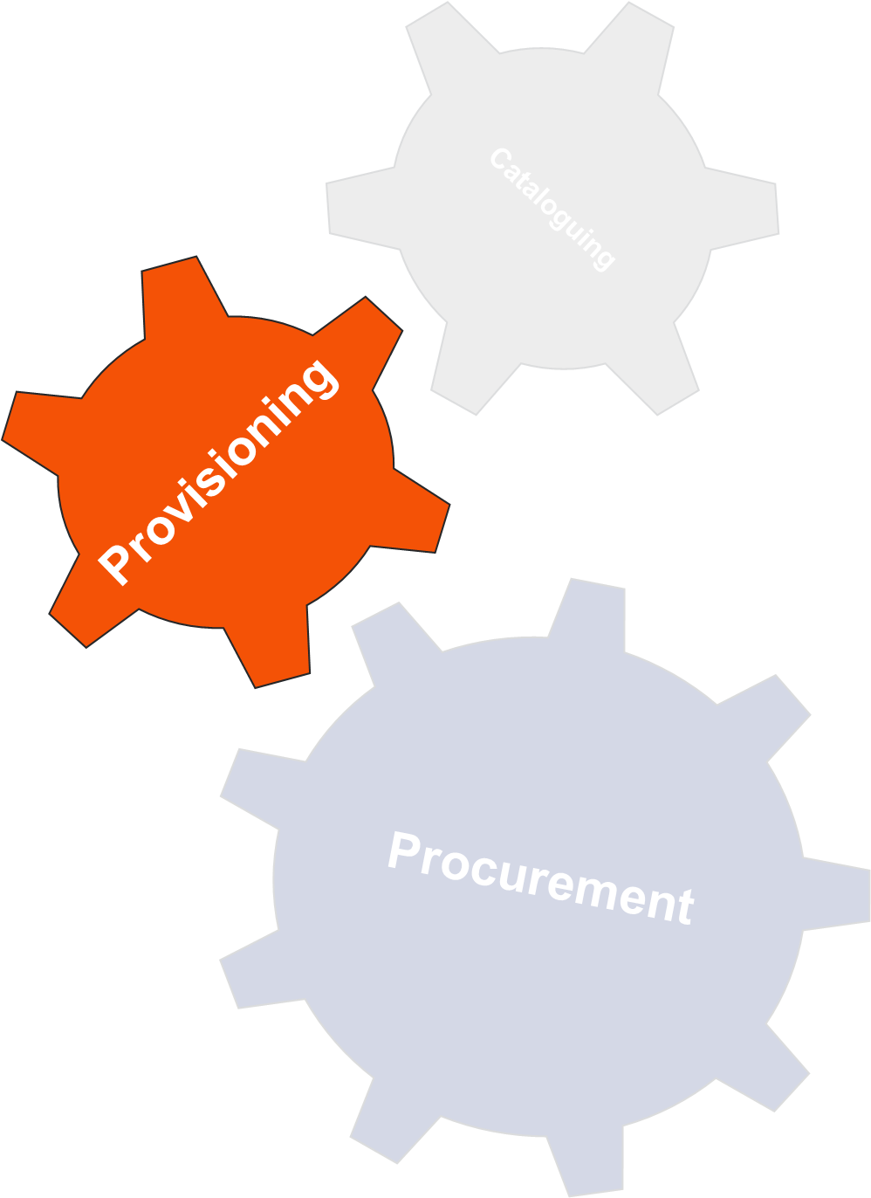
Sustainment Processes
… Provisioning
Provisioning is the process of determining and acquiring the range and quantity of spares and repair parts, and support and test equipment required to operate and maintain an end item of material for an initial period of service.
Is Technical Data available and complete?
Critical requirements?
Does Technical Data support parts requested for cataloguing?
Other considerations?
Cleared for Release

Slide 4
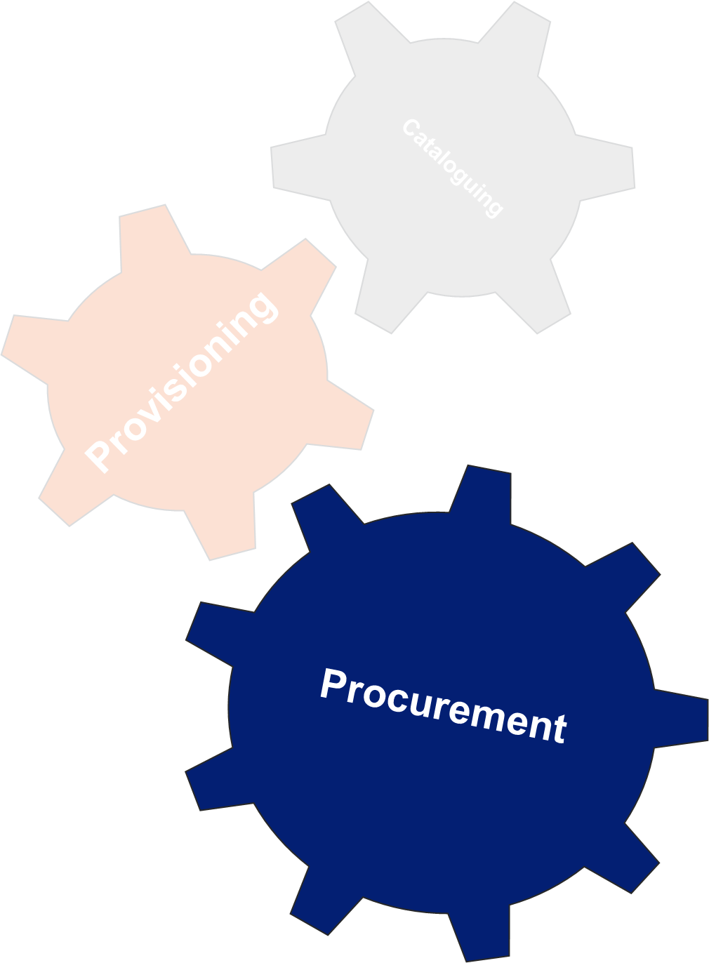
Sustainment Processes
… Procurement
Procurement is the act of buying goods and services for the government.
National Stock Number (NSN) is created and assigned as a “first time buy” in the Enterprise Buyer System (EBS).
Purchase request (PR) generated.
Product Specialist (PS) determined adequacy of technical data including tolerances, materials, and QA requirements.
If NSN is bought in accordance with technical data, the buyer publishes the PR.
Inspection using relevant tech data and contract requirements provided in cFolders.
Cleared for Release

Slide 5
Digital Product Model Data
supports the entire life cycle of the product
The focus has been on model-based systems engineering, product design, and manufacturing.
Sustainment can no longer be neglected.
Was a “nice to have,” but with emerging technologies it is becoming a fundamental requirement.
Extensibility is necessary as data is added through the products life cycle.
The authoritative source.
Cleared for Release

Slide 6
The Bottom Line
the right data to the right place at the right time
The vast majority of the product data required to perform a downstream function probably exists in electronic form. The problem is to find, trust it, translate it, and USE it.
FINDING THE DATA : The case for an Integrated Product Data Environment
TRUSTING THE DATA : The case for Accreditation
VISUALIZING THE DATA : The case for the 3D Technical Data Package
TRANSLATING THE DATA : The case for STEP
We need to make sure that we acquire and manage the product data commensurate with the level of the data rights to which we are entitled.
Form, fit, and function in the cases where the governments rights are limited.
All OMIT data (operation, maintenance, installation, training).
Detailed manufacturing data in the cases where the government has the appropriate rights.
The data developed to support design and manufacturing is valuable
Additional data is required to support the product post delivery
Cleared for Release

Slide 7
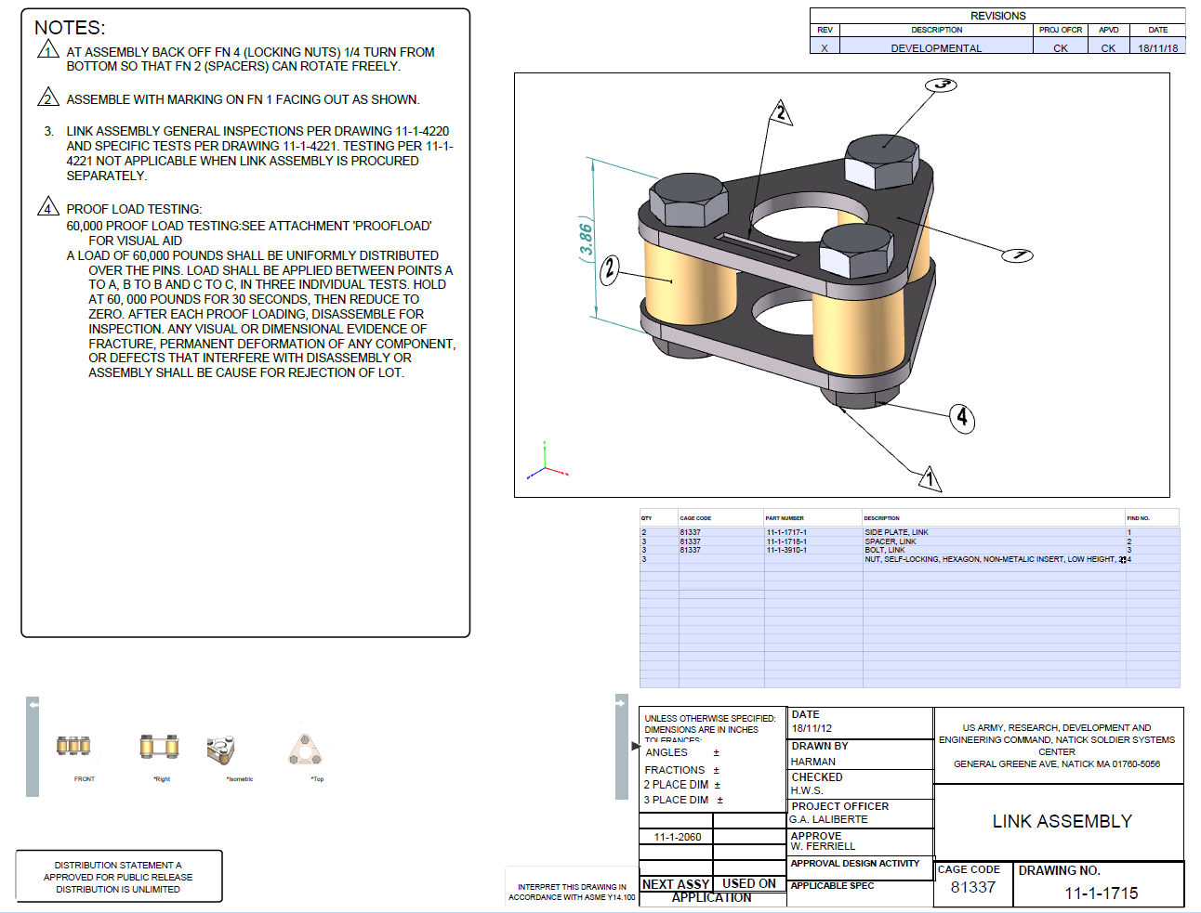
3D Technical Data Package
acceptable to DLA
3D PDF view
ISO 14739-1:2014
Other acceptable 3D formats
ISO 14306:2017 Industrial automation systems and integration -- JT file format specification for 3D visualization
HTML 5.2 World Wide Web: the Hypertext Markup Language (HTML)
ISO 10303-242:2014 Industrial automation systems and integration -- Product data representation and exchange -- Part 242: Application protocol: Managed model-based 3D engineering
ISO/IEC 19775-1:2013 Information technology — Computer graphics, image processing and environmental data representation — Extensible 3D (X3D) — Part 1: Architecture and base components
PDF may not be the preferred approach for every program.
DLA is looking at other formats.
Cleared for Release

Slide 8
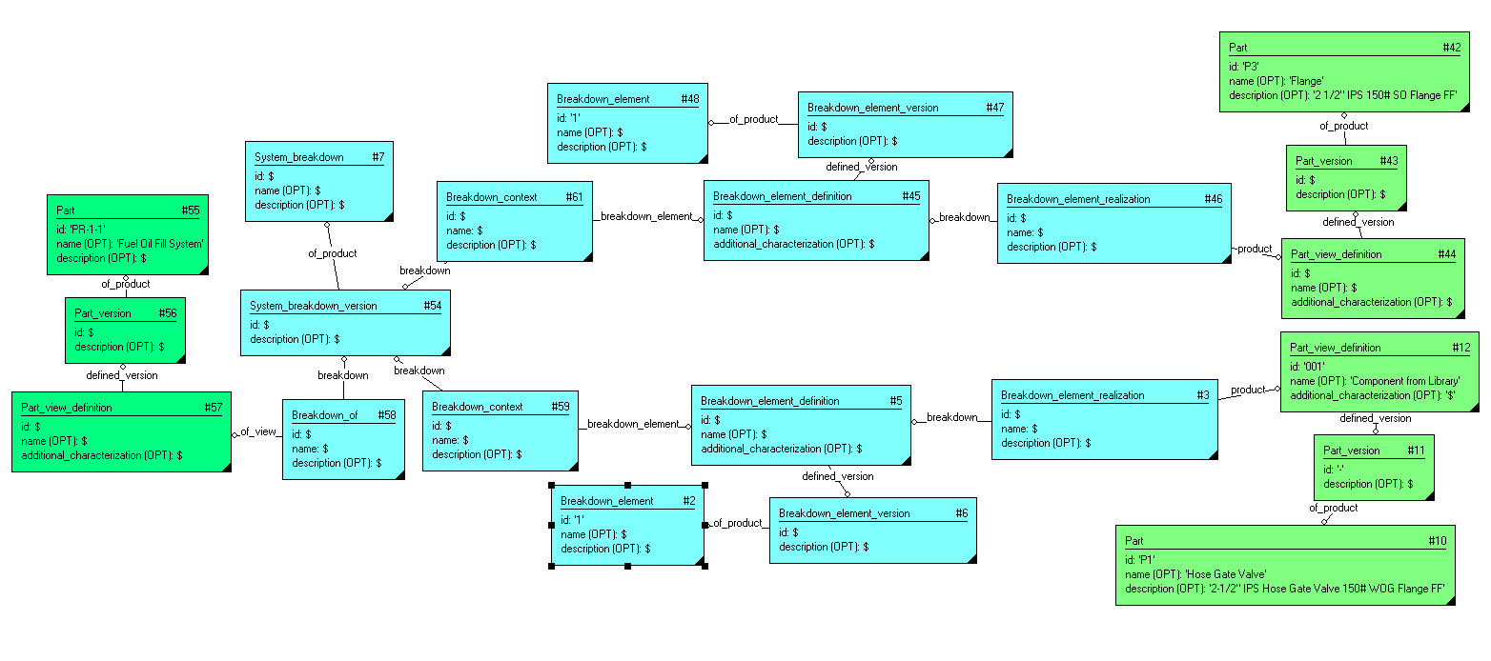
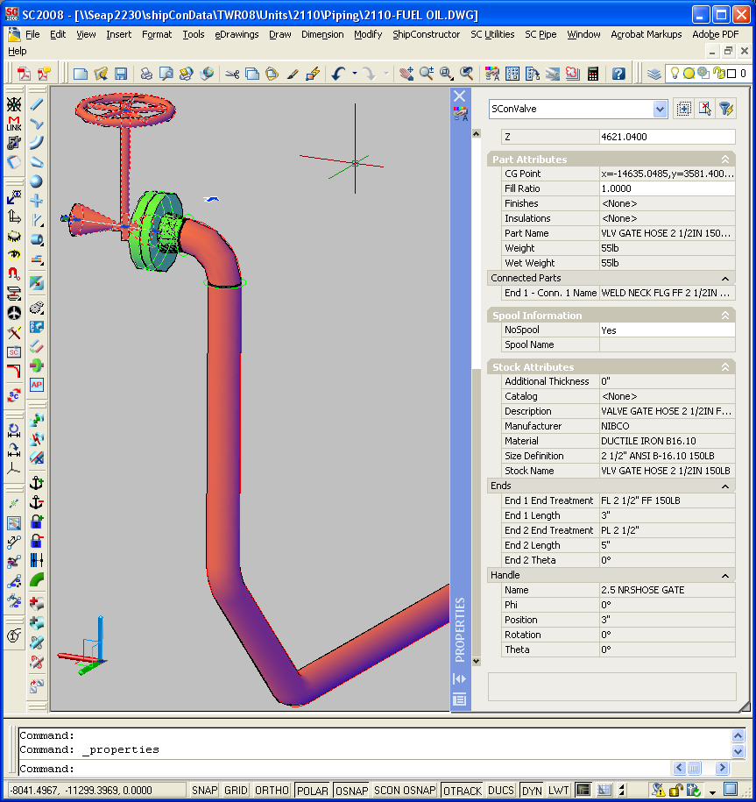
Neutral is Nice
but native is not nasty
/* Fuel Oil Fill System Definition */
#58 = BREAKDOWN_OF($,$,$,#54,#57);
#54 = SYSTEM_BREAKDOWN_VERSION($,$,#7);
#7 = SYSTEM_BREAKDOWN($,$,$);
/* Hose Gate Valve as member of Fuel Oil Fill System */
#59 = BREAKDOWN_CONTEXT($,$,$,#54,#5);
#5 = BREAKDOWN_ELEMENT_DEFINITION($,$,$,$,(),#6);
#6 = BREAKDOWN_ELEMENT_VERSION($,$,#2);
#2 = BREAKDOWN_ELEMENT('1',$,$);
#3 = BREAKDOWN_ELEMENT_REALIZATION($,$,$,#5,#12);
/* Flange as member of Fuel Oil Fill System */
#61 = BREAKDOWN_CONTEXT($,$,$,#54,#45);
#45 = BREAKDOWN_ELEMENT_DEFINITION($,$,$,$,(),#47);
#47 = BREAKDOWN_ELEMENT_VERSION($,$,#48);
#48 = BREAKDOWN_ELEMENT('1',$,$);
#46 = BREAKDOWN_ELEMENT_REALIZATION($,$,$,#45,#44);
/* Connection between hose gate valve and flange */
#66 = INTERFACE_CONNECTION($,$,'bolted',#63,#64);
#65 = INTERFACE_CONNECTOR_DEFINITION($,$,'1/8" gasket,
4 - 3/8 - 16UNC" x 2" bolt ',$,(),$,$);
#64 = INTERFACE_CONNECTOR_OCCURRENCE($,$,$,#65,#44);
#63 = INTERFACE_CONNECTOR_OCCURRENCE($,$,$,#65,#12);
ENDSEC;
END-ISO-10303-21;
Cleared for Release

Slide 9
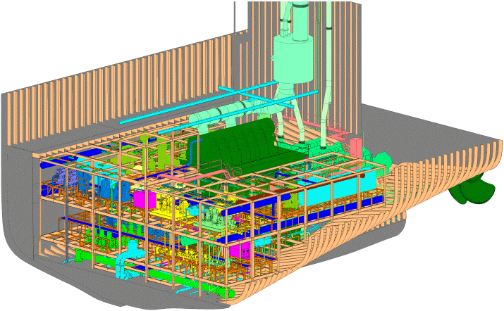
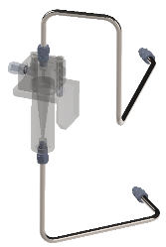
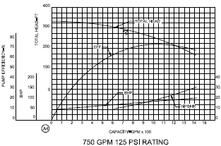
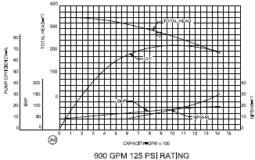
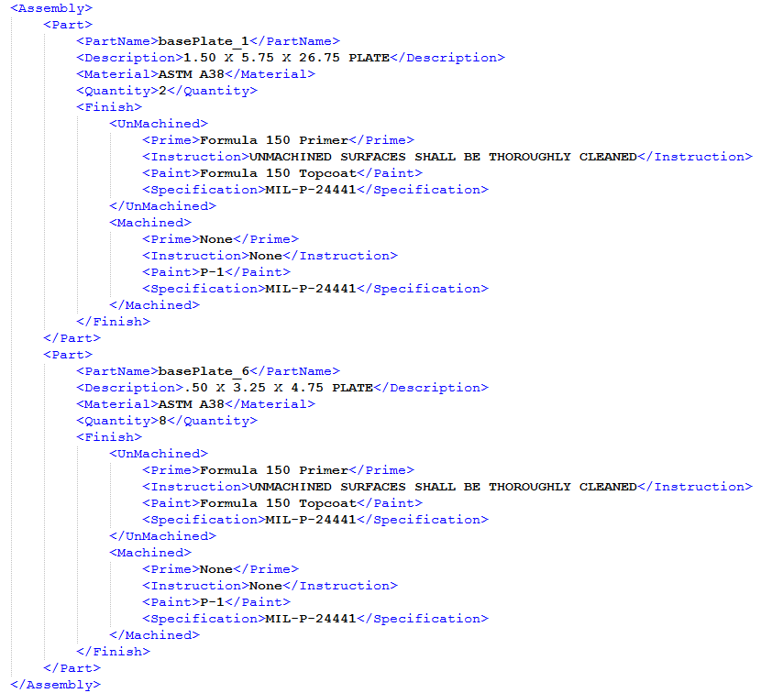
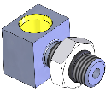
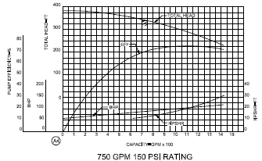
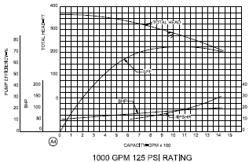
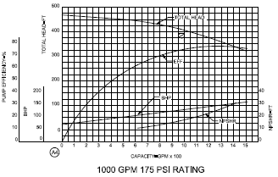
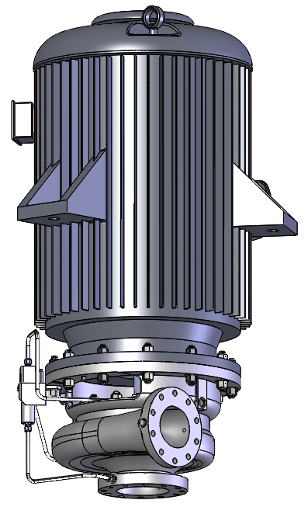
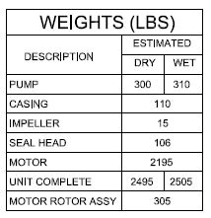
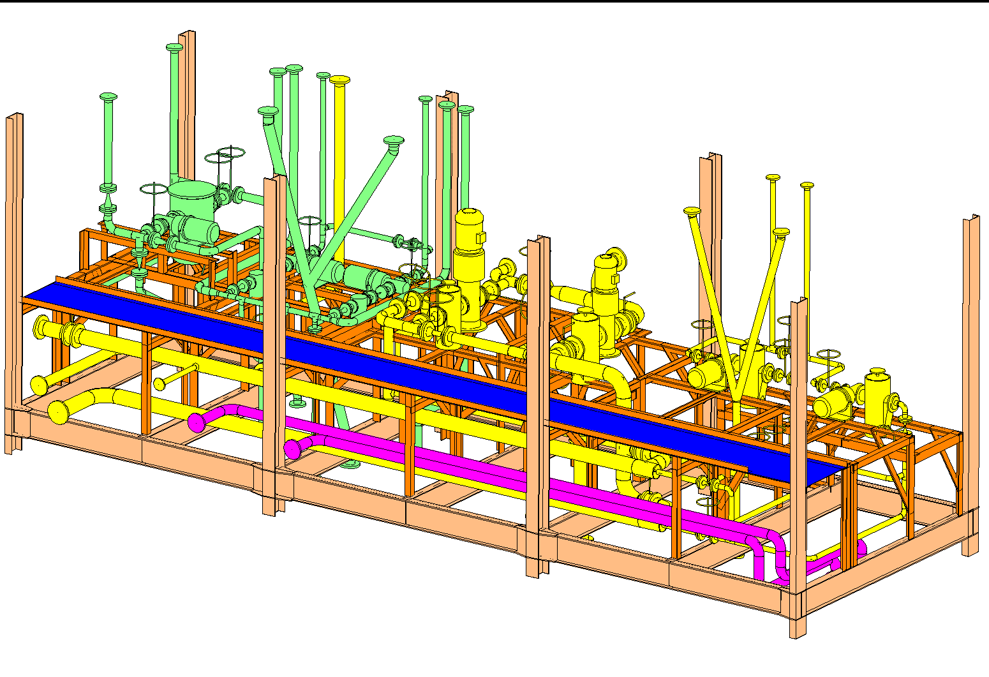
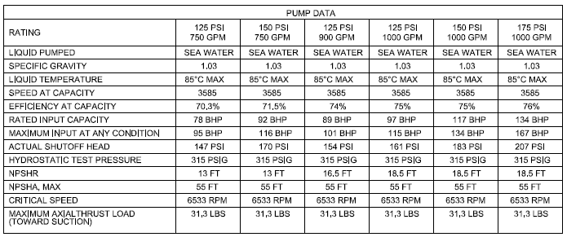
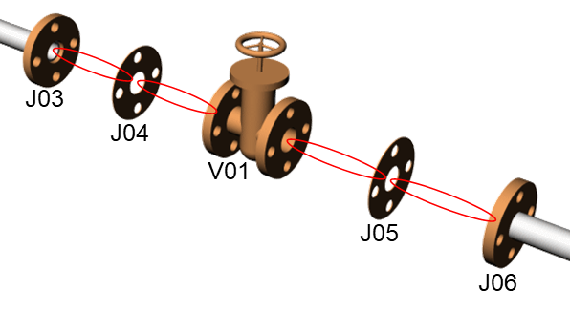
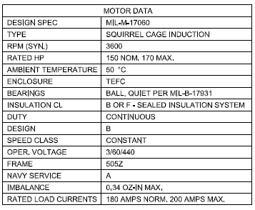
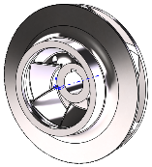
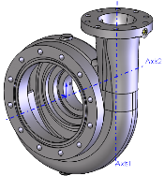
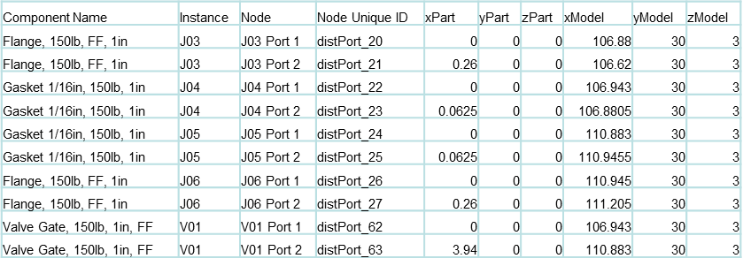
3D Technical Data Package
where System Engineering meets Product Design
Commodity
Part
Lube Oil & Fuel Oil
Transfer Unit
Slow Speed Diesel
Engine Room
Functional
View of a
System
Cleared for Release

Slide 10
Data Elements and Attributes
… requested by DLA as part of a 3D TDP for procurement
Specifications
Dimensions
Tolerances
Welding requirements
Materials (ballistics)
Temper
Heat treatments
Finishes
Rights in Data
License Agreement
Distribution Statement
Document Type
Assurance Provision, etc.
Security code
Tech data availability code
Foreign secure
Nuclear
Subsafe
Control code
Legibility
Completeness
Restrictions
Document approval
Document title
Document number
Revision and date
Revision type
Expiration date
Document data code
Size of drawing
Call outs
Sources
First Article Test requirements
Inspection requirements
Higher level contract quality requirements
Part number
NSN
Export control
CAGE code
Cleared for Release

Slide 11
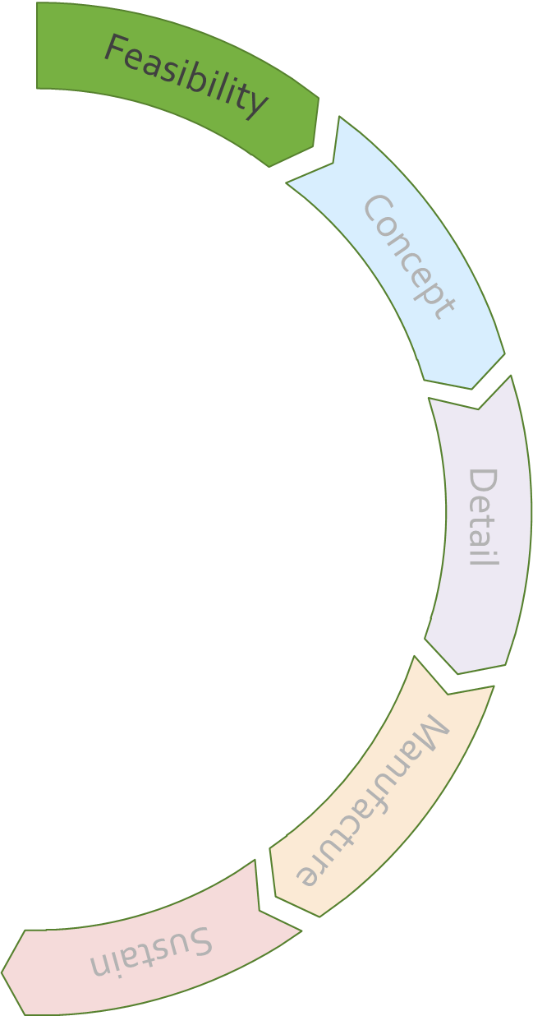
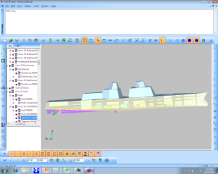
Digital Product Model Data
feasibility
images either developed by NSWCCD or obtained from various public websites
Author
The source of technical data used to describe a concept and determine the feasibility is often developed by the government.
Predominantly specifications and requirements, but the government is increasing its use of models and simulations earlier in the program.
Consume
Commonly shared within the government.
Visualization, source data for other engineering analyses, and simulations.
This technical data may be shared with industry and other partners developing the concept.
Archive
Not uncommon for this technical data and models to be used to synthesize a variant or next generation system.
Cleared for Release

Slide 12
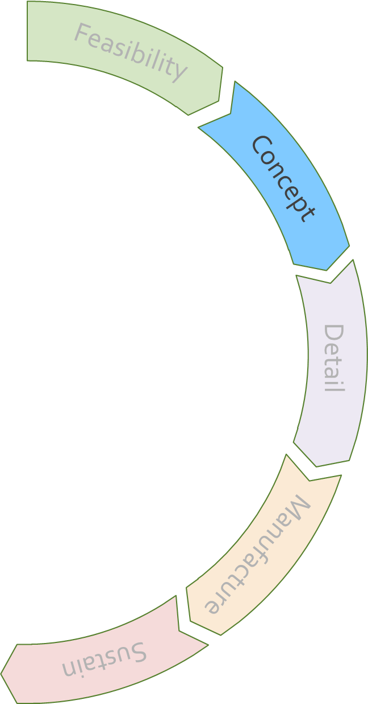
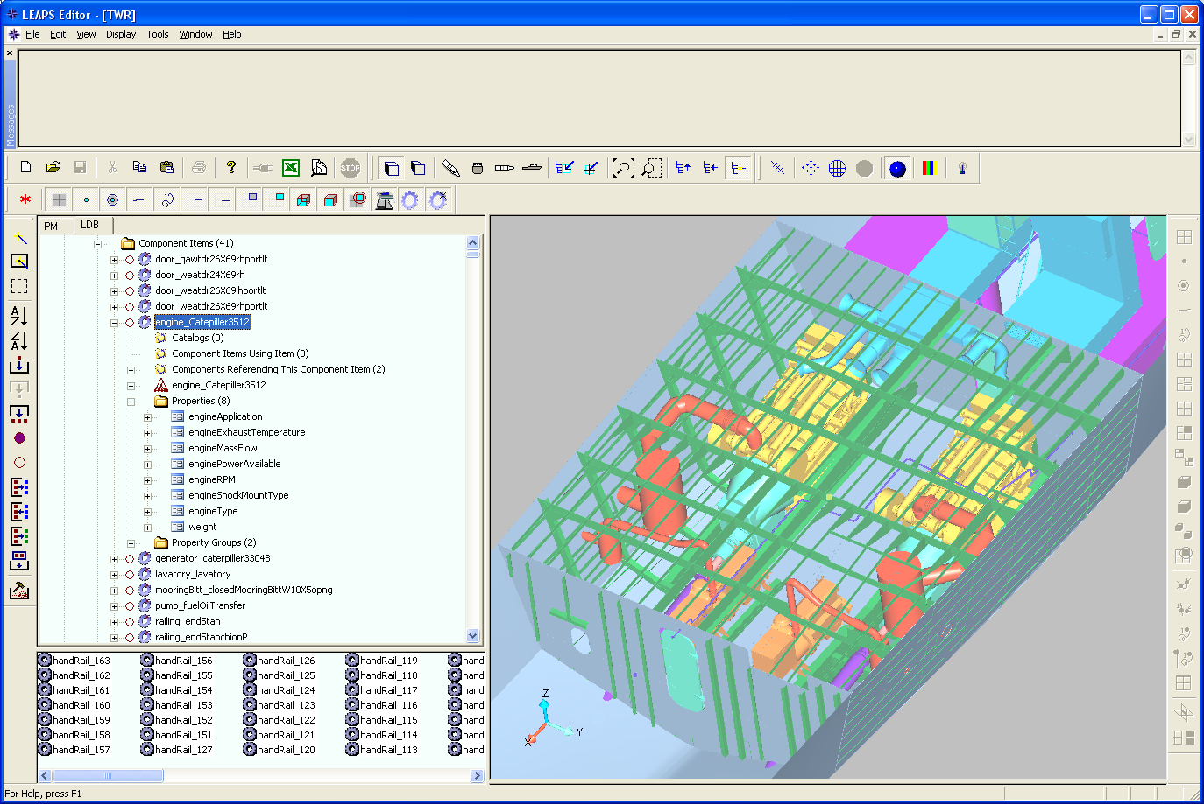
Digital Product Model Data
concept development
Author
Government or industry may be principally involved with refining the concept to the point where it becomes a feasible.
Different organizations may be responsible for refining different sub systems.
Consume
Commonly shared across the virtual enterprise.
Visualization, source data for other engineering analyses, and simulations.
The earliest stage where authoritative source of truth becomes significant.
Archive
This data is often used to synthesize the detail design and to generate output products to support milestone decisions.
The first significant source for design intent.
Cleared for Release

Slide 13
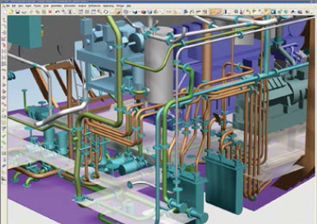
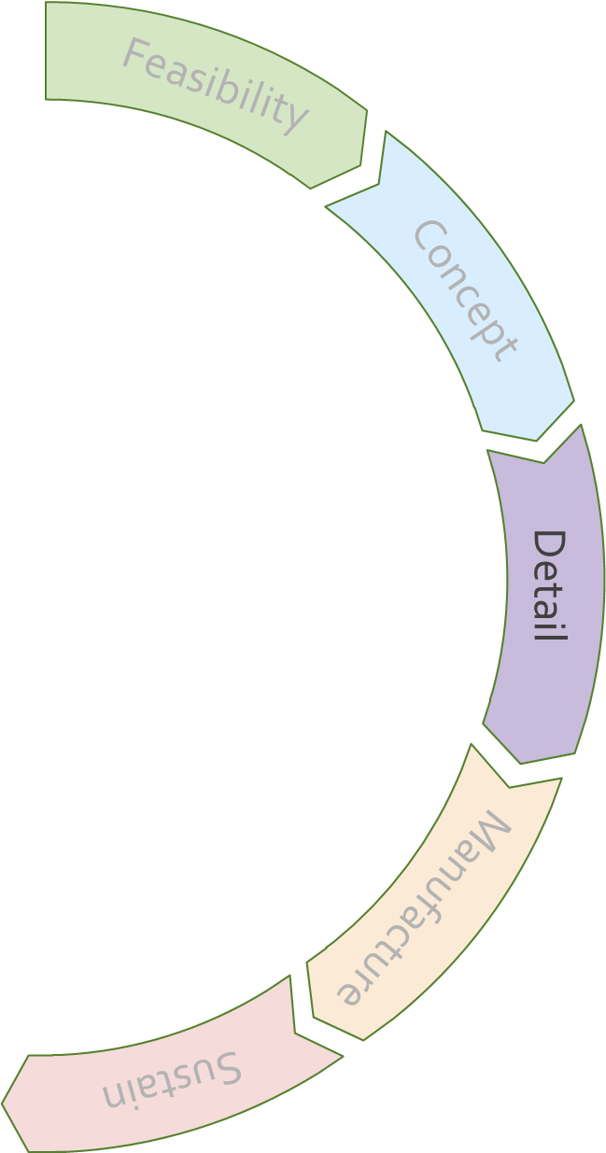
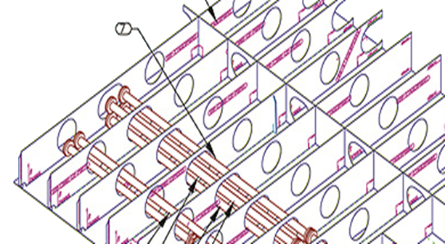
Digital Product Model Data
… its more than just detail design
Author
Industry principally involved with preparing the technical data and documentation necessary to deliver the product.
Different enterprises may be responsible for delivering different sub systems.
Rights in Technical Data become an issue.
Consume
Commonly shared across the virtual enterprise.
Output products may be required for Government review and comment.
Access to the primary PLM by the government.
Significant and formal configuration management emerge.
Archive
The complete virtual definition of the product. Source for many downstream applications.
Cleared for Release

Slide 14
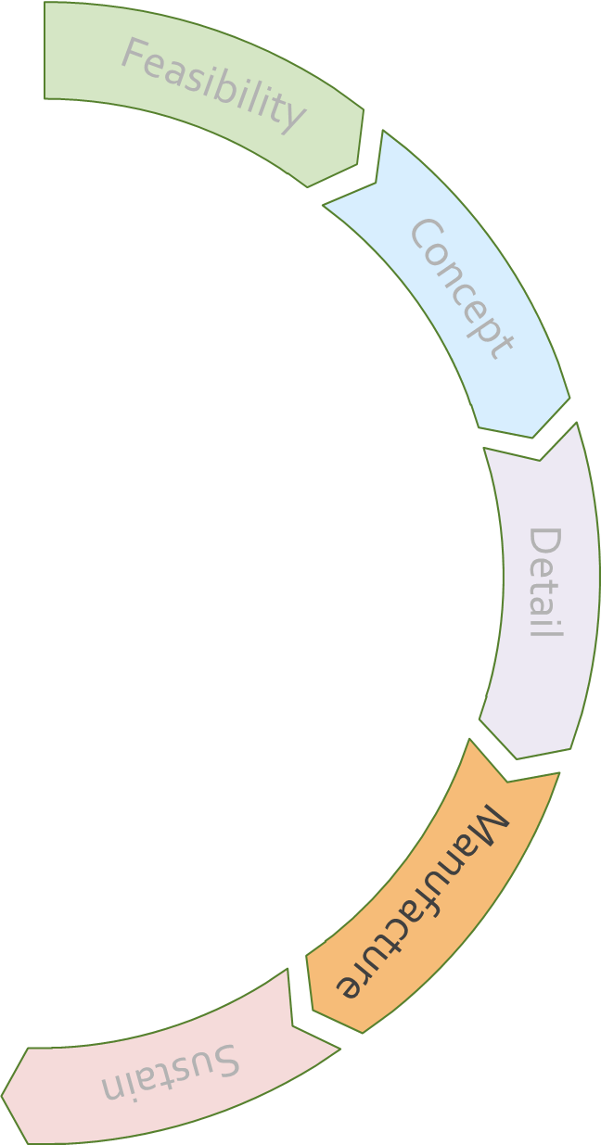
Digital Product Model Data
… its more than just manufacture, assemble, and deliver
Author
Industry principally involved with preparing the technical data and documentation necessary to manufacture the product.
Different enterprises may be responsible for delivering different sub systems.
Rights in Technical Data for COTS parts becomes an issue.
Consume
Commonly shared across the virtual enterprise.
Output products may be required for Government review and comment.
Access to the primary PLM by the government.
Significant and formal configuration management emerge.
Archive
The complete virtual definition of the product. Source for many downstream applications.
Cleared for Release

Slide 15
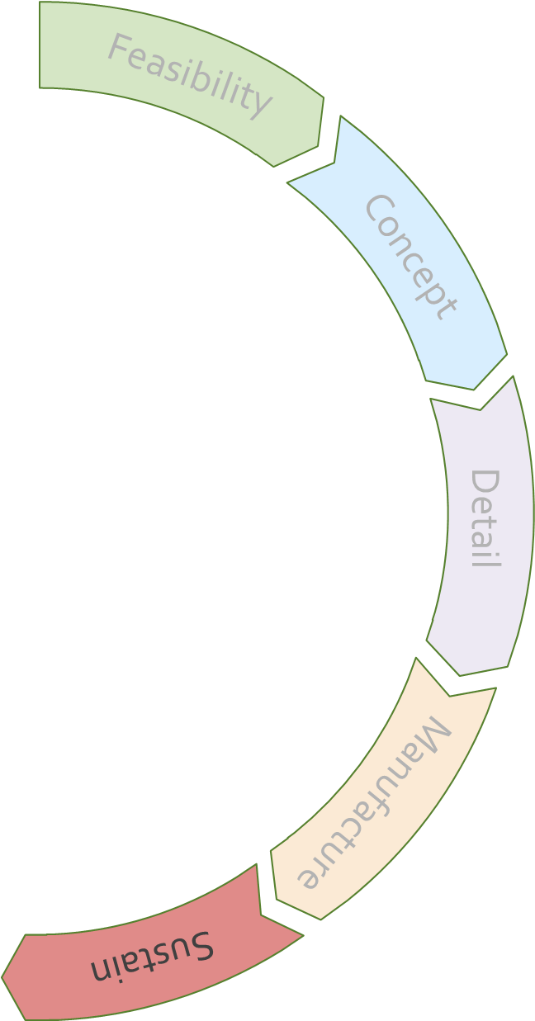
Digital Product Model Data
… its more than just sustain
Author
Prime, Subcontractors, OEM, government, and who knows who else.
Be prepared to provide the government with unlimited rights in technical data.
Consume
Authors may be consumers
Massive mix of low end and high technology.
Configuration management and authoritative source of truth are critical.
Archive
The complete virtual definition of the product. Source for many downstream applications.
Consumers may be actively accessing the archive.
Cleared for Release

Slide 16
Technical Data
the new backbone of the enterprise
© 2018 LMI. All rights reserved.
Cleared for Release

Slide 17
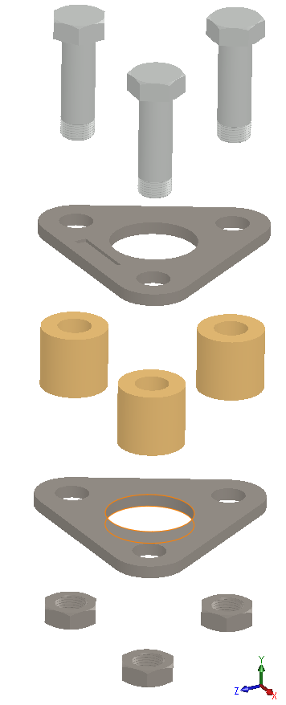
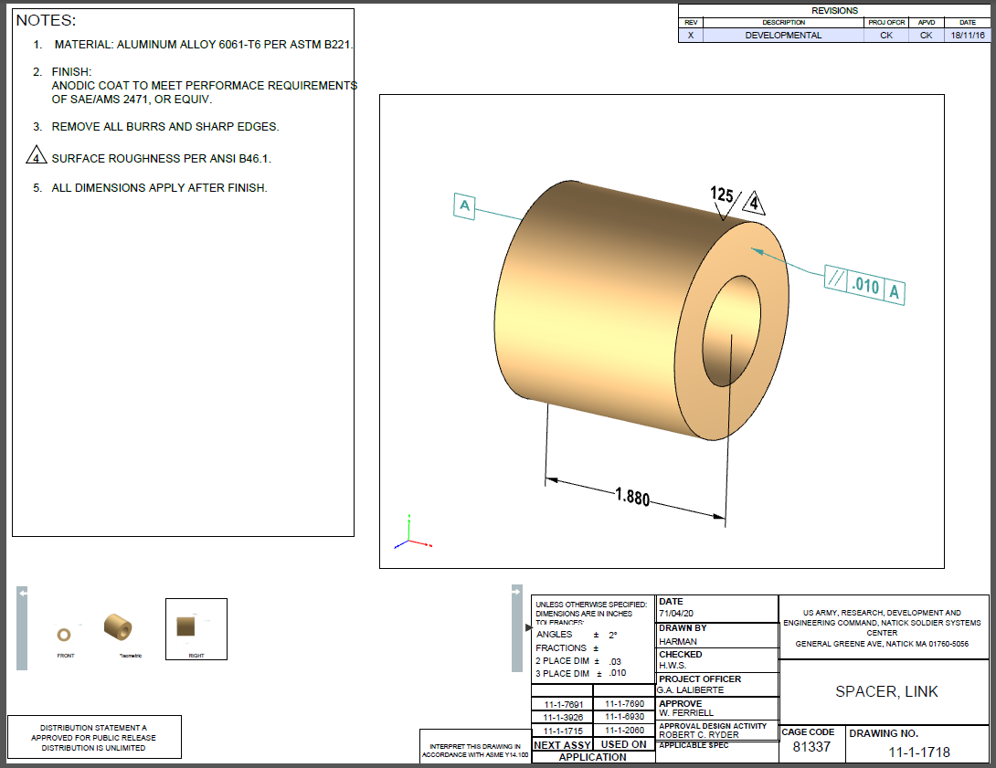
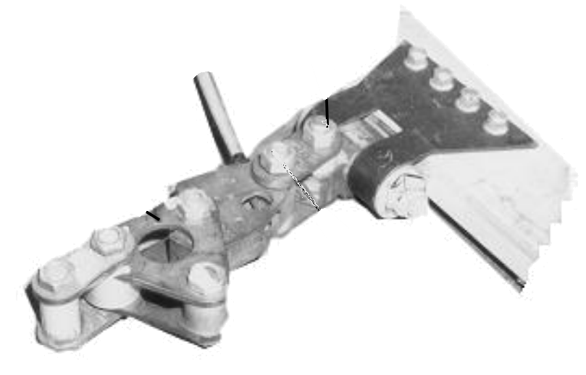
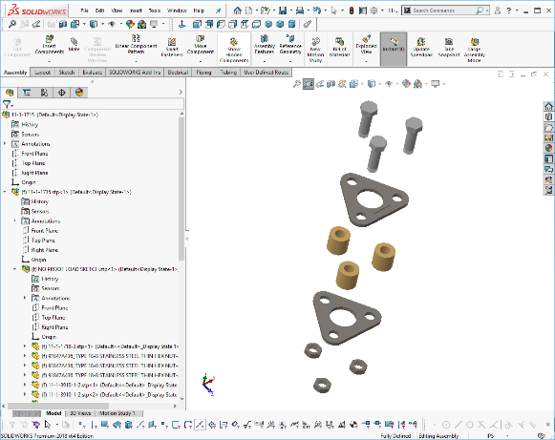
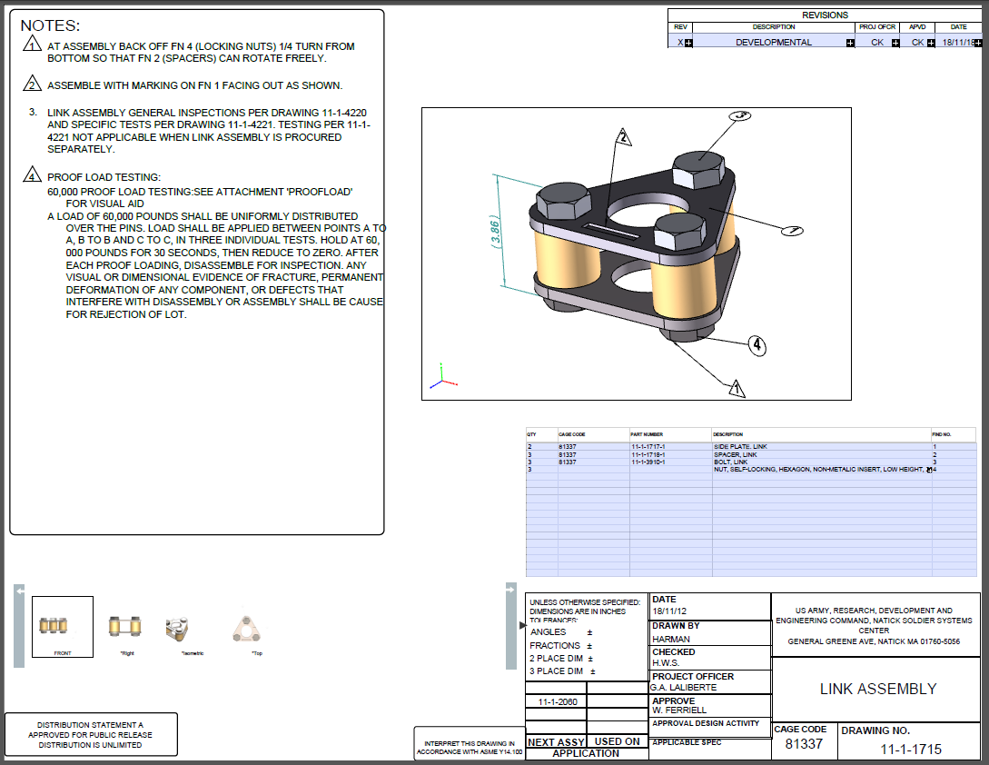
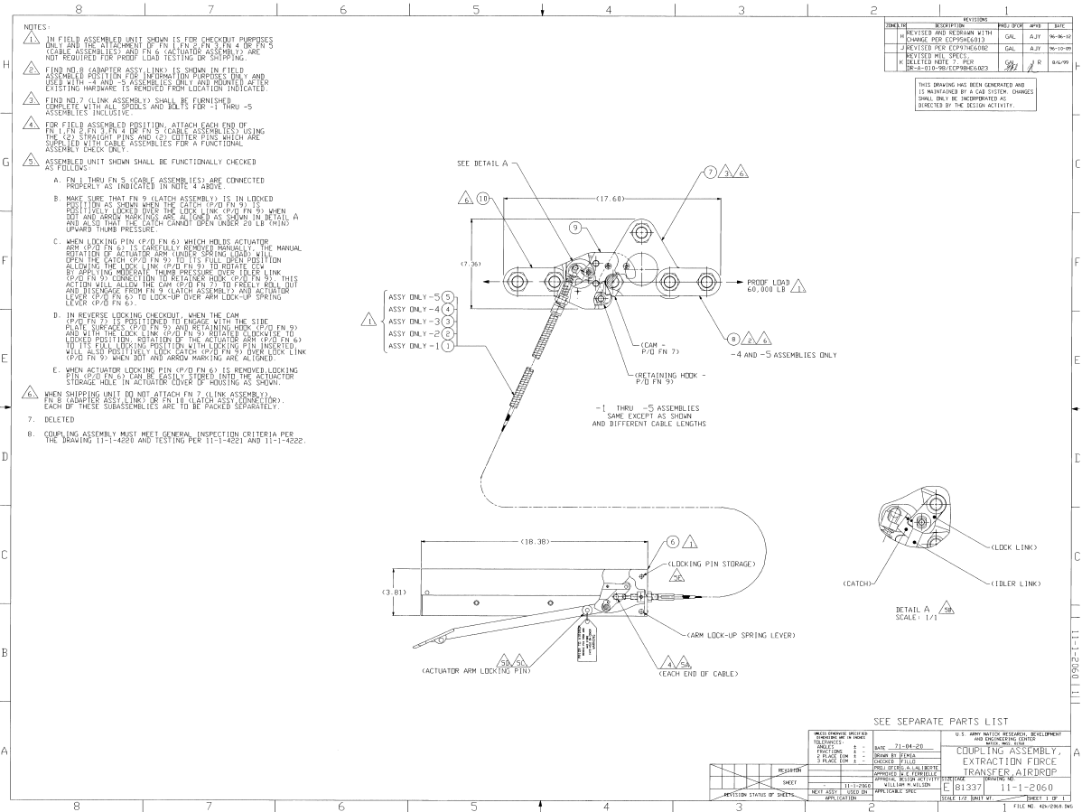
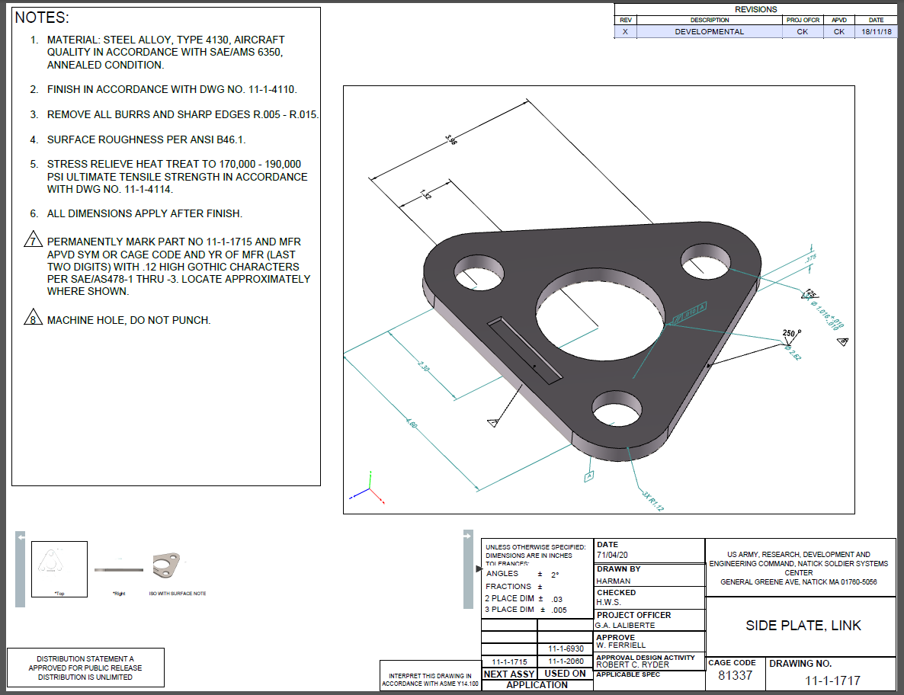
Potential R & D Topics
Legacy and Missing data
Scanned point cloud
Manual measurements
Non destructive testing
Destructive testing
Document research
Contextual intuition
The only data is the part
Manual modeling
Raster trace
Design intent from notes
2D to 3D conversion
GD&T interpretation
Contextual intuition
Legacy Data
Cleared for Release

Slide 18
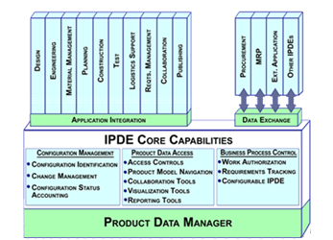
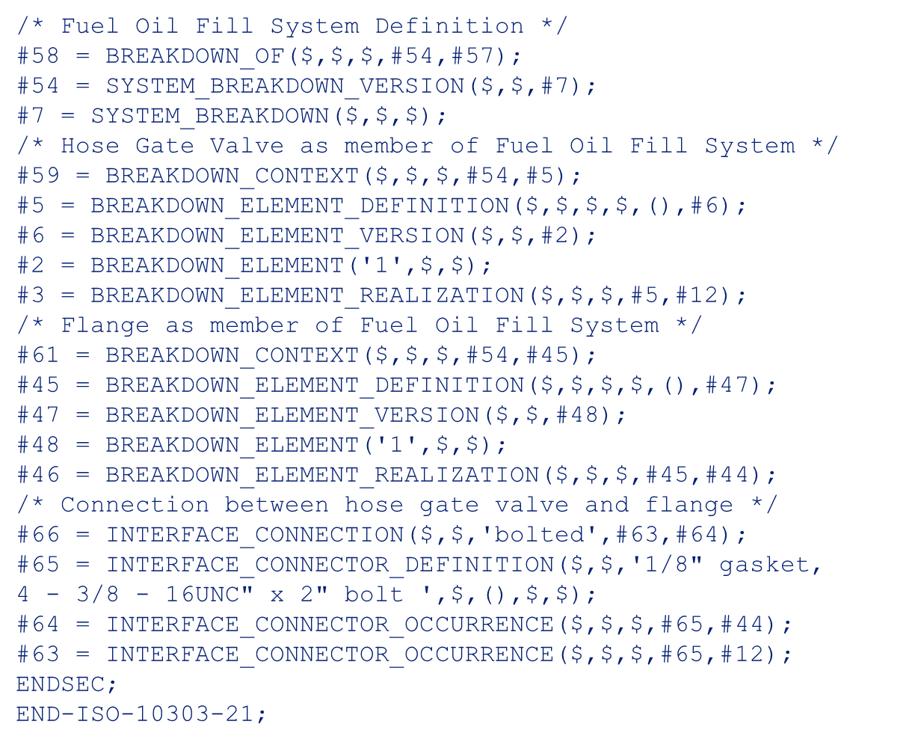
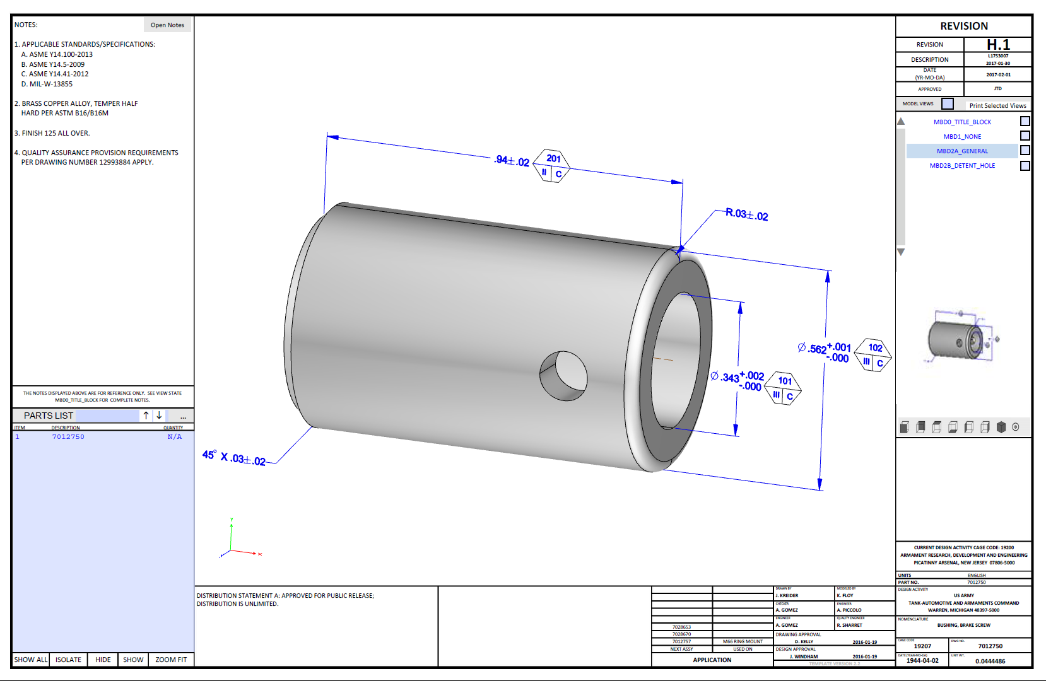
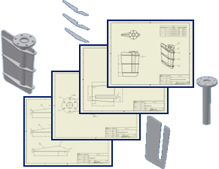
Potential R & D Topics
Connecting the Model Based Environment
Original Equipment Manufacturer
User
System Integrator
User
Design Agent
DATA
DoD Engineering Activity
DATA
DATA
Government Agency
DATA
Data Repository
DATA
User
Network of connections between data repositories, PLM, and other enterprise systems
Cleared for Release

Slide 19
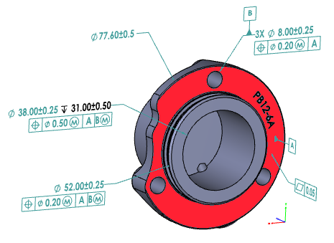
Potential R & D Topics
Semantic with Visual
Most 3D Technical Data Packages convey the non geometric data as text. This is referred to as Visual Product Manufacturing Information.
A 3D Technical Data Package contains 3D geometric data.
A Technical Data Package that contains spreadsheets, drawings, images, pages of text, and a single simple part formatted in “3D PDF” without any annotation is a 3D Technical Data Package.
A Technical Data Package that contains nothing but 3D geometric data with all of the annotation defined semantically is a 3D Technical Data Package.
Cleared for Release

Slide 20
Technical Data
DLA Priorities
Data interoperability and exchange of data between systems
Legacy data conversion
Digital rights management techniques
Modernization of the federal catalog
Cleared for Release

Slide 21
Questions?
DISCUSSION
Comments?
Cleared for Release

